Slide 1

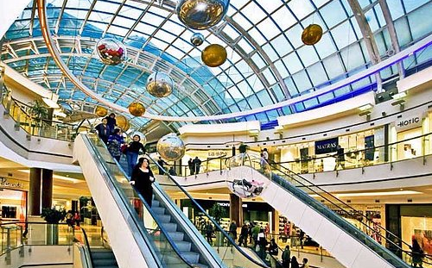
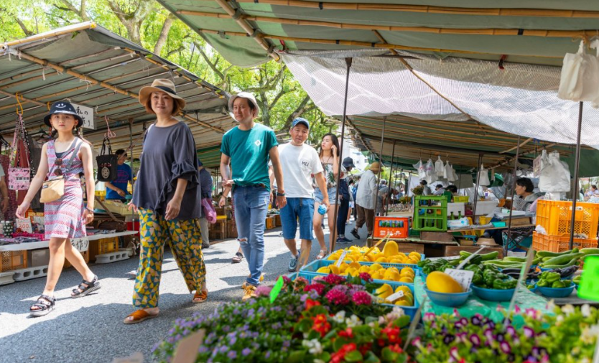
Unit
8
SHOPPING
LESSON 5: SKILLS 1
1
HOBBIES
READING
SPEAKING

Slide 2
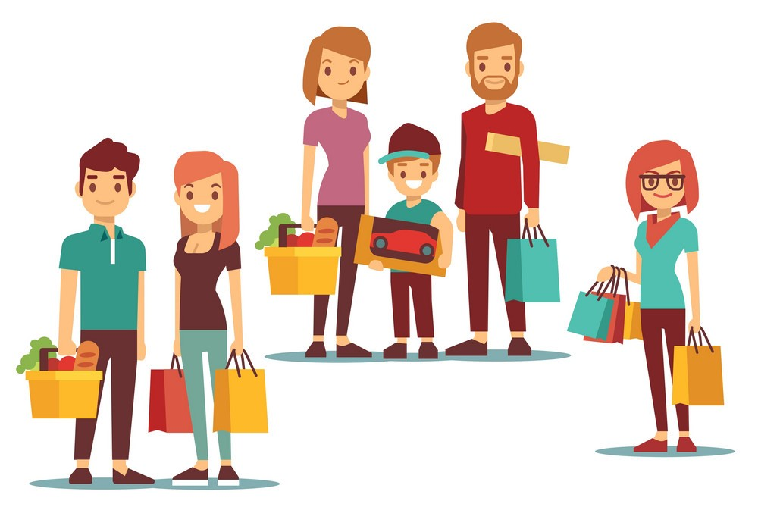
CHATTING
WARM-UP
Do you like shopping?
How often do you go shopping?
Why do you go to shopping centers?

Slide 3

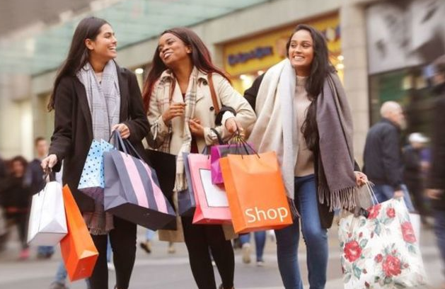
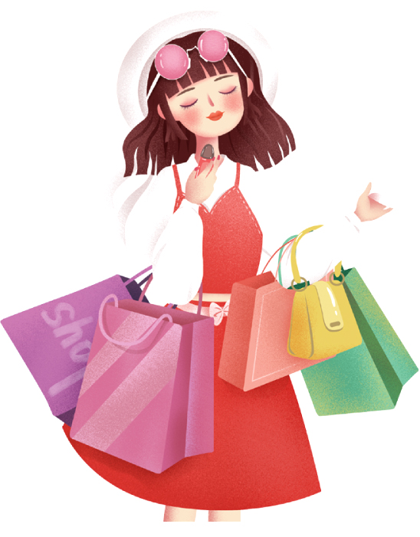
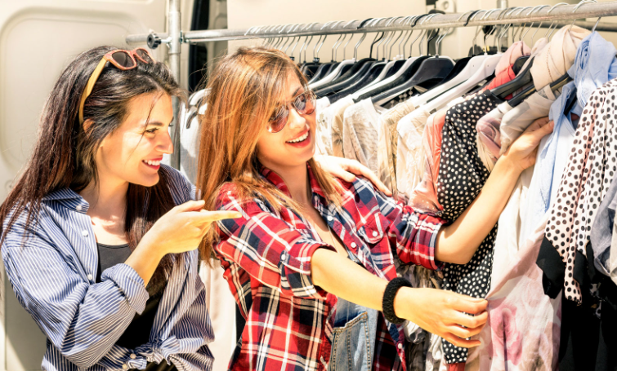
READING
1
Read the list below and tick the most common reason(s) why you go shopping.
Hanging out with friends
Reducing stress
Buying goods
Exercising
Browsing

Slide 4
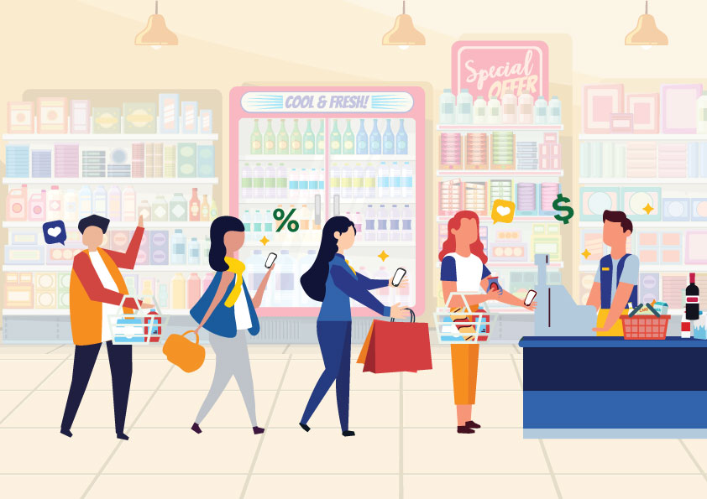

READING
customer (n)
/ˈkʌstəmə/
khách hàng

Slide 5
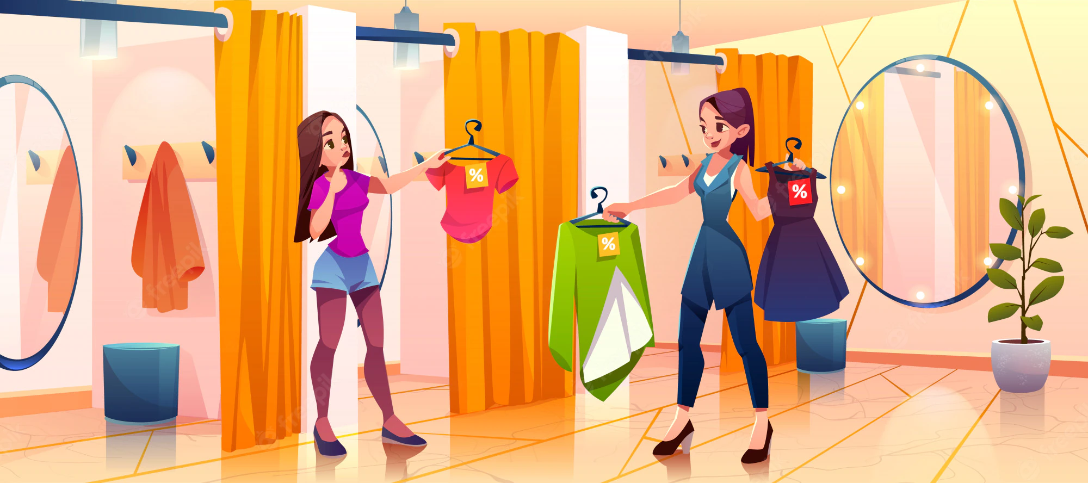
READING
try on (v)
/traɪ ɒn/
thử (quần áo, giày dép)

Slide 6
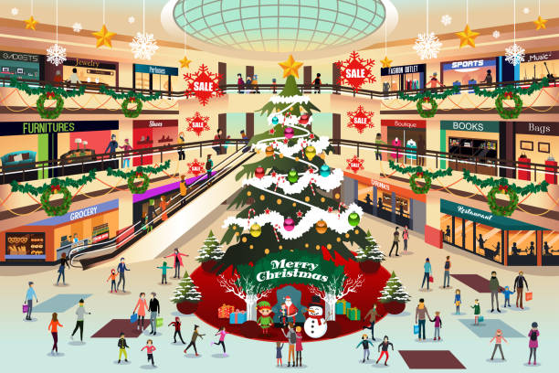
READING
decoration (n)
/ˌdekəˈreɪʃn/
đồ trang trí

Slide 7

READING
wander (v)
/ˈwɑːndər/
đi lang thang, thả bộ

Slide 8
READING
2
Read the passage and choose the correct answer A, B, or C.
1. People go to a shopping centre ______.
A. only for shopping
B. mainly to hang out
C. for many reasons
However, people also go to shopping centres for many other reasons. Some people go there for entertainment. These centres often offer year-round free entertainment for customers of all ages such as live music and special performances.

Slide 9
READING
2
Read the passage and choose the correct answer A, B, or C.
2. At shopping centres, customers can ______.
A. touch the product
B. bargain to get lower prices
C. pay to watch live performances.
Shopping centres offer a wide range of products to choose from. Customers can touch the products and try on clothes and shoes. This makes them feel more comfortable when they decide to buy something.

Slide 10
READING
2
Read the passage and choose the correct answer A, B, or C.
3. A kind of entertainment at a shopping centre is _______.
A. fashion contests
B. live music
C. painting exhibitions
However, people also go to shopping centres for many other reasons. Some people go there for entertainment. These centres often offer year-round free entertainment for customers of all ages such as live music and special performances.

Slide 11
READING
2
Read the passage and choose the correct answer A, B, or C.
4. Some people exercise at a shopping centre because they like its ______.
A. crowds B. well-lit areas C. shops
They enjoy walking for one or two hours in clean and well-lit areas. Some people even go there to avoid the heat or cold outside. Shopping centres offer free air conditioning and heating.

Slide 12
READING
2
Read the passage and choose the correct answer A, B, or C.
5. The word “year-round” in paragraph 2 is similar in meaning to ______.
A. always B. sometimes C. rarely
However, people also go to shopping centres for many other reasons. Some people go there for entertainment. These centres often offer year-round free entertainment for customers of all ages such as live music and special performances.

Slide 13
READING
3
Fill in each blank with ONE word from the passage.
Shopping centres
1. attract a lot of customers during _______. 2. allow customers to _______ on clothes and shoes. 3. offer free ______________ for customers of all ages. 4. are full of ___________ during holidays. 5. offer ______ air conditioning and heating.
sales
try
entertainment
decorations
free

Slide 14
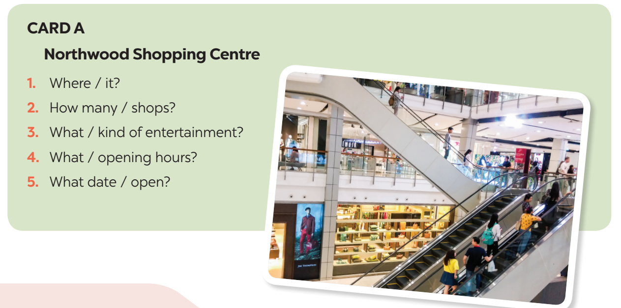

SPEAKING
4
Work in pairs. Ask and answer about a new shopping centre.
Student A reads the suggestions for questions on card A.
Student B reads the information about the new shopping centre on card B (page 91).

Slide 15
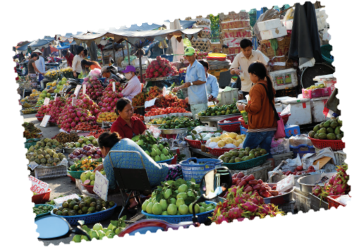
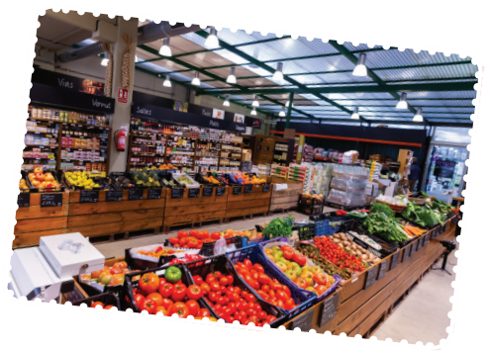
SPEAKING
5
Work in pairs. Ask and answer about a shopping centre, a supermarket, or an
open-air market in your area. Take notes of your partner’s answers and report them to the class.
You can use the suggestions below:
where it is
how you get there
what its opening hours are
what you do there
what you like/ don’t like about it.

Slide 16

CONSOLIDATION
1
Wrap-up
What have we learnt in this lesson?
Reasons why we go to shopping centres.
Information about new shopping centres.

Slide 17

CONSOLIDATION
2
Homework
Learn the new words by heart.
Make a speech introducing a new shopping centre in your city.
Do the exercises in the Workbook

Slide 18

Website: hoclieu.vn
Fanpage: facebook.com/tienganhglobalsuccess.vn/

