Slide 1



Slide 2


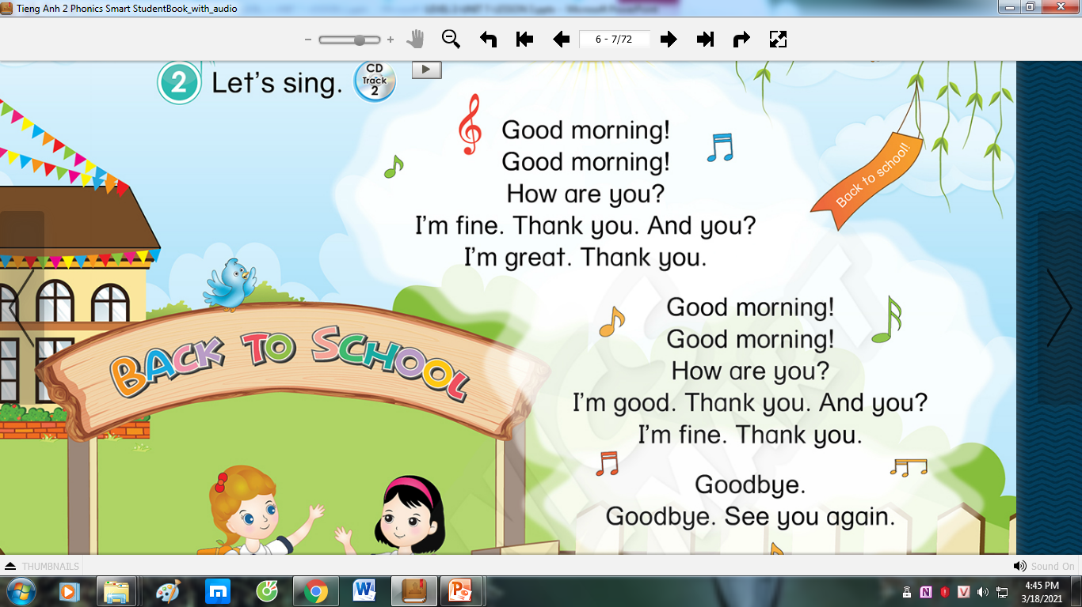


LET’S SING!

Slide 3



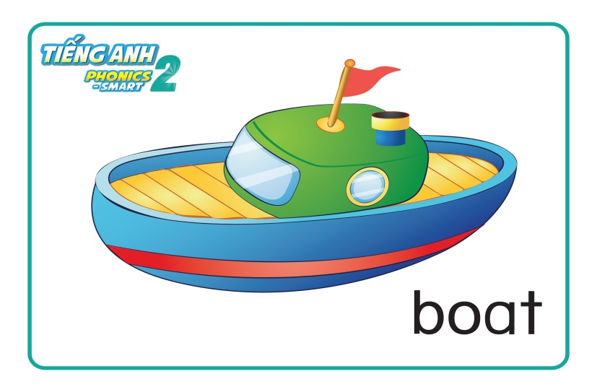

REVISION

Slide 4

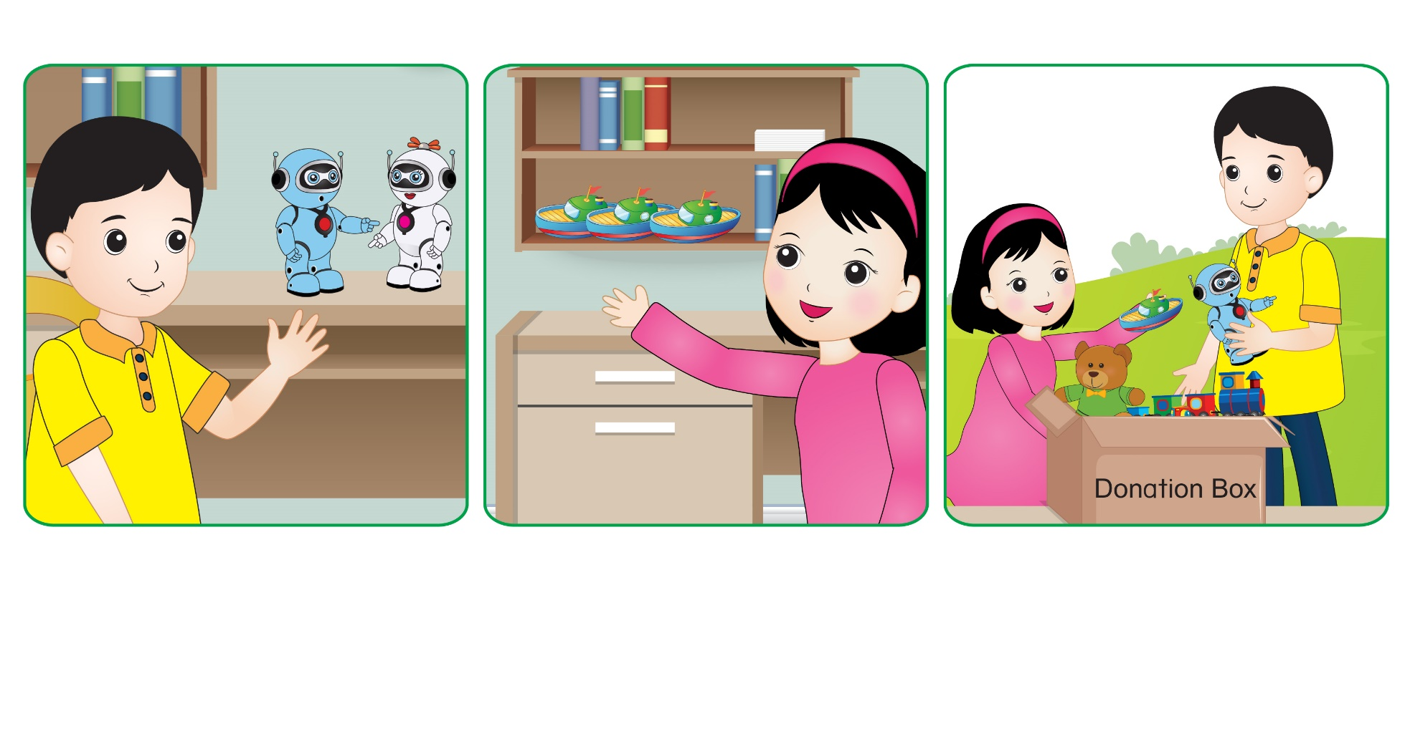
Unit 7: Lesson 3

Slide 5
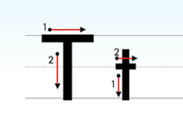
Unit 7: Lesson 3 Tt
1. Trace the letters.

Slide 6

Unit 7: Lesson 3 Tt
1. Trace the letters.
Let’s write letter Tt on your board.
T
t
T
T
t

Slide 7


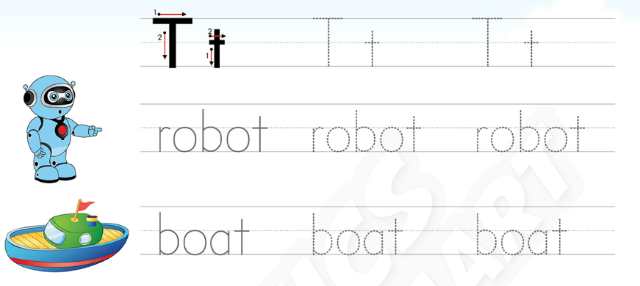

Unit 7: Lesson 3 Tt
1. Trace the letters.
36

Slide 8
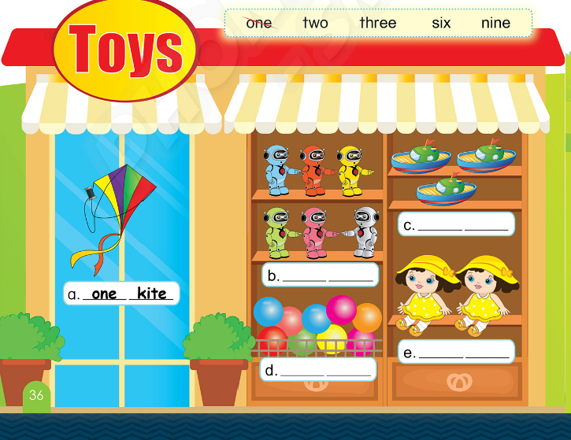
Unit 7: Lesson 3 Tt
1. Trace the letters.
36
2. Choose, write and say.

Slide 9
Unit 7: Lesson 3 Tt
1. Trace the letters.
2. Choose, write and say.
three
boats
six
robots
nine
two
dolls
balls

Slide 10
BIG WHEEL GAME
1
2
3
4
5
6
SPIN
STOP
Notes:
- HS chọn câu hỏi, trả lời và quay lấy sao.

Slide 11
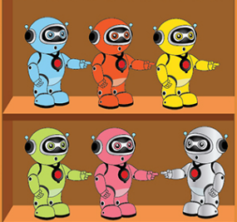

How many robots?
There are …
six robots
back

Slide 12

How many boats?
There are …
three boats
back

Slide 13

How many balls?
There are …
nine balls
back

Slide 14
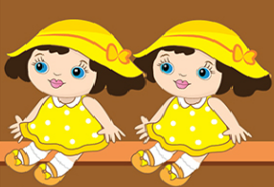
How many dolls?
There are …
two dolls
back

Slide 15
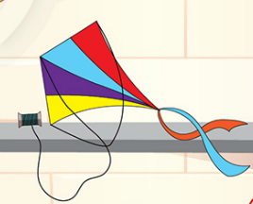
How many kites?
There is …
one kite
back

Slide 16

How many cars?
There are …
two cars
back

