Slide 1
Welcome to PowerPoint
5 tips for a simpler way to work

Slide 2
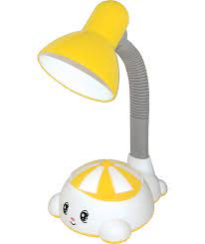
Ôn đếm nhận biết số lượng trong phạm vi 3

Slide 3
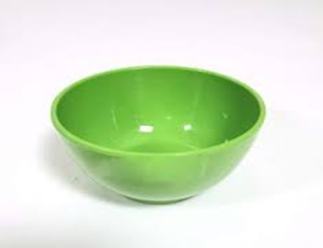
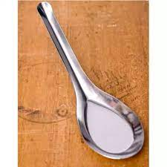
so sánh số lượng 2 và số lượng 3
Morph makes smooth animations and object movements in your presentation. You use two similar slides to perform the animation, but it looks to your audience like the action happens on one slide.
Play the video on the right to see a quick example.
Morph is a subscription-only feature. If you have an Office 365 subscription, you can try it yourself with the steps on the next slide.

Slide 4
so sánh số lượng 2 và số lượng 3
Morph makes smooth animations and object movements in your presentation. You use two similar slides to perform the animation, but it looks to your audience like the action happens on one slide.
Play the video on the right to see a quick example.
Morph is a subscription-only feature. If you have an Office 365 subscription, you can try it yourself with the steps on the next slide.

Slide 5
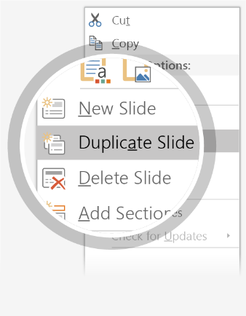
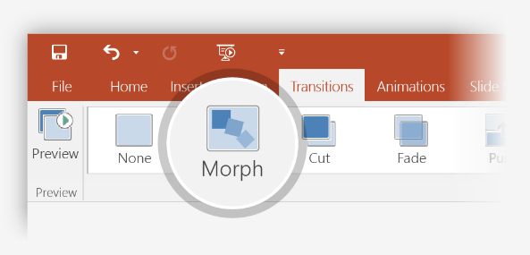
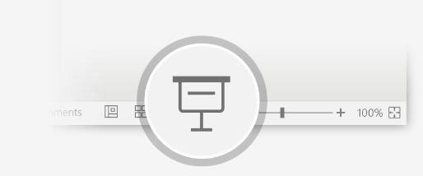
Trò chơi: Ai nhanh hơn
Trò chơi: Ai nhanh hơn
Try it yourself with these two simple “planets”:
1
Duplicate this slide: Right-click the slide thumbnail and select Duplicate Slide.
2
In the second of these two identical slides, change the shapes on the right in some way (move, resize, change color), then go to Transitions > Morph.
3
Return to the first of the two slides and press Slide Show button and then select Play to see your circle morph!
Hint: Effect Options gives you even more options for Morph.

Slide 6
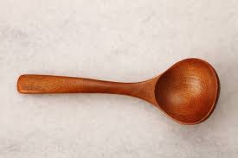
Đố các con biết đồ vật nào có số lượng nhiều hơn.
Morph makes smooth animations and object movements in your presentation. You use two similar slides to perform the animation, but it looks to your audience like the action happens on one slide.
Play the video on the right to see a quick example.
Morph is a subscription-only feature. If you have an Office 365 subscription, you can try it yourself with the steps on the next slide.

Slide 7
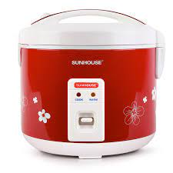
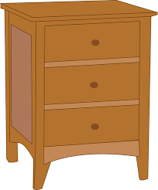
Đố các con biết đồ vật nào có số lượng nhiều hơn.
Morph makes smooth animations and object movements in your presentation. You use two similar slides to perform the animation, but it looks to your audience like the action happens on one slide.
Play the video on the right to see a quick example.
Morph is a subscription-only feature. If you have an Office 365 subscription, you can try it yourself with the steps on the next slide.

