Slide 1
Teacher:Dinh Thi Hoai

Slide 3
Unit
5
1
Unit
FAMILY LIFE
INVENTIONS
LESSON 2
LANGUAGE

Slide 4
Unit
1
1
FAMILY LIFE
Family Life
Unit
OBJECTIVES
Use the lexical items related to the topic Inventions;
Pronounce stress in three-syllable nouns correctly;
Understand the present perfect, gerunds and to-infinitives.

Slide 5
LESSON 2
LANGUAGE
WARM-UP
Guessing the years of inventions
PRONUNCIATION
Task 1: Listen and repeat.
Task 2: Cross the river.
VOCABULARY
Task 1: Unscramble the letters.
Task 2: Match the words with their meanings.
Present perfect: Circle the correct answers.
Gerunds and to-infinitives: Complete the sentences.
Game: Running dictation
GRAMMAR
CONSOLIDATION
Wrap-up
Homework

Slide 6
LESSON 2
LANGUAGE
WARM-UP
Guessing the years of inventions

Slide 7
WARM-UP
Unit
GETTING STARTED
WHICH YEAR DID THESE INVENTIONS COME?
1. The Internet
1983
2. Refrigerator
1899
3. Light bulb
1879
4. Telephone
1876
5. Paper
105

Slide 8
LESSON 2
LANGUAGE
WARM-UP
Guessing the years of inventions
PRONUNCIATION
Task 1: Listen and repeat.
Task 2: Cross the river.

Slide 9
PRONUNCIATION
Tips:
Most three syllable nouns are stressed on the first syllable.
Examples:
'century 'holiday 'energy
Nouns ending in “-tion”, “-sion” or “-al” generally have the stress on the syllable before these suffixes.
Examples:
con'sumption de'nial in'vention

Slide 10
PRONUNCIATION
1
Listen and repeat. Pay attention to the stressed syllable in each word.
invention computer holiday century

Slide 11
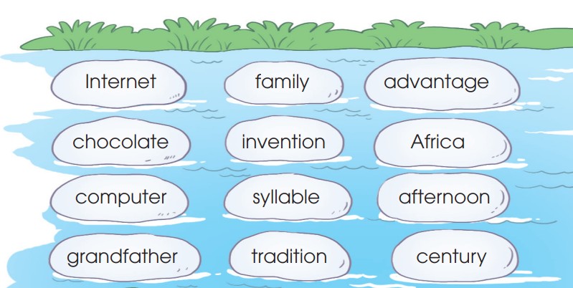
PRONUNCIATION
2
Connect all the words with the stress pattern -•- to cross the river. Then listen and check your answers. Practise saying these words in pairs.

Slide 12
LESSON 2
LANGUAGE
WARM-UP
Guessing the years of inventions
PRONUNCIATION
Task 1: Listen and repeat.
Task 2: Cross the river.
VOCABULARY
Task 1: Unscramble the letters.
Task 2: Match the words with their meanings.

Slide 13
VOCABULARY
1
Unscramble the words.
EXPERIMENT

Slide 14
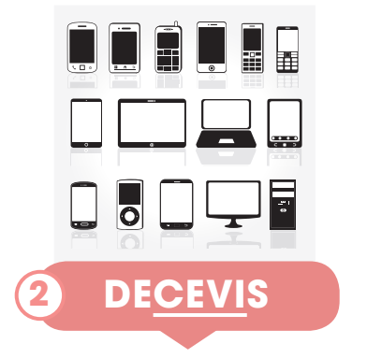
VOCABULARY
1
Unscramble the words.
DEVICES

Slide 15
VOCABULARY
1
Unscramble the words.
LABORATORY

Slide 16
VOCABULARY
1
Unscramble the words.
HARDWARE

Slide 17
VOCABULARY
1
Unscramble the words.
SOFTWARE

Slide 18
VOCABULARY
1
Unscramble the words.
EQUIPMENT

Slide 19
VOCABULARY
2
Match the words with their meanings.
1. device (n)
a. the machines and electronic parts in a computer or other electronic system
2. laboratory (n)
b. a scientific test that is done in order to study what happens and to gain new knowledge
3. experiment (n)
c. ​the programs used by a computer for doing particular jobs
4. equipment (n)
d. a room or building used for scientific research, experiments, testing, etc.
5. software (n)
e. the things that are needed for a particular purpose or activity
6. hardware (n)
f. a piece of computer equipment, especially a small one such as a smartphone

Slide 20
LESSON 2
LANGUAGE
WARM-UP
Guessing the years of inventions
PRONUNCIATION
Task 1: Listen and repeat.
Task 2: Cross the river.
VOCABULARY
Task 1: Unscramble the letters.
Task 2: Match the words with their meanings.
Present perfect: Circle the correct answers.
Gerunds and to-infinitives: Complete the sentences.
Game: Running dictation
GRAMMAR

Slide 21
GRAMMAR
PRACTICE
1
Circle the correct answers.
1. They just found / have just found a suitable solution to the problem.
2. Since people invented / have invented the first computer, they
create / have created many more interesting inventions.
3. The woman is very angry because her son lost / has lost his smartphone.

Slide 22
PRACTICE
GRAMMAR
2
Complete the sentences.
1. Many children enjoy (use) _________ modern devices nowadays.
2. I decided (study) ____________ computer science at university.
3. (Play) _________________ language games on a smartphone is fun.
4. It is very convenient (study) _________________ with a smartphone.
using
to study
Playing / To play
to study

Slide 23
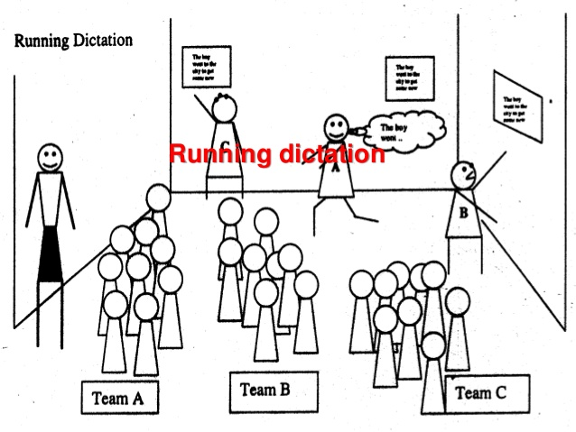
GAME: RUNNING DICTATION
Work in groups.
Find the sentence strips on the walls.
Memorize as much as you can.
Run back to your teams and dictate what you remember to the secretary.
Repeat running and dictating until the whole group has correctly dictated the sentences.

Slide 24
LESSON 2
LANGUAGE
WARM-UP
Guessing the years of inventions
PRONUNCIATION
Task 1: Listen and repeat.
Task 2: Cross the river.
VOCABULARY
Task 1: Unscramble the letters.
Task 2: Match the words with their meanings.
Present perfect: Circle the correct answers.
Gerunds and to-infinitives: Complete the sentences.
Game: Running dictation
GRAMMAR
CONSOLIDATION
Wrap-up
Homework

Slide 25
CONSOLIDATION
1
Wrap-up
Use the lexical items related to the topic Inventions;
Pronounce stress in three-syllable nouns correctly;
Understand the the present perfect, gerunds and to-infinitives.

Slide 26
CONSOLIDATION
2
Homework
1. Prepare for the next lesson: Unit 5 - Reading
2. Do exercises in the workbook

Slide 27
Website: sachmem.vn
Fanpage: facebook.com/sachmem.vn/

