Slide 1
Teacher:Dinh Thi Hoai

Slide 3
Unit
5
1
Unit
FAMILY LIFE
INVENTIONS
LESSON 4
SPEAKING
Inventions and how they are used

Slide 4
Unit
1
1
FAMILY LIFE
Family Life
Unit
OBJECTIVES
Talk about inventions and how they are used.

Slide 5
LESSON 4
SPEAKING
WARM-UP
Guessing game
Task 1: Talk about the uses of these inventions.
CONTROLLED PRACTICE
LESS CONTROLLED PRACTICE
Task 2: Talk more about one of the inventions in task 1.
Task 3: Present your ideas to the whole class.
CONSOLIDATION
Wrap-up
Homework

Slide 6
LESSON 4
SPEAKING
WARM-UP
Guessing game

Slide 7
GUESSING GAME
Pick a card containing the name of the invention.
Explain it to the class without showing the word.
The rest of the class guess its name.

Slide 8
LESSON 4
SPEAKING
WARM-UP
Guessing game
Task 1: Talk about the uses of these inventions.
CONTROLLED PRACTICE

Slide 9
CONTROLLED PRACTICE
Functions | Useful expressions
Uses of inventions | - … help(s)/ allow(s) us to do st Example: The Internet helps us to communicate over long distances. - We/ People (can) use st to do/ for st Example: People can use the Internet to communicate over long distances. - … is/ are used for st/ doing st Example: The Internet is used for communication/ communicating over long distances.

Slide 10
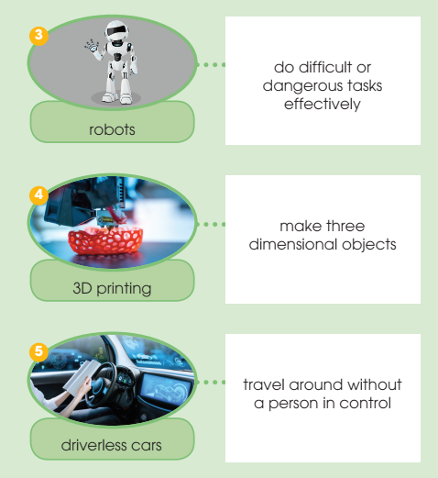
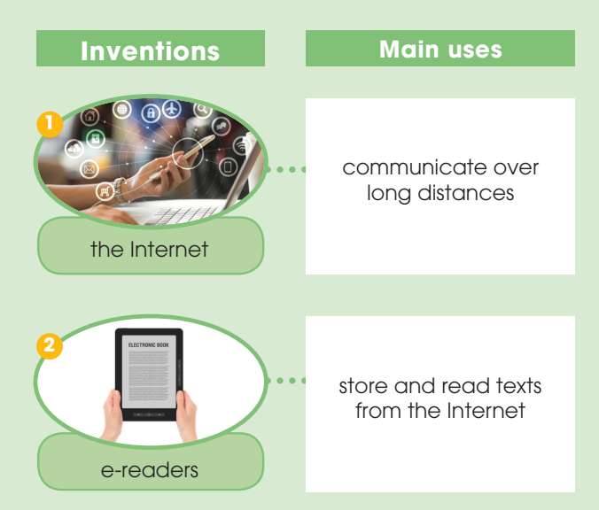
CONTROLLED PRACTICE
1
Work in pairs. Talk about the uses of these inventions. Use the expressions below to help you.

Slide 11
LESSON 4
SPEAKING
WARM-UP
Guessing game
Task 1: Talk about the uses of these inventions.
CONTROLLED PRACTICE
LESS CONTROLLED PRACTICE
Task 2: Talk more about one of the inventions in task 1.
Task 3: Present your ideas to the whole class.

Slide 12
LESS CONTROLLED PRACTICE
2
Work in groups. Talk more about one of the inventions in activity 1. Use the outline below to help you prepare a group presentation.

Slide 13
LESS CONTROLLED PRACTICE
3
Present your ideas to the whole class. Then vote for the most interesting group presentation.
Present group’s ideas.
Give comments for friends’ groups and vote for the most interesting group presentation.

Slide 14
LESSON 4
SPEAKING
WARM-UP
Guessing game
Task 1: Talk about the uses of these inventions.
CONTROLLED PRACTICE
LESS CONTROLLED PRACTICE
Task 2: Talk more about one of the inventions in task 1.
Task 3: Present your ideas to the whole class.
CONSOLIDATION
Wrap-up
Homework

Slide 15
CONSOLIDATION
1
Wrap-up
Speaking about inventions and how they are used.

Slide 16
CONSOLIDATION
2
Homework
Prepare for the next lesson: Unit 5 – Listening
2. Do exercises in the workbook

Slide 17
Website: sachmem.vn
Fanpage: facebook.com/sachmem.vn/

