Slide 1
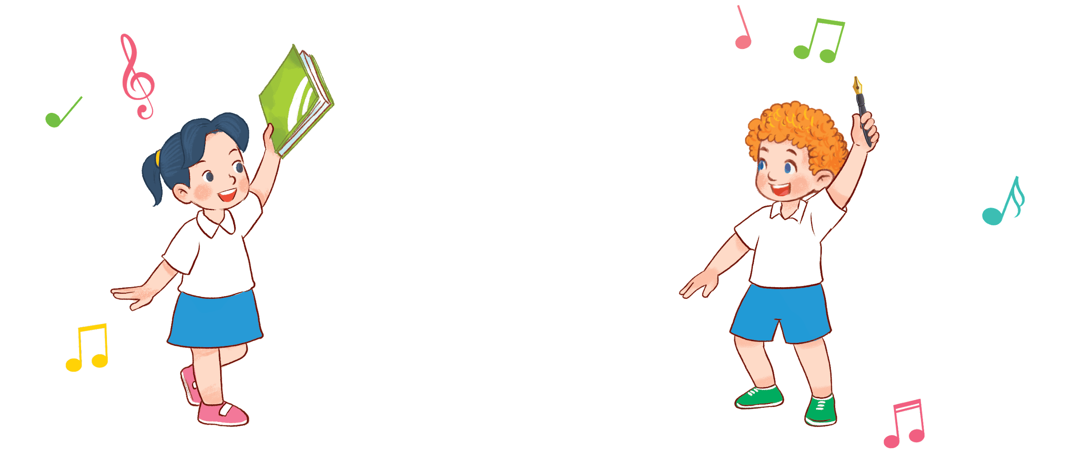
8
3
Period 5

Slide 2
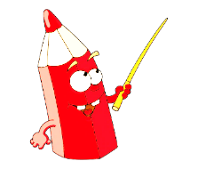
①
Warm-up and review
Contents
②
Listen and repeat.
③
Listen and circle.
④
Let’s chant.
⑤
Fun corner and wrap-up

Slide 3
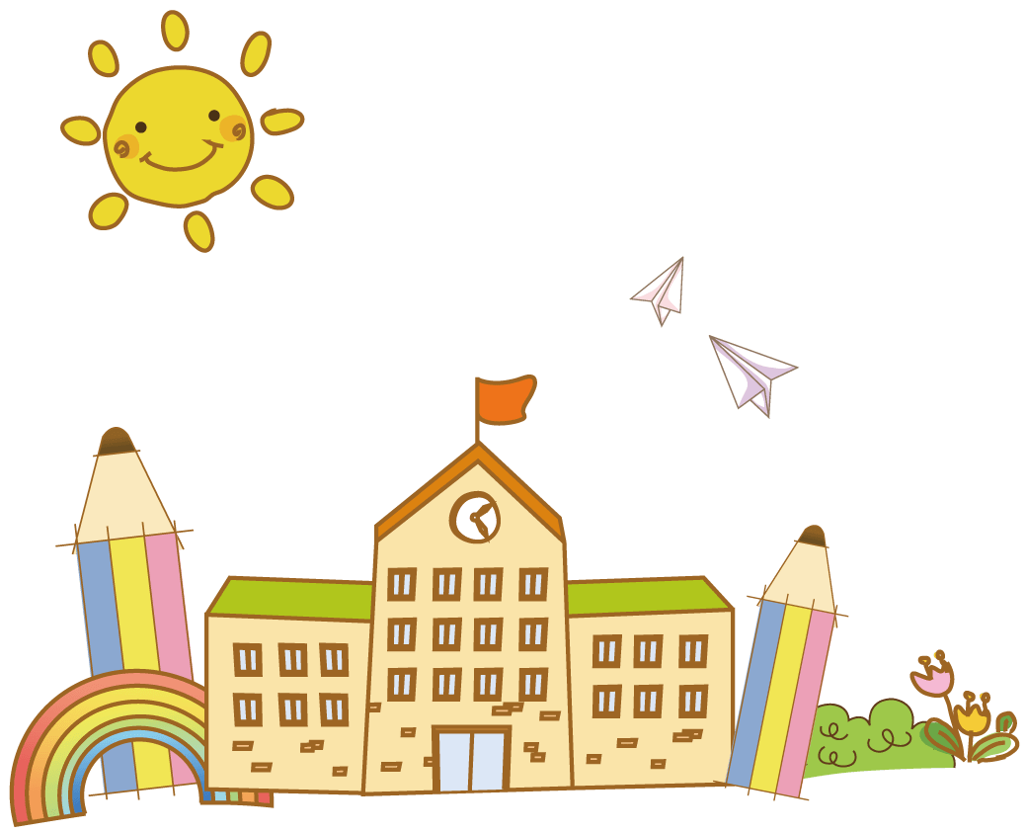
①
Warm-up and review

Slide 4
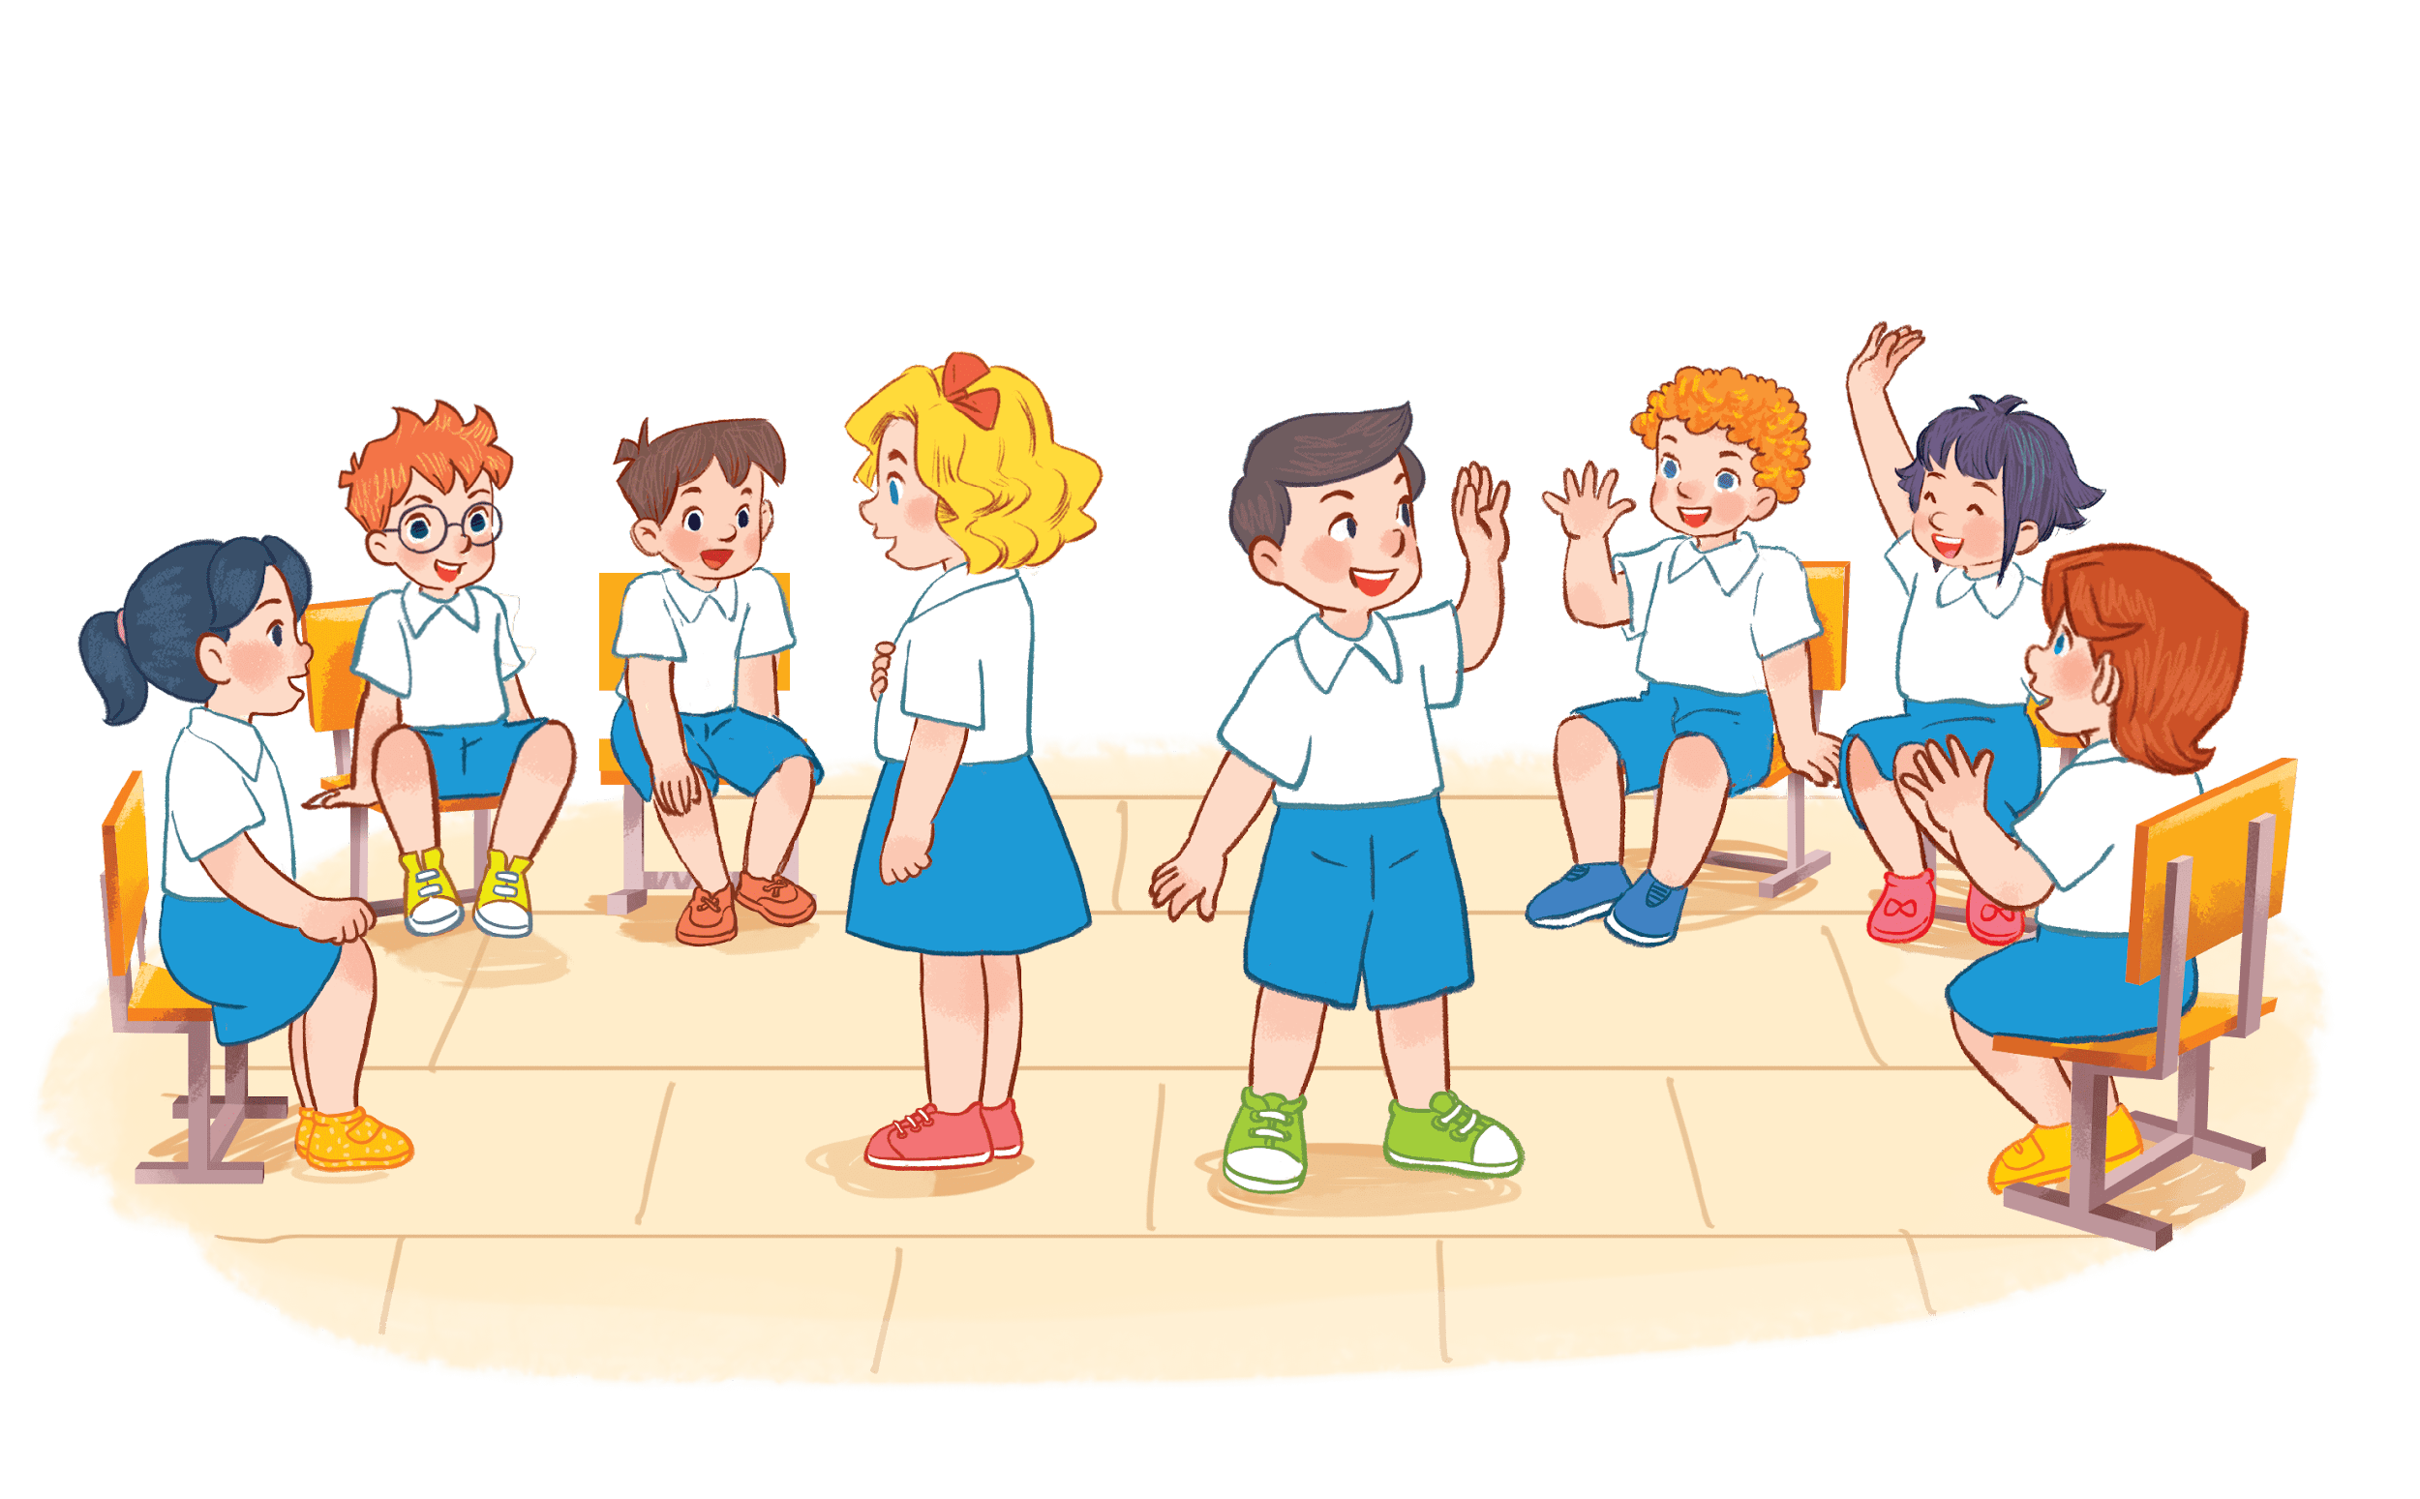
I have a book.
Notes:
Game: Pass the school things.
Review the previous lesson by having the class pass the school things (a book, a pencil, a pen…) while playing the music. When the music stops, those who have the school things have to say the sentence: I have a …

Slide 5
I have a pen.

Slide 6
②
Listen and repeat.

Slide 8
Game: Listen and choose!
Notes:
Divide the class into 2 groups.
Let the pupils listen to the recording, then choose the correct moving shapes.

Slide 9
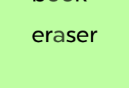
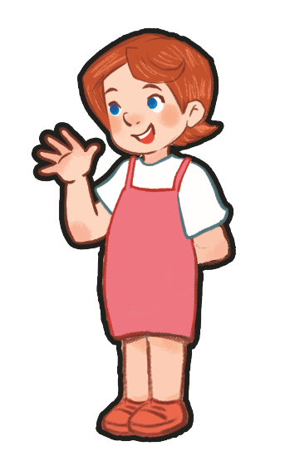

Slide 11
Do you have an eraser?
book
eraser
I have a book.

Slide 12
I have a book.
Do you have an eraser?
eraser
a

Slide 13
③
Listen and circle.

Slide 15
Game: Listen and tick the box!
Notes:
Play the recording for pupils to choose a correct answer and tick the box.

Slide 16
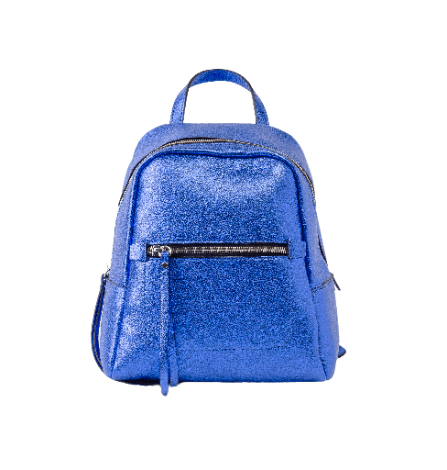
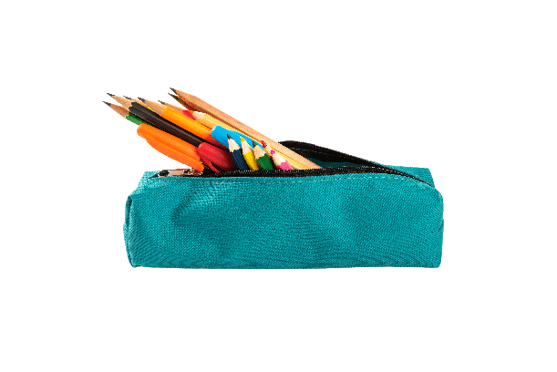
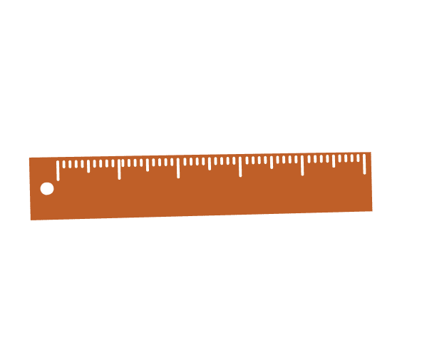
Good job!
✔
A
B
C

Slide 17
Well done!
✔
A
B
C

Slide 18
Way to go!
✔
A
B
C

Slide 19
Great job!
✔
A
B
C

Slide 20
Way to go!
✔
A
B
C

Slide 21
Great job!
✔
A
B
C

Slide 22
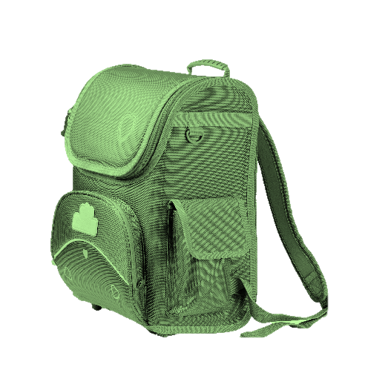
Well done!
✔
A
B
C

Slide 23
④
Let’s chant.
.

Slide 25
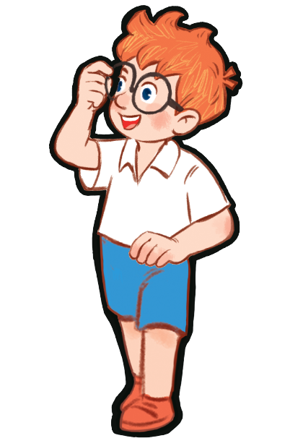
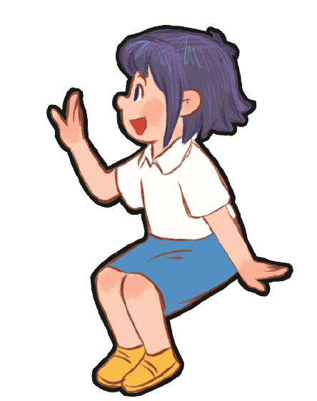
Book, book, book.
I have a book.
Do you have a book?
Yes, I do. Yes, I do.
Notes:
Game: Show me!
- Divide the class into four groups. Ask pupils to say the chant again, then show their school things as they say the chant.
- T can change the name of school things for pupils to chant and show theirs as they chant.

Slide 26
Eraser, eraser, eraser.
I have an eraser.
Do you have an eraser?
No, I don’t. No, I don’t.

Slide 27
Pencil, pencil, pencil.
I have a pencil.
Do you have a pencil?
Yes, I do. Yes, I do.

