Slide 1
UNIT 10:
Our summer holiday
LESSON 2 ( P2)
Made by: Nguyen thi thu phuong

Slide 2
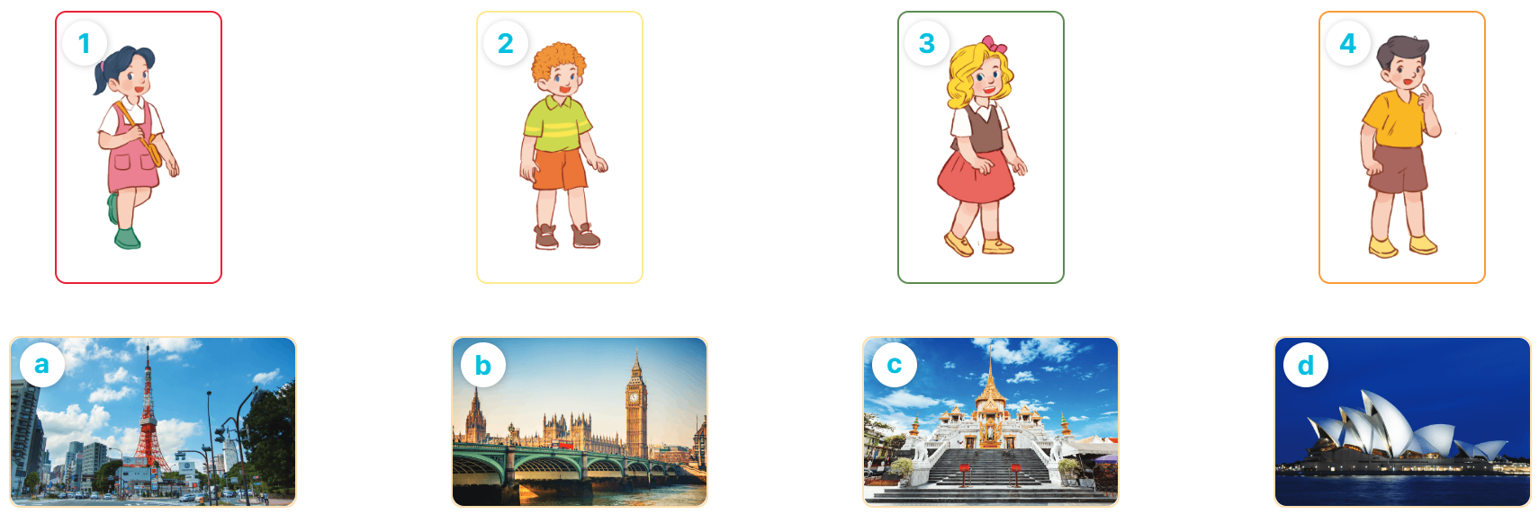
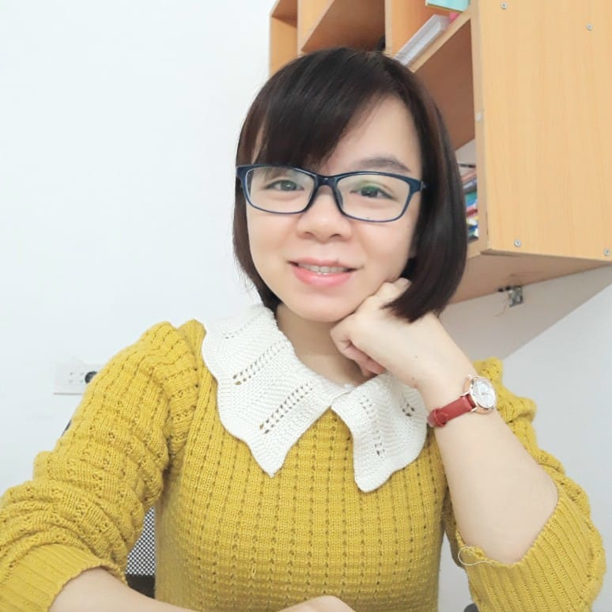
4
Listen and match.
MsPham
0936082789

Slide 3
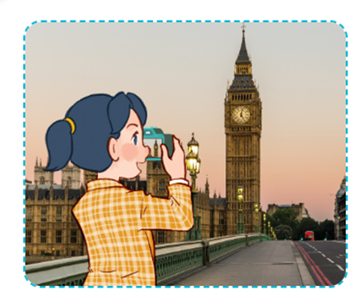
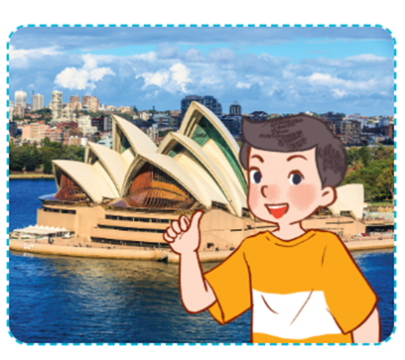
5
Look, complete and read.
1
A: Where were you last summner, Mai?
B: I was in ___________.
A: Is it a bog city?
B: ______, it is.
London
Yes
A: Where were you last summner, Nam?
B: I ______ in Sydney. Were you in Sydney, too?
A: ______, I wasn’t.
2
was
No

Slide 4
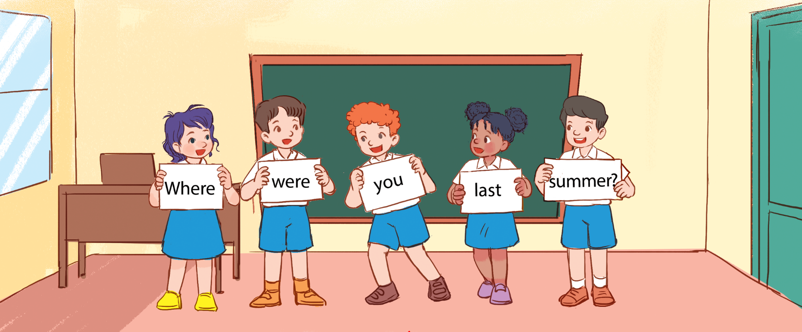
6
Let’s play.
Making sentences

