Slide 1
Where are you from?
(Bạn đến từ đâu?)
MsPham
0936082789
I’m from _________.
(Tớ đến từ ____)
I am = I’m
Vietnam
MsPham
0936082789
Australia
America
Britain

Slide 2
MsPham
0936082789
Where’s he/she from?
He’s/She’s from ________.
is = ’s
Thailand
Japan
MsPham
0936082789
Malaysia
Singapore

Slide 3
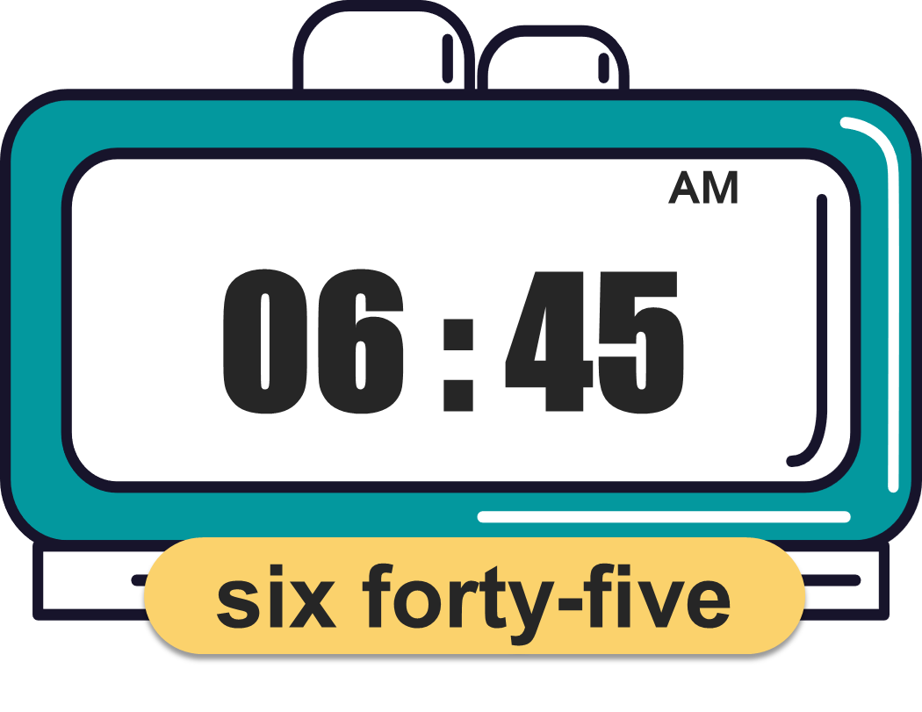
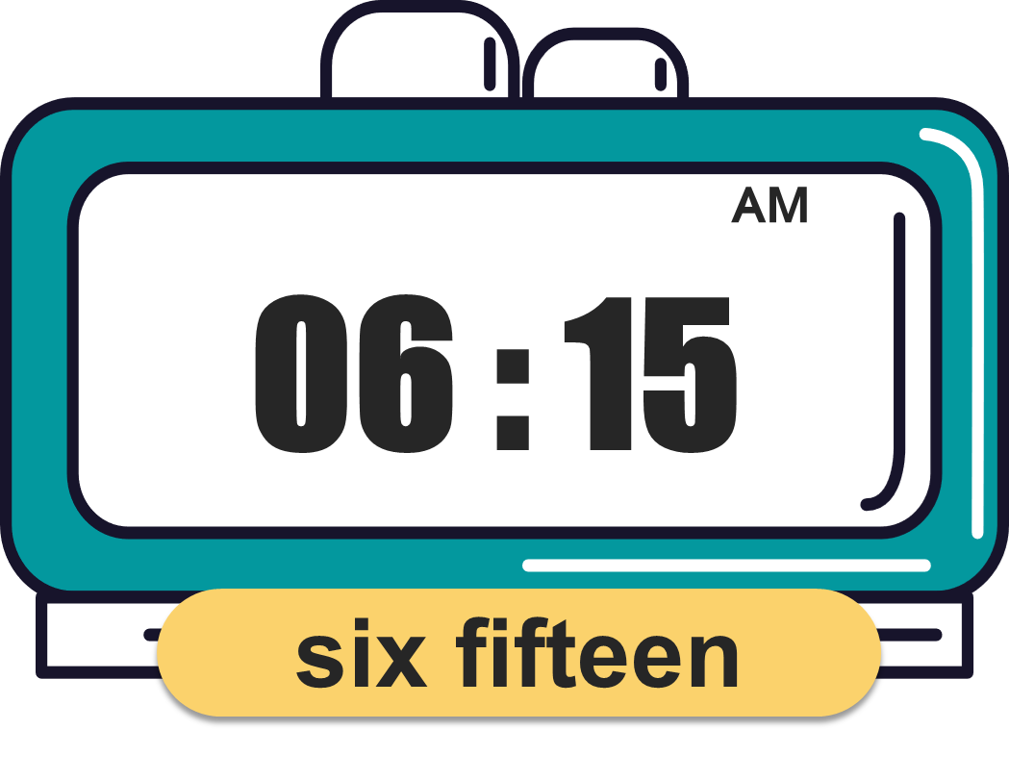
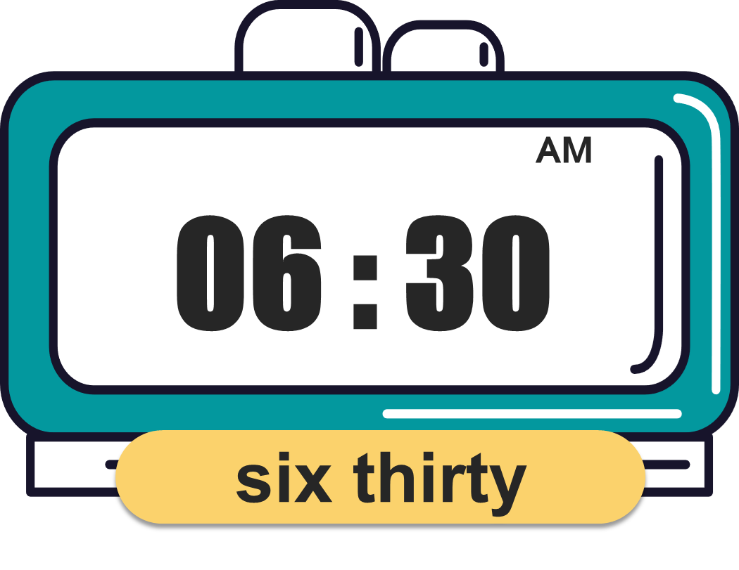
What time is it?
(Mấy giờ rồi?)
MsPham
0936082789
It’s _________.
(____)
MsPham
0936082789

Slide 4
What time do you _______?
I ________ at ________.
MsPham
0936082789
get up
go to bed
have breakfast
go to school

Slide 5
Monday
Tuesday
Wednesday
Sunday
MsPham
0936082789
What day is it today?
It’s _________.
MsPham
0936082789
Thursday
Saturday
Friday

Slide 6
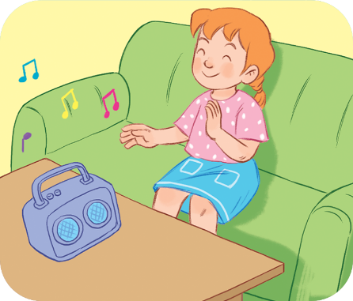
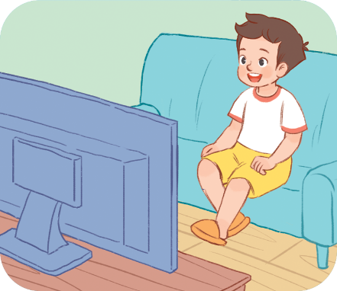
Monday
Tuesday
Wednesday
Sunday
MsPham
0936082789
What do you do on _____s?
I _________.
MsPham
0936082789
Saturday
Thursday
Friday

Slide 7
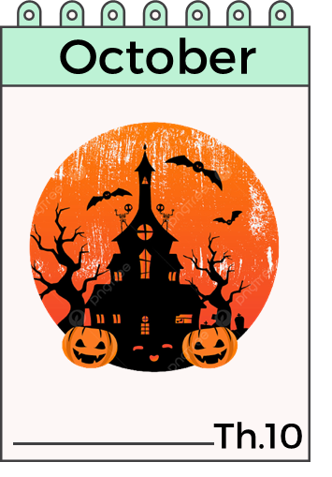
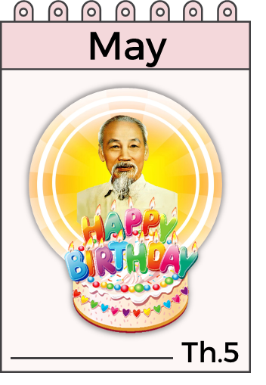
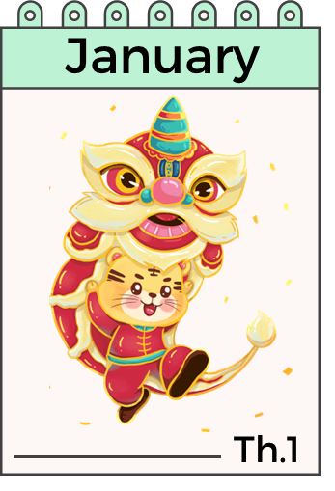
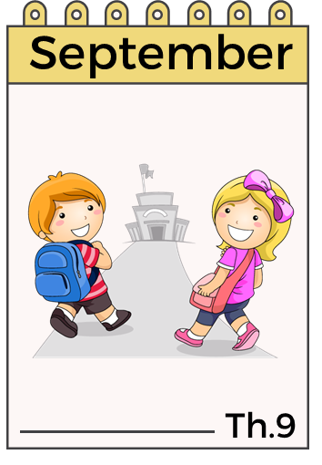
When’s your birthday?
It’s in ___________.
MsPham
0936082789

Slide 8
What do you want to eat/drink?
I want some _________.
MsPham
0936082789
chips
water
grapes
lemonade
jam
juice

Slide 9
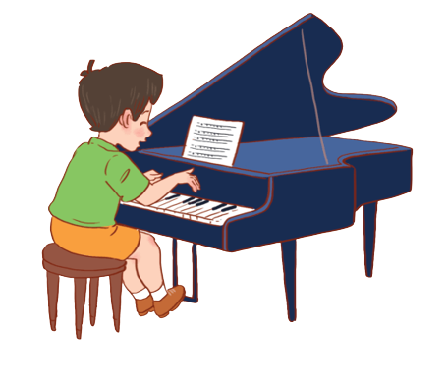
Yes, I can.
Can you + __________?
MsPham
0936082789
No, I can’t.
play the guitar
ride a bike
MsPham
0936082789
play the piano
ride a horse
skip
fly a kite

Slide 10
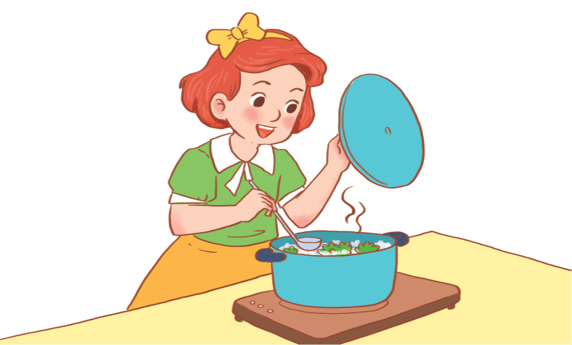
Yes, he/she can.
Can he/she + _________?
No, he/she can’t.
MsPham
0936082789
draw
cook
roller skate
swim
play
football
play
badminton

