Slide 1




WELCOME TO OUR CLASS TODAY
An Tien primary school
Class 5
Unit 5 : My future job
Lesson 3 : P. 4,5,6
Teacher : Nguyễn Thị Nhung

Slide 2
Warm up

Slide 3
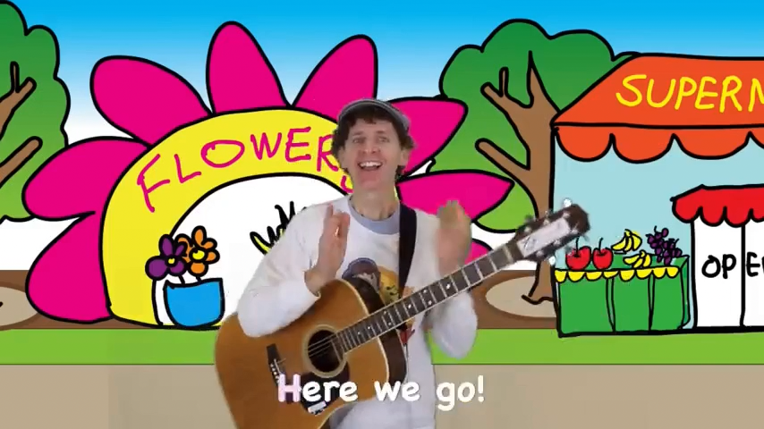

Slide 4


Game

Slide 5
https://wordwall.net/vi/resource/27314538/job

Slide 7
Interview

Slide 8


Ask your friends:
1. What would you like to be in the future?
2. Why would you like to be……?
Name | Future job | Reason

Slide 10
Join the quiz:
https://quizizz.com/admin/quiz/6715b466c2ad9d85cef5eb78

Slide 11
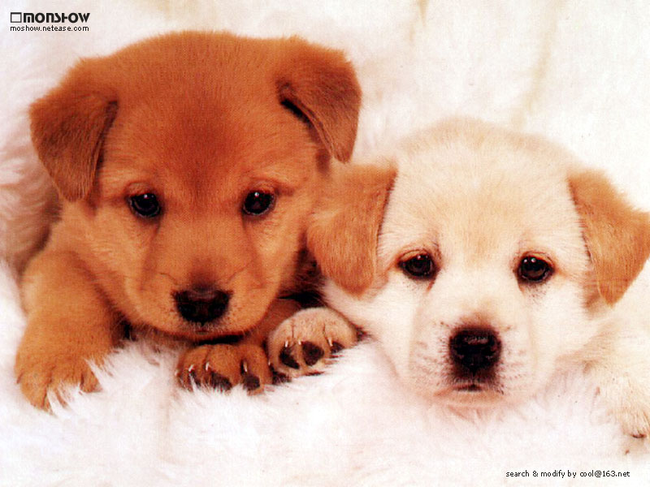

Thank you for your attention!
Thank you for your attention!

