Slide 1


Slide 2


Our sports day
9
Lesson 3 - Period 5

Slide 3
TABLE OF CONTENTS
01
02
03
04
Review
Listen and repeat.
Listen and circle.
Let’s chant.

Slide 4
01
Review

Slide 5
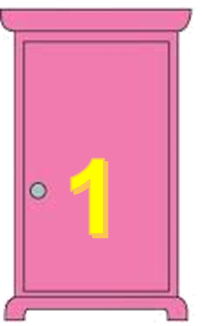

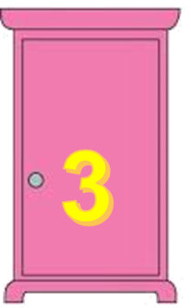
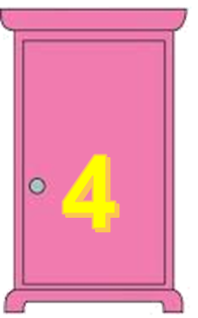
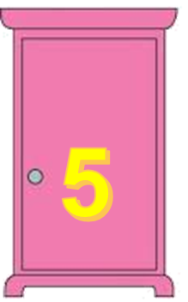
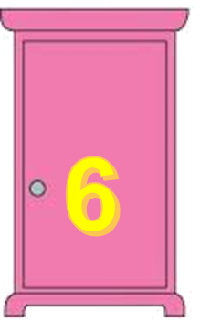
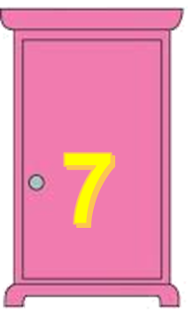


TEAM 1
TEAM 2

Slide 6
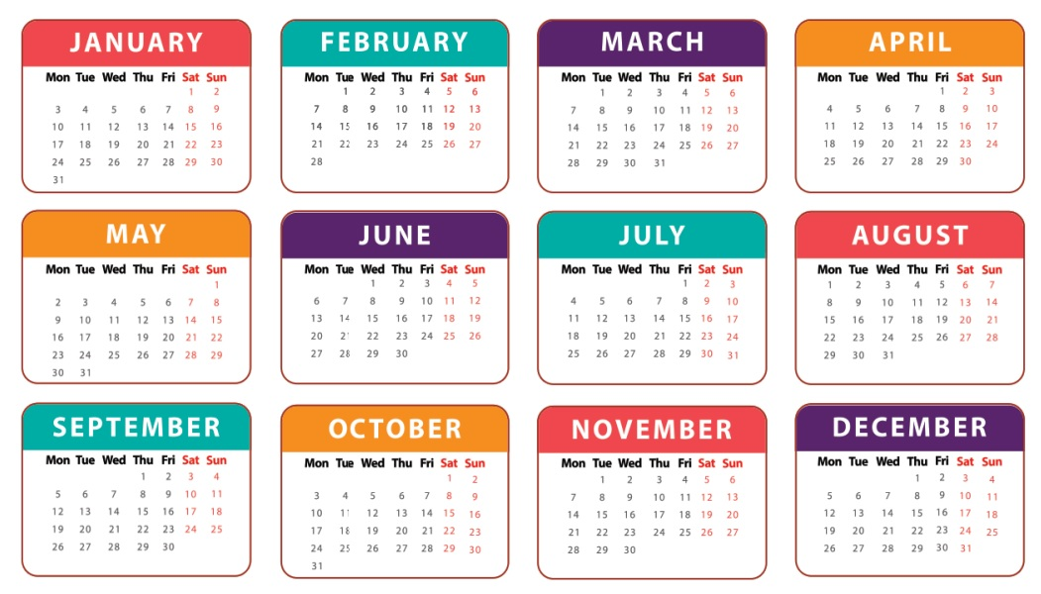
When’s your sports day?
It’s in June.

Slide 7
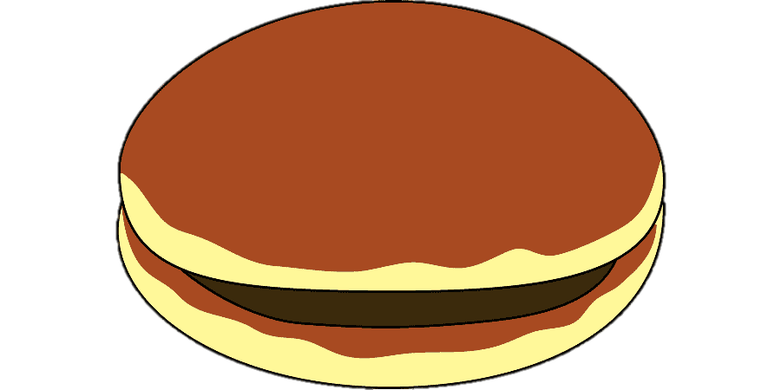
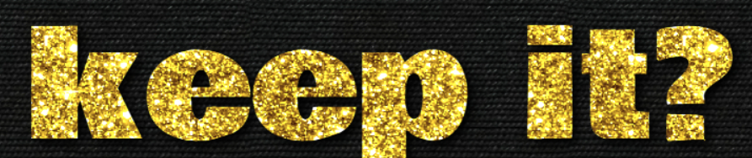
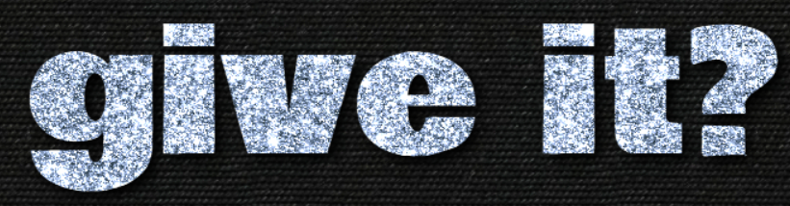
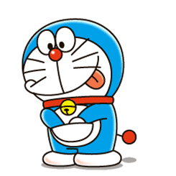

4 points
or

Slide 8
Is your sports day in February?
Yes, it is.

Slide 9
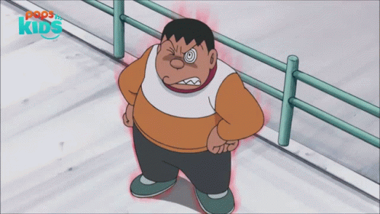

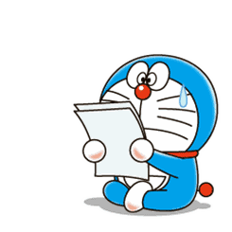
1 points
or

Slide 10
Is your sports day in July?
No, it isn’t.

Slide 11
3 points
or

Slide 12
When’s your sports day?
It’s in December.

Slide 13
2 points
or

Slide 14
When’s your birthday?
It’s in April.

Slide 15
2 points
or

Slide 16
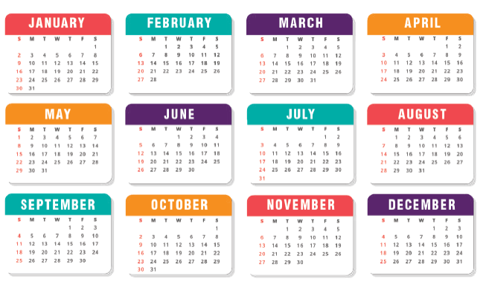
Is your sports day in October?
Yes, it is.

Slide 17
3 points
or

Slide 18
When’s your birthday?
It’s in May.

Slide 19
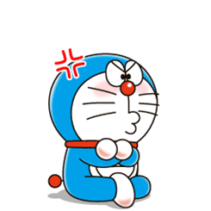
0 points
or

Slide 20
Is your sports day in January?
No, it isn’t.

Slide 21
6 points
or

Slide 22
02
Listen and repeat.

Slide 23
letter y
/i/
/aɪ/
February
July

Slide 24

1
Listen and repeat.
y February
Our sports day is in February.
y July
My birthday is in July.

Slide 25
03
Listen and circle.

Slide 26
2
Listen and circle.
1. Is your sports day in ___?
a. July b. February c. January
2. I like ___.
a. July b. January c. cycling

Slide 27
04
Let’s chant.

Slide 28


3
Let’s chant.
When’s your sports day?
In January, February or May?
In January, in January.
It’s in January.
When’s your sports day?
In May, June or July?
In July, in July.
It’s in July.

Slide 29
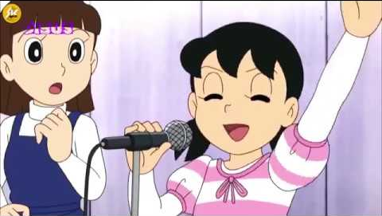
Chant like Shizuka does!

Slide 30
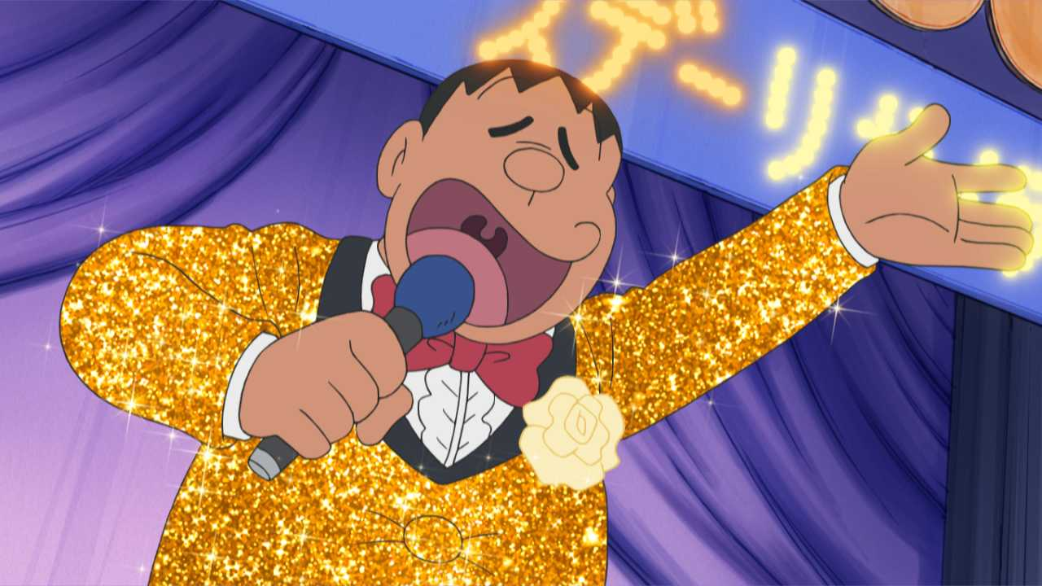
Chant like Jaian does!

Slide 31
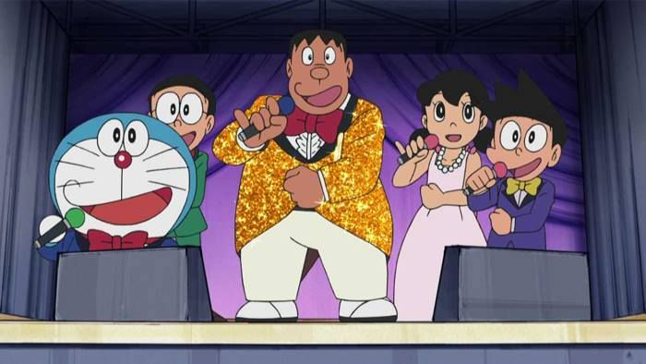
Let’s chant together!

Slide 32

Website: hoclieu.vn
Fanpage: facebook.com/www.tienganhglobalsuccess.vn
Website: sachmem.vn; hoclieu.vn
Fanpage: www.facebook.com/sachmem.vn

