Slide 1
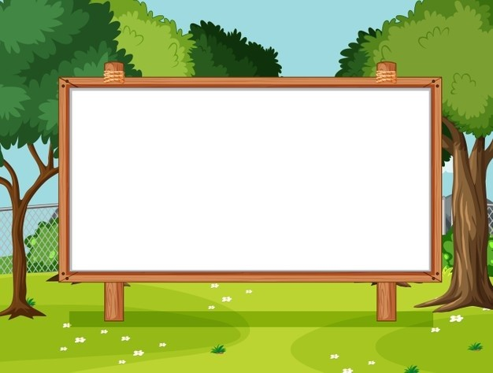
Unit 9
Our outdoor activities
Lesson 3 - Period 6

Slide 2
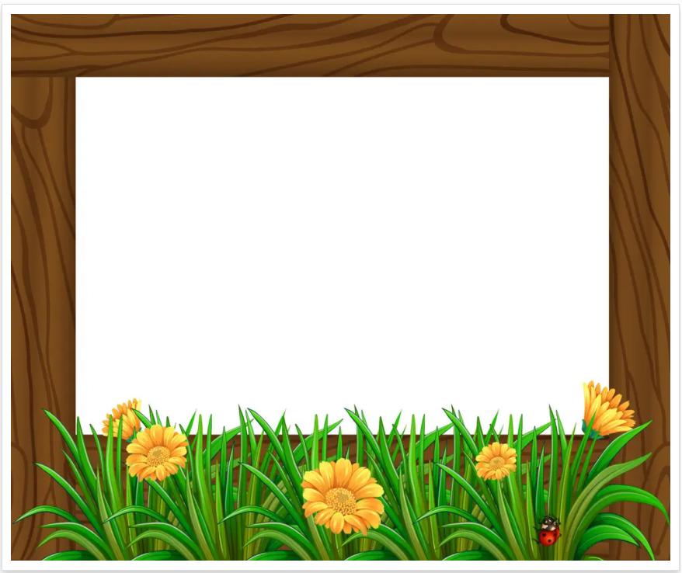
Table of contents
01
Warm-up and Review
02
Activity 4. Read and complete.
03
Activity 5. Let’s write.
04
Activity 6. Project
05
Fun corner and Wrap-up

Slide 3
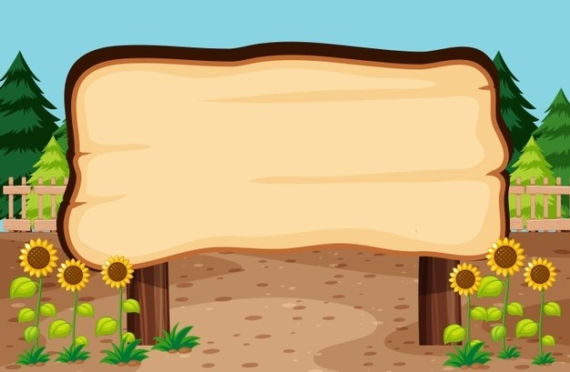

01
Warm-up and Review

Slide 4
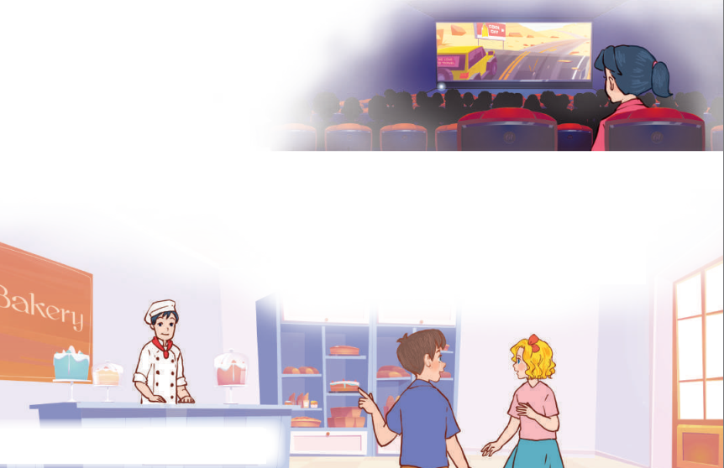
Let’s chant.
Yesterday, I was at the cinema.
I wanted to watch a film.
The film was interesting.
I liked the film.
Yesterday, we were at the bakery.
We wanted to buy some cakes.
The cakes were delicious.
We loved the cakes.

Slide 5
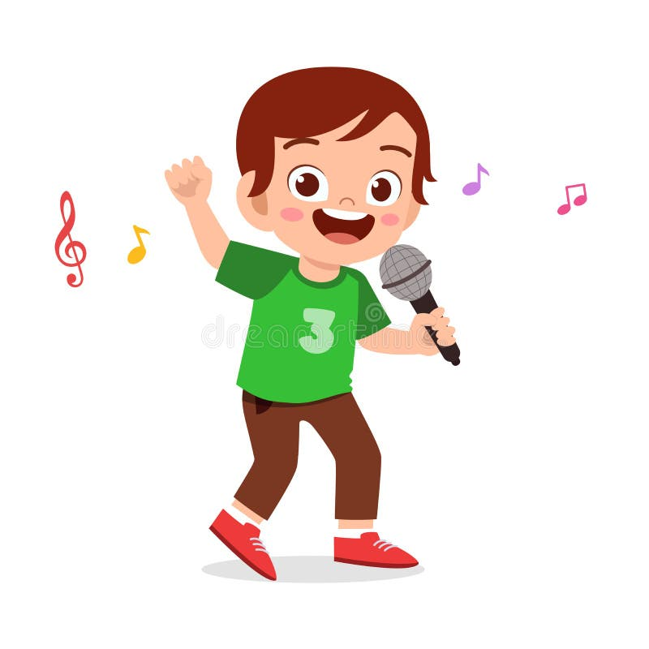
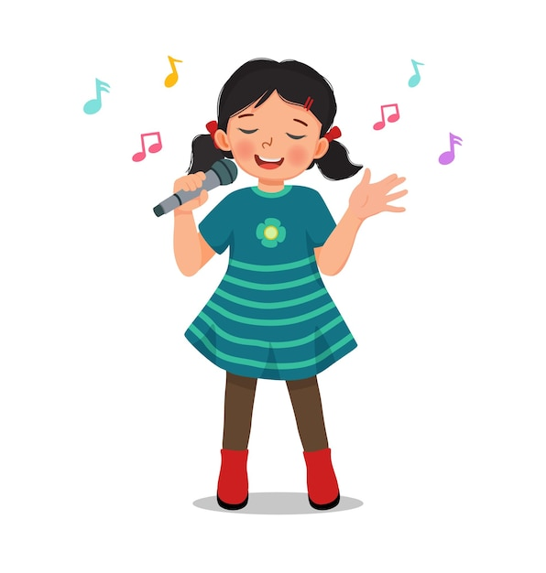
Let’s chant.

Slide 6
02
Activity 4. Read and complete.

Slide 7
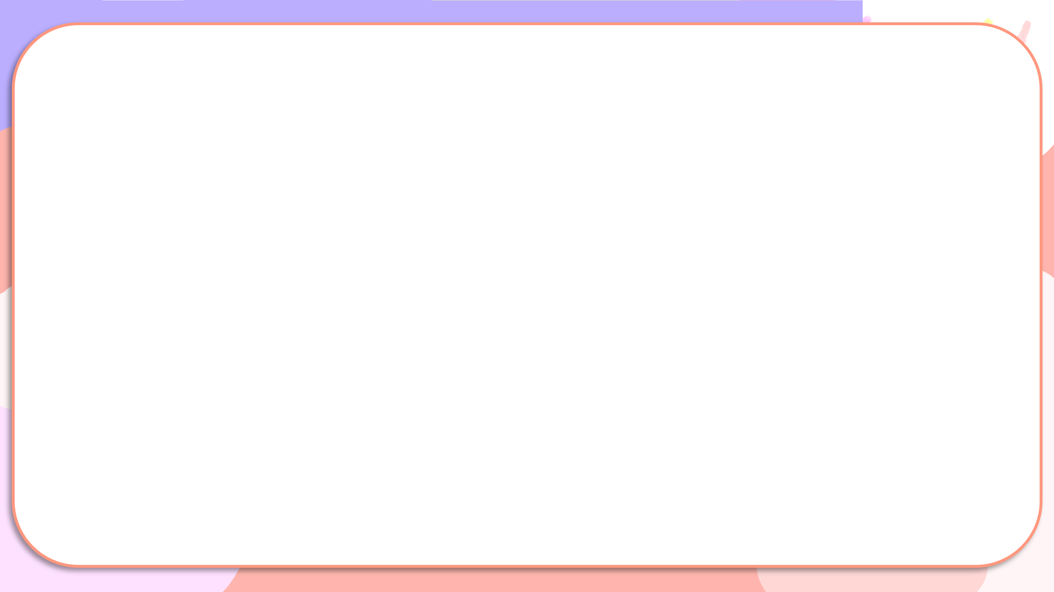
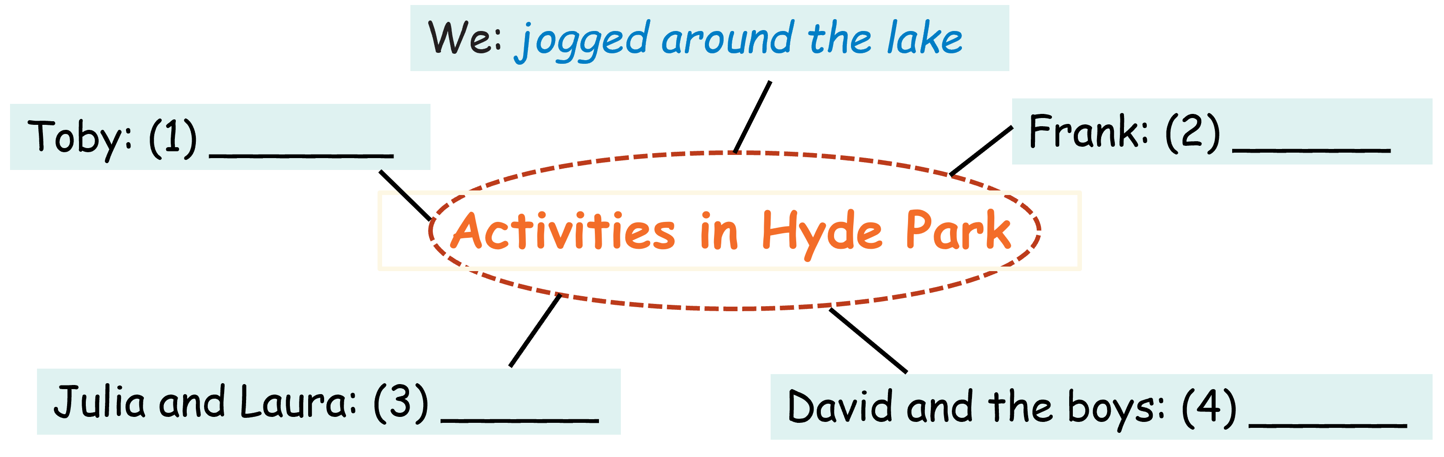
Read and complete.
Last Saturday, my classmates and I went to Hyde Park, a big park in London. We had a lot of fun there. In the morning, we jogged around the lake. We had a party at noon. Toby played the guitar, Frank sang and our classmates danced. In the afternoon, we looked at flowers in the Rose Garden. Then Julia played badminton with Laura, and David and the boys learned how to ride horses at Hyde Park Stables. We had such a wonderful day!

Slide 8
Read and complete
Last Saturday, my classmates and I went to Hyde Park, a big park in London. We had a lot of fun there. In the morning, we jogged around the lake. We had a party at noon. Toby played the guitar, Frank sang and our classmates danced. In the afternoon, we looked at flowers in the Rose Garden. Then Julia played badminton with Laura, and David and the boys learned how to ride horses at Hyde Park Stables. We had such a wonderful day!
played the guitar
Toby: _____________

Slide 9
Read and complete
Last Saturday, my classmates and I went to Hyde Park, a big park in London. We had a lot of fun there. In the morning, we jogged around the lake. We had a party at noon. Toby played the guitar, Frank sang and our classmates danced. In the afternoon, we looked at flowers in the Rose Garden. Then Julia played badminton with Laura, and David and the boys learned how to ride horses at Hyde Park Stables. We had such a wonderful day!
sang
Frank:_________

Slide 10
Read and complete
Last Saturday, my classmates and I went to Hyde Park, a big park in London. We had a lot of fun there. In the morning, we jogged around the lake. We had a party at noon. Toby played the guitar, Frank sang and our classmates danced. In the afternoon, we looked at flowers in the Rose Garden. Then Julia with Laura, and David and the boys learned how to ride horses at Hyde Park Stables. We had such a wonderful day!
played badminton
Julia and Laura:_______________

Slide 11
Read and complete
Last Saturday, my classmates and I went to Hyde Park, a big park in London. We had a lot of fun there. In the morning, we jogged around the lake. We had a party at noon. Toby played the guitar, Frank sang and our classmates danced. In the afternoon, we looked at flowers in the Rose Garden. Then Julia played badminton with Laura, and David and the boys at Hyde Park Stables. We had such a wonderful day!
learned how to ride horses
David and the boys:____________________

Slide 12
Complete
We: jogged around the lake
played the guitar
Toby: _____________
sang
Frank:_________
Activities in Hyde Park
played badminton
Julia and Laura: ____________
David and the boys: ____________________
learned how to ride horses
Notes:
Nháy vào bức thư nhỏ ở góc để xuất hiện bức thư và nhấn vào bức thư để làm biến mất nó

Slide 13
03
Activity 6. Let’s write.

Slide 14

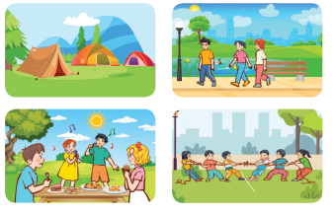
Let’s write.

Slide 15
Let’s write.
Our outdoor activities
Last summer, we went to _________.
In the morning, we __________. At noon, ________. In the afternoon, ________. We were all happy.

Slide 16
Let’s write.
Suggested answer
Our outdoor activities
Last summer, we went to_______. In the morning, we _______________________________________. At noon, _______________________________________________
________ In the afternoon, ________________________
_______________ . We were all happy.
campsite
walked along the long road and watched the flowers
we had a small party. We sang some English songs and ate cakes and sweets.
the boys played tag of war and the
girls played badminton

Slide 17
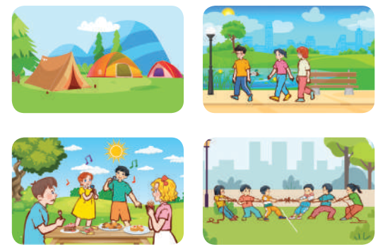
Let’s write.
Our outdoor activities
Last summer, we went to _________.
In the morning, we __________. At noon, ________. In the afternoon, ________. We were all happy.

Slide 18
04
Activity 3. Project

Slide 19

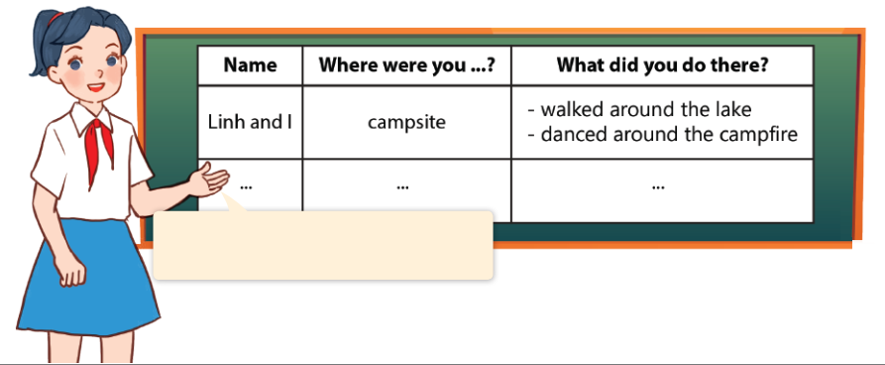
Project
Our outdoor activities
Last summer, Linh and I were at the campsite. We walked _______.

Slide 20
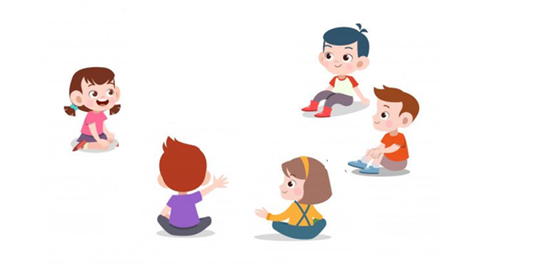
Last summer, Linh and
I were at the campsite. We walked _______.
____________.

Slide 21
05
Fun corner and Wrap-up

Slide 22
