Slide 1
Welcome to our class
English 3
Teacher : Hoàng Thị Tỵ

Slide 2
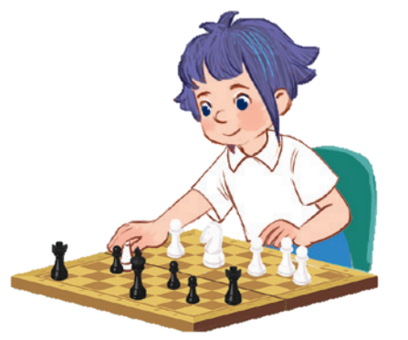
10
Period 1

Slide 3
Contents
1
5
Fun corner and wrap-up
Warm-up and review
4
2
3
Let’s talk.
Look, listen and repeat.
Listen, point and say.

Slide 4
Warm-up AND REVIEW
Notes:
Game: Look and Guess
- Teacher shows 4 pictures numbered 1 to 4 on the board.
- Teacher lets the pupils choose 1 square on the screen and open it.
- Teacher lets the pupils guess the corresponding number of the picture.

Slide 5
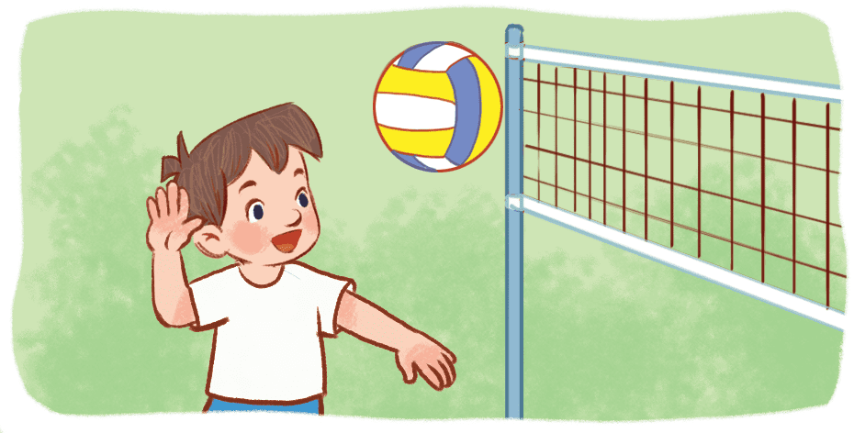
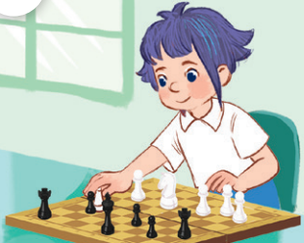
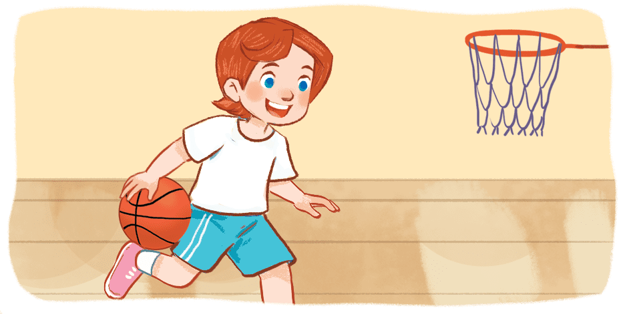
(1)
(3)
(2)
(4)
Notes:
Game: Look and Guess
- Teacher shows 4 pictures on the board with numbers.
- Teacher lets the pupils choose 1 square on the screen and open it.
- Teacher lets the pupils guess the number of the pictures.

Slide 6
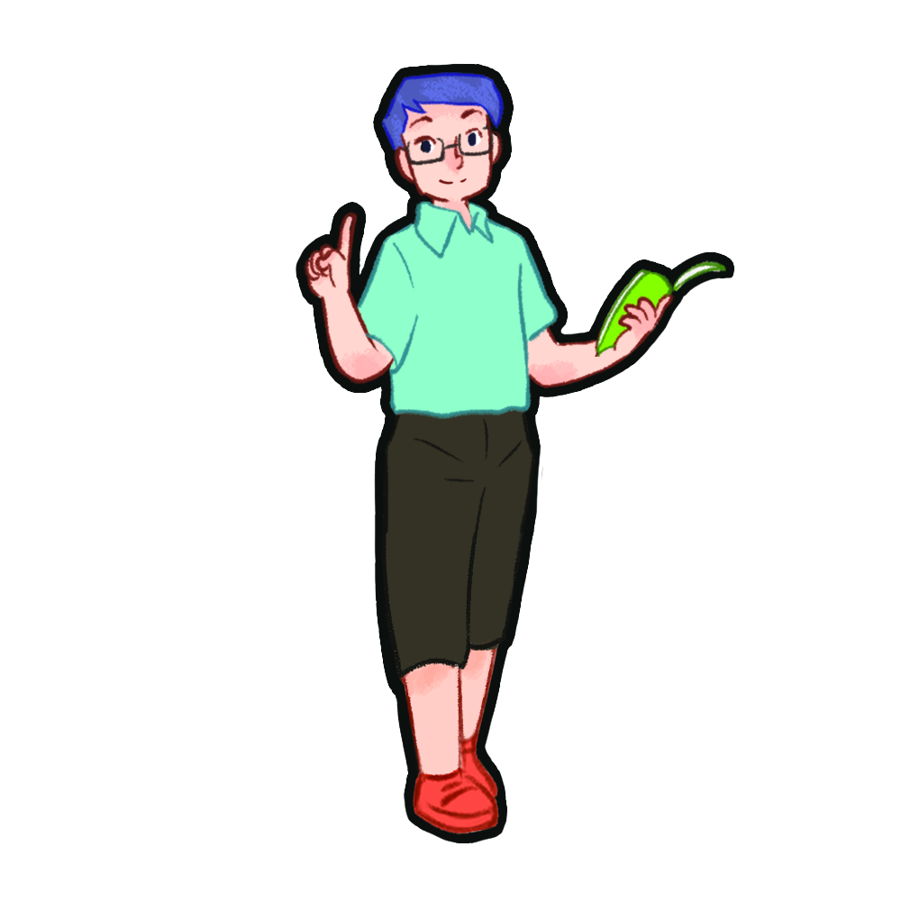
Look, listen and repeat.

Slide 7
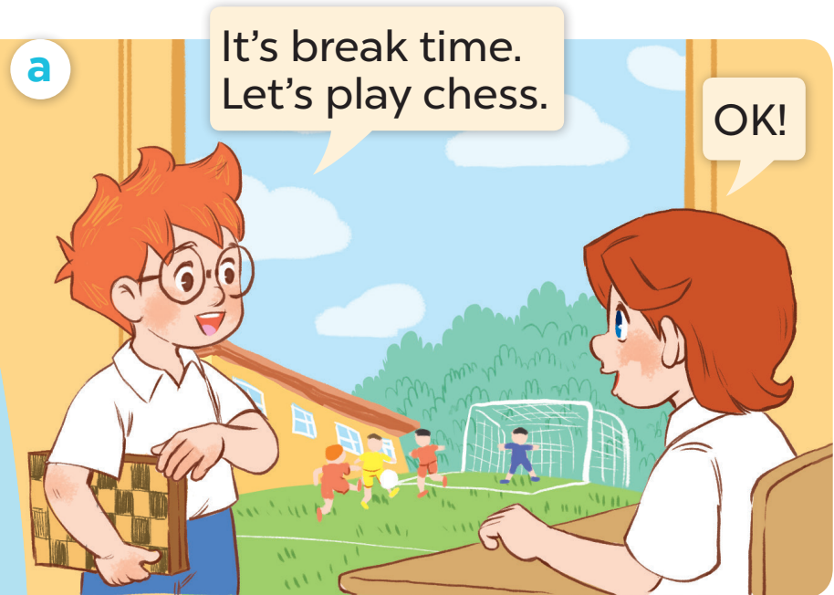
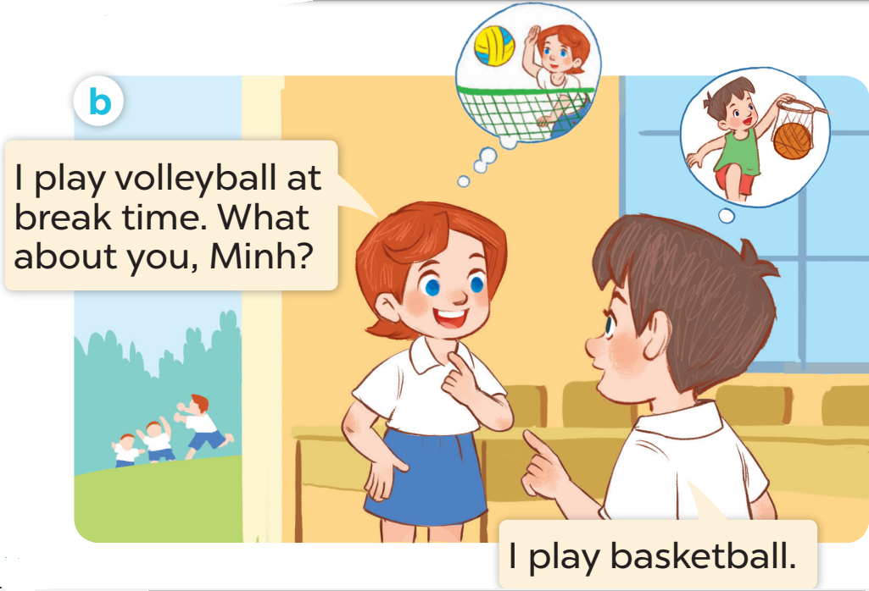

Slide 8
Listen, point and say.

Slide 9
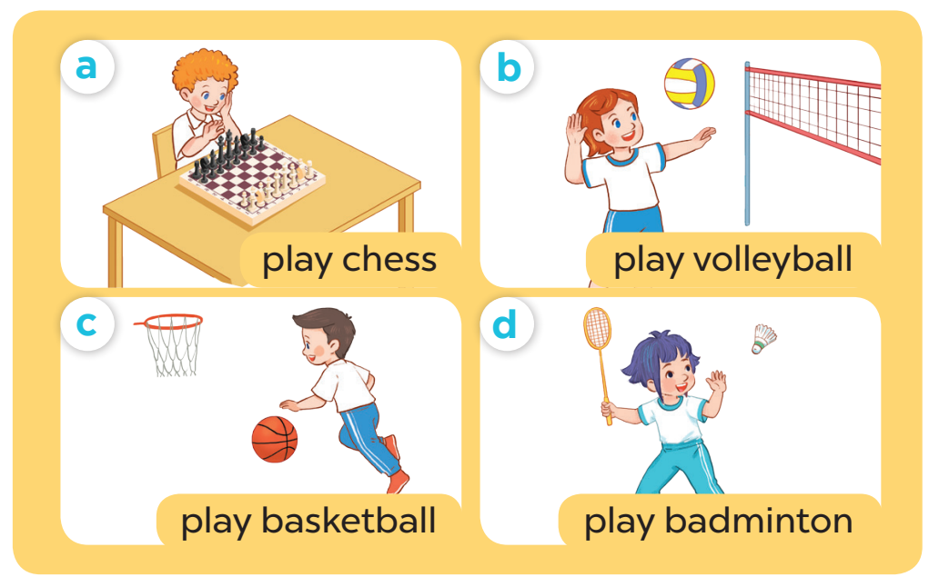

Slide 10
Game time
Notes:
Game: Whisper
- Teacher divides the class into groups of 4.
- Teachers asks 2 groups to get in 2 lines and stand back to the board.
- Teacher asks the first pupil of each line to look at one picture and whisper to the next pupil.
- The last one of each line comes to the board and choose the picture and stick it on the board.
- Change the position of the first pupil and repeat the activities.

Slide 11
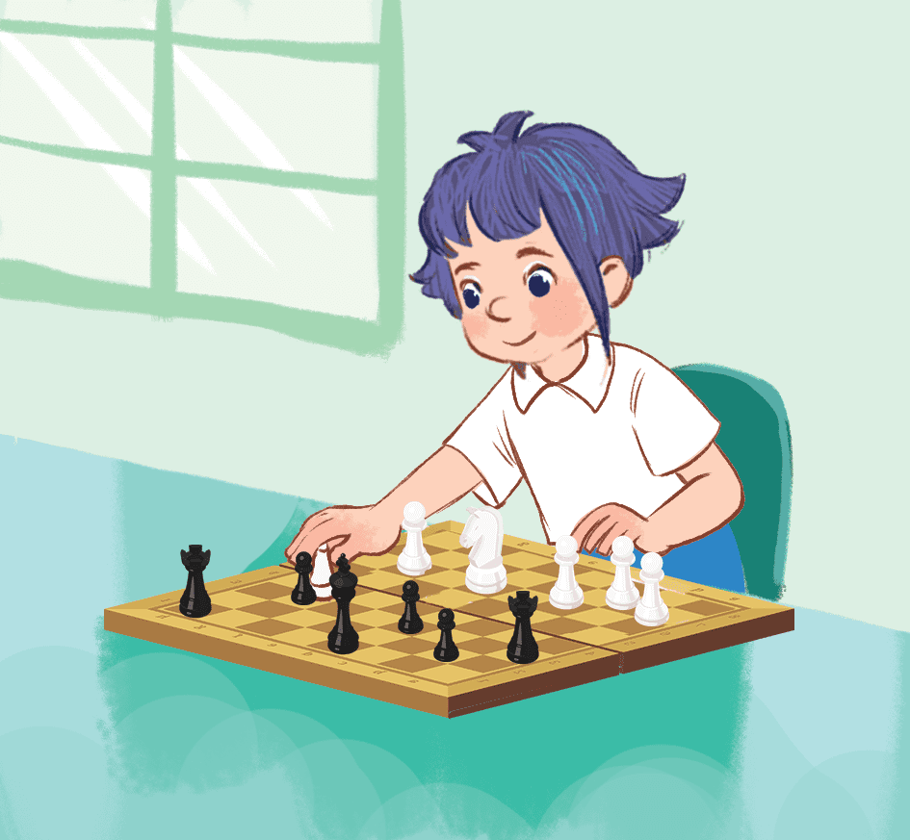
TEAM B
TEAM A

Slide 12
TEAM B
TEAM A

Slide 13
TEAM B
TEAM A

Slide 14
Let’s talk.

Slide 16
I ……….. at break time
Notes:
-T asks pupils to practise in pairs asking and answering.
-T asks some pairs to present in front of the class.

