Slide 1
Unit 19
Which place would you like to visit?
Lesson 1

Slide 2
Vocabulary

Slide 3
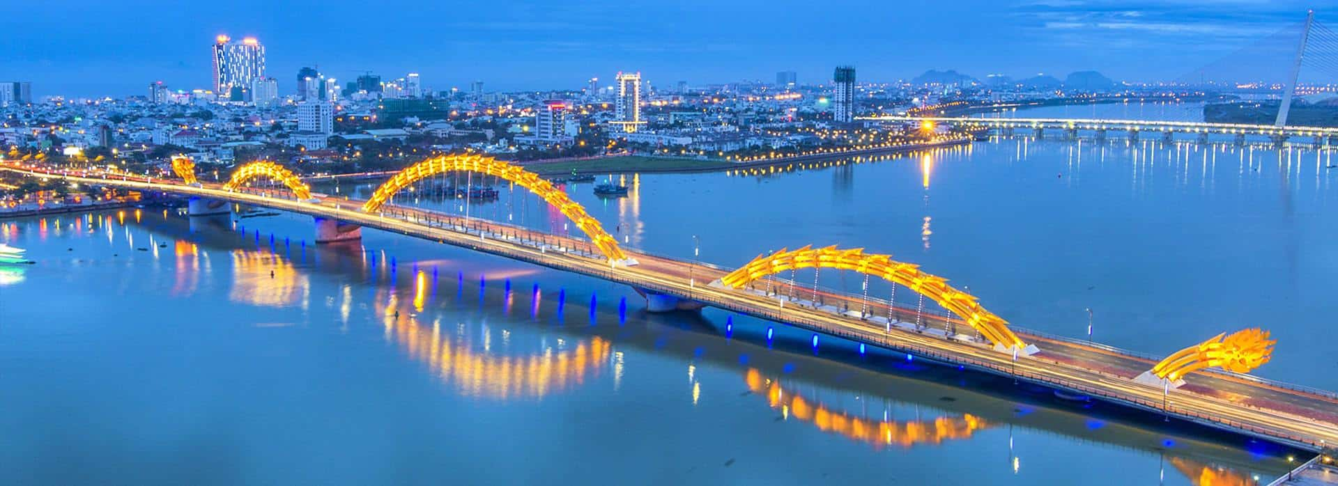
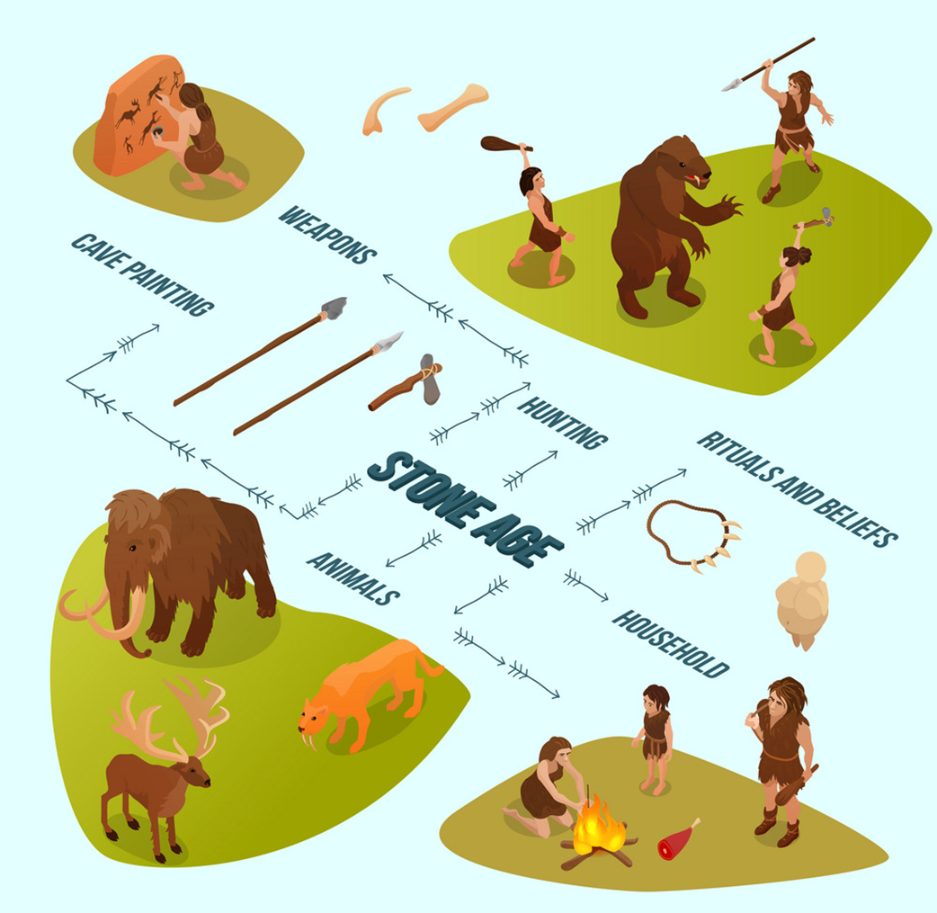
Vocabulary
pagoda
bridge
/pəˈɡəʊdə/
/brɪdʒ/
history
centre
/ˈhɪstri/
/ˈsentər/

Slide 4
Grammar

Slide 5
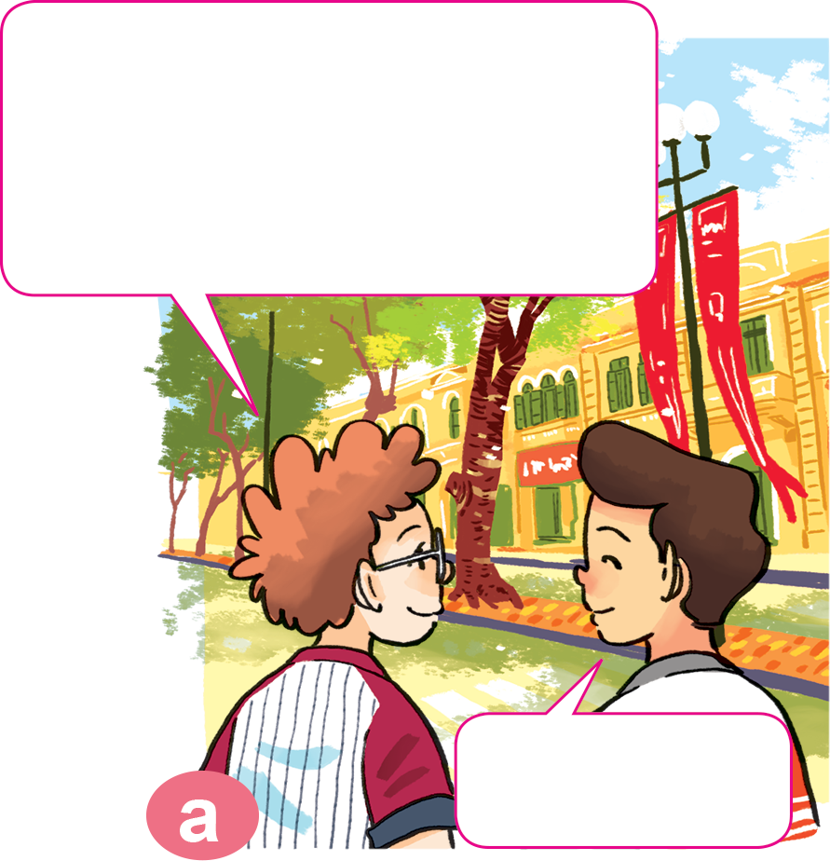
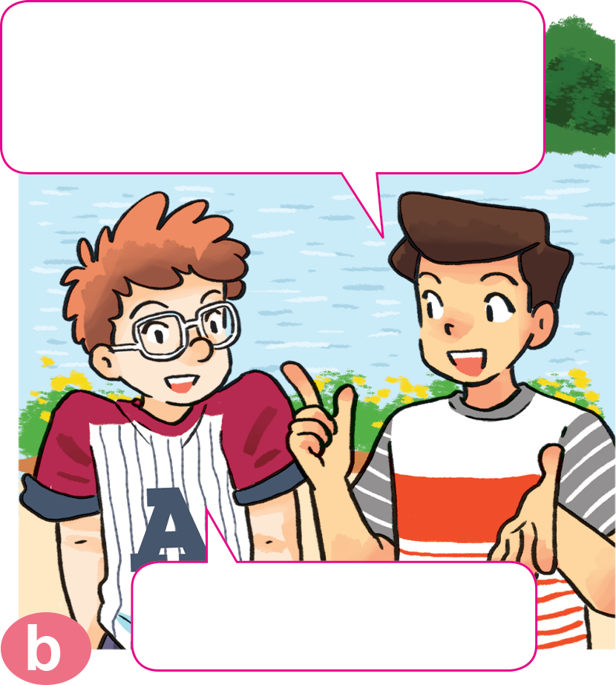
1. Look, listen and repeat.
Would you like to go somewhere, Tom?
The weather is beautiful in Ha Noi today.
Yes, it is.
Yes, I'd like to.

Slide 6
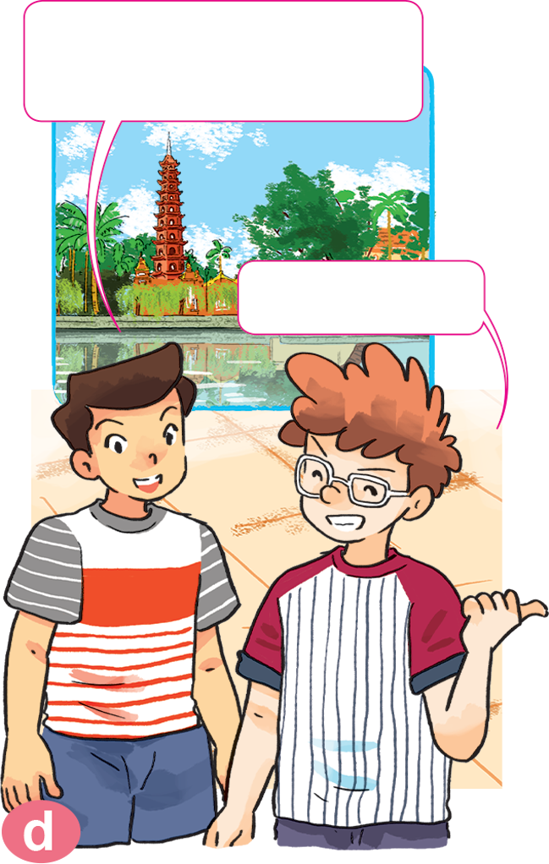
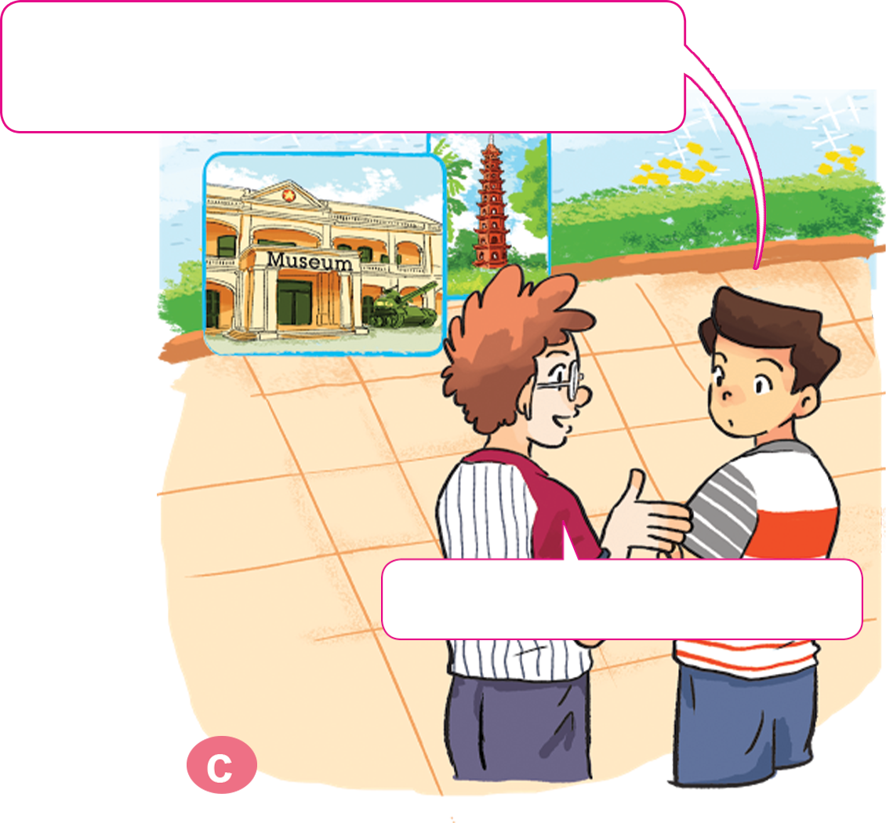
1. Look, listen and repeat.
Let's visit Tran Quoc Pagoda.
Which place would you like to visit, a museum or a pagoda?
OK. Let's go.
I'd like to visit a pagoda.

Slide 7
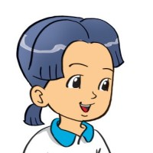
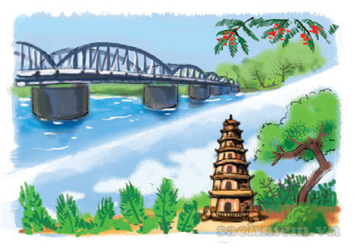
2. Point and say
Which place would you like to visit, ________________ or ________________ ?
Trang Tien Bridge
Thien Mu Pagoda
I'd like to visit ________________.
Thien Mu Pagoda

Slide 8
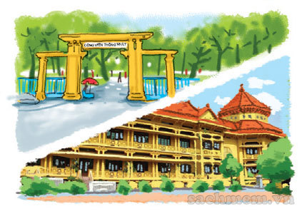
2. Point and say
Which place would you like to visit, _______________ or ____________________ ?
Thong Nhat Park
the Museum of History
I'd like to visit ___________________.
the Museum of History

Slide 9
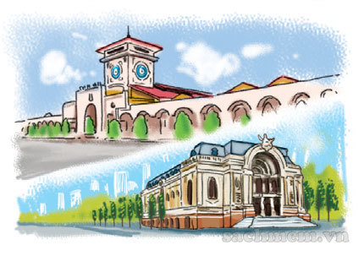
2. Point and say
Which place would you like to visit, ________________ or ________________ ?
Ben Thanh Market
the City Theatre
I'd like to visit ________________.
Ben Thanh Market

Slide 10
2. Point and say
Which place would you like to visit, ________________ or ________________ ?
Bai Dinh Pagoda
Hoa Lu Temple
I'd like to visit ________________.
Bai Dinh Pagoda

Slide 11
3. Let’s talk.
Which place would you like to visit, _ or _?
I'd like to visit ______________.
Is it far from here?
Yes/No, ______________.
How can I get there?
You can ______________.

Slide 12
Click hình chú Thỏ hoặc chú Rùa khi chọn đáp án.
Notes:
Ms Huyền Phạm - 0936.082.789 – YOUTUBE: MsPham. Facebook: Dạy và học cùng công nghệ.

Slide 13
Which place would you like to visit, Trang Tien Bridge or Thien Mu _________?
Bridge
Pagoda
Notes:
Ms Huyền Phạm - 0936.082.789 – YOUTUBE: MsPham. Facebook: Dạy và học cùng công nghệ.

Slide 14
Which place would you like to visit, Trang Tien ______ or Thien Mu pagoda?
Bridge
Park
Notes:
Ms Huyền Phạm - 0936.082.789 – YOUTUBE: MsPham. Facebook: Dạy và học cùng công nghệ.

Slide 15
Which place would you like to visit, Thong Nhat Park or the Museum of ________?
bridge
history
Notes:
Ms Huyền Phạm - 0936.082.789 – YOUTUBE: MsPham. Facebook: Dạy và học cùng công nghệ.

Slide 16
Which place would you like to visit, Ben Thanh Market ____ the City Theatre?
or
and
Notes:
Ms Huyền Phạm - 0936.082.789 – YOUTUBE: MsPham. Facebook: Dạy và học cùng công nghệ.

Slide 17
Which place would you like to visit, Bai Dinh Pagoda or Hoa Lu Temple?
I’d like to visit Bai Dinh Pagoda
I’d like to
Bai Dinh Pagoda
Notes:
Ms Huyền Phạm - 0936.082.789 – YOUTUBE: MsPham. Facebook: Dạy và học cùng công nghệ.

Slide 18
___________ , Trang Tien bridge or
Thien Mu pagoda?
I’d like to visit Thien Mu pagoda.
Which place would you like to visit
Which place
do you like to visit
Notes:
Ms Huyền Phạm - 0936.082.789 – YOUTUBE: MsPham. Facebook: Dạy và học cùng công nghệ.

Slide 19
Which place would you like to visit, Trang Tien Bridge or _____?
I’d like to visit Hoan Kiem Lake.
Thien Mu Pagoda
Hoan Kiem Lake
Notes:
Ms Huyền Phạm - 0936.082.789 – YOUTUBE: MsPham. Facebook: Dạy và học cùng công nghệ.

Slide 20
______ would you like to visit,
Ho Chi Minh city or Ha Noi?
I’d like to visit Ho Chi Minh city.
Which place
What place
Notes:
Ms Huyền Phạm - 0936.082.789 – YOUTUBE: MsPham. Facebook: Dạy và học cùng công nghệ.

Slide 21
Which place would you like to visit,
Yen Tu Pagoda or Ha Long Bay?
I’d like ___ visit Ha Long Bay.
a
to
Notes:
Ms Huyền Phạm - 0936.082.789 – YOUTUBE: MsPham. Facebook: Dạy và học cùng công nghệ.

Slide 22
Which place would you like to visit,
Cat Ba Island or Do Son Beach?
I’d like to visit _______.
Cat Ba Island
Centre Museum
Notes:
Ms Huyền Phạm - 0936.082.789 – YOUTUBE: MsPham. Facebook: Dạy và học cùng công nghệ.

Slide 23
Notes:
Ms Huyền Phạm - 0936.082.789 – YOUTUBE: MsPham. Facebook: Dạy và học cùng công nghệ.

Slide 24
THANK YOU FOR YOUR ATTENTION

