Slide 1

Period 99 UNIT 12: ROBOTS
Lesson 5: Skills 1
Teacher: Tran Thi Tam
Cap Tien-Bach Dang Secondary School

Slide 2


Reading
Teacher: Tran Thi Tam
Cap Tien-Bach Dang Secondary School

Slide 3


Work in pairs. Discuss the following questions.
1.
What types of robots are there?
2.
What robots are children interested in?
Teacher: Tran Thi Tam
Cap Tien-Bach Dang Secondary School

Slide 4
Vocabulary
international (a): thuộc quốc tế
choice (n): sự lựa chọn
improve (v): cải thiện, nâng cao
look after (v): chăm sóc
space station ( n) : trạm vũ trụ
planet (n): hành tinh
type (n): loại
Teacher: Tran Thi Tam
Cap Tien-Bach Dang Secondary School

Slide 5

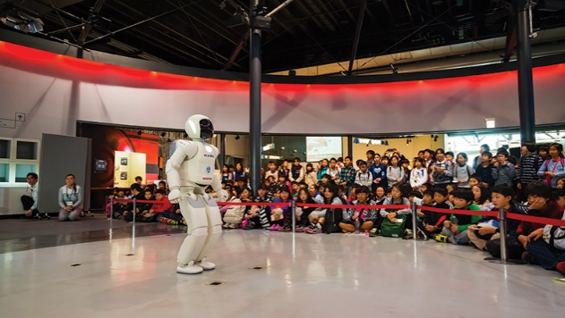
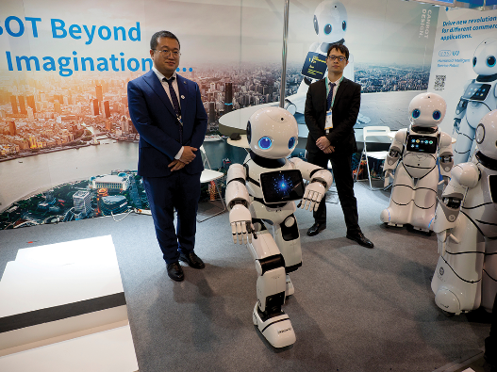
Read the text and choose the best answer to each of the questions.
Today there is an international robot show in Ha Noi. People can see many types of robots there.
Home robots are useful for housework. They can do most of the housework: cook meals, clean the house, do the washing, and iron clothes.
Teacher robots are the best choice for children. They can help them to study. They can teach them English, literature, maths and other subjects. They can also help children to improve their English pronunciation.
People are also interested in other types of robots at the show. Worker robots can build houses and move heavy things; doctor robots can look after sick people and space robots can build space stations on the Moon and on planets.

Slide 6
Teacher: Tran Thi Tam
Cap Tien-Bach Dang Secondary School
1.
What show is on in Ha Noi now?
A.
A fashion show
B.
A robot show
C.
A pet show
2.
Which type of robots can help children in their study?
A.
Home robots
B.
Worker robots
C.
Teacher robots
3.
Doctor robots can _______.
A.
help children to study
B.
build houses
C.
take care of sick people
4.
Which of the following sentences is NOT true according to the passage?
A.
Worker robots can build houses and move heavy things.
B.
Space robots can build space stations on the Moon.
C.
Home robots can’t do much of the housework.

Slide 7
Read the text and choose the best answer to each of the questions.
Today there is an international robot show in Ha Noi. People can see many types of robots there.
Home robots are useful for housework. They can do most of the housework: cook meals, clean the house, do the washing, and iron clothes.
Teacher robots are the best choice for children. They can help them to study. They can teach them English, literature, maths and other subjects. They can also help children to improve their English pronunciation.
People are also interested in other types of robots at the show. Worker robots can build houses and move heavy things; doctor robots can look after sick people and space robots can build space stations on the Moon and on planets.

Slide 8

Read the text again and fill the table below.
Types of robots | What they can do
Home robots
Teacher robots
Worker robots
Doctor robots
Space robots
cook meals, clean the house, do the washing and iron clothes
help children study, teach English, literature, maths and other subjects, help children improve English pronunciation
build houses, move heavy things
look after sick people
build space stations on the Moon and on planets
Teacher: Tran Thi Tam
Cap Tien-Bach Dang Secondary School

Slide 9
Speaking
Teacher: Tran Thi Tam
Cap Tien-Bach Dang Secondary School

Slide 10

Work in pairs. Discuss what you think robots can do in the following places.
Places | What robots can do
Home
Schools
Factory
Hospital
Garden
Example:
A: What can robots do at home?
B: They can take care of children.

Slide 11

Work in groups. Take turns to talk about robots and what you think they can do. Can you think of other types of robots?

Slide 12







