Slide 2
Unit
4
MUSIC AND ARTS
LESSON 2: A CLOSER LOOK 1
VOCABULARY
PRONUNCIATION
Unit
HOBBIES

Slide 3
OBJECTIVES
By the end of the lesson, students will be able to:
Vocabulary: use the lexical items related to the topic Music and arts.
Pronunciation: pronounce and recognize the sounds /ʃ/ and /ʒ/.

Slide 4
LESSON 2: A CLOSER LOOK 1
WARM-UP
Game: Guessing game
Task 1: Listen and repeat. Write them in the correct columns.
Task 2: Match a word in A with a word or phrase in B.
Task 3: Underline the correct word to complete each sentence.
VOCABULARY
Task 4: Listen and repeat.
Task 5: Listen and repeat, and single – underline the words with the sound /ʃ/ and double – underline the words with the sound /ʒ/.
PRONUNCIATION
PRODUCTION
Game: Simon says
CONSOLIDATION
Wrap-up
Homework

Slide 5
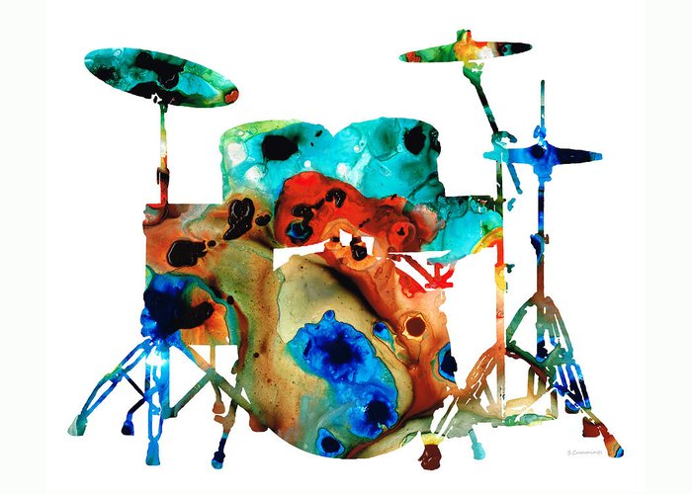
LESSON 2: A CLOSER LOOK 1
WARM-UP
Game: Guessing game
Aims of the stage:
to activate students’ prior knowledge and vocabulary related to the topic, the targeted vocabulary, and its pronunciation

Slide 6
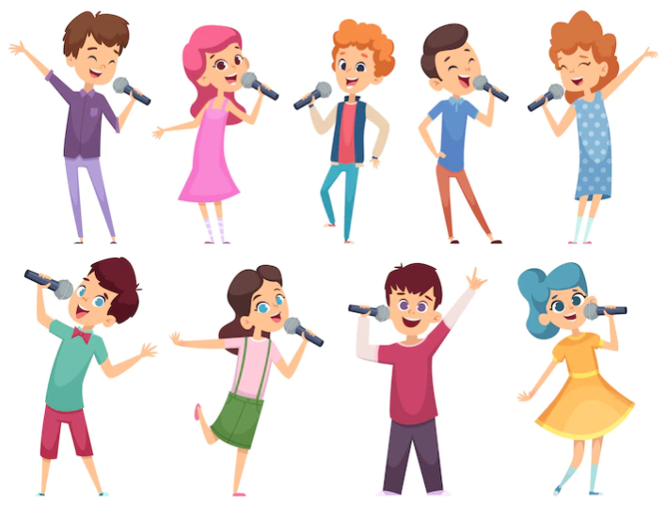
WARM-UP
WHAT KINDS OF MUSIC ARE THEY?
WARM-UP: GUESSING GAME

Slide 7
LESSON 2: A CLOSER LOOK 1
WARM-UP
Game: Guessing game
Task 1: Listen and repeat. Write them in the correct columns.
Task 2: Match a word in A with a word or phrase in B.
Task 3: Underline the correct word to complete each sentence.
VOCABULARY
Aims of the stage:
to introduce visually some nouns related to the topic

Slide 8
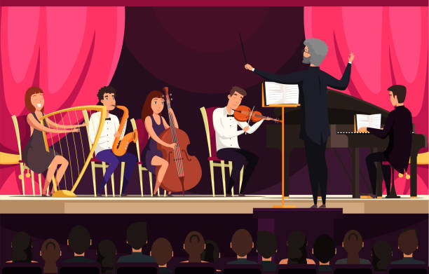
VOCABULARY
concert hall (n)
/ˈkɒnsət ˌhɔːl/
phòng hòa nhạc

Slide 9
VOCABULARY
actress (n)
/ˈæktrəs/
diễn viên nữ

Slide 10
VOCABULARY
artist (n)
/ˈɑːtɪst/
họa sĩ

Slide 11
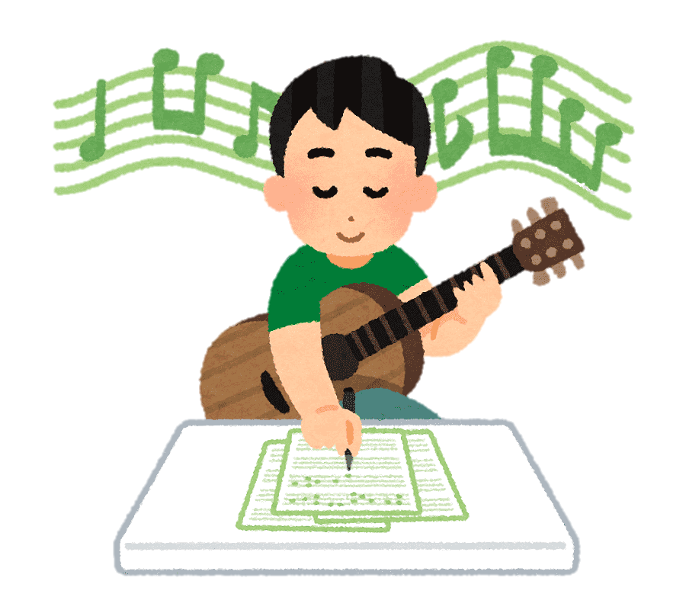
VOCABULARY
composer (n)
/kəmˈpəʊzər/
nhà soạn nhạc

Slide 12
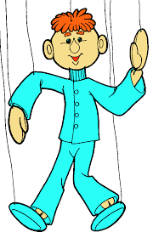
VOCABULARY
puppet (n)
/ˈpʌpɪt/
con rối

Slide 13
VOCABULARY
portrait (n)
/ˈpɔːtrət/
chân dung

Slide 14
VOCABULARY
photography (n)
/fəˈtɒɡrəfi/
nhiếp ảnh

Slide 15
VOCABULARY
perform (v)
/pəˈfɔːm/
thực hiện, trình diễn

Slide 16
VOCABULARY
New words | Pronunciation | Meaning
1. concert hall (n) | /ˈkɒnsət ˌhɔːl/ | phòng hòa nhạc
2. actress (n) | /ˈæktrəs/ | nữ diễn viên
3. artist (n) | /ˈɑːtɪst/ | nghệ sĩ
4. composer (n) | /kəmˈpəʊzər/ | nhà soạn nhạc
5. puppet (n) | /ˈpʌpɪt/ | con rối
6. portrait (n) | /ˈpɔːtrət/ | chân dung
7. photography (n) | /fəˈtɒɡrəfi/ | nhiếp ảnh
8. perform (v) | /pəˈfɔːm/ | thực hiện/ trình diễn

Slide 17
VOCABULARY
1
Listen and repeat these words and phrases, then write them in the correct columns.
art gallery concert hall actress artist composer
musician painter puppet theatre
People | Places
actress
artist
composer
musician
painter
art gallery
concert hall
puppet theatre

Slide 18
VOCABULARY
2
Match a word in A with a word or phrase in B.
A | B
compose paint perform play take | a show a photo the guitar a portrait music

Slide 19
VOCABULARY
3
Underline the correct word to complete each sentence.
The little girl’s drawing/ photography of her kitten shows a lot of talent.
Van Cao was a great Vietnamese scientist/ composer. He was also a painter and poet.
The Louvre in Paris is the world’s largest museum/ puppet theater.
The orchestra will perform its final portrait/ concert of the season tomorrow.
Did you see the film Amazon Jungle on TV last night? The photography/ drawing was excellent.

Slide 20
LESSON 2: A CLOSER LOOK 1
WARM-UP
Game: Guessing game
Task 1: Listen and repeat. Write them in the correct columns.
Task 2: Match a word in A with a word or phrase in B.
Task 3: Underline the correct word to complete each sentence.
VOCABULARY
Task 4: Listen and repeat.
Task 5: Listen and repeat, and single – underline the words with the sound /ʃ/ and double – underline the words with the sound /ʒ/.
PRONUNCIATION

Slide 21
PRONUNCIATION
/ʃ/ and /ʒ/
Aims of the stage:
to help students identify how to pronounce the sounds /ʃ/ and /ʒ/

Slide 22
PRONUNCIATION
/ʃ/ and /ʒ/

Slide 23
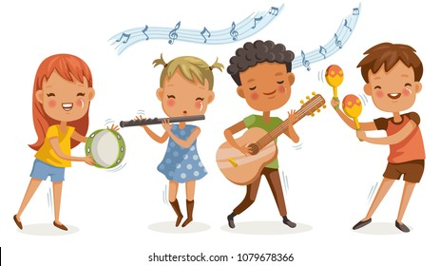
PRONUNCIATION
4
Listen and repeat the words. Pay attention to the sounds /ʃ/ and /ʒ/.
/ʃ/ | /ʒ/
musician show share nation | television visual unusual decision

Slide 24
PRONUNCIATION
5
Listen and repeat, and single – underline the words with the sound /ʃ/ and double – underline the words with the sound /ʒ/.
We finally came to a decision.
Did you watch the talent show on T`V last night?
Let’s share the pictures we took last week.
She often paints in her leisure time.
It was a pleasure to listen to the musicians performing yesterday.
/ʃ/ and /ʒ/

Slide 25
LESSON 2: A CLOSER LOOK 1
WARM-UP
Game: Guessing game
Task 1: Listen and repeat. Write them in the correct columns.
Task 2: Match a word in A with a word or phrase in B.
Task 3: Underline the correct word to complete each sentence.
VOCABULARY
Task 4: Listen and repeat.
Task 5: Listen and repeat, and single – underline the words with the sound /ʃ/ and double – underline the words with the sound /ʒ/.
PRONUNCIATION
PRODUCTION
Game: Simon says

Slide 26
PRODUCTION
Game: Simon says
Aims of the stage:
to give students chance to apply what they have learnt

Slide 27
PRODUCTION
Game: Simon says

Slide 28
LESSON 2: A CLOSER LOOK 1
WARM-UP
Game: Guessing game
Task 1: Listen and repeat. Write them in the correct columns.
Task 2: Match a word in A with a word or phrase in B.
Task 3: Underline the correct word to complete each sentence.
VOCABULARY
Task 4: Listen and repeat.
Task 5: Listen and repeat, and single – underline the words with the sound /ʃ/ and double – underline the words with the sound /ʒ/.
PRONUNCIATION
PRODUCTION
Game: Simon says
CONSOLIDATION
Wrap-up
Homework

Slide 29
CONSOLIDATION
1
WRAP-UP
VOCABULARY
PRONUNCIATION

Slide 30
CONSOLIDATION
2
HOMEWORK
Find 5 more words with the sound /ʃ/ and 5 more words with the sound /ʒ/. Write them down and practice pronouncing the words.

Slide 31
Website: sachmem.vn
Fanpage: facebook.com/sachmem.vn/

