Slide 1


Slide 2


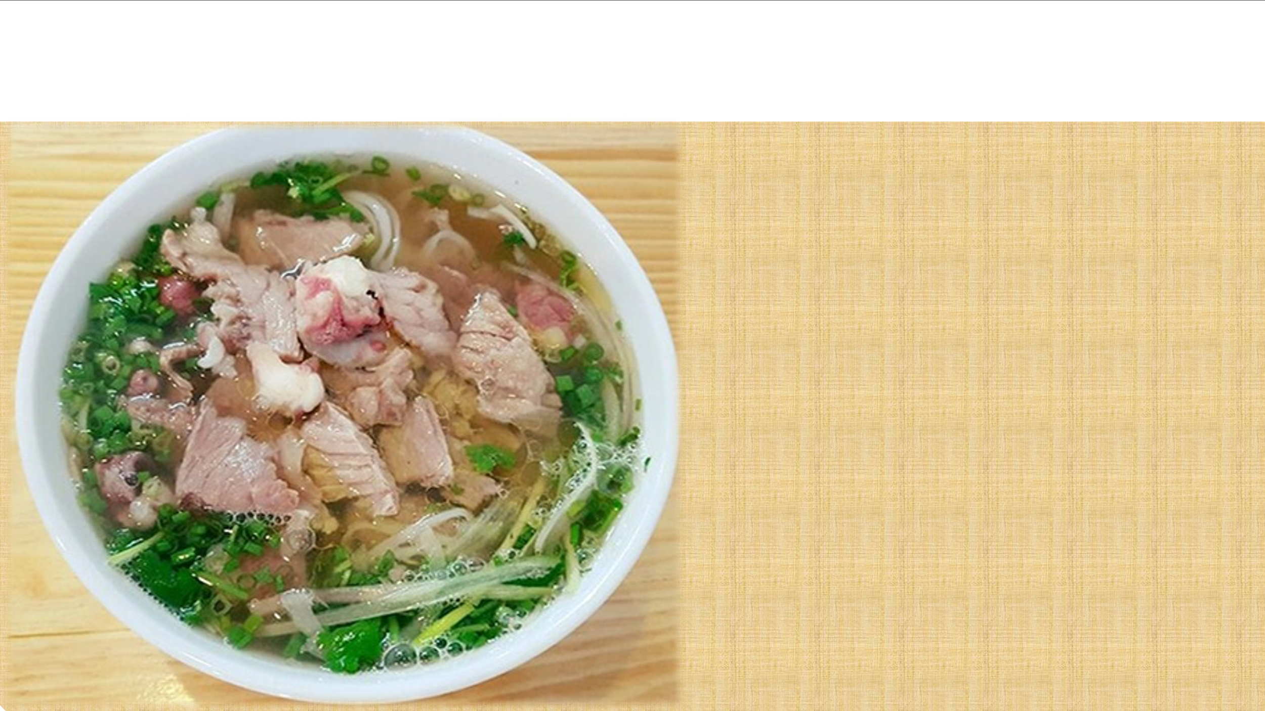

Unit
5
FOOD AND DRINK
Lesson 5: SKILLS 1

Slide 3

OBJECTIVES
By the end of this lesson, Ss will be able to:
1. Knowledge
Develop their reading skill for specific information about food and drink
Talk about the popular food and drink
2. Core competences
Develop communication skills and creativity
Be collaborative and supportive in pairwork and teamwork
Develop presentation skills
Actively join in class activities
3. Personal qualities
Promote pride in the values ​​of Vietnamese culture
Develop love for family and traditional food and drink

Slide 4
LESSON 5: SKILLS 1
WARM-UP
Mini game
Task 1: Work in pairs. Discuss the questions.
Task 2: Read Phong's blog. Match the underlined words with their meanings.
Task 3: Read Phong’s blog again and circle the correct answer
READING
Task 4: Make notes about a popular food and drink in your area. Think about its main ingredients, how often and when you have it.
Task 5: Work in groups of 3 or 4. Take turns to talk about a popular food or drink in your area.
SPEAKING
CONSOLIDATION
Wrap-up
Homework

Slide 5
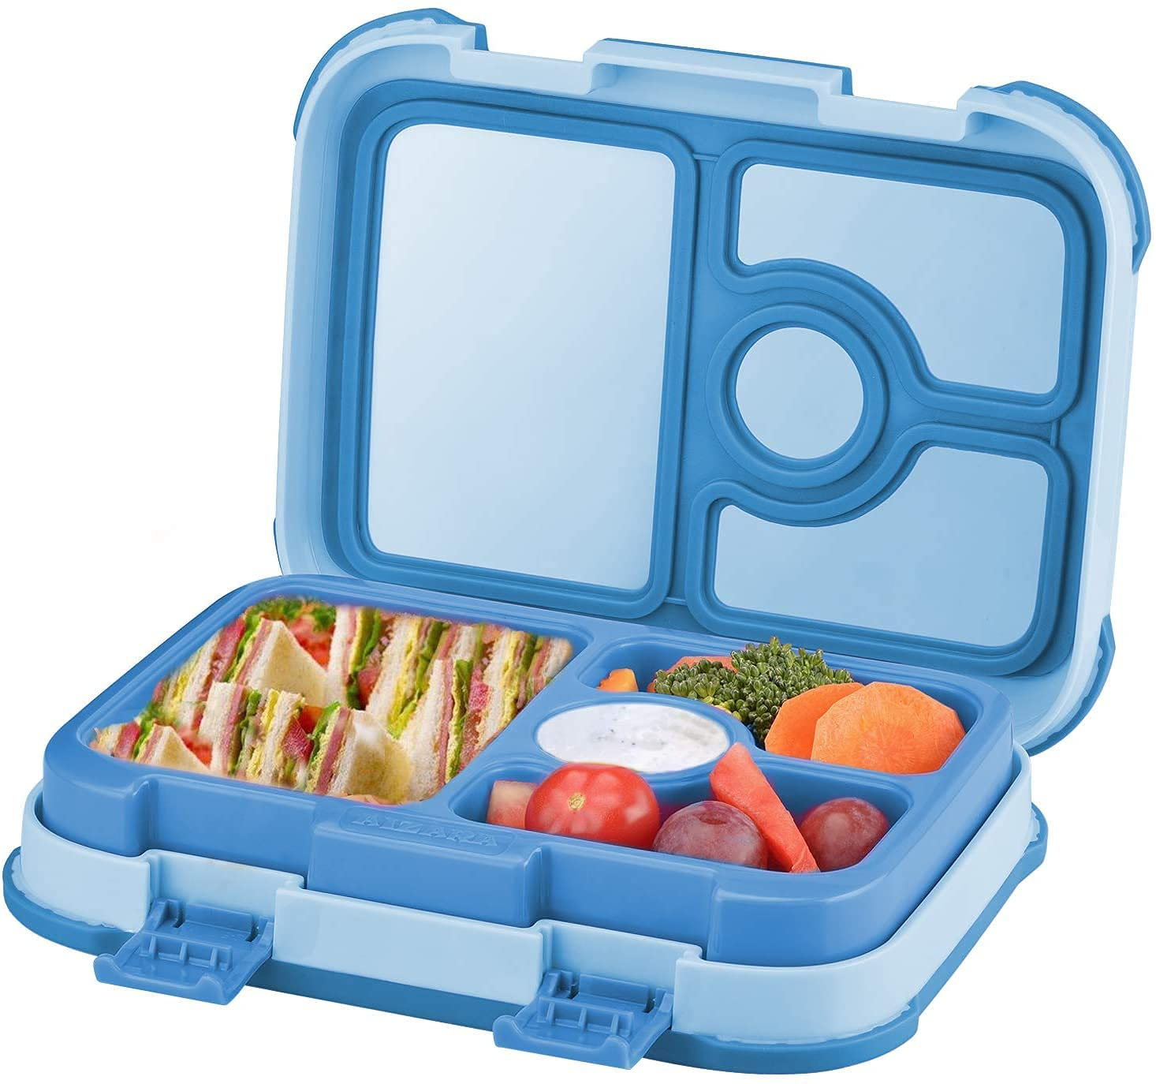
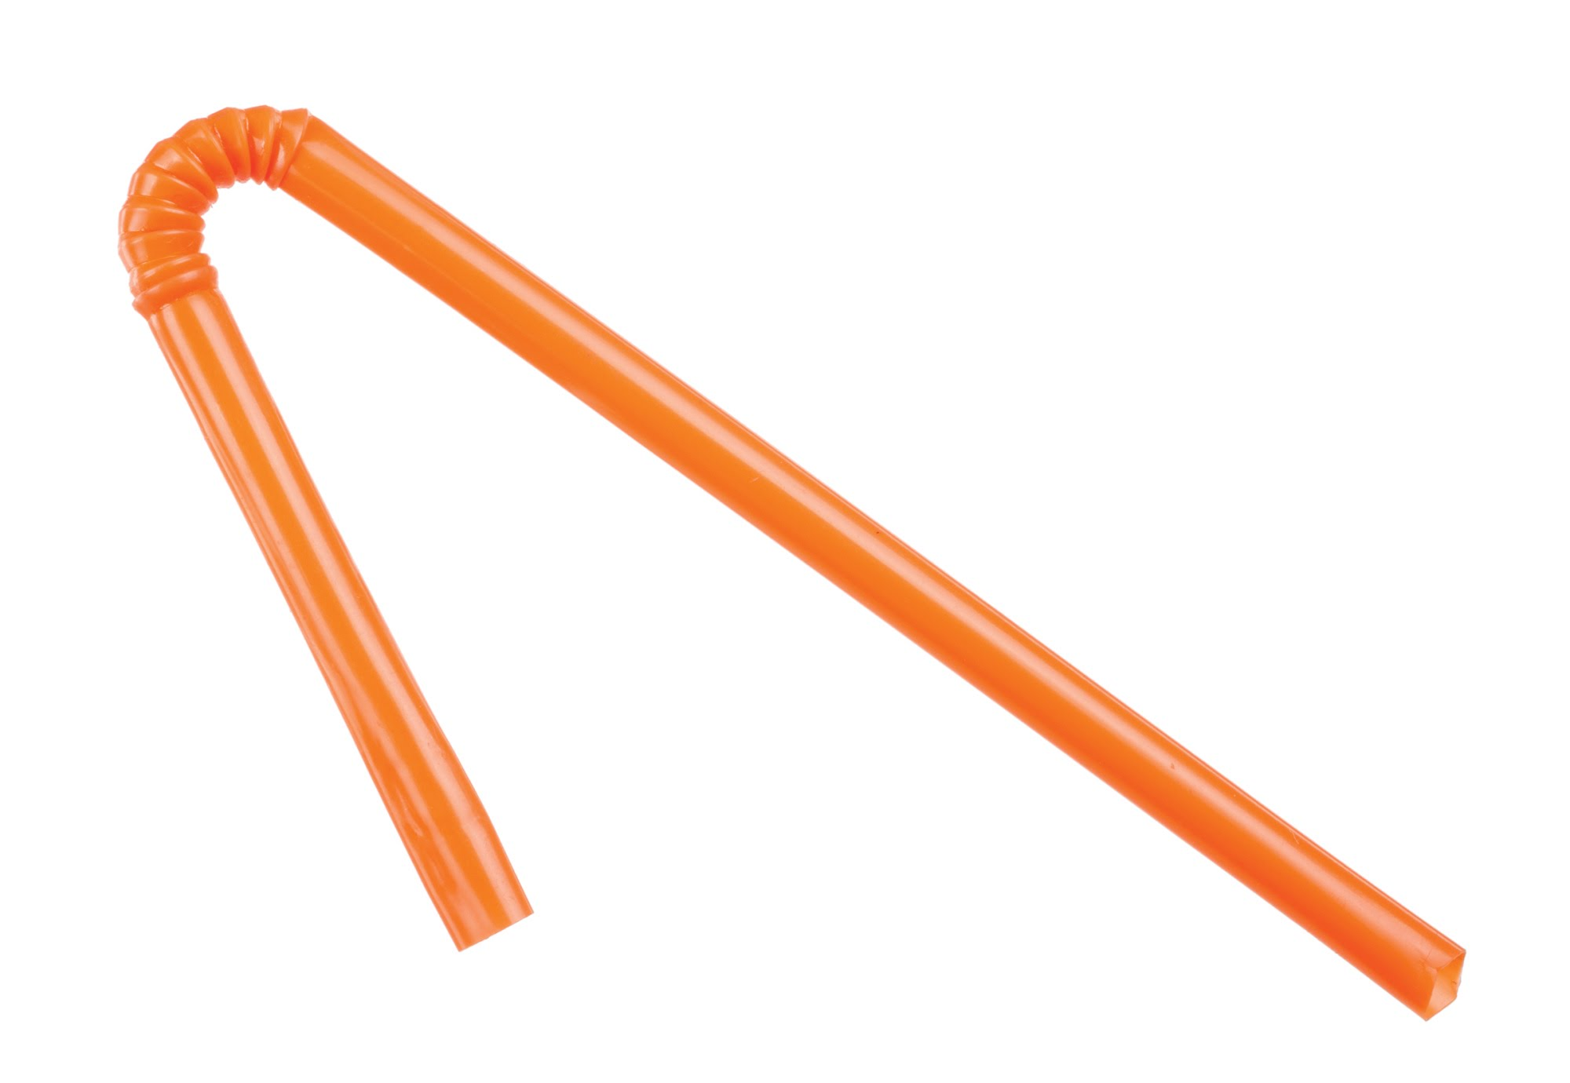
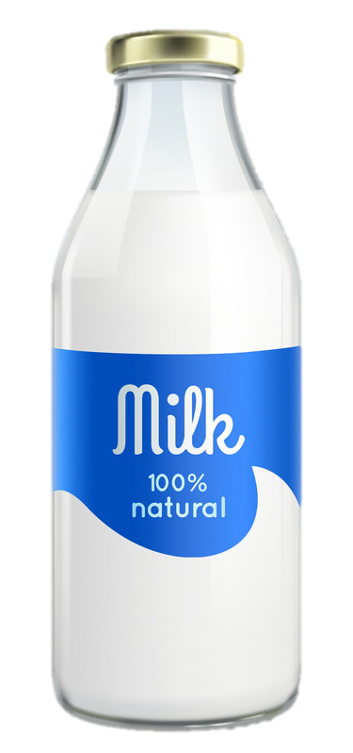
LESSON 5: SKILLS 1
WARM-UP
Lunch time
Stage aims
To create an active atmosphere in the class before the lesson.
To get students interested in the topic.

Slide 6
MINI GAME
Lunch time
Open your lunchbox.
Take out a sandwich.
Unwrap the sandwich.
Take a bite of the sandwich. Mmmm it's good.
Open your milk container.
Put in the straw.
Drink some milk.
Eat the rest of your sandwich.
Drink the rest of the milk
Wipe your face with your napkin.
Close your lunchbox.
Stand up.
Clean up the table.
Take the garbage to the garbage can.
Look at the clock. It's time for lunch.
Stand up.
Get your lunchbox
Line up.
Go to the lunchroom.
Sit down.

Slide 7
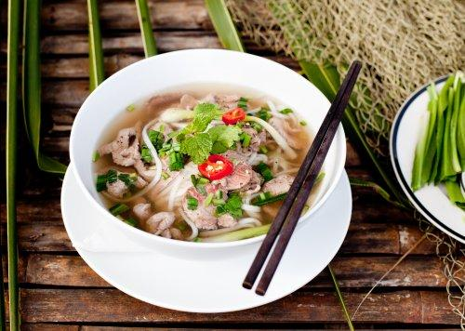
LESSON 5: SKILLS 1
WARM-UP
Mini game
Task 1: Work in pairs. Discuss the questions.
Task 2: Read Phong's blog. Match the underlined words with their meanings.
Task 3: Read Phong’s blog again and circle the correct answer
READING
Stage aims
To help students use key language more appropriately.
To help Ss develop their reading skill for specific information (scanning).

Slide 8
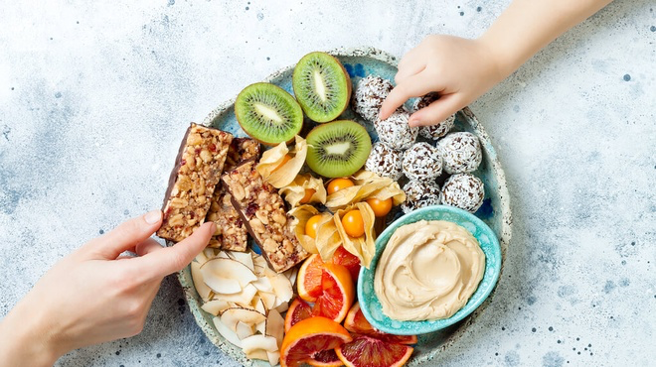
Vocabulary check
snack
/snæk/
đồ ăn vặt

Slide 9
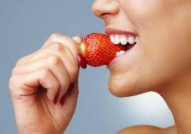
Vocabulary check
taste
/teɪst/
nếm

Slide 10
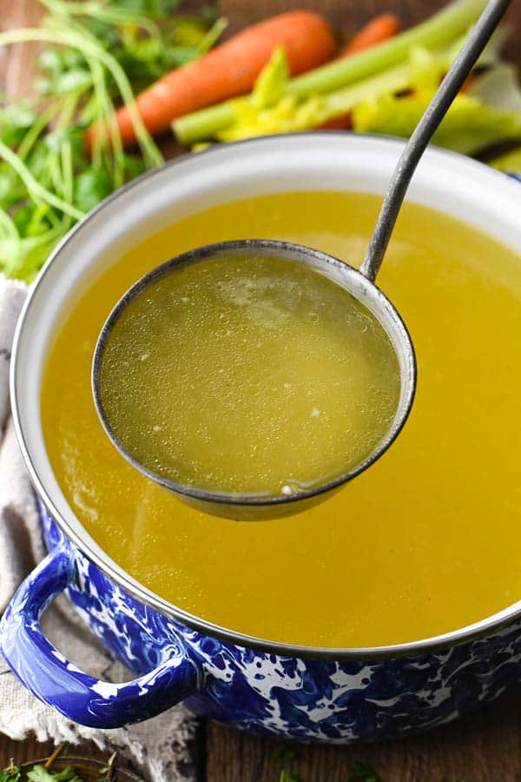
Vocabulary check
broth
/brɒθ/
nước dùng, canh

Slide 11
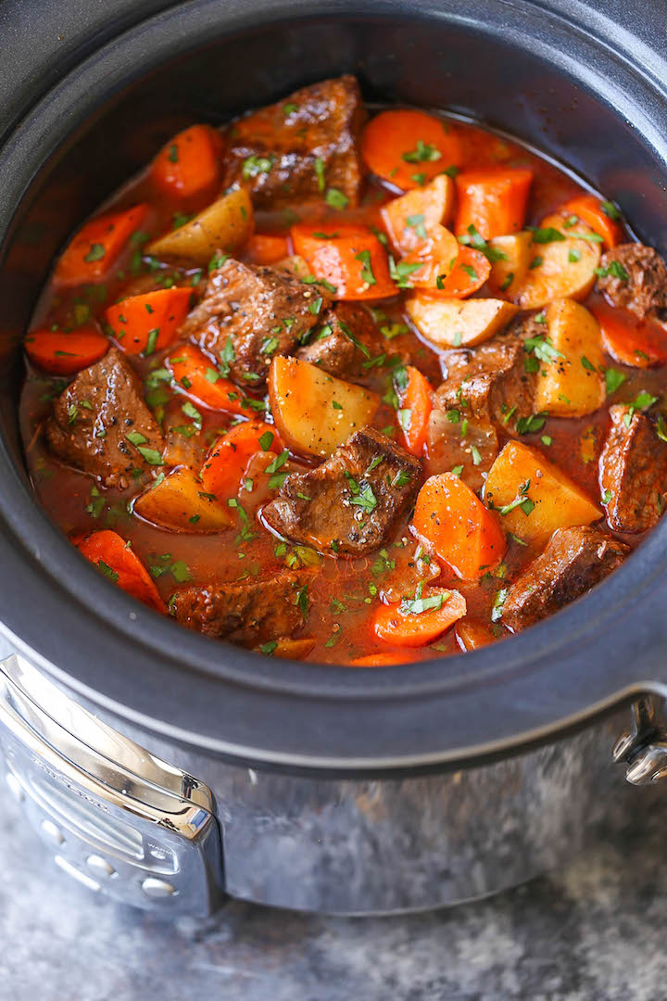
Vocabulary check
stew
/stju:/
hầm

Slide 12
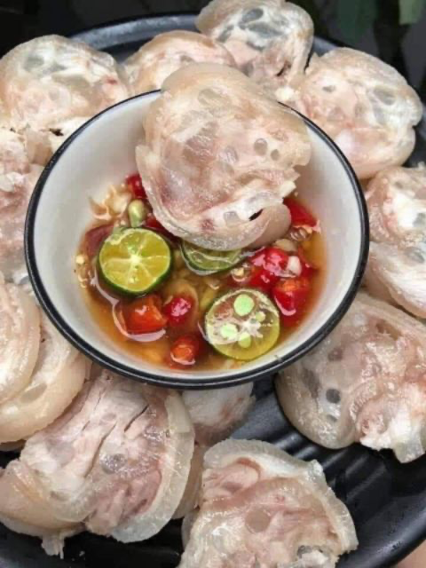
Vocabulary check
boneless
/ˈbəʊnləs/
không xương

Slide 13
Vocabulary
1. snack /snæk/: đồ ăn vặt
2. taste /teɪst/: nếm
3. broth /brɒθ/: nước dùng, canh
4. stew /stju:/: hầm
5. boneless /ˈbəʊnləs/: không xương

Slide 14
READING
1
Work in pairs. Discuss the following questions.
1. Is pho popular in your neighbourhood?
2. When can we have pho?
3. What are the main ingredients of pho?

Slide 15
READING
2
Read Phong's blog. Match the underlined words in the text with their meanings.
1. snack
a. cooking something slowly, often in water
Pho is a special kind of traditional Vietnamese dish. Its main ingredients are rice noodles and slices of beef or chicken. It is one of the most common dishes you will find in Viet Nam. People enjoy pho at all times of the day, even for a late night snack. Pho has a very special taste. The rice noodles are made from the best kind of rice. There are two main kinds of pho: pho bo (beef noodle soup) and pho ga (chicken noodle soup). The broth for pho is made by stewing beef or chicken bones for a long time in a big pot. The meat (beef and chicken) served with pho is boneless and cut into thin slices ... It's really delicious!
Tell me about a popular dish in your area!
Posted by Phong on Feb 22 at 5:30 p.m.
d. a small meal, usually eaten in a hurry
2. taste
b. the flavour of something
b. the flavour of something
c. soup made by boiling bones, meat, etc, and vegetables in water
c. soup made by boiling bones, meat, etc, and vegetables in water
3. broth
4. stewing
a. cooking something slowly, often in water
d. a small meal, usually eaten in a hurry
5. boneless
e. without bones
e. without bones

Slide 16
WHILE-READING
3
Read Phong’s blog again and circle the correct answer A, B or C.
1. The text is mainly about _____.
A. pho, a popular dish in Viet Nam
B. popular dishes in Viet Nam
C. different ways to cook pho
2. Pho is made mainly with _____.
A. rice noodles and beef or chicken
B. rice, pork, and vegetables
C. fish, shrimp, and noodles
3. We enjoy pho _____.
A. only for breakfast
B. for lunch and dinner
C. at any time of the day
4. To make noodles for pho, we use _____.
A. a variety of sticky rice
B. the best kind of rice
C. eggs and rice flour
5. The broth for pho is made by _____.
A. slowly cooking beef or chicken bones
B. cooking beef or chicken with fish sauce
C. boiling potatoes and chicken bones for a long time

Slide 17
LESSON 5: SKILLS 1
WARM-UP
Mini game
Task 1: Work in pairs. Discuss the questions.
Task 2: Read Phong's blog. Match the underlined words with their meanings.
Task 3: Read Phong’s blog again and circle the correct answer
READING
Task 4: Make notes about a popular food and drink in your area. Think about its main ingredients, how often and when you have it.
Task 5: Work in groups of 3 or 4. Take turns to talk about a popular food or drink in your area.
WHILE-SPEAKING
Stage aims:
To help Ss generate ideas for the speaking activity.
To get student to practise talking about a popular food or drink.

Slide 18
SPEAKING
4
Make notes about a popular food and drink in your area. Think about its main ingredients, how often and when you have it.
1
main
ingredients
How often?
a popular food and drink in your area
When?
Where?

Slide 19
SPEAKING
5
Work in groups of 3 or 4. Take turns to talk about a popular food or drink in your area.
1
main
ingredients
How often?
a popular food and drink in your area
When?
Where?

Slide 20
LESSON 5: SKILLS 1
WARM-UP
Mini game
Task 1: Work in pairs. Discuss the questions.
Task 2: Read Phong's blog. Match the underlined words with their meanings.
Task 3: Read Phong’s blog again and circle the correct answer
READING
Task 4: Make notes about a popular food and drink in your area. Think about its main ingredients, how often and when you have it.
Task 5: Work in groups of 3 or 4. Take turns to talk about a popular food or drink in your area.
SPEAKING
CONSOLIDATION
Wrap-up
Homework

Slide 21
CONSOLIDATION
1
WRAP-UP
In this lesson, we have learn to:
Read for specific information about food and drink
Talk about popular food in the area.

Slide 22
CONSOLIDATION
2
HOMEWORK
Video your presentation about popular food and drink
Prepare for the next lesson: Skills 2

Slide 23

Website: sachmem.vn
Fanpage: www.facebook.com/sachmem.vn

