Slide 2
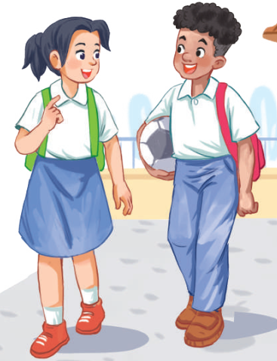
Unit
7
TRAFFIC
LESSON 1: GETTING STARTED
Meeting in the school yard
Unit
HOBBIES

Slide 3
OBJECTIVES
By the end of the lesson, students will be able to:
An overview about the topic Traffic.
Vocabulary to talk about means of transport

Slide 4
LESSON 1: GETTING STARTED
WARM-UP
Miming game
PRESENTATION
Vocabulary
Listen and read
Task 1: Read the conversation and choose the correct answer
Task 2: Write one word from the conversation to complete each sentence.
Task 3: Look at the pictures and write a word under each.
PRACTICE
PRODUCTION
Task 4: Game: Find someone who …
CONSOLIDATION
Wrap-up
Home work

Slide 5
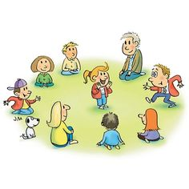
LESSON 1: GETTING STARTED
WARM-UP
Miming game
Aims of the stage:
- To activate students’ knowledge on the topic of the unit
- To enhance students’ skills of cooperating with team mates

Slide 6
LESSON 1: GETTING STARTED
WARM-UP
Miming game
PRESENTATION
Vocabulary
Aims of the stage:
To provide students with vocabulary.
To help students well-prepared for the listening and reading tasks.

Slide 7
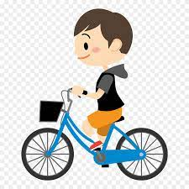
PRESENTATION
cycle (v)
/ˈsaɪkl/
ĐẠP XE

Slide 8
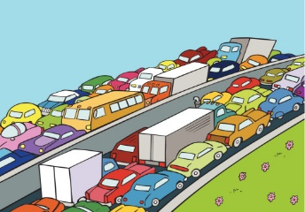
PRESENTATION
traffic jam (n)
/ˈtræfɪk dʒæm/
TẮC ĐƯỜNG

Slide 9
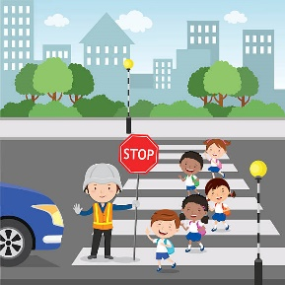
PRESENTATION
cross the road (v)
/krɒs ðə rəʊd/
BĂNG QUA ĐƯỜNG

Slide 10
PRESENTATION
rush hour (n)
/ˈrʌʃ aʊə(r)/
GIỜ CAO ĐIỂM

Slide 11
PRESENTATION
New words | Pronunciation | Meaning
cycle (v) | /ˈsaɪkl/ | đạp xe
traffic jam (n) | /ˈtræfɪk dʒæm/ | tắc đường
cross the road (v) | /krɒs ðə rəʊd/ | băng qua đường
rush hour (n) | /ˈrʌʃ aʊə(r)/ | giờ cao điểm

Slide 12
LESSON 1: GETTING STARTED
Miming game
WARM-UP
Vocabulary
Listen and read
PRESENTATION
Task 1: Read the conversation and choose the correct answer
Task 2: Write one word from the conversation to complete each sentence.
Task 3: Look at the pictures and write a word under each.
PRACTICE

Slide 13
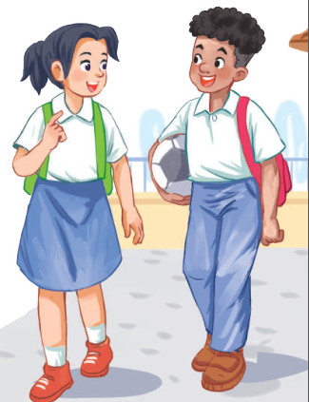
PRESENTATION: LISTEN AND READ
Aim of the task:
To get students interested in the topic
To set the context
To help Ss understand the main idea of the text

Slide 14
PRESENTATION: LISTEN AND READ
Lan: Hi, Mark. How are you?
Mark: Good, thanks. And you?
What did you do last Sunday?
Lan: I’m fine. Last Sunday afternoon,
I cycled round the lake near my home.
Mark: That sounds really healthy.
By the way, do you often cycle to
school too?
Lan: Yes, but sometimes my mum takes
me on her motorbike.
Mark: How far is it from your home
to school?
Lan: It’s about two kilometres.
Mark: How long does it take you to
cycle there?
Lan: About 10 minutes. Sometimes,
when there are traffic jams, it takes
longer.
Mark: You should be careful, especially
when you cross the road.
Lan: Right. The roads get really crowded.
Mark: Hey, how about going cycling
round the lake this Sunday?
Lan: Great! Can you come to my house
at 3 p.m.?
Mark: OK, Lan. See you then.

Slide 15
PRACTICE
1
Tick the correct answer.
Aim of the task:
To practise reading and listening for specific information
To practise scanning
To develop Ss' knowledge of vocabulary

Slide 16
PRACTICE
2
Read the conversation and choose the correct answer
1. How does Lan often go to school?
A. By bicycle. B. By motorbike. C. On foot.
2. It normally takes Lan ___ to get to school.
A. two minutes B. ten minutes C. twenty minutes
3. Lan and Mark agree to go cycling ______.
A. tomorrow B. every day C. at the weekend

Slide 17
PRACTICE
3
Write one word from the conversation to complete each sentence.
1. Last Sunday afternoon, Lan ______ round the lake near her home.
2. Mark says to Lan: “You ______ be careful, especially when you cross the road.
3. Traffic ______ are a problem in big cities.
4. – ______ does your mum go shopping?
– She often walks.
5. This road is very __________ during the rush hours.,
cycled
should
jams
How
crowded

Slide 18
PRACTICE
3
Complete each sentence with a word from the conversation.
Aim of the task:
To help student develop the vocabulary about the topic

Slide 19
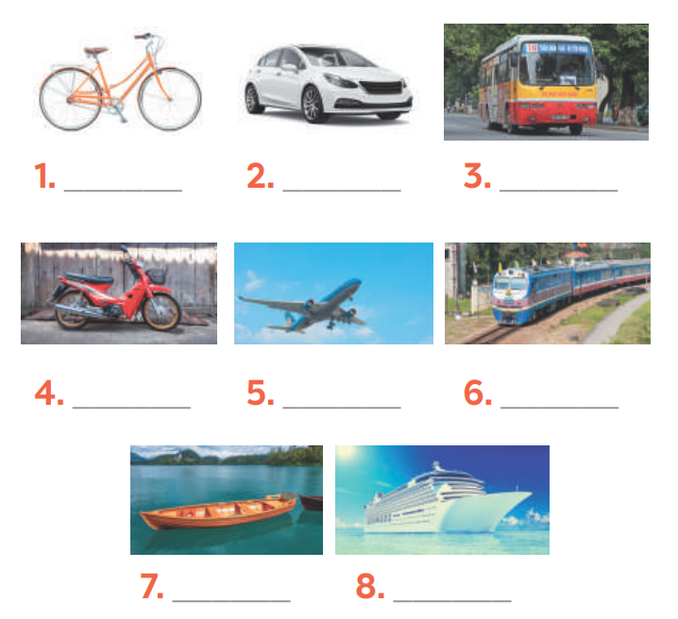
PRACTICE
4
Look at the pictures and write a word under each.
bicycle
car
bus
motorbike
air-plane
train
boat
ship

Slide 20
LESSON 1: GETTING STARTED
WARM-UP
Miming game
PRESENTATION
Vocabulary
Listen and read
Task 1: Read the conversation and choose the correct answer
Task 2: Write one word from the conversation to complete each sentence.
Task 3: Look at the pictures and write a word under each.
PRACTICE
PRODUCTION
Task 4: Game: Find someone who …

Slide 21
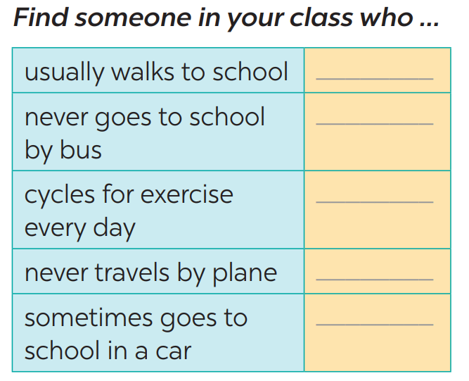
PRODUCTION
5
Find someone who … Write your friends’ names in the blanks. Then report to the class

Slide 22
LESSON 1: GETTING STARTED
WARM-UP
Miming game
PRESENTATION
Vocabulary
Listen and read
Task 1: Read the conversation and choose the correct answer
Task 2: Write one word from the conversation to complete each sentence.
Task 3: Look at the pictures and write a word under each.
PRACTICE
PRODUCTION
Task 4: Game: Find someone who …
CONSOLIDATION
Wrap-up
Home work

Slide 23
CONSOLIDATION
1
WRAP-UP
TRAFFIC
MEANS OF TRANSPORT
TRAFFIC PROBLEMS
Topic of the unit
Vocabulary

Slide 24
CONSOLIDATION
HOMEWORK
talk about the traffic in your neighbourhood
Prepare the vocabulary for the next lesson: A closer look 1.

