Slide 2
Unit
7
TRAFFIC
LESSON 2: A CLOSER LOOK 1
VOCABULARY
PRONUNCIATION
Unit
HOBBIES

Slide 3
OBJECTIVES
By the end of the lesson, students will be able to:
Vocabulary:
+ the verbs to use means of transport
+ Vocabulary to read the road signs.
Pronunciation: pronounce and recognize the sounds /aɪ/ and /eɪ/

Slide 4
LESSON 2: A CLOSER LOOK 1
WARM-UP
Game: Jumbled words
Vocabulary
Task 1: Match the words in A with the phrases in B.
Task 2: Look at these road signs. Then write the correct phrases under the signs.
Task 3: Work in pairs. Take turns to say which of the signs in 2 you see on the way to school.
and repeat
VOCABULARY
PRONUNCIATION
Pronunciation
Task 4: Listen and repeat. Pay attention to the sounds /aɪ/ and /eɪ/.
Task 5: Underline the words with the sound /aɪ/ and circle the words with the sound /eɪ/. Then listen, check
CONSOLIDATION
Wrap-up
Home work

Slide 5
LESSON 2: A CLOSER LOOK 1
WARM-UP
Game: Jumble words
Aims of the stage:
To activate students’ prior knowledge and vocabulary related to the topic, the targeted vocabulary, and its pronunciation.

Slide 6
WARM-UP: JUMBLED WORDS
MEANS OF TRANSPORT
1- OTBA -> BOAT thuyền
2- ITANR -> TRAIN tàu hỏa
3- NPEILAPRA -> AIRPLANE máy bay
4- RSOTRPCA -> SPORT CAR xe ô tô thể thao
5- OTMIROEKB -> MOTORBIKE xe máy

Slide 7
LESSON 2: A CLOSER LOOK 1
WARM-UP
Game: Jumbled words
Vocabulary
Task 1: Match the words in A with the phrases in B.
Task 2: Look at these road signs. Then write the correct phrases under the signs.
Task 3: Work in pairs. Take turns to say which of the signs in 2 you see on the way to school.
and repeat
VOCABULARY
Aims of the stage:
To introduce visually some nouns related to the topic

Slide 8
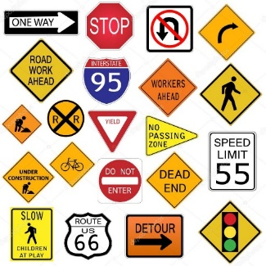
PRESENTATION
road sign (n):
/ˈrəʊd saɪn/
BIỂN BÁO
GIAO THÔNG

Slide 9
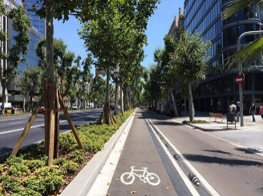
PRESENTATION
cycle lane (n)
/ˈsaɪkl leɪn/
LÀN ĐƯỜNG
DÀNH RIÊNG CHO XE ĐẠP

Slide 10
PRESENTATION
traffic lights
/ˈtræfɪk laɪt/
ĐÈN GIAO THÔNG

Slide 11
PRESENTATION
New words | Pronunciation | Meaning
1. road sign (n) | /ˈrəʊd saɪn/ | biển báo giao thông
2. cycle lane (n) | /ˈsaɪkl leɪn/ | làn đường dành riêng cho xe đạp
3. traffic light (n) | /ˈtræfɪk laɪt/ | đèn giao thông

Slide 12
LESSON 2: A CLOSER LOOK 1
WARM-UP
Game: Jumbled words
Vocabulary
Task 1: Match the words in A with the phrases in B.
Task 2: Look at these road signs. Then write the correct phrases under the signs.
Task 3: Work in pairs. Take turns to say which of the signs in 2 you see on the way to school.
and repeat
VOCABULARY

Slide 13
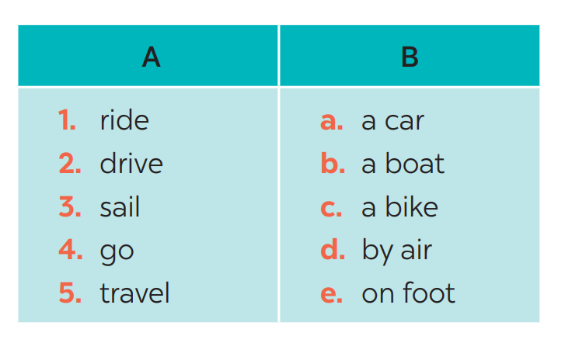
VOCABULARY
1
Match the words in A with the phrases in B.
1. c
2. a
3. b
4. e
5. d

Slide 14
VOCABULARY
2
Look at these road signs. Then write the correct phrases under the signs.
No right turn
cycle lane
traffic lights
Hospital ahead
School ahead
No cycling

Slide 15
VOCABULARY
3
Work in pairs. Take turns to say which of the signs in 2 you see on the way to school.

Slide 16
LESSON 2: A CLOSER LOOK 1
WARM-UP
Game: Jumbled words
Vocabulary
Task 1: Match the words in A with the phrases in B.
Task 2: Look at these road signs. Then write the correct phrases under the signs.
Task 3: Work in pairs. Take turns to say which of the signs in 2 you see on the way to school.
and repeat
VOCABULARY
PRONUNCIATION
Pronunciation
Task 4: Listen and repeat. Pay attention to the sounds /aɪ/ and /eɪ/.
Task 5: Underline the words with the sound /aɪ/ and circle the words with the sound /eɪ/. Then listen, check

Slide 17
PRONUNCIATION
aɪ/ and /eɪ/
Aims of the stage:
To help Ss identify the and classify the sounds
To give students authentic practice in using pronouncing sounds in common words

Slide 18
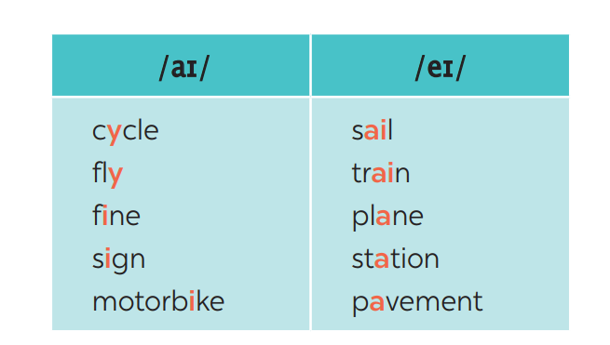
PRONUNCIATION
4
Listen and repeat. Pay attention to the sounds /aɪ/ and /eɪ/.

Slide 19
PRONUNCIATION
5
Underline the words with the sound /aɪ/ and circle the words with the sound /eɪ/. Then listen, check and repeat
1. The bus station is far from my house.
2. Remember to ride your bike carefully.
3. We must obey traffіc rules for our safety.
4. You have to get there in time for the train.
5. Don’t ride on the pavement.

Slide 20
LESSON 2: A CLOSER LOOK 1
WARM-UP
Game: Jumbled words
Vocabulary
Task 1: Match the words in A with the phrases in B.
Task 2: Look at these road signs. Then write the correct phrases under the signs.
Task 3: Work in pairs. Take turns to say which of the signs in 2 you see on the way to school.
and repeat
VOCABULARY
PRONUNCIATION
Pronunciation
Task 4: Listen and repeat. Pay attention to the sounds /aɪ/ and /eɪ/.
Task 5: Underline the words with the sound /aɪ/ and circle the words with the sound /eɪ/. Then listen, check
CONSOLIDATION
Wrap-up
Home work

Slide 21
CONSOLIDATION
1
WRAP-UP
VOCABULARY
PRONUNCIATION

Slide 22
CONSOLIDATION
2
HOMEWORK
Exercises in the workbook

