Slide 2
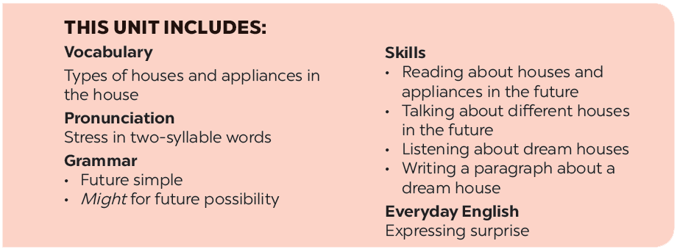

Slide 3
My future house
Listen and read.
Order the words to make a phrase about a place. Each group has one extra word.
Read the conversation again. Find and write down the words or phrases that show:
In groups, describe to your classmates what you can see outside the window of your future house. Your group tries to guess where your house is.
Read the conversation again. Tick () T (True) or F (False).

Slide 4
Listen and read.
My future house

Slide 5
My future house
Nick: What are you doing, Phong?
Phong: I’m painting a picture of my house.
Nick: Your house! That’s a UFO.
Phong: It looks like a UFO but it’s my house in the future.
Nick: Where will it be?
Phong: It’ll be in the mountains.
Nick: What will it be like?
Phong: It’ll be a large house. It’ll have twenty rooms.
Nick: Twenty rooms!
Phong: Yes, and it’ll have solar energy.
Nick: Fantastic! Which room will you like best?
Phong: My bedroom, of course.
Nick: What appliances might the house have?
Phong: My house might have some smart TVs and ten robots.
Nick: Sounds great! And how much will ...

Slide 6
Read the conversation again. Find and write down the words or phrases that show:
Type of house
Location
Appliances in the house
UFO
in the mountains
some smart TVs and ten robots

Slide 7
My future house
Nick: What are you doing, Phong?
Phong: I’m painting a picture of my house.
Nick: Your house! That’s a UFO.
Phong: It looks like a UFO but it’s my house in the future.
Nick: Where will it be?
Phong: It’ll be in the mountains.
Nick: What will it be like?
Phong: It’ll be a large house. It’ll have twenty rooms.
Nick: Twenty rooms!
Phong: Yes, and it’ll have solar energy.
Nick: Fantastic! Which room will you like best?
Phong: My bedroom, of course.
Nick: What appliances might the house have?
Phong: My house might have some smart TVs and ten robots.
Nick: Sounds great! And how much will ...

Slide 8
Read the conversation again. Tick () T (True) or F (False).
 | T | F
1. Phong’s house will be in the mountains.
2. His house will be large.
3. There’ll be a lot of rooms in his house.
4. He might have a smart TV and five robots.





Slide 9
Order the words to make a phrase about a place.
Each group has one extra word.
1.
sea / a / in / the
5.
countryside / a / the / in
in the sea
in the countryside
2.
on / in / the / city
6.
Moon / in / the / on
in the city
on the Moon
3.
the / in / at / town
7.
in / at / the / sky
in the town
in the sky
4.
the / on / in / mountains
in the mountains

Slide 10
In groups, describe to your classmates what you can see outside the window of your future house. Your group tries to guess where your house is.
Example:
A: Outside my window I can see the beach and the water. Where’s my house?
B: It’s in the sea.
A: Correct!

