Slide 2
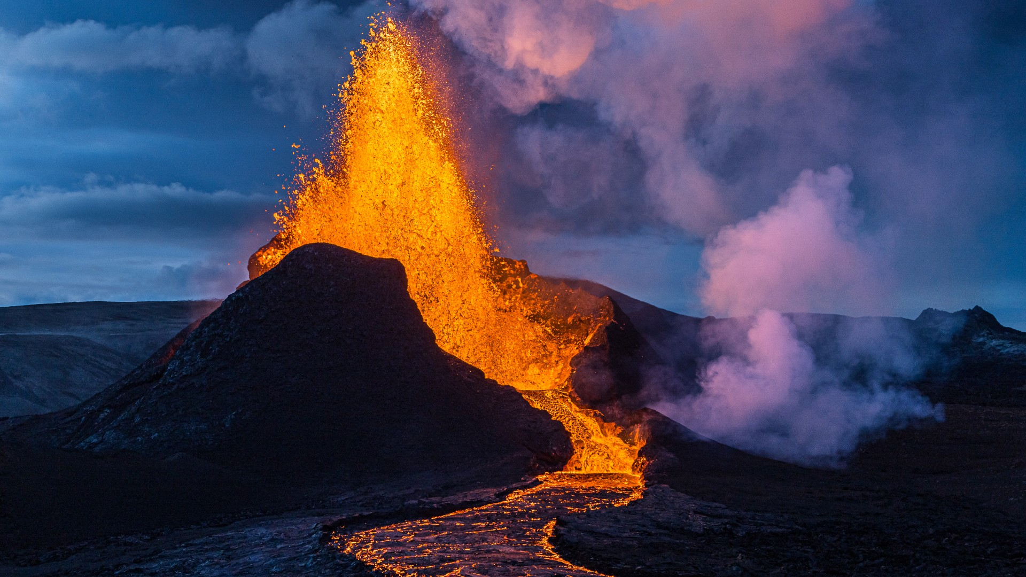
Unit
9
NATURAL DISASTERS
Unit
ETHNIC GROUPS OF VIET NAM
LESSON 5: SKILLS 1
LESSON 3: A CLOSER LOOK 2
Unit
HOBBIES

Slide 3
LESSON 5: SKILLS 1
WARM-UP
Who’s faster?
Aims of the stage:
To review words related to natural disasters and introduce the new lesson.

Slide 4
WARM-UP
Erupt
Natural disasters

Slide 5
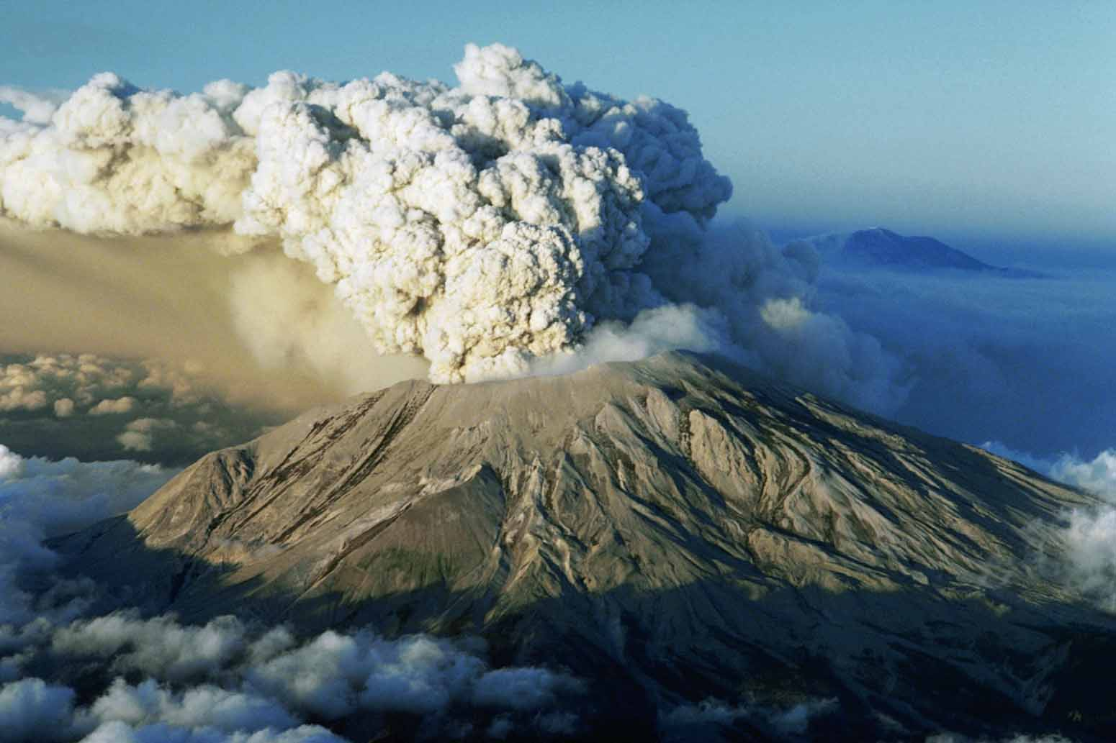
VOCABULARY
Ash (n)
/æʃ/
Tro

Slide 6
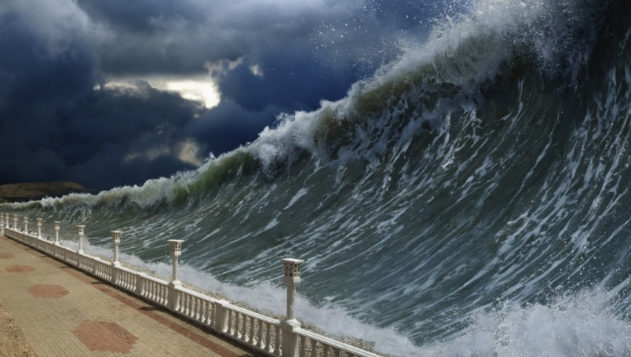
VOCABULARY
Tsunami (n)
/tsuːˈnɑː.mi/
Trận sóng thần

Slide 7
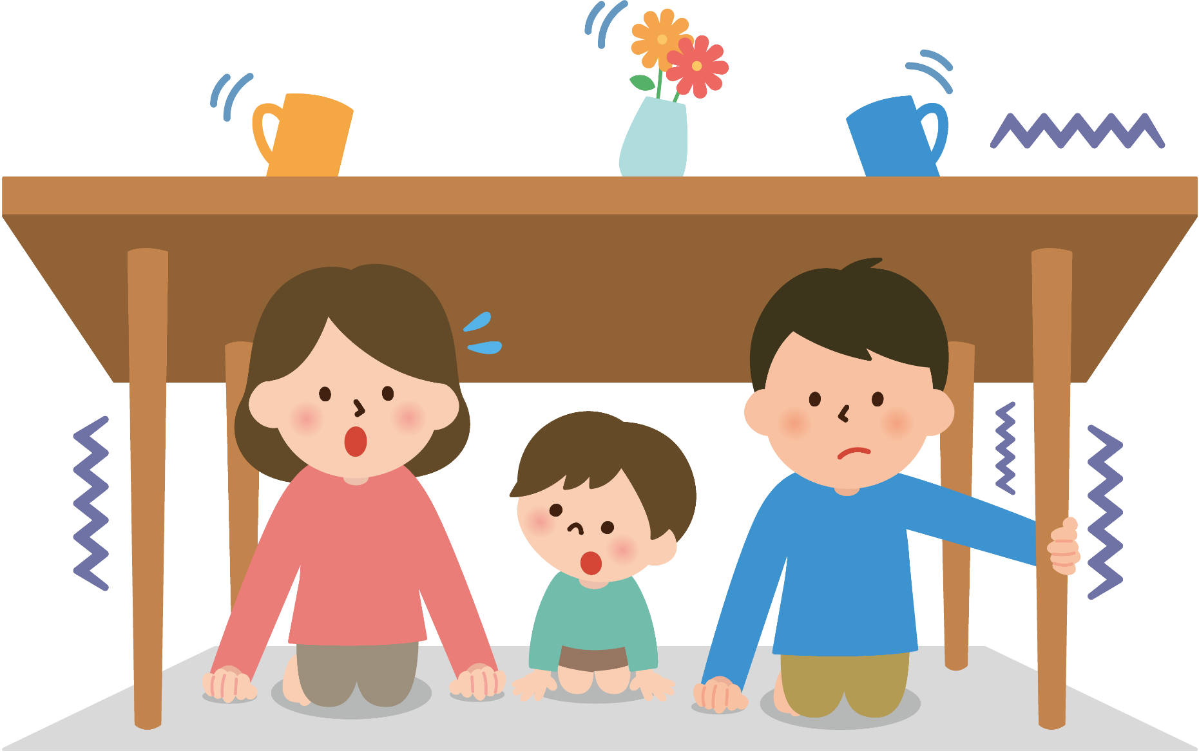
VOCABULARY
Tremble (v)
/ˈtrembəl/
Rung lắc

Slide 8
VOCABULARY
Vocabulary | Pronunciation | Meaning
1. Ash (n) | /æʃ/ | Tro
2. Tsunami (n) | /tsuːˈnɑː.mi/ | Trận sóng thần
3. Tremble (v) | /ˈtrembəl/ | Rung lắc

Slide 9
VOCABULARY
Vocabulary |  | Meaning
1. Ash (n)
2. Tsunami (n)
3. Tremble (v)
Trận sóng thần
Rung lắc
Tro

Slide 10
READING
1
Match the headlines (1 – 2) with the natural disasters (A – B).
Headlines |  | Natural disasters
1. 30 seconds of a slight shaking in Ha Noi.
2. A thick layer of ash covers Tonga.
A. volcanic eruption
B. earthquake

Slide 11
READING
2
Read the two news articles. Match the highlighted words with their meanings.
Highlighted words |  | Meanings
1. violently
2. tsunami
3. missing
4. trembling
5. fear
a. not yet found
b. slightly shaking
c. the bad feeling you have when you are frightened
d. very strongly
e. very large waves in the sea

Slide 12
READING
3
Read the articles again and answer the questions.
Where and when did the eruption happen?
=> ___________________________________________________________
2. What did the eruption cause?
=> ___________________________________________________________
3. What were the other effects of the eruption?
___________________________________________________________
___________________________________________________________
4. How long did the buildings shake?
=> ___________________________________________________________
5. What caused the shaking?
=> ___________________________________________________________
In the South Pacific last Saturday.
A tsunami.
It destroyed hundreds of homes on some small islands, and more than twenty people on these islands are missing.
For about 30 seconds.
A strong earthquake in China.

Slide 13
SPEAKING
4
Work in pairs. Match the questions with the answers.
Questions | Answers
1. What kind of natural disaster was it? | a. Five days of heavy rain caused it.
2. When and where did it happen? | b. Many houses were flooded, two villagers died, and five others were missing.
3. What caused it? | c. It was a serious flood.
4. What were its effects? | d. Rescue workers looked for the missing people, and volunteers gave food and drinks to the victims.
5. How did people help the victims? | e. It happened in a village in Phu Yen last week.
1. c 2. e 3. a 4. b 5. d

Slide 14
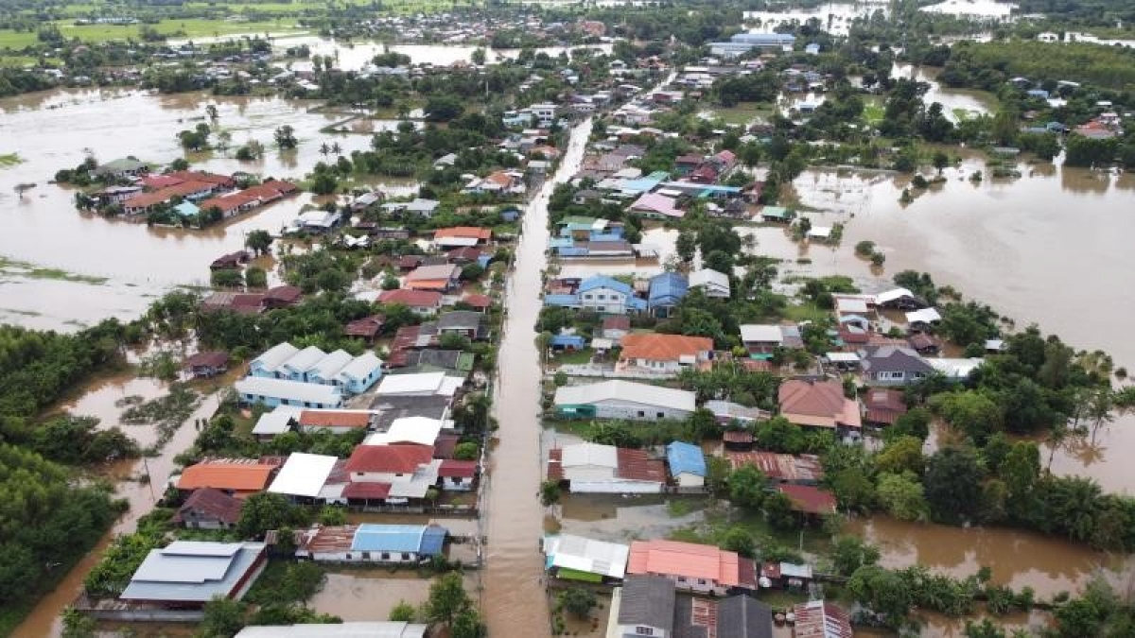
SPEAKING
5
Work in groups. Prepare a short piece of news about the natural disaster in 4 or one you know of. Report the news to the class.
Example:
Five days of heavy rain caused a serious flood in a village in Phu Yen. The flood happened last week. …

Slide 15
CONSOLIDATION
1
WRAP-UP
In this lesson, you have:
learnt new words related to natural disasters.
read 2 passages about volcano and earthquake.
Write a short piece of news about the natural disaster.

Slide 16
CONSOLIDATION
2
HOME ASSIGNMENTS
Make sentences using all the words.
Do exercises in the workbook.

Slide 17
Website: hoclieu.vn
Fanpage: facebook.com/sachmem.vn/

