Slide 2
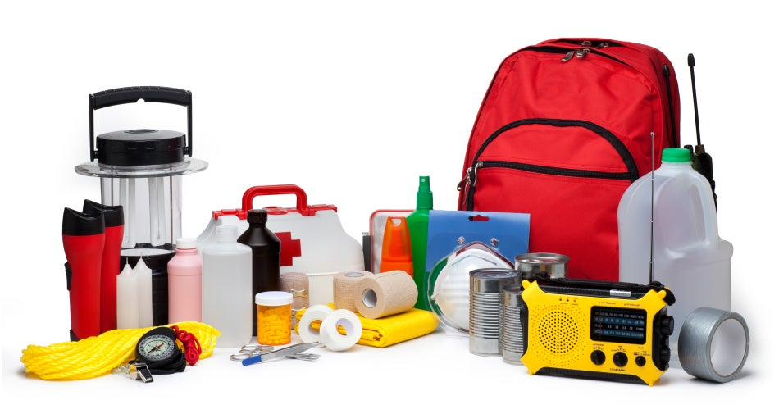
Unit
9
NATURAL DISASTERS
Unit
ETHNIC GROUPS OF VIET NAM
LESSON 6: SKILLS 2
LESSON 3: A CLOSER LOOK 2
Unit
HOBBIES

Slide 3
LESSON 5: SKILLS 1
WARM-UP
Chatting: What should people do before, during and after a storm?

Slide 4
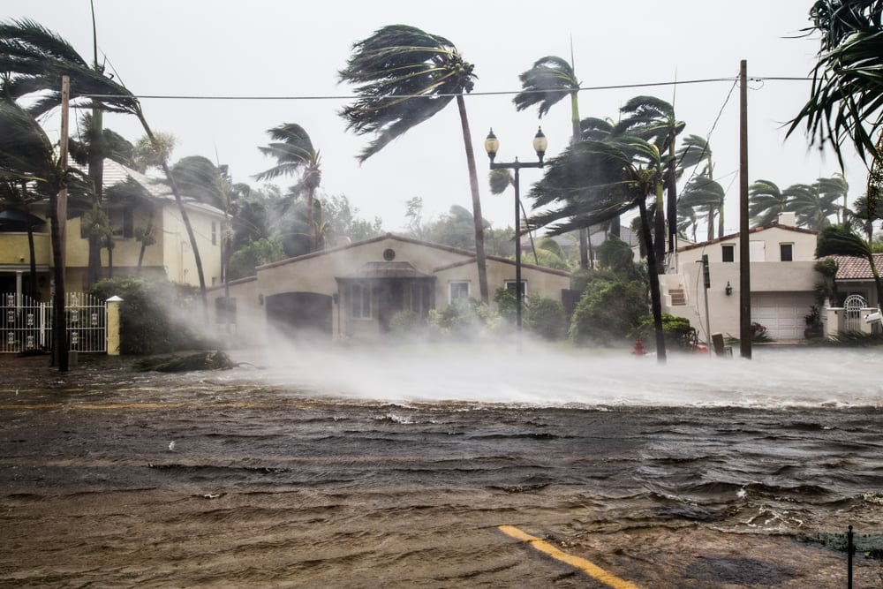
WARM-UP
Buy candles
What should people do before, during and after a storm?

Slide 5
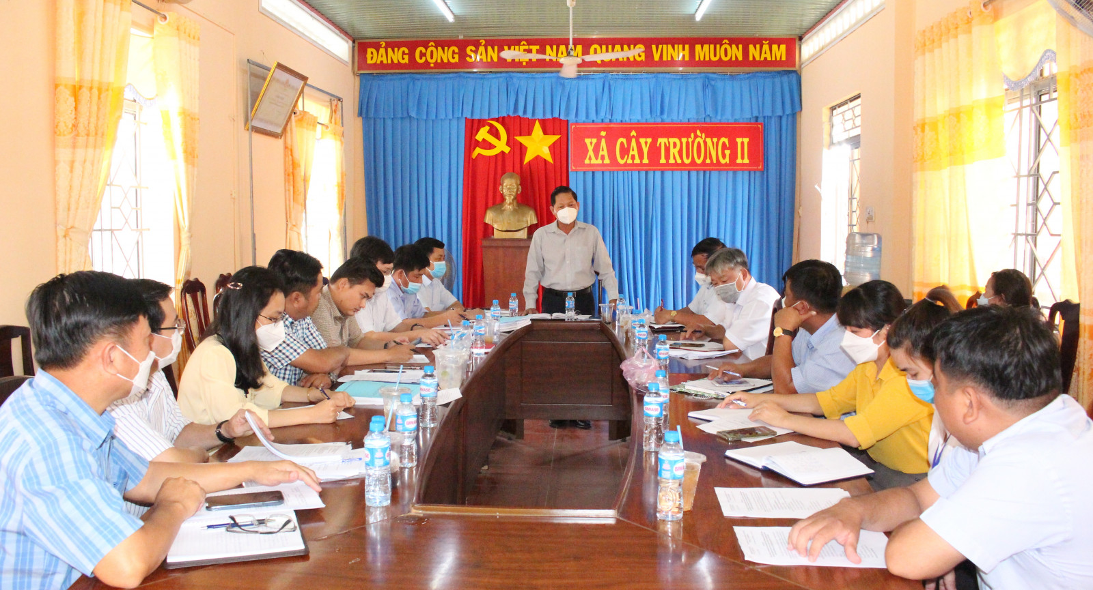
VOCABULARY
Authority (n)
/ɔːˈθɒrəti/
Chính quyền

Slide 6
VOCABULARY
Warn (v)
/wɔːn/
Cảnh báo

Slide 7
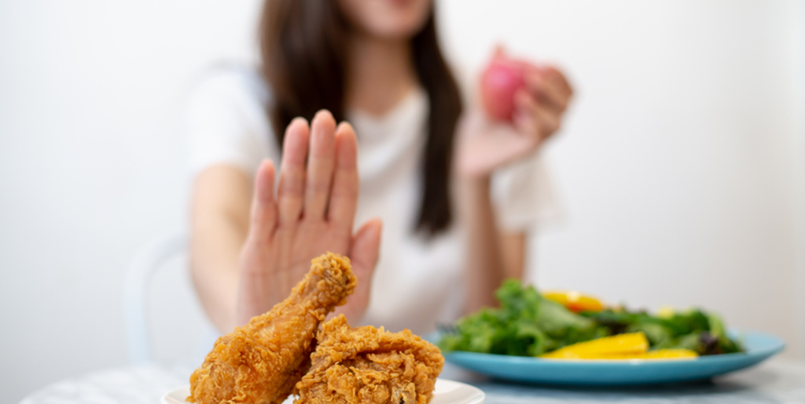
VOCABULARY
Avoid (v)
/əˈvɔɪd/
Tránh, tránh xa

Slide 8
VOCABULARY
Vocabulary | Pronunciation | Meaning
1. Authority (n) | /ɔːˈθɒrəti/ | Chính quyền
2. Warn (v) | /wɔːn/ | Cảnh báo
3. Avoid (v) | /əˈvɔɪd/ | Tránh, tránh xa

Slide 9
VOCABULARY
New words |  | Meaning
1. Authority (n)
2. Warn (v)
3. Avoid (v)
Cảnh báo
Tránh, tránh xa
Chính quyền

Slide 10
LISTENING
1
Work in pairs. Look at the picture and answer the questions.
What can you see in the picture?
2. When do we need these things?

Slide 11
* Suggested answer:
A torch, a mask, a lamp, a whistle, a bottle of water, some medicine, matches, a radio, some plasters, a candle, a multi-purpose knife, some batteries, a blanket

Slide 12
LISTENING
2
Listen to a broadcast. Put the activities (1 – 6) in the correct column.
Before a storm | During a storm | After a storm
2,6
3,5
1,4
Listen to instructions from local authorities
2. Prepare an emergency kit
3. Stay inside the house
4. Keep away from dangerous areas
5. Avoid windows and glass doors
6. Strengthen houses

Slide 13
LISTENING
3
Listen again and tick (√) T (True) or F (False) for each sentence.
 | T | F
1. The broadcast is on TV.
2. You should bring flowerpots and rubbish bins into the house.
3. Right after the storm, you can leave your home.
4. The local authority may warn you about dangerous places.

Slide 14
WRITING
4
Work in pairs. Discuss what you should do before, during, and after a flood. Write your ideas in the columns.
Before a flood | During a flood | After a flood
-Prepare an emergency
kit.
.........
-Stay inside a safe and high place.
…….
-Avoid moving water.
……..

Slide 15
WRITING
5
Write instructions (80 - 100 words) about things to do before, during, and after a flood.

Slide 16
*Suggested answer:
Here are the things you should do before, during, and after a flood.
Before:
- Prepare an emergency kit with necessary things.
- Build barriers to stop floodwater from entering the house.
- Move to a higher place if necessary.
During:
- Listen to the radio or television for warnings and information.
- Be careful with flash flooding.
After:
- Avoid moving water.
- Stay away from damaged areas unless the local authority needs your help.

Slide 17
CONSOLIDATION
1
WRAP-UP
In this lesson, you have:
learnt new words related to natural disasters.
known more about things to do before, during, and after a storm.
Written instructions about things to do before, during, and after a flood.

Slide 18
CONSOLIDATION
2
HOME ASSIGNMENTS
Learn by heart all the words.
Do exercises in the workbook.
Prepare for Lesson 7 – Looking back + project.

Slide 19
Website: hoclieu.vn
Fanpage: facebook.com/sachmem.vn/

