Slide 2
Unit
8
SHOPPING
LESSON 2: A closer look 1
1

Slide 3
LESSON 1: GETTING STARTED
WARM-UP
Vocabulary
PRESENTATION
Task 1: Write a word or phrase from the box under each picture.
Task 2: Choose the option that best completes each phrase.
Task 3: Complete the sentences with the words and phrases from the box.
PRACTICE
Pronunciation: Sentence stress
Task 4: Listen and repeat the sentences. Pay attention to the bold syllables.
Task 5: Listen and repeat the sentences. How many stressed words are there in each sentence.
PRODUCTION
CONSOLIDATION
Wrap-up
Homework

Slide 4
GAME: LABELLING
WARM-UP
RULE:
Work in 2 teams
Receive the pictures of things and strips of paper with the phrases.
Stick the phrases to the right pictures.
The team with the most correct answers wins

Slide 5
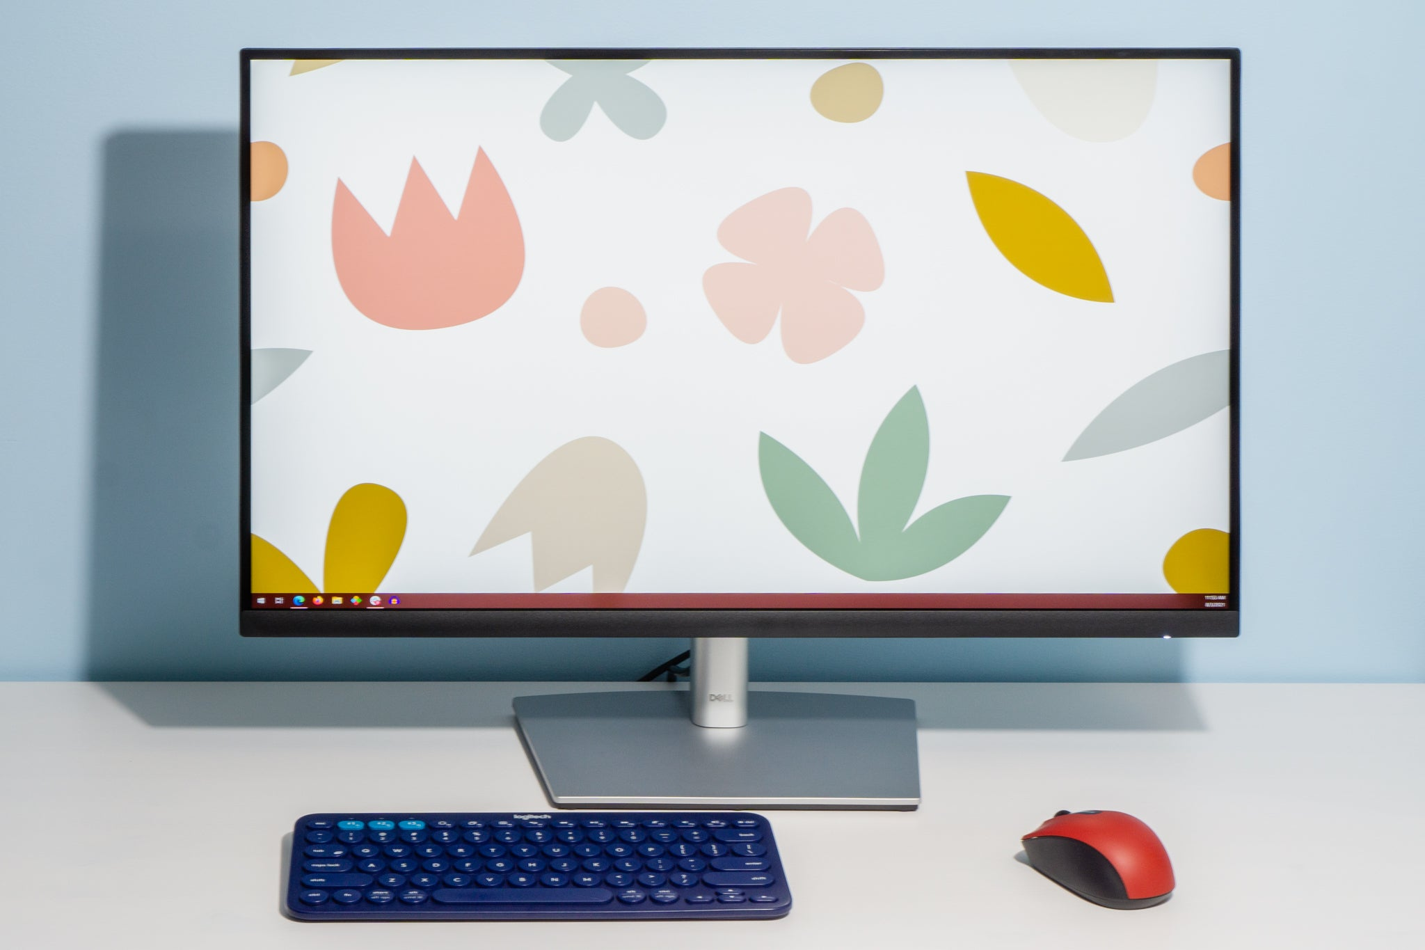
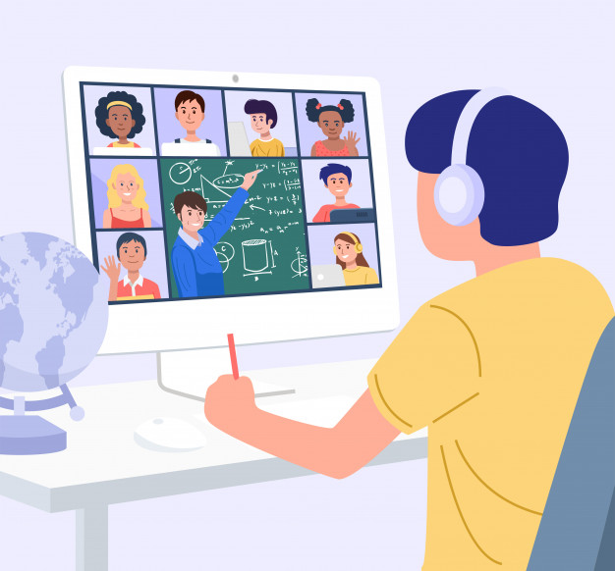
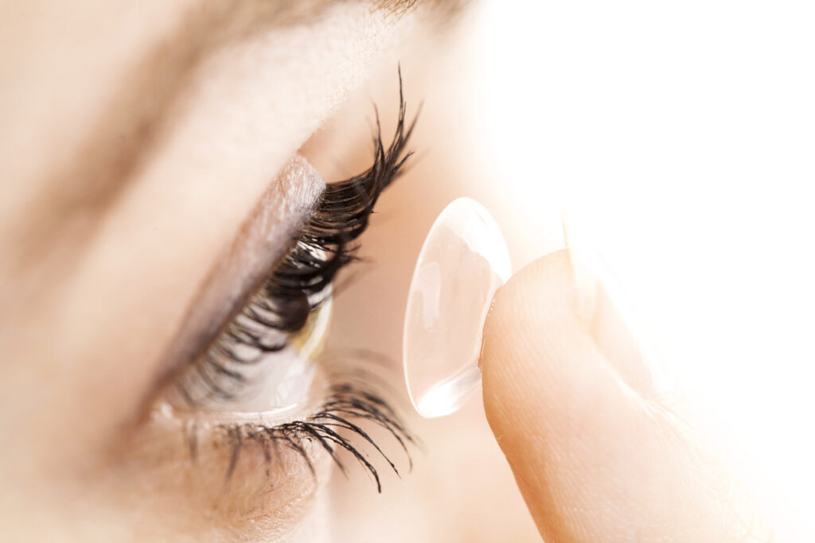
GAME: LABELLING
WARM-UP
Computer screen
Breakout rooms
Robot teacher
Online class
3D contact lenses
Connection

Slide 6
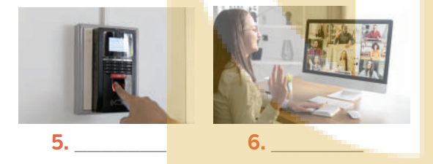
I. VOCABULARY
PRACTICE
1
Write the words and phrases under each picture.
face recognition
experiment
video conference
eye tracking
fingerprint scanner
digital communication

Slide 7
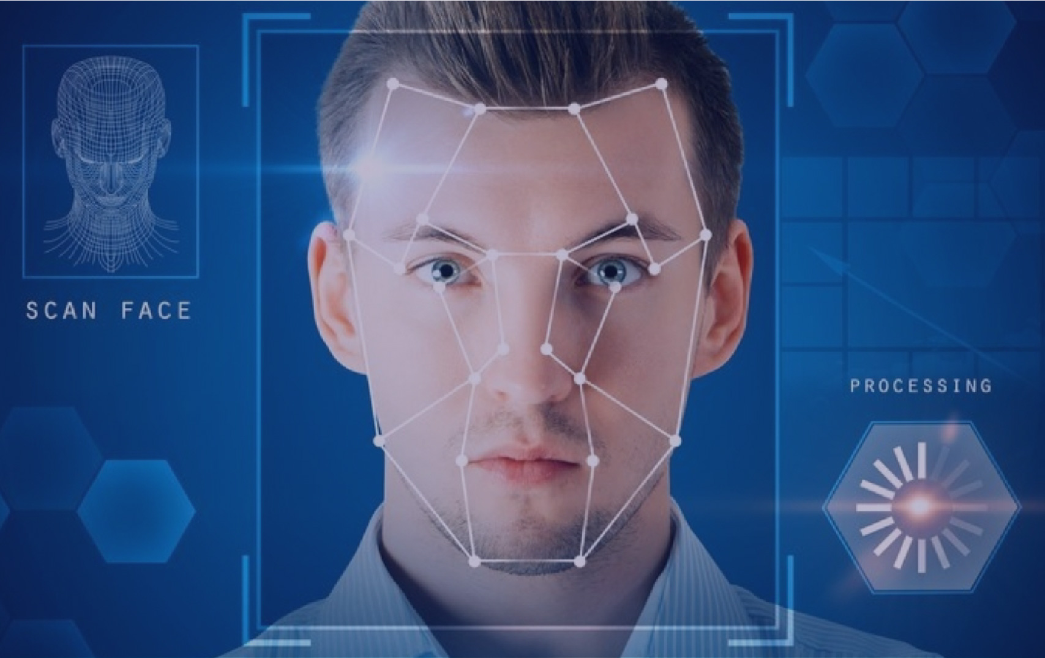
PRESENTATION
face recognition (n)
/feɪsˌrekəɡˈnɪʃn/
Công nghệ nhận biết/ diện gương mặt

Slide 8
PRESENTATION
experiment (n)
/ɪkˈsperɪmənt/
Thí nghiệm

Slide 9
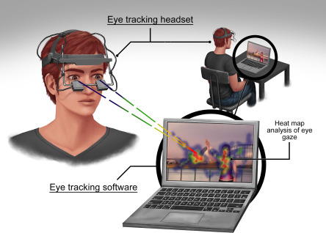
PRESENTATION
eye tracking (n)
/’ai ,trækɪŋ/
Công nghệ dõi (cử động) mắt

Slide 10
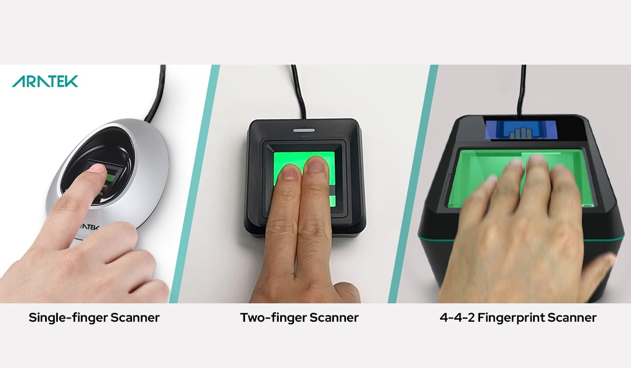
PRESENTATION
fingerprint scanner(n)
/ˈfɪŋɡəprɪnt ˈskænə(r)/
Máy quét vân tay

Slide 11
PRESENTATION
digital communication (n)
/ˈdɪdʒɪtl /kəˌmjuːnɪˈkeɪʃn/
Giao tiếp kỹ thuật số

Slide 12
VOCABULARY
PRESENTATION
New words | Pronunciation | Meaning
1. face recognition (n) | /feɪsˌrekəɡˈnɪʃn/ | Công nghệ nhận diện/nhận biết gương mặt
2. experiment (n) | /ɪkˈsperɪmənt/ | Thí nghiệm
3. eye tracking (n) | /’ai ,trækɪŋ/ | Công nghệ dõi (cử động) mắt
4. fingerprint scanner(n) | /ˈfɪŋɡəprɪnt ˈskænə(r)/ | Máy quét vân tay
5. digital communication (n) | /ˈdɪdʒɪtl /kəˌmjuːnɪˈkeɪʃn/ | Giao tiếp kỹ thuật số

Slide 13
I. VOCABULARY
PRACTICE
2
Choose the option that best completes each phrase.
A. a device
1.
invent
B. a new area
A. a device
2.
discover
B. a new area
A. a device
3.
create
B. a new area
A. a device
4.
develop
B. a new area

Slide 14
I. VOCABULARY
PRACTICE
3
Complete the sentences with the words and phrases from the box.
invented
created
experiments
discovered
fingerprint scanner
Marie Curie and Pierre Curie_____________radium and polonium.
Thomas Edison__________the light bulb in 1880.
Sarah Gilbert is the creator of a vaccine. She _________ it in 2020.
Scientists have carried out many_____________to find a cure for cancer.
Scan your finger on this _________________to check attendance, please.

Slide 15
II. PRONUNCIATION: Sentence stress
PRACTICE

Slide 16
II. PRONUNCIATION
PRACTICE
4
Listen and repeat the sentences. Pay attention to the bold syllables.
1. I don’t have a computer.
2. Do you call her every day? – No, I don’t.
3. They are not familiar with that new computer.
4. Did you lend her your laptop? – Yes, I did.
5. Who do you work with on Sundays?

Slide 17
II. PRONUNCIATION
PRACTICE
5
Listen and repeat the sentences. How many stressed words are there in each sentence.
1. He is an inventor.
2. We won’t have a robot teacher next year.
3. She likes learning online.
4. Was she checking attendance when you came? - No, she wasn’t.
5. What did he invent?

Slide 18
II. PRONUNCIATION
PRACTICE
5
Listen and repeat the sentences. How many stressed words are there in each sentence.
1. He is an inventor.
2. We won’t have a robot teacher next year.
3. She likes learning online.
4. Was she checking attendance when you came? - No, she wasn’t.
5. What did he invent?
1
5
3
6
2

Slide 19
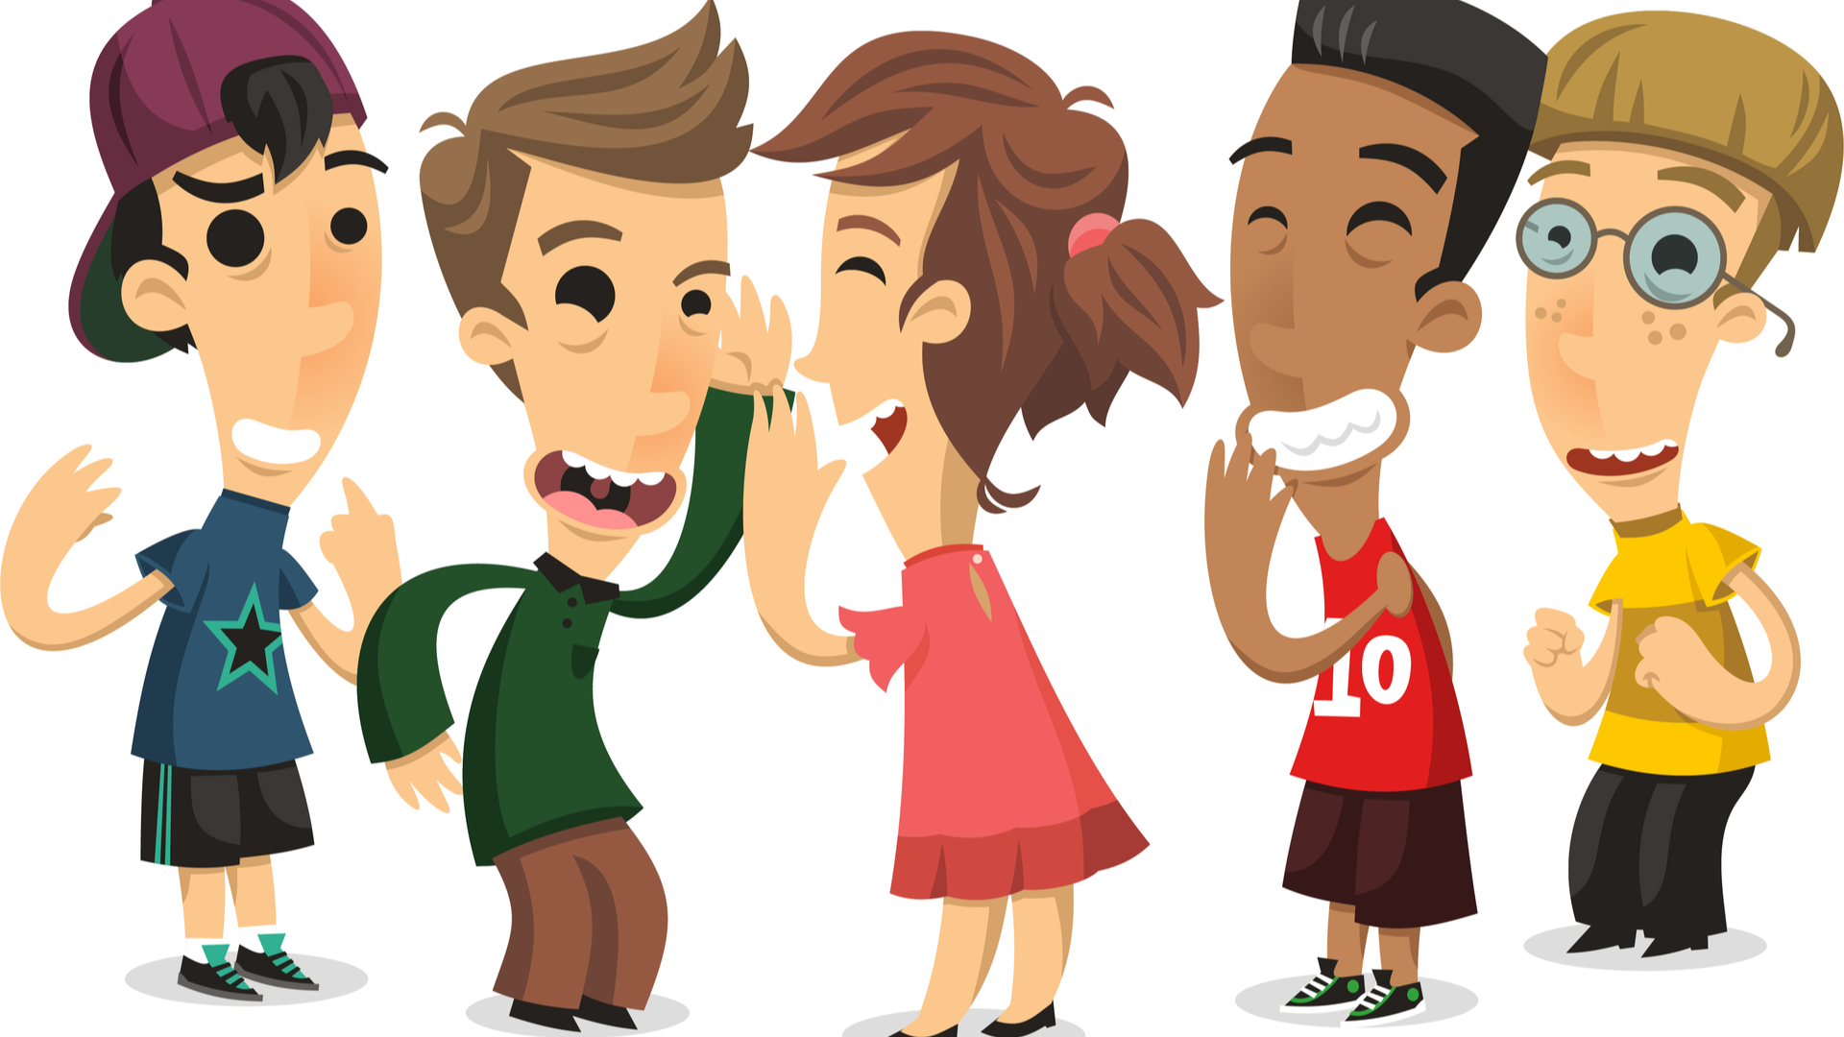
PRODUCTION
5
GAME: BROKEN TELEPHONE
RULE:
Gather 3 or more players.
The person starting the game thinks of SENTENCE and whispers it into the next player’s ear only once, with no repeats allowed.
That listener tries to correctly repeat that SENTENCE into the next player’s ear (Paying attention to the sentence’s stress). The last person in the line or at the end of the circle repeats the SENTENCE
Allow a moment for giggles if the message is “broken” or changed. The player who started announces the correct SENTENCE
Players take turns thinking of the next SENTENCE to pass through a whisper.

Slide 20
CONSOLIDATION
1
Wrap-up
What have we learnt in this lesson?
words and phrases related to new technologies.
new verb phrases that are used to talk about inventions, discoveries, creation, and development.
sentences stress

Slide 21
CONSOLIDATION
2
Homework
Learn by heart words and phrases related to new technologies and new verb phrases that are used to talk about inventions, discoveries, creation, and development.
Learn by heart “REMEMBER” about sentence stress
Do Exercise ………..page ……Unit 11/Workbook

Slide 22
Website: hoclieu.vn
Fanpage: facebook.com/sachmem.vn/

