Slide 1
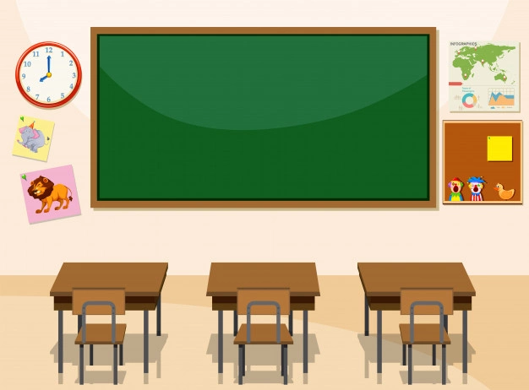
Welcome to our class

Slide 2
* Warm - up
Game: Keywords
-There are 3 sets of pictures
- You choose a set and then find a keyword for each set of pictures.
Set 1
Set 2
Set 3

Slide 3
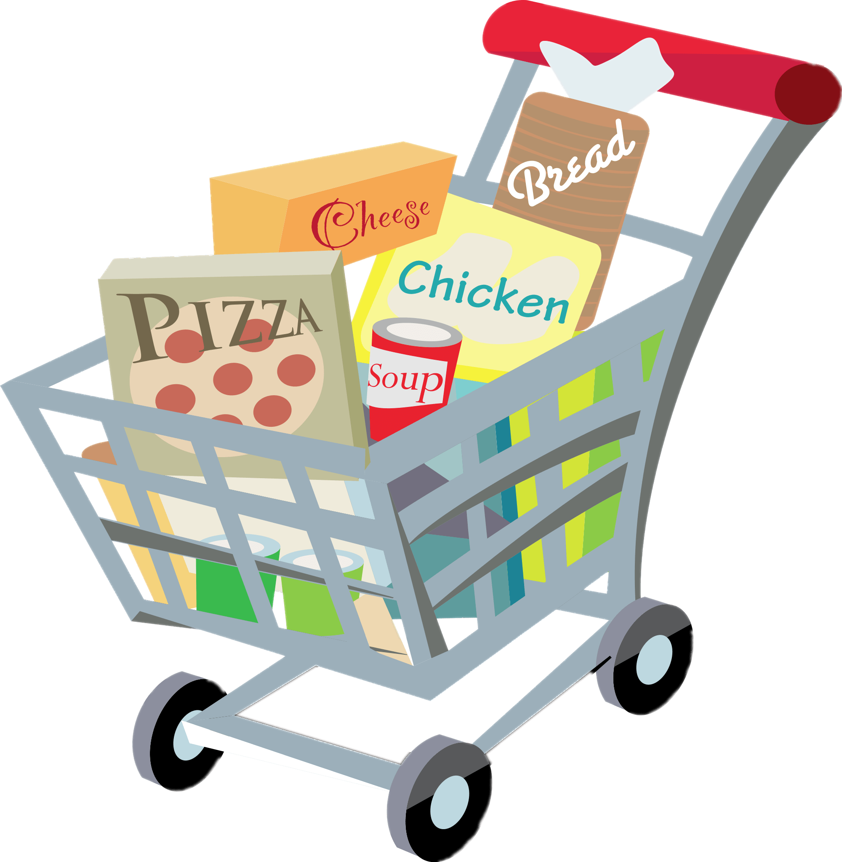
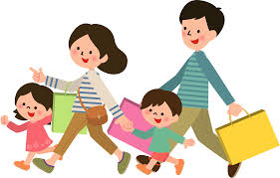
SET 1
UNIT 8: SHOPPING

Slide 4
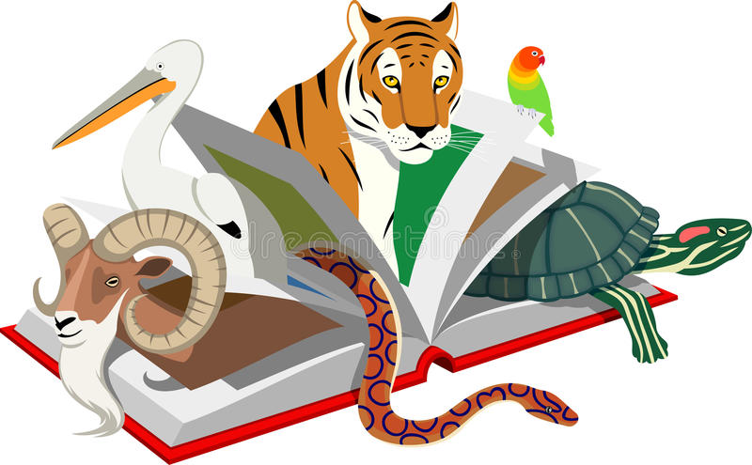
* WARM-UP
SET 3
UNIT 7: ENVIRONMENTAL PROTECTION

Slide 5
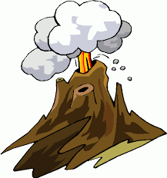
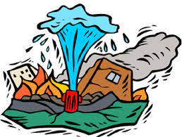
SET 2
UNIT 9: NATURAL DISASTERS

Slide 6
REVIEW
3
UNIT 7-8-9
LESSON 1: LANGUAGE
1

Slide 7
* PRONUNCIATION
1
a Listen and repeat, paying attention to the underlined words
1. The sky today is clear and blue.
2. The speaker talked a lot about honesty.
3. The store on that corner sells local specialities.
clear /klɪə(r)/
blue /bluː/
speaker /ˈspiːkə(r)/
honesty /ˈɒnəsti/
store /stɔː(r)/
specialities /ˈspeʃəlti/

Slide 8
* PRONUNCIATION
1
b Choose A, B, C, or D to show the word in each group with a different stress pattern.
ˈ
ˈ
ˈ
ˈ
1. A. humorous B. tremendous C. numerous D. generous
2. A. national B. animal C. arrival D. typical
3. A. festival B. cultural C. poisonous D. ambitious
ˈ
ˈ
ˈ
ˈ
ˈ
ˈ
ˈ
ˈ

Slide 9
* VOCABULARY
2
Complete each of the sentences with a word or phrase from the box.
customers bargain single-use habitats natural disasters
single-use
1. We should recycle various _________________products instead of throwing them away.
2. Shopping centres attract a lot of ________________during the sales season.
3. Population growth is causing destruction of wildlife ____________ throughout the world.
4. Luckily, my home town rarely suffers from __________________, such as floods or storms.
5. Generally you can’t ______________over prices of goods in supermarkets.
customers
habitats
natural disasters
bargain

Slide 10
3
Use the correct forms of the words in brackets to complete the sentences.
destructive
1. The tsunami in Tonga was very (destroy) ______________; hundreds of houses were swept away.
2. One (advantage) _________________of shopping online is that you do not know exactly what you will get.
3. Endangered species are animals in the wild that face a high risk of (extinct) ______________.
4. (Addict) ___________ shopping is a form of behaviour that makes shoppers buy many items they don’t need.
5. When a natural disaster happens, we must listen to (instruct) ___________from local authorities.
disadvantage
extinction
Addictive
instructions

Slide 11
4
Use the correct forms of the words in brackets to complete the sentences.
was cleaning
1. While I (clean) ______________ out my cupboards, I found these photos.
2. Sam is studying hard. He (have) _________ his exam this Friday.
3. This brochure says that the big sale (start) ________ next Friday.
4. ________ the flood victims still (wait) _________ when the rescuers came?
5. I (fall) _______________ asleep last night when I (hear) _________ a knock at the door
has
starts
Were
waiting
was just falling
heard

Slide 12
* GRAMMAR
5
Complete the sentences, so that they are true for you.
my friends were waiting for me
1. When I finished my lessons yesterday, ______________________________.
2. Before I go to bed at night, _______________________________________.
3. I will wait until the teacher _______________________________________.
4. As soon as we have our summer holiday, ____________________________.
5. I usually listen to music while _____________________________________.
my mother read a story for me
finds out my exam paper
we will go to our uncle’s farm
I am doing my housework

Slide 13
* CONSOLIDATION
What have we learnt in this lesson?
review the vocabulary and grammar of Unit 7, 8, 9

Slide 14
* Homework
Do exercise in workbook.
Prepare for the next lesson: Review (SKILLS).

Slide 15
Thanks for your atendance!
Goodbye. See you again
Notes:
15

