Slide 1
UBND QUẬN HẢI AN TRƯỜNG TIỀU HỌC ĐẰNG HẢI
MsPham-0936082789
TIẾNG ANH 3
Unit 2
Our names

Slide 2
MsPham-0936082789
TUẦN 4
Unit 2
Our name
Lesson 3 - Period 16

Slide 3
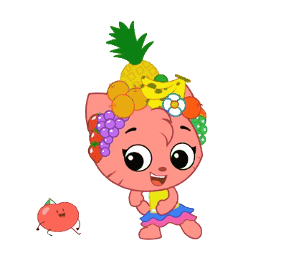
Warm - up
Play

Slide 4
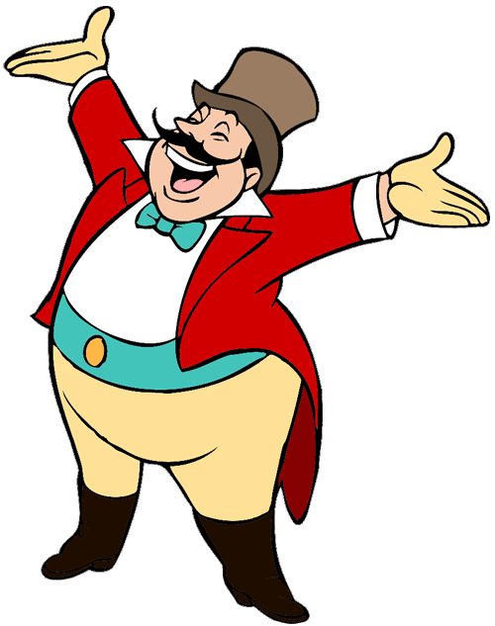
START

Slide 5
Hello. I’m Ben.
My name’s Nam.
I’m fine. Thank.
Hi, Ben. I’m Nam.

Slide 6
Hello.
How are you?
Fine, thank you.
I’m nine
years old.
Goodbye.
Next

Slide 7
What's your name?
I’m ten
years old.
My name’s Mary.
Thank you.

Slide 8
My name’s _______.
seven years old
Linh
Fine, thank you

Slide 9
How old ________?
are you
your name
my name
Next

Slide 10
Goodbye!
Fine, thank you.
Hello.
Bye.

Slide 12
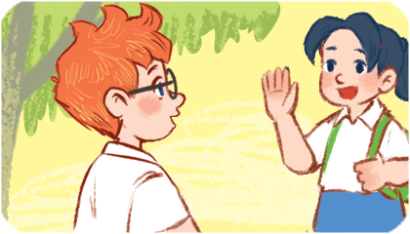
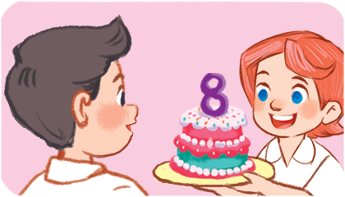
4
Read and match.
A: Hi. My name’s Linh. What’s your name?
B: My name’s Mary.
A: How old are you, Lucy?
B: I’m eight years old.
A: Hi. I’m Mai.
B: Hello, Mai. I’m Ben.
a
b
c
1
2
3

Slide 13
5
Let’s write.
Minh: Hi. I’m Minh. What’s your name?
You: _________________________.
Minh: How old are you?
You: _________________________.
I’m Alice
I’m eight years old
What's your name?
.

Slide 14
6
Project
Hello. I'm Lucy. I'm eight years old.

