Slide 1
Unit 13 Appearance
Lesson3 – P4,5,6

Slide 2
Sorting
He/She is ... | He/She has ...
a round face
beautiful
long legs
slim
a big nose
tall
small eyes
big

Slide 3
Sorting
He/She is ... | He/She has ...
a round face
slim
a big nose
tall
long legs
big
small eyes
beautiful

Slide 4
Number Race
1
2
1
2
3
4
3
4
Notes:
- Teacher devides class into teams.
- Teacher gives each pupil in one team a number so that each team has equal numbers.
- Teacher shows the questions, allow time for pupils to think. Then T calls out a number, pupils with that number from each team stands up and shouts out the answers. T praise and give points for the teams.

Slide 5
Find the odd one out.
long hair
tall
short
A
B
C

Slide 6
Find the odd one out.
slim
big
handsome
A
B
C

Slide 7
Find the odd one out.
big eyes
tall
a round face
A
B
C

Slide 8
Find the odd one out.
big eyes
slim
big
A
B
C

Slide 9
Find the odd one out.
has
she
is
A
B
C

Slide 10
Find the odd one out.
mother
round
sister
A
B
C

Slide 11
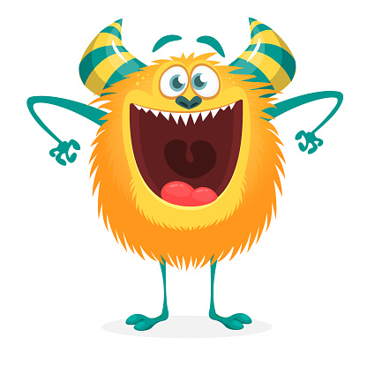
The monster _____ a big mouth.
Is/ has
has

Slide 12
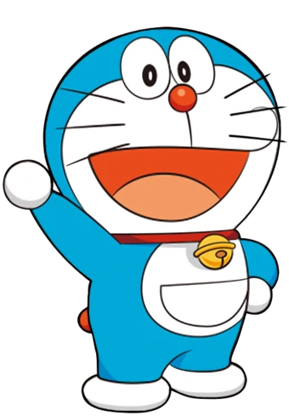
Doraemon ____ short.
Is/ has
is

Slide 13
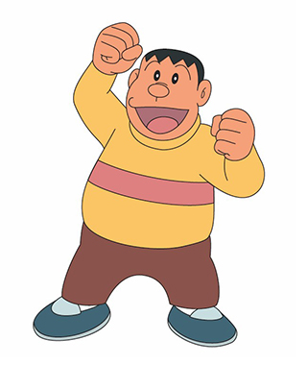
Jaian is _____.
Small / big
big

Slide 14
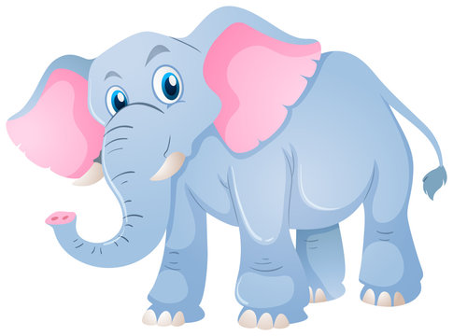
The elephant _____ big ears.
Is/ has
has

Slide 15
The elephant has long _____.
Nose / Eyes
nose

Slide 16
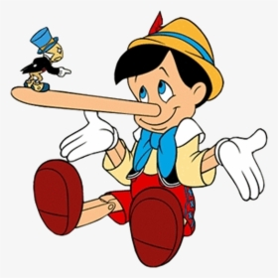
Pinocchio has a _____ nose.
Short / long
long

Slide 17
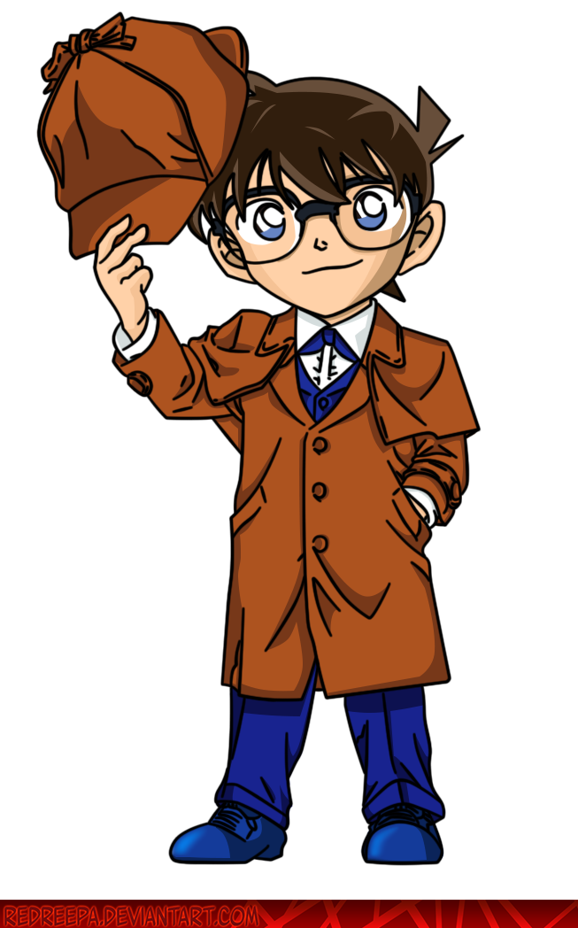
Conan _____ short hair.
Is/ has
has

Slide 18
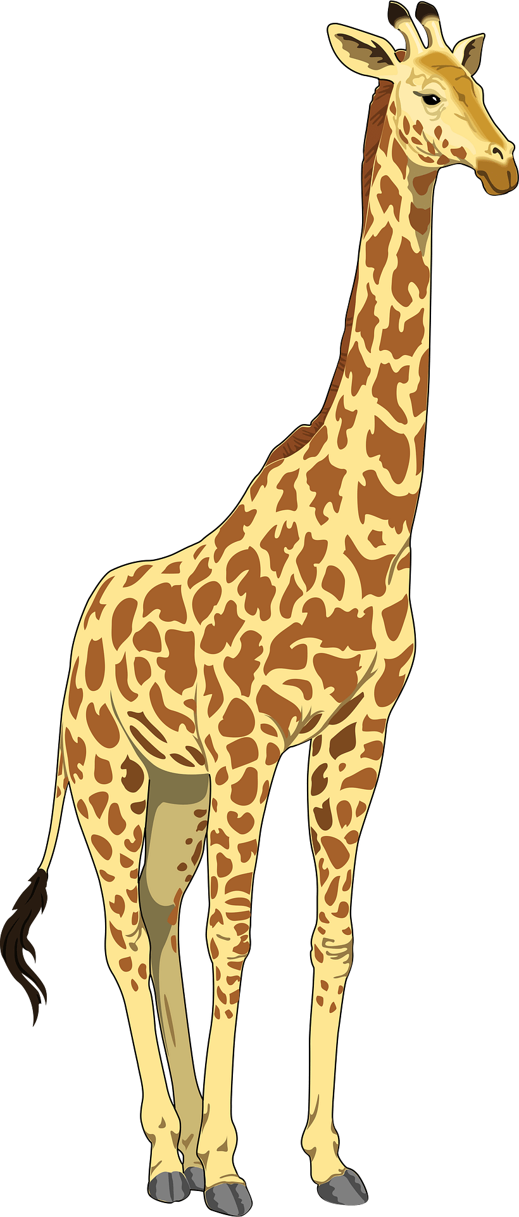
The giraffe _________.
Is tall / has tall
Is tall

Slide 19
big
very tall
long hair
a round face and big eyes

Slide 20
There are + (số người ) people in my family.
My father is + ( số tuổi)/ đặc điểm. He has + ( đặc điểm).
My mother is ____. She has ____.
My sister/ brother is ____. She/ he has_________
I love my family!
Notes:
Teacher adds a picture and details about T's family

