Slide 1
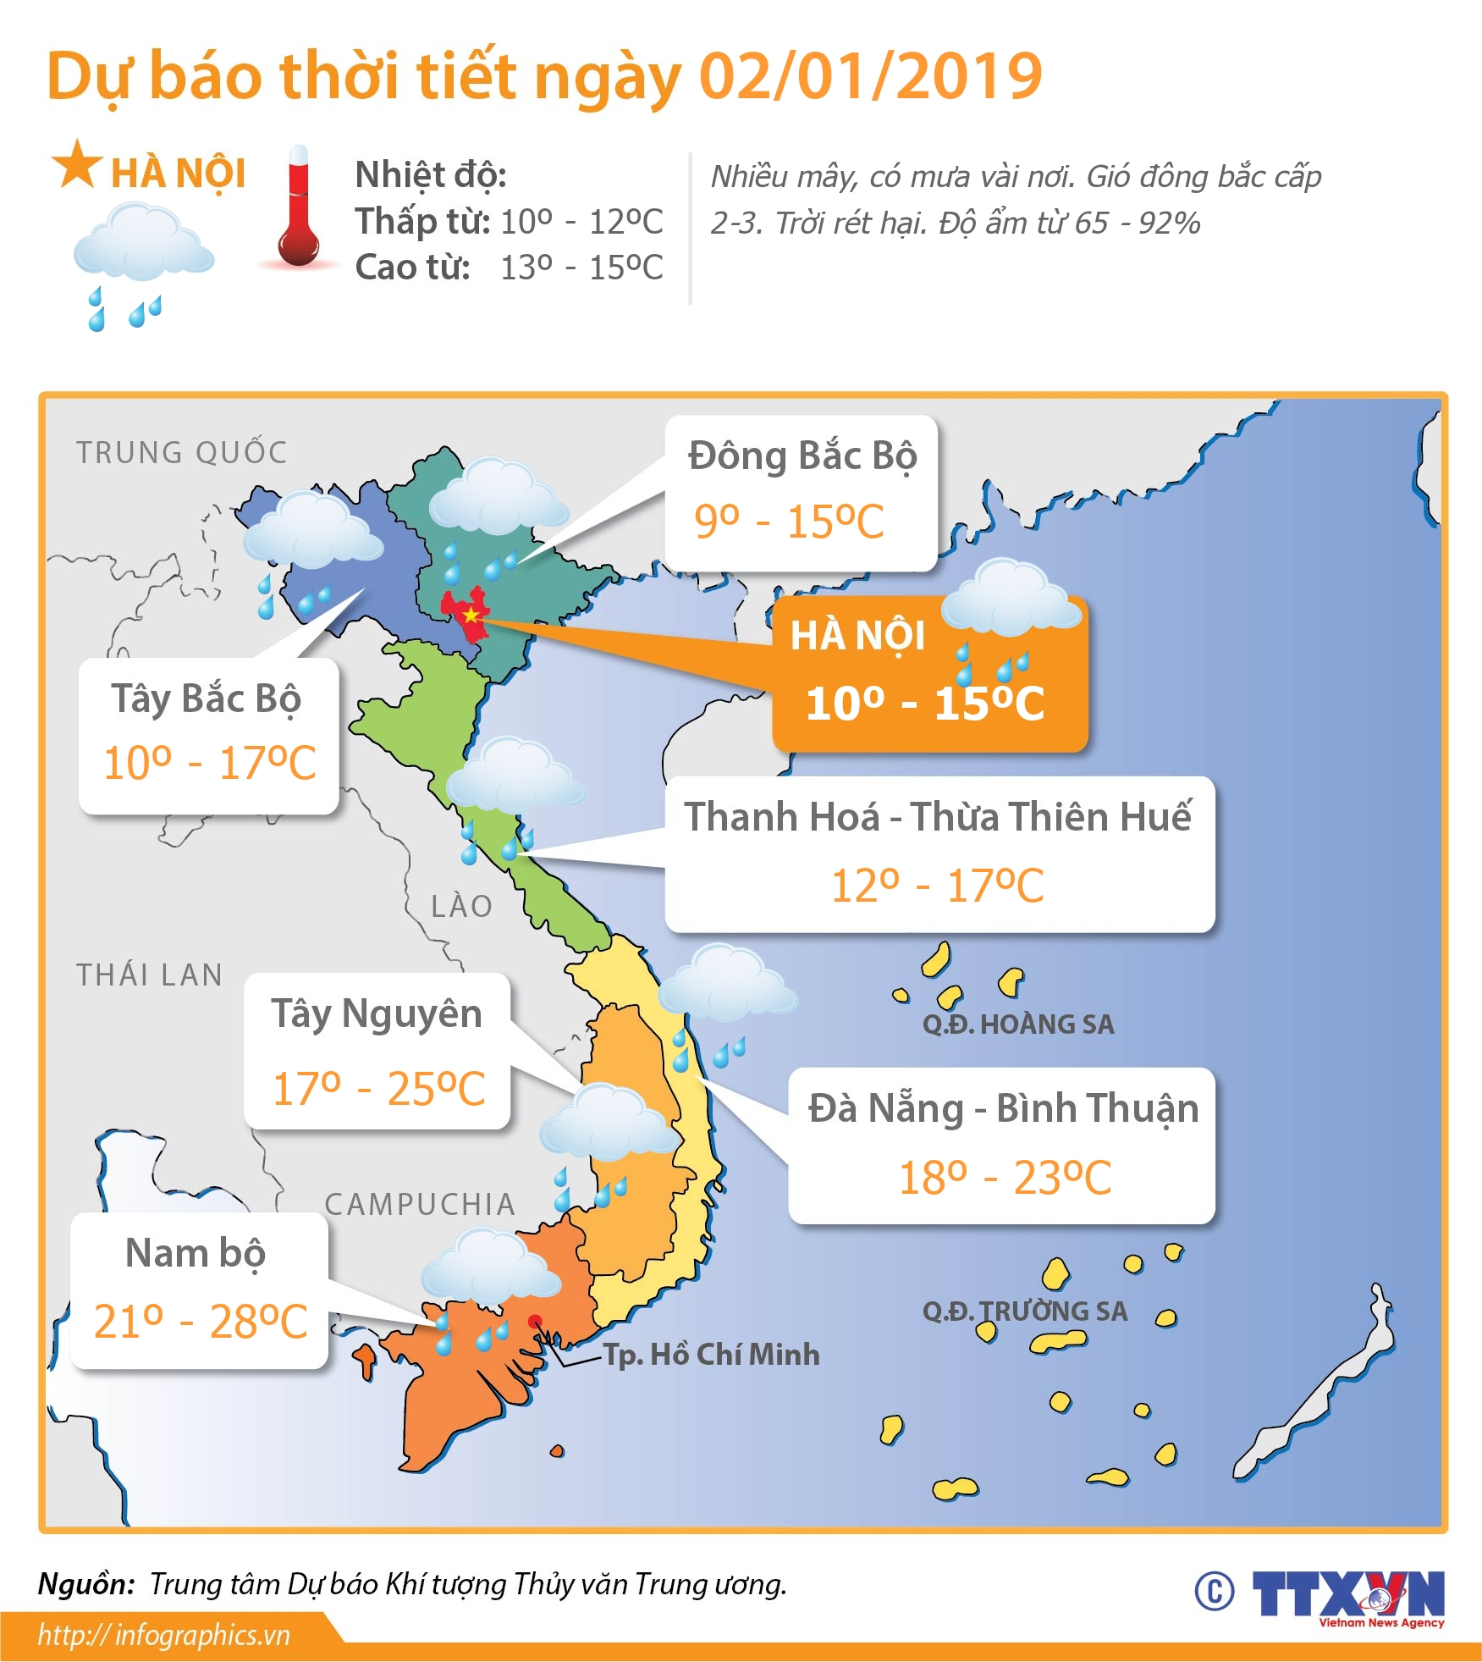
UNIT 16 WEATHER (lesson 3/p4,5,6)

Slide 2
1/Warm-up and review
*Dance: Roll your hand( video) *Game: What’s missing ?(6pictures about weather)

Slide 4
1.What was the weather like yesterday ?
1
2
3
4
2. What is the weather like today ?
3. Where is Kate now ?
4.Where is Jim now

Slide 5
Checks answers by game : lucky spin.
LUCKY SPIN

Slide 8
(Discuss - interview)
1.The weather is lovely today .
2.My family go shopping.
3.My parents want to buy some clothes.
4.I want to buy some school things.
5.My brother wants to buy some drinks.

Slide 9
6.Project
Task 1.
Talk about the weather as table model.
Task 2.
Talk about the weather forecast.
( on TV)

