Slide 1
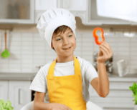
Review
1
REVIEW 1

Slide 2
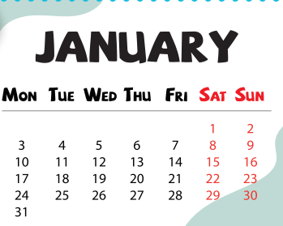
Choose the odd.

Slide 3
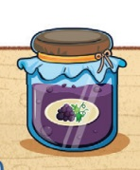
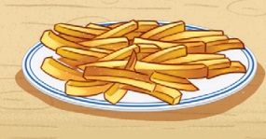
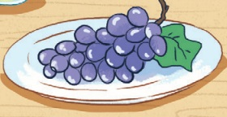
Choose the odd.

Slide 4
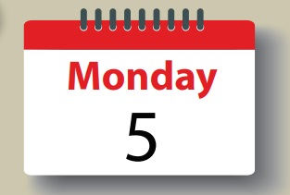
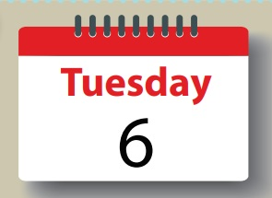
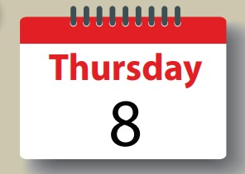
Choose the odd.

Slide 5
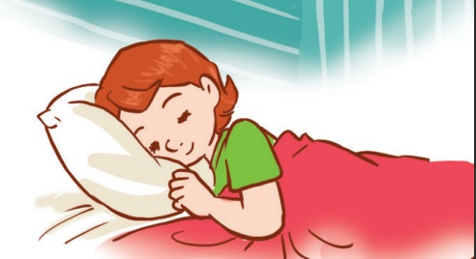
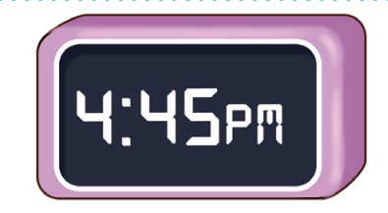
Choose the odd.

Slide 6
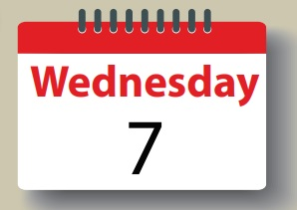
Choose the odd.

Slide 7
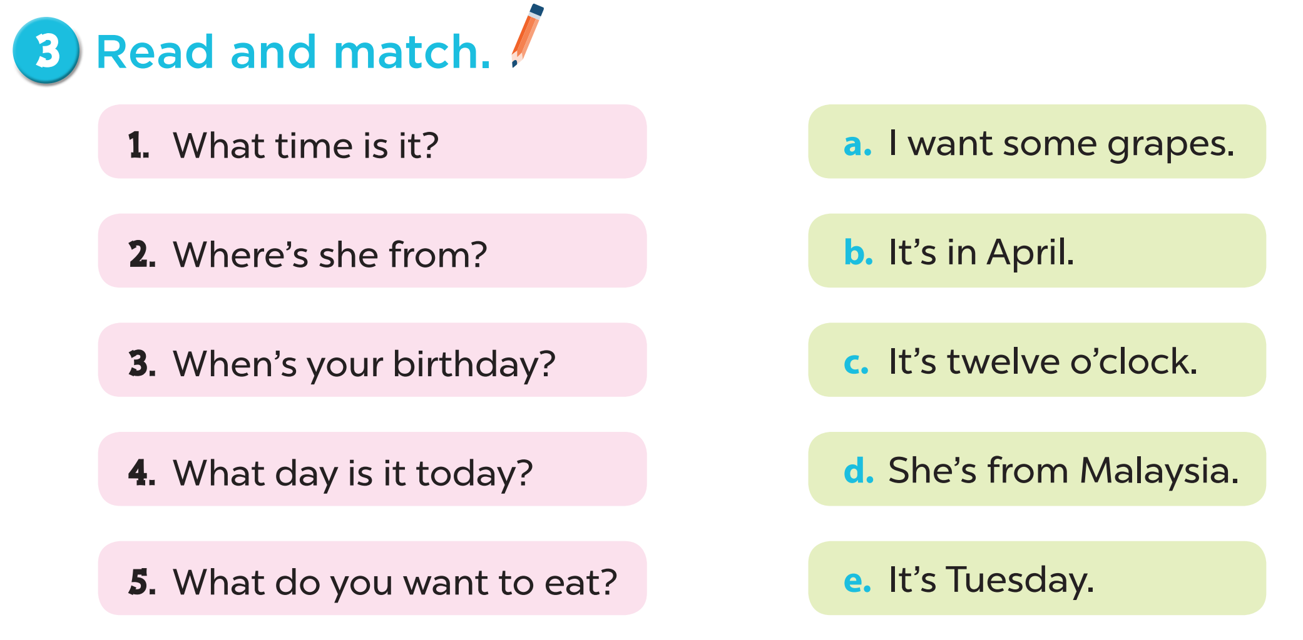
Notes:
Key: 1. c 2. d 3. b 4. e 5. a

Slide 8
Read the text.

Slide 9
Let’s check.
Australia
Fridays
guitar
Saturdays

Slide 10
Reading comprehension

Slide 11
Where is Ben from?
He’s from Australia.

Slide 12
How many days does Ben go to school?
Five days
(from Monday to Friday).

Slide 13
Can he play football?
Yes, he can.

Slide 14
Can he play the guitar?
Yes, he can.

Slide 15
Does he go to school on Saturdays?
No, he doesn’t.

Slide 16
04
Let’s write.

Slide 17
America
April
sing
draw
roller skate

