Slide 2
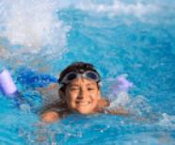
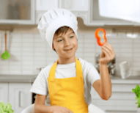
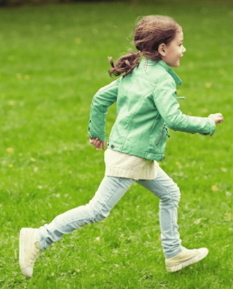
5
My hobbies
LESSON 3

Slide 3
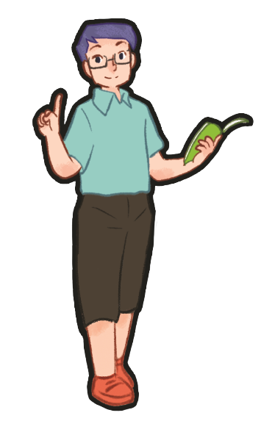
Game
Warm-up
Notes:
Review Numbers 1-10 and Alphabet

Slide 4
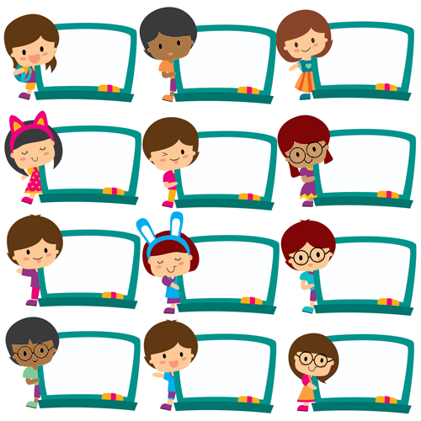
dancing
cooking
painting
swimming
dancing
painting
cooking
cooking
dancing
dancing
swimming
swimming
Notes:
- Greet the class. Divide the class into two groups to take turns to sing the song
My hobby on page 37. One group sings the first verse. The other sings the
second verse.
- T asks pupils to write 1 hobby on their board and when they hear the word of their hobby in the song, they will stand up and raise their board.

Slide 5
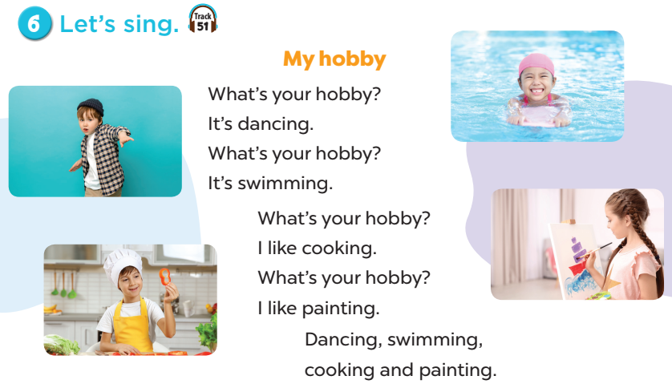
Notes:
- Greet the class. Divide the class into two groups to take turns to sing the song
My hobby on page 37. One group sings the first verse. The other sings the
second verse.
- T asks pupils to write 1 hobby on their board and when they hear the word of their hobby in the song, they will stand up and raise their board.

Slide 6
1. Listen and repeat.
Notes:
Review Numbers 1-10 and Alphabet

Slide 7
Notes:
Step 1: Draw pupils’ attention to the letter p, the word painting and the sentence I like painting.
Play the recording and encourage pupils to point to the letter / word / sentence while listening.
Step 2: Play the recording again for pupils to listen and repeat. Do this several times until
pupils feel confident. Correct their pronunciation where necessary and praise them if their
pronunciation is good.
Step 3: Repeat Steps 1 and 2 for the letter r.

Slide 8
2. Listen and circle.
Notes:
Review Numbers 1-10 and Alphabet

Slide 9
Notes:
Step 1: Draw pupils’ attention to the exchanges and the answer options. Tell pupils about the
activity. Play the recording for pupils to listen. Play the recording again for them to do the task.
Play the recording a third time for them to check the answers.
Step 2: Tell pupils to swap books with a partner then check the answers as a class. Write the
correct answers on the board for pupils to correct their answers.
Step 3: Play the recording again for pupils to check their answers again.
Extension: Invite one or two pupils to stand up, listen to and repeat the exchanges.

Slide 10
4. Read and tick.

Slide 11
✔
✔
✔
✔
Notes:
Step 1: Tell pupils about the activity. Pupils should read the communicative context in silence,
pay attention to the sentences and complete the table by ticking the correct boxes.
Step 2: Give the class time to do the task. Circulate round the classroom during the activity and
offer help where necessary.
Step 3: Check the answers as a class. Get pupils to swap and correct their answers in pairs.

Slide 12
5. Let’s write.

Slide 13
Notes:
Step 1: Explain to the class the goal of this activity. Show them how to complete the task. They
should read each gapped sentence, guess the missing information and complete the sentence
with their own personal information. Check comprehension and give feedback.
Step 2: Give pupils time to write their answers. Circulate round the classroom during the
activity and offer help where necessary.
Step 3: Ask pupils to swap and correct their answers in pairs. Check the answers as a class.
Extension: If time allows, invite a pupil to stand up and read his / her completed sentences.
The rest of the class listen, and cheer or clap their hands if the performers do a good job.

Slide 14
Game time

Slide 15
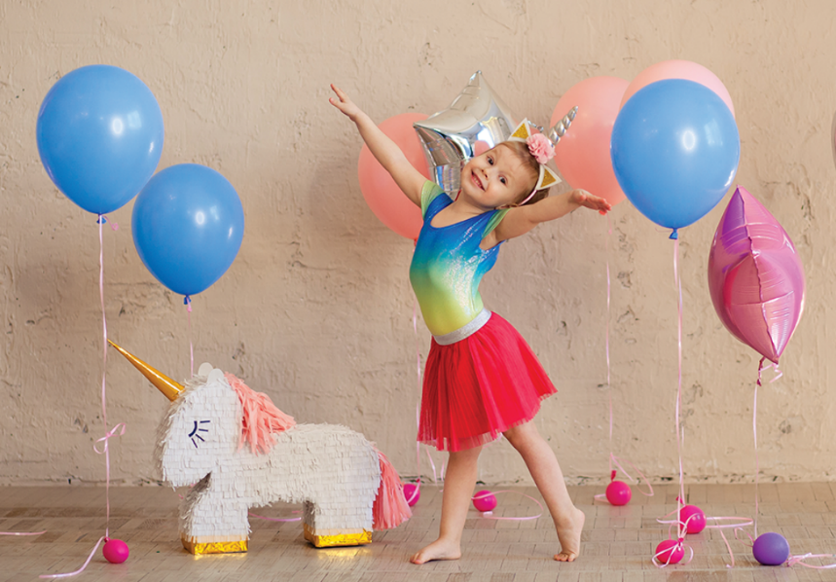
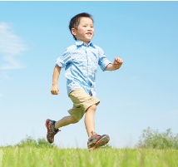
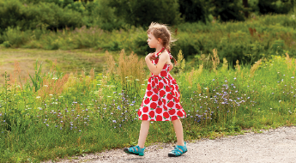
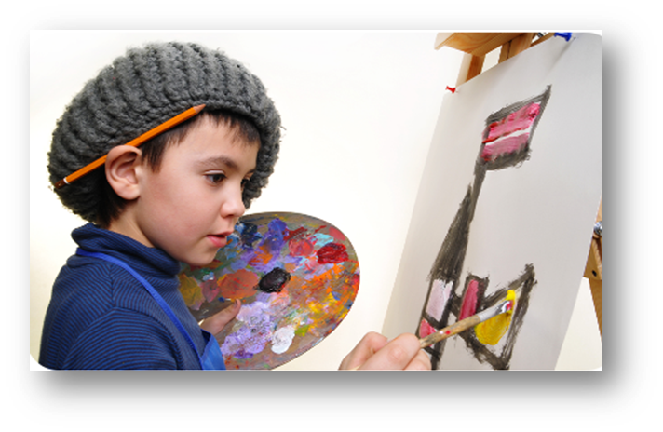
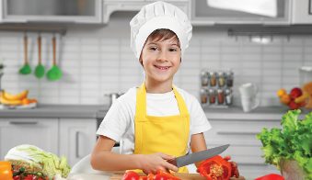
HOBBIES
Notes:
- T review words of hobbies by showing pictures.
- T divides class into 2 teams (Boys and Girls).
- T asks 1 pupil of each team come to the board and face to the others (they can’t see the pictures and questions on ppt at the beginning).
- When T says GO, 2 pupils will turn back, look at the screen, and say out loud the answers (A-B-C-D-E-F) as quickly as they can.
- The first one to say the letter and the word is the winner.

Slide 16
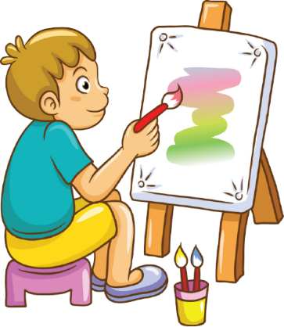
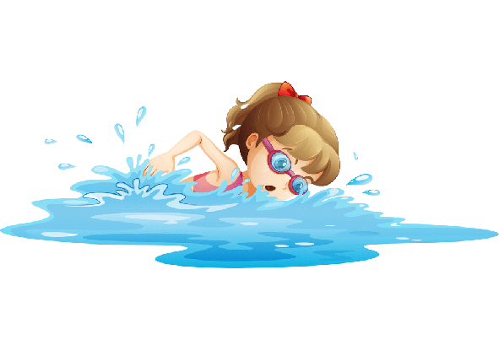
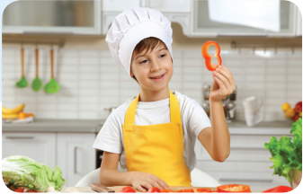
1
2
3
- What’s your hobby?
- It’s running.
- What’s your hobby?
- I like singing.
4
5
6
- What’s your hobby?
- It’s swimming.
7
8
9
- What’s your hobby?
- I like walking.
10
11
12
- What’s your hobby?
- It’s painting.
- What’s your hobby?
- I like cooking.
Notes:
Game: Matching
- T divides class into 2 teams (Boys and Girls).
- Pupils in 2 teams take turn to open the boxes to match the questions and answers to their pictures (open: click the numbers - close: click the red signs).
- Pupils of each team will get points if their matching is correct.
- Review hobbies: painting, cooking, running, walking, singing, swimming.

Slide 17
Fun corner and Wrap-up

Slide 18
SPELLING HOBBIES
Notes:
Game: Spelling
- T divides class into 2 teams (Boys and Girls).
- Pupils in 2 teams listen to the recording spelling of hobbies
- Pupils of each team will get points if they choose correct answers.
- Review hobbies: painting, cooking, running, walking, singing, swimming.

Slide 19
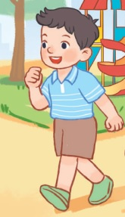
How do you spell this hobby?
Click here
r u n n i n g
w a l k i n g
c o o k i n g
NEXT

Slide 20
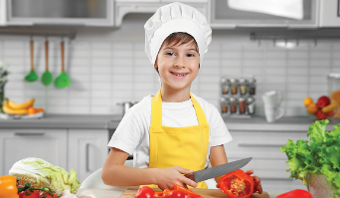
How do you spell this hobby?
Click here
d a n c i n g
s w i m m i n g
c o o k i n g
NEXT

Slide 21
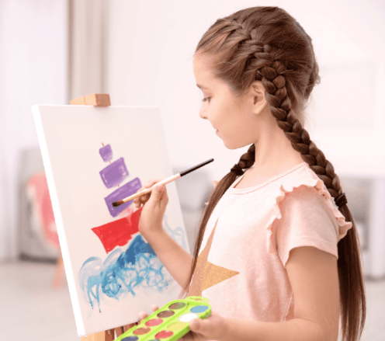
How do you spell this hobby?
Click here
p a i n t i n g
s i n g i n g
d r a w i n g
NEXT

Slide 22
How do you spell this hobby?
Click here
d a n c i n g
r u n n i n g
c o o k i n g
NEXT

Slide 23
How do you spell this hobby?
Click here
p a i n t i n g
d a n c i n g
s i n g i n g
NEXT

Slide 24
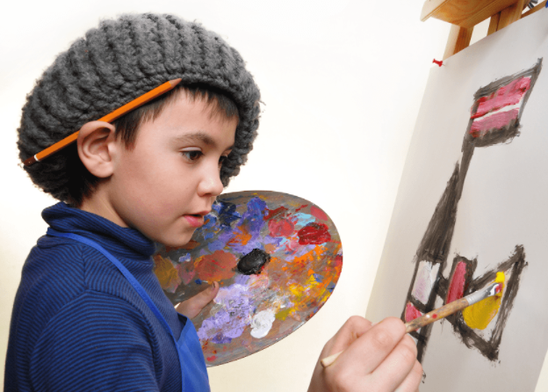
How do you spell this hobby?
Click here
d a n c i n g
d r a w i n g
w a l k i n g
NEXT

Slide 25
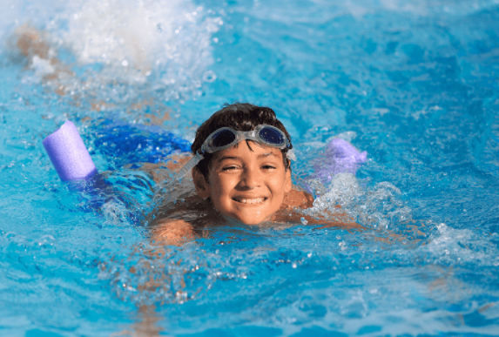
How do you spell this hobby?
Click here
w a l k i n g
s i n g i n g
s w i m m i n g
NEXT

Slide 26
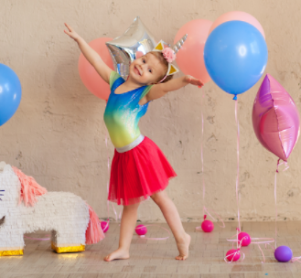
How do you spell this hobby?
Click here
p a i n t i n g
d a n c i n g
c o o k i n g
NEXT

Slide 27
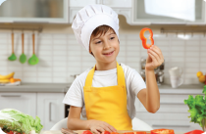
Notes:
T shows 4 pictures on the board and asks pupils to repeat -> Wrap up.

