Slide 1

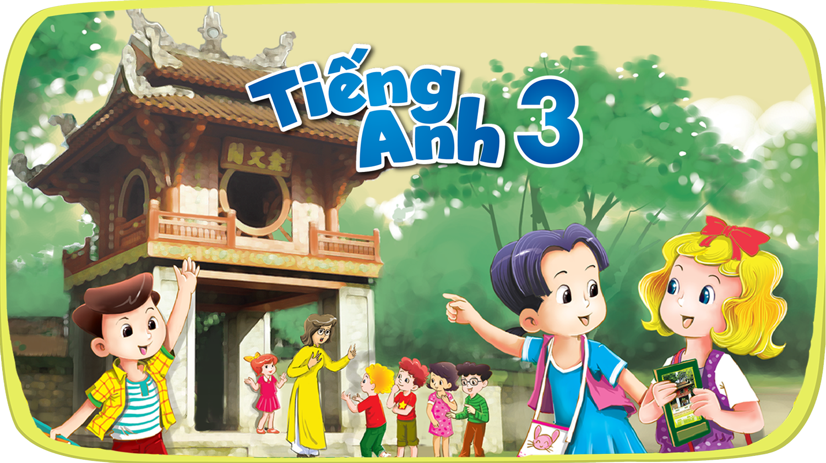


Slide 2



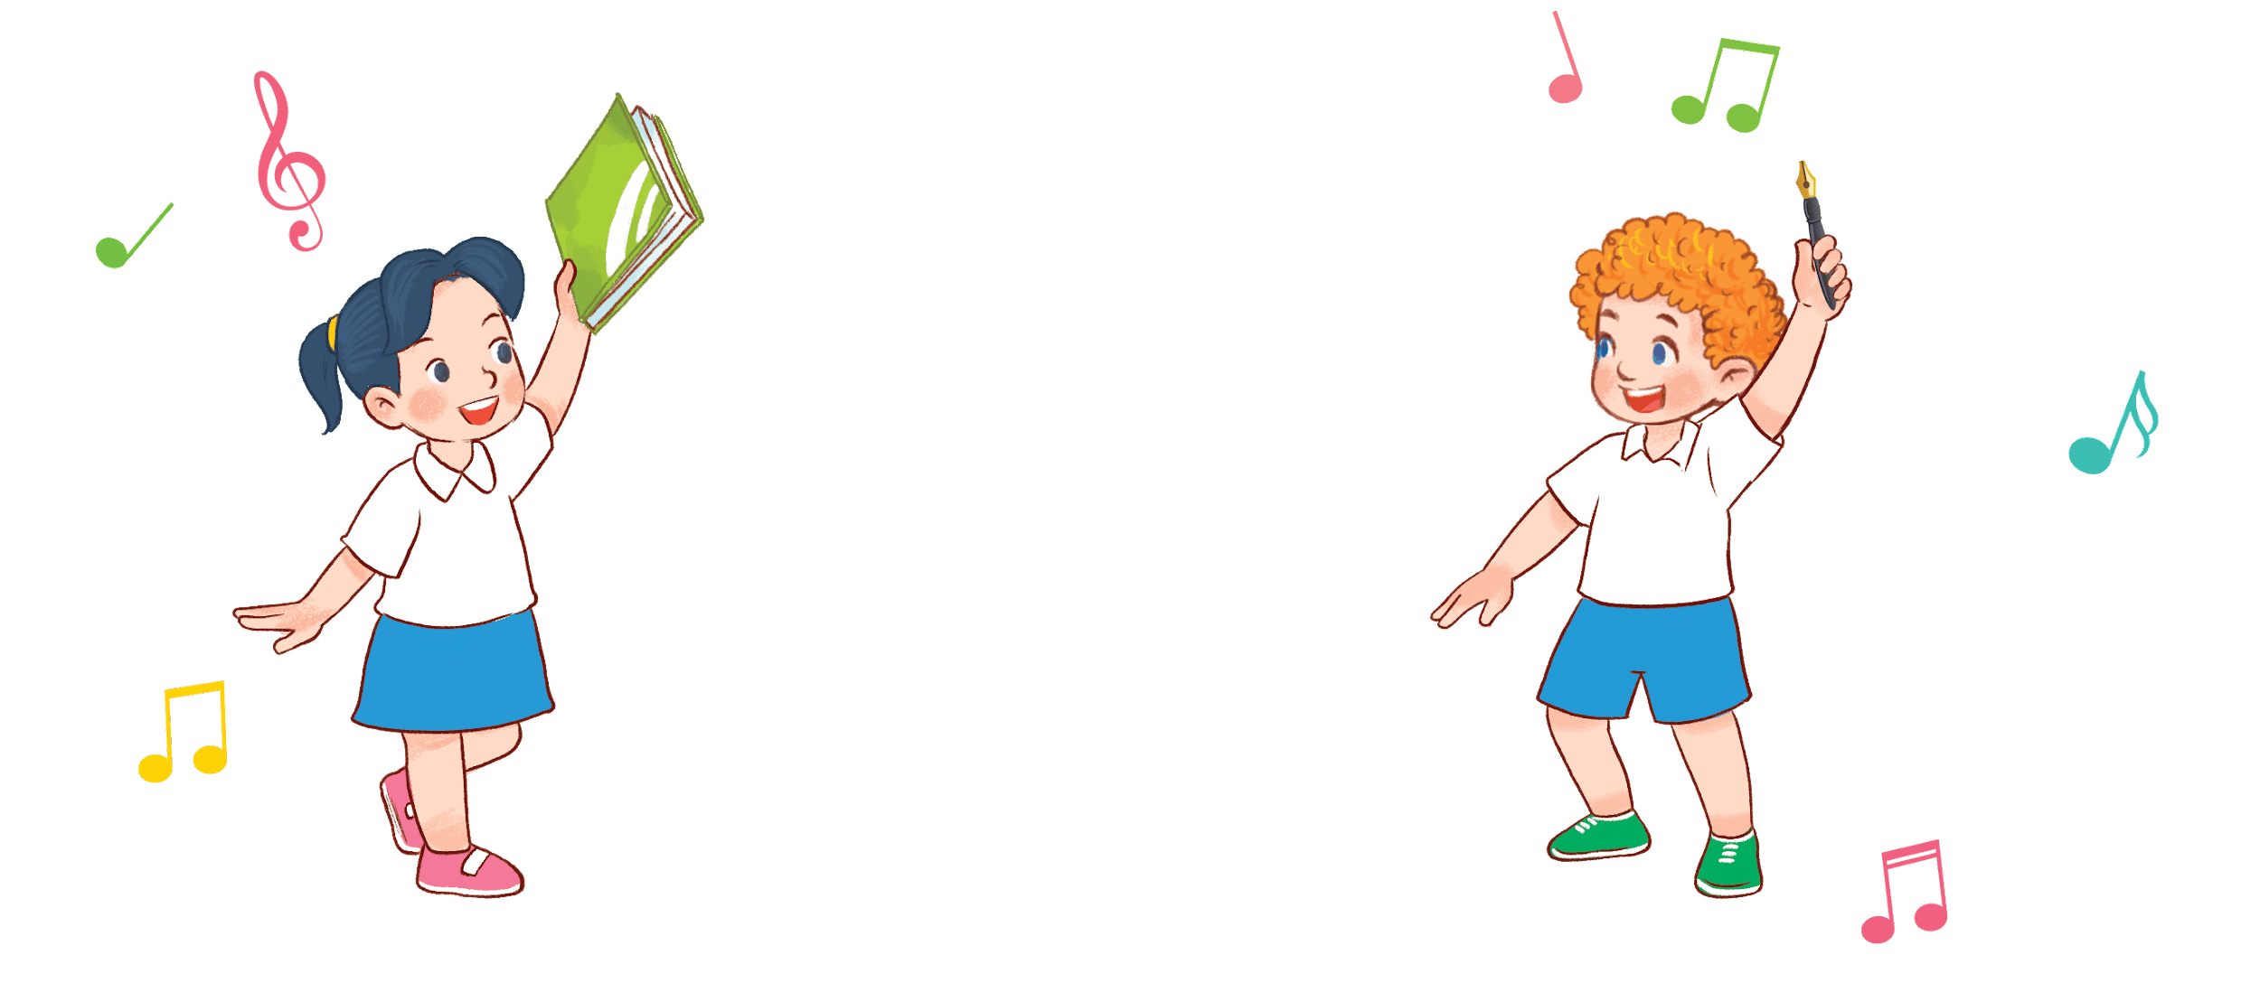

8
3
Period 5

Slide 3
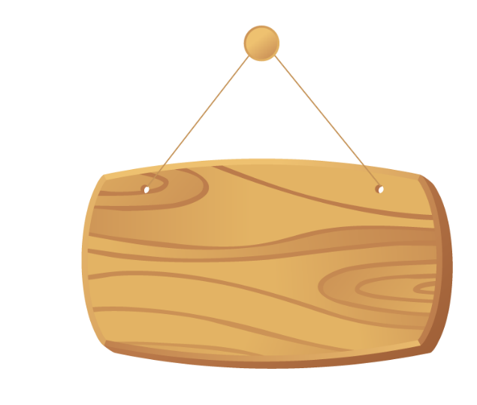

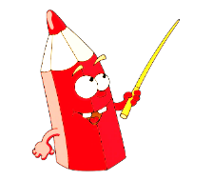
①
Warm-up and review
Contents
②
Listen and repeat.
③
Listen and circle.
④
Let’s chant.
⑤
Fun corner and wrap-up

Slide 4

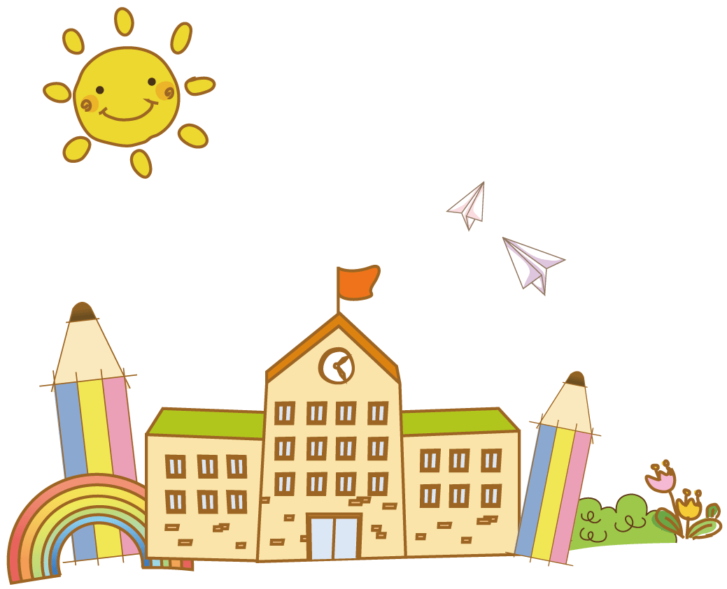
①
Warm-up and review

Slide 5
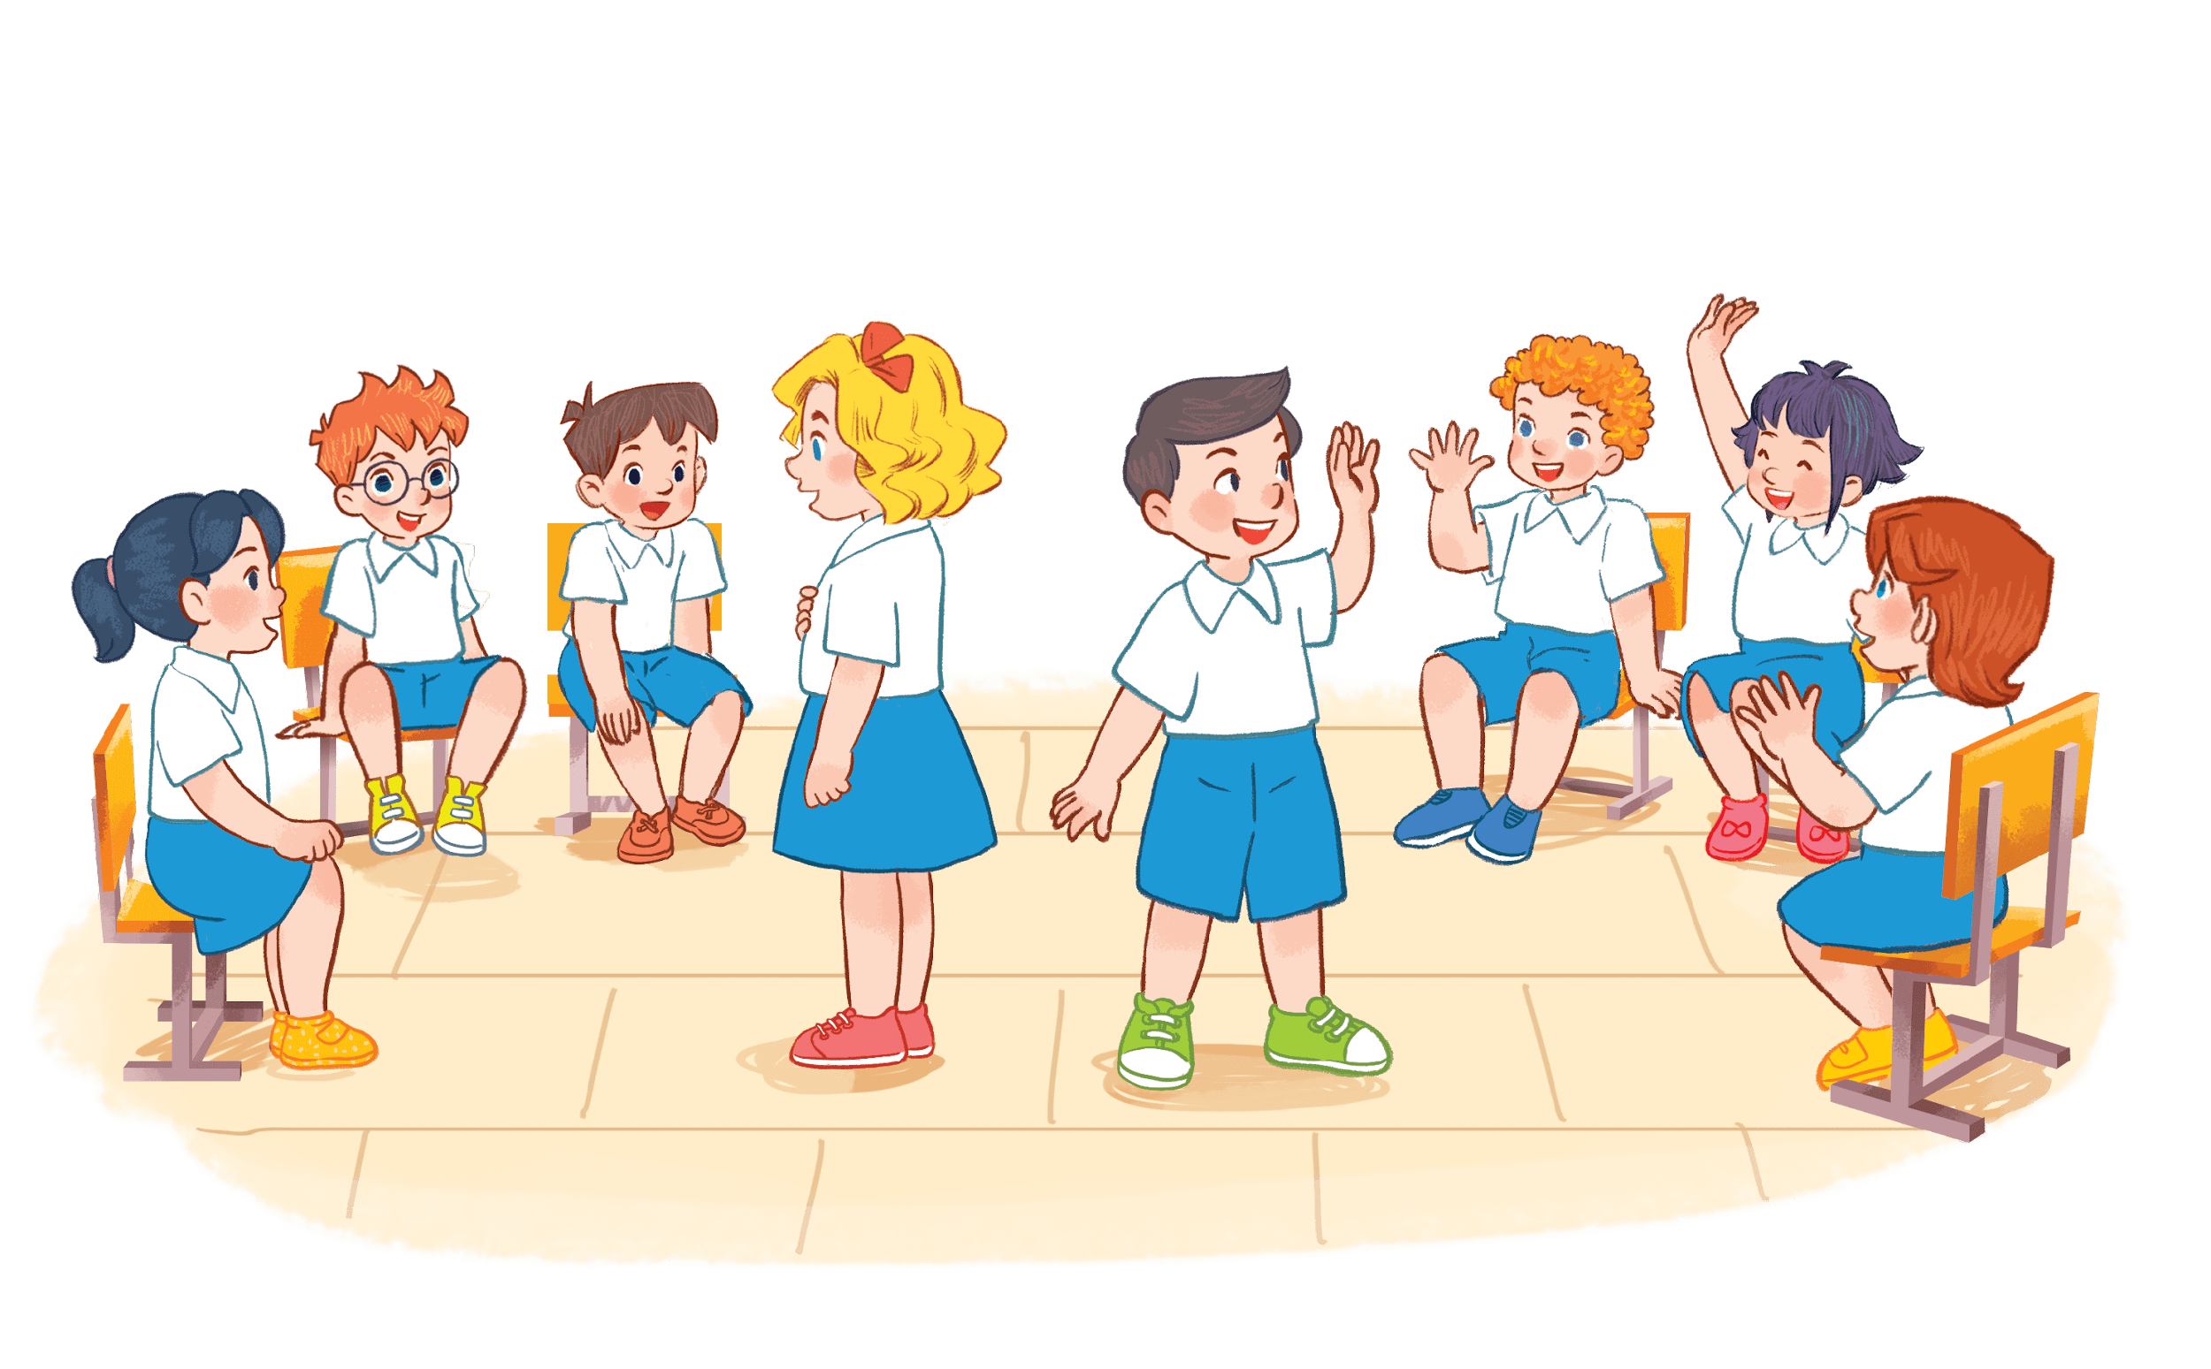


I have a book.
Notes:
Game: Pass the school things.
Review the previous lesson by having the class pass the school things (a book, a pencil, a pen…) while playing the music. When the music stops, those who have the school things have to say the sentence: I have a …

Slide 6

I have a pen.

Slide 7
②
Listen and repeat.

Slide 8
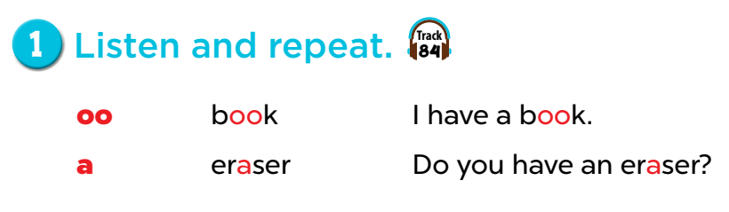

Slide 9
Game: Listen and choose!
Notes:
Divide the class into 2 groups.
Let the pupils listen to the recording, then choose the correct moving shapes.

Slide 10

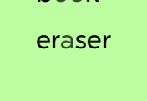


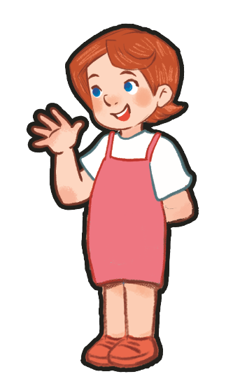


Slide 11


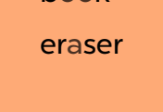

Slide 14
Do you have an eraser?
book
eraser
I have a book.

Slide 15
I have a book.
Do you have an eraser?
eraser
a

Slide 16
③
Listen and circle.

Slide 17
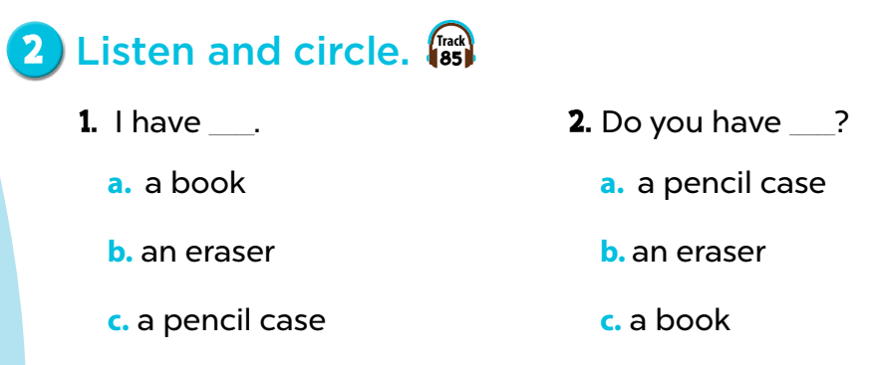

Slide 18
Game: Listen and tick the box!
Notes:
Play the recording for pupils to choose a correct answer and tick the box.

Slide 19
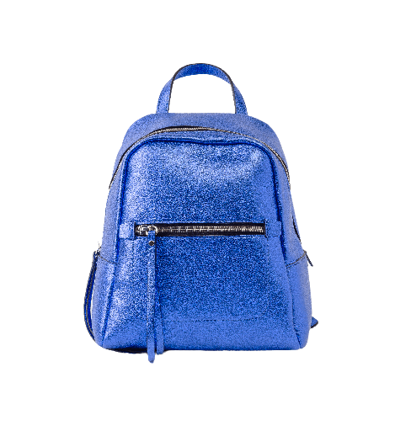
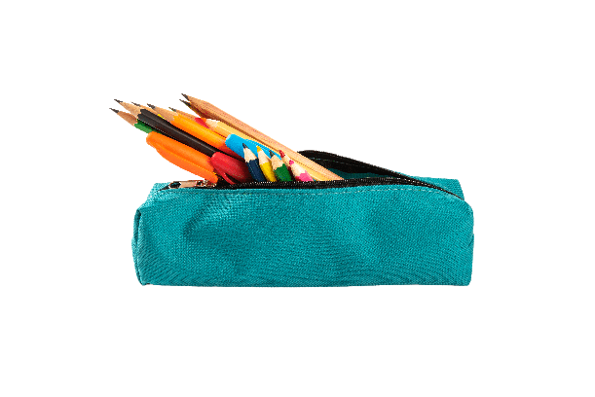
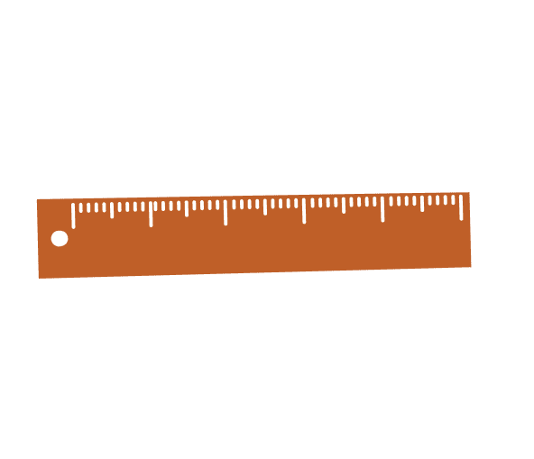

Good job!
✔
A
B
C

Slide 20


Well done!
✔
A
B
C

Slide 21
Way to go!
✔
A
B
C

Slide 22
Great job!
✔
A
B
C

Slide 23
Way to go!
✔
A
B
C

Slide 24
Great job!
✔
A
B
C

Slide 25
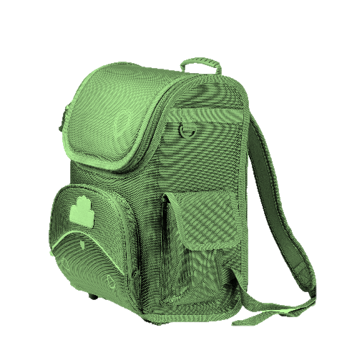
Well done!
✔
A
B
C

Slide 26
④
Let’s chant.
.

Slide 27
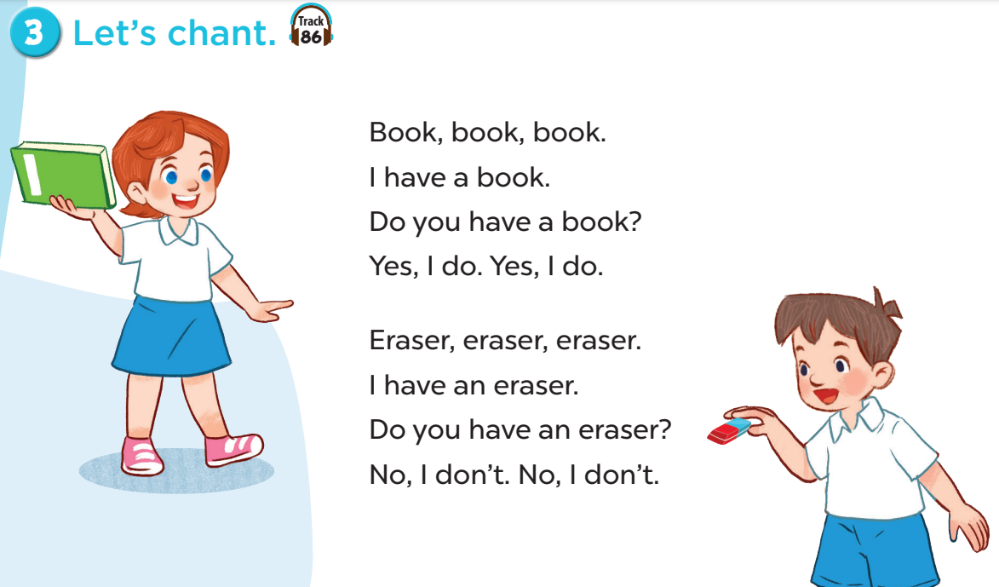

Slide 28
⑤
Fun corner and wrap-up

Slide 29
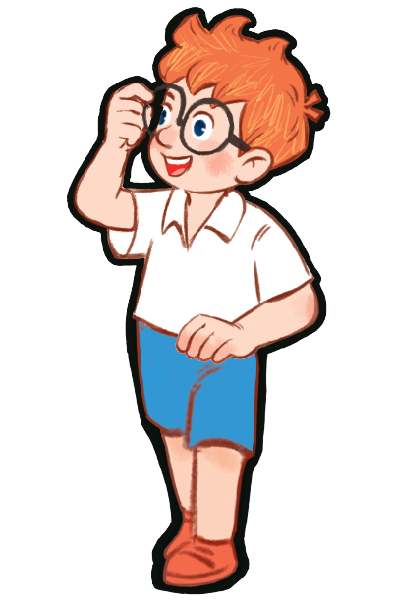
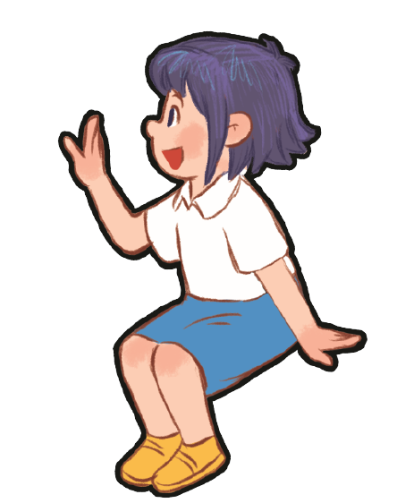


Book, book, book.
I have a book.
Do you have a book?
Yes, I do. Yes, I do.
Notes:
Game: Show me!
- Divide the class into four groups. Ask pupils to say the chant again, then show their school things as they say the chant.
- T can change the name of school things for pupils to chant and show theirs as they chant.

Slide 30
Eraser, eraser, eraser.
I have an eraser.
Do you have an eraser?
No, I don’t.
No, I don’t.

Slide 31
Bag, bag, bag.
I have a bag.
Do you have a bag?
Yes, I do. Yes, I do.

Slide 32
Ruler, ruler, ruler.
I have a ruler. Do you have a ruler?
No, I don’t.
No, I don’t.

Slide 33
Pencil case, pencil case, pencil case.
I have a pencil case.
Do you have a pencil case?
Yes, I do. Yes, I do.

Slide 34
Pen, pen, pen.
I have a pen.
Do you have a pen?
Yes, I do. Yes, I do.

Slide 35
Pencil, pencil, pencil.
I have a pencil.
Do you have a pencil?
Yes, I do. Yes, I do.

Slide 36

Website: sachmem.vn
Fanpage: www.facebook.com/sachmem.vn

