Slide 1
Unit 6:
Our school facilities
QUANG TRUNG PRIMARY SCHOOL
Lesson 1 – Period 2
Teacher: Bui Thi Minh Ngoc

Slide 2
Table of contents
Warm-up
Guessing game
01
02
03
Activity 6
Let’s play.
04
Activity 4
Listen and number.
Game
05
Activity 5
Look, complete
and read.

Slide 3
01
Warm-up
Guessing game

Slide 4

school
Remove

Slide 5

city
Remove

Slide 6

village
Remove

Slide 7

mountains
Remove

Slide 8
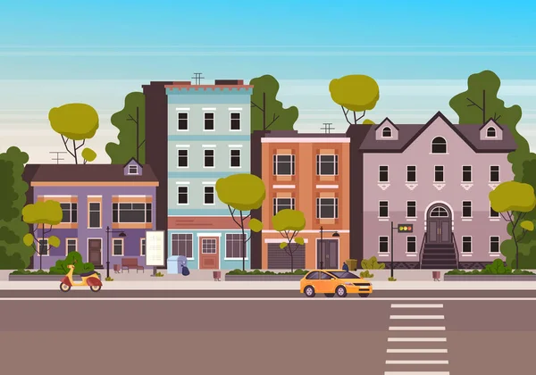
town
Remove

Slide 9
02
Activity 4
Listen and number.

Slide 10
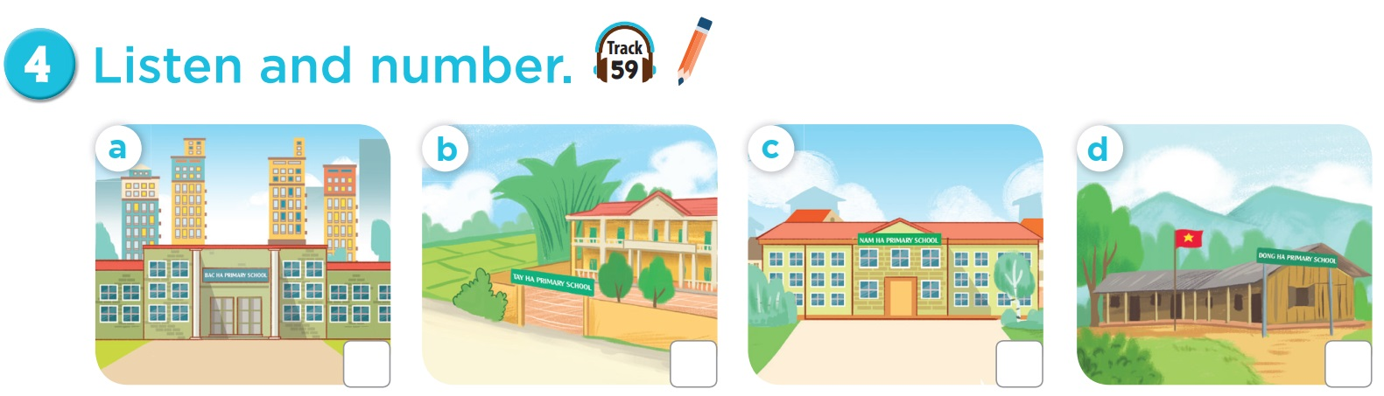

3
4
1
2

Slide 11
03
Activity 5
Look, complete and read.

Slide 12
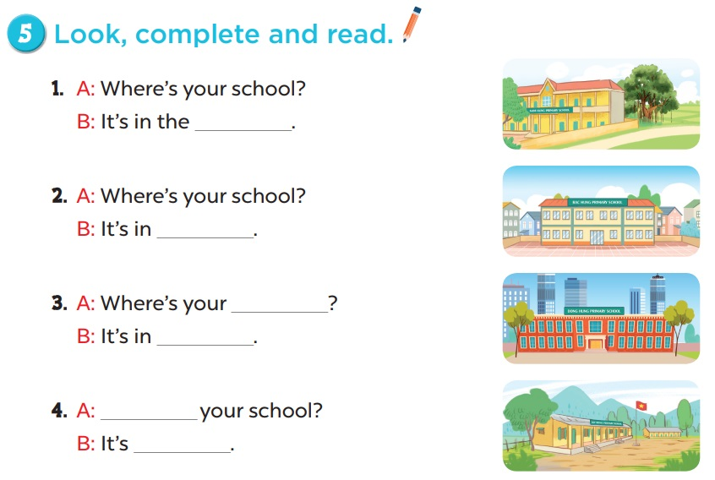

Slide 13
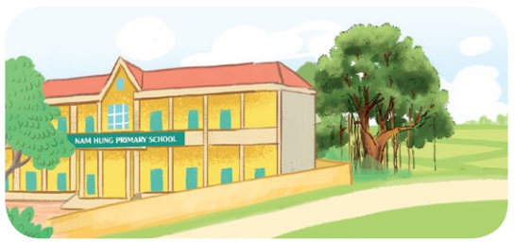
A: Where’s your school?
B: It’s in the ______.
village

Slide 14

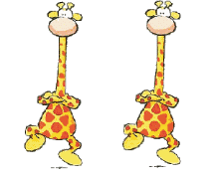

Congratulations

Slide 15

A: Where’s your school?
B: It’s in _______.
the town
Notes:
Câu này yêu cầu học sinh đọc câu hỏi và sau đó có thể cho nó chọn một đứa khác để trả lời.

Slide 16
CongratulationS!

Slide 17

school
A: Where’s your _______?
B: It’s in _______.
the city
Notes:
Câu này có thể hỏi học sinh là What is it? trước. Và sau đó yêu cầu chúng nó đánh vần ạ.

Slide 18
CongratulationS!

Slide 19
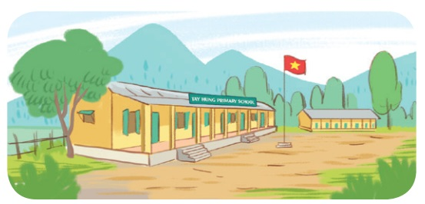
A: ______ your school?
B: It’s ______________.
Where’s
in the mountains

Slide 20
Congratulation

Slide 21
04
Activity 6
Let’s play.

Slide 22
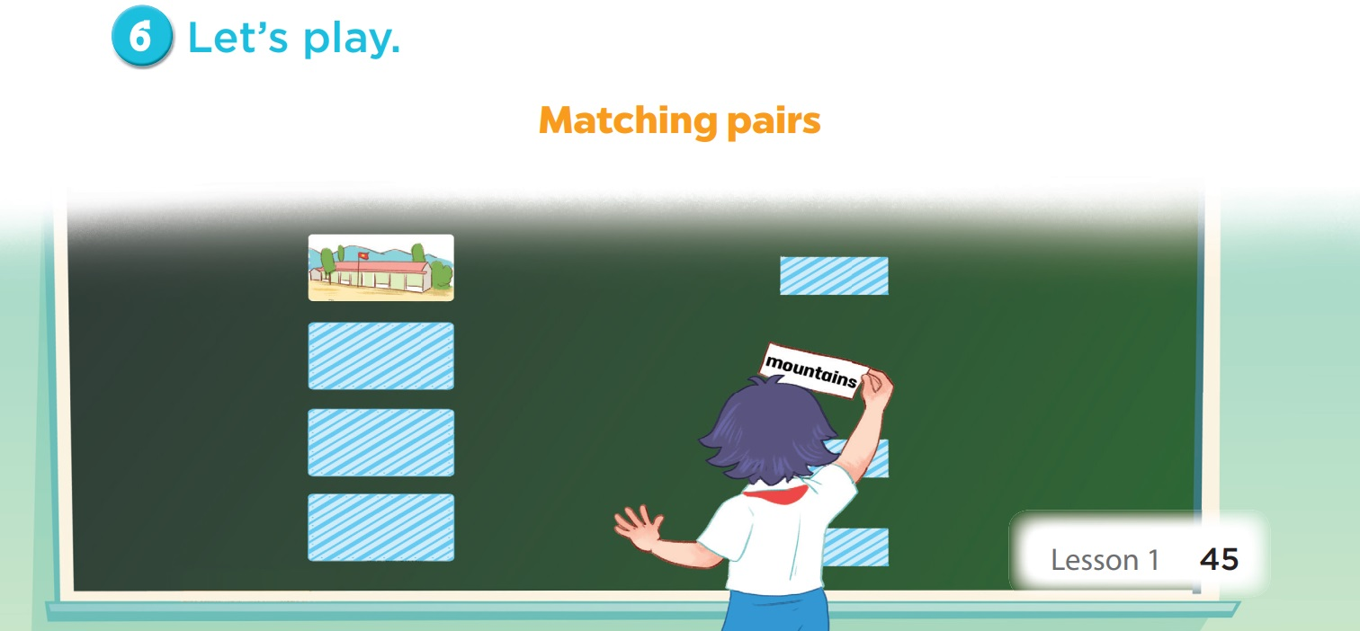

Slide 23
05
Game

Slide 24

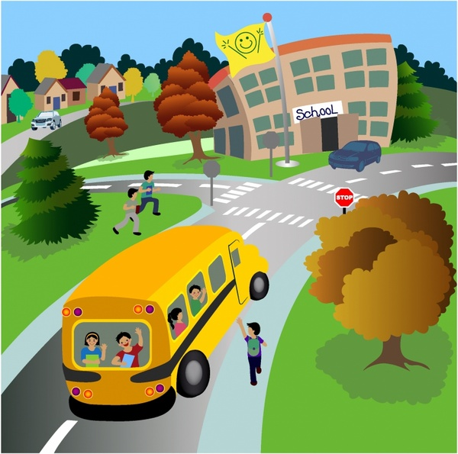
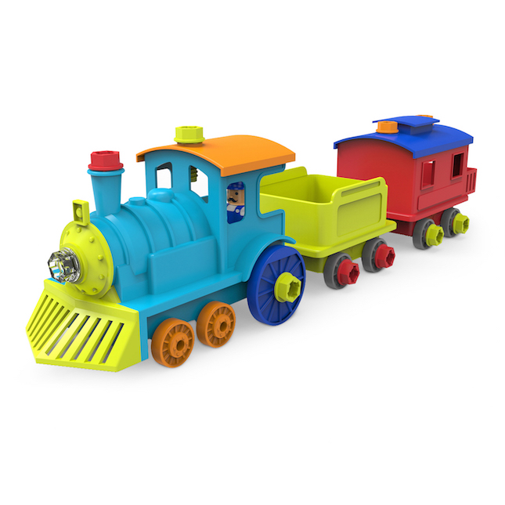


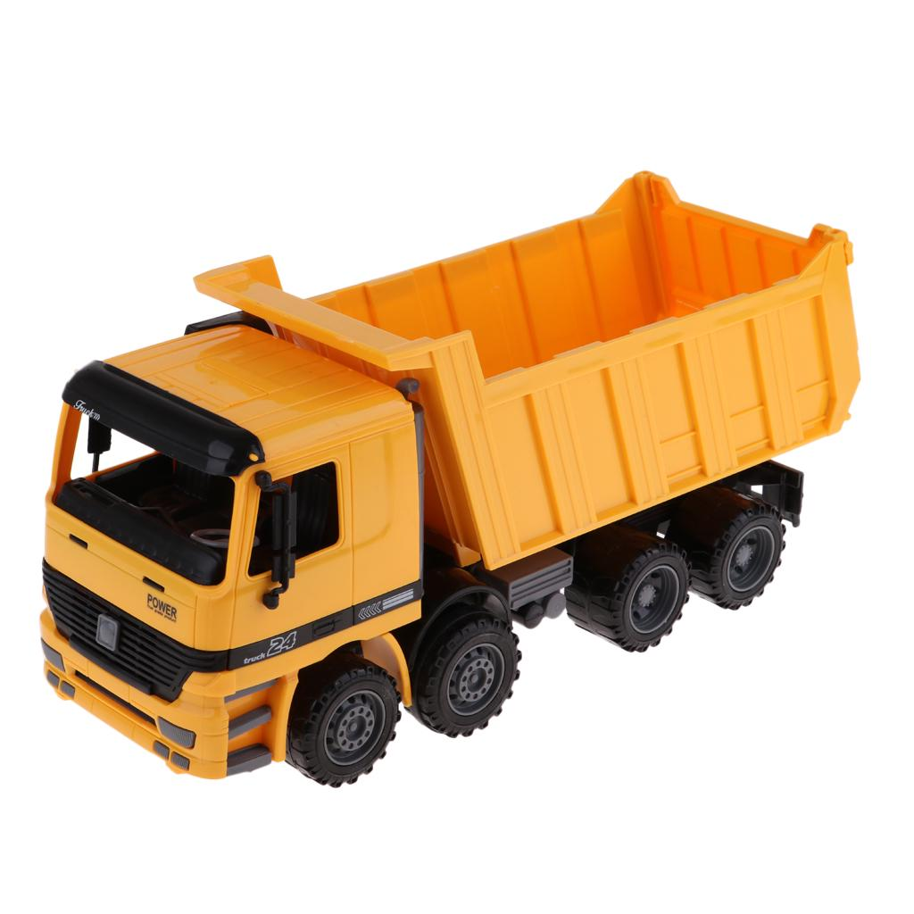
1
2
3
5
school
mountains
4
city
6
7
8
10
town
village
9

