Slide 1
6
Our school
LESSON 2 - PERIOD 4
Teacher: Duong Thi Bich Ngoc
Quang Trung Primary School

Slide 2
WARM-UP AND REVIEW

Slide 3
LISTEN AND NUMBER.

Slide 4
Listen and number.
4
2
1
3

Slide 5
READ AND MATCH.

Slide 6
Look and read aloud.

Slide 8
LET’S PLAY.

Slide 10
FUN CORNER

Slide 11
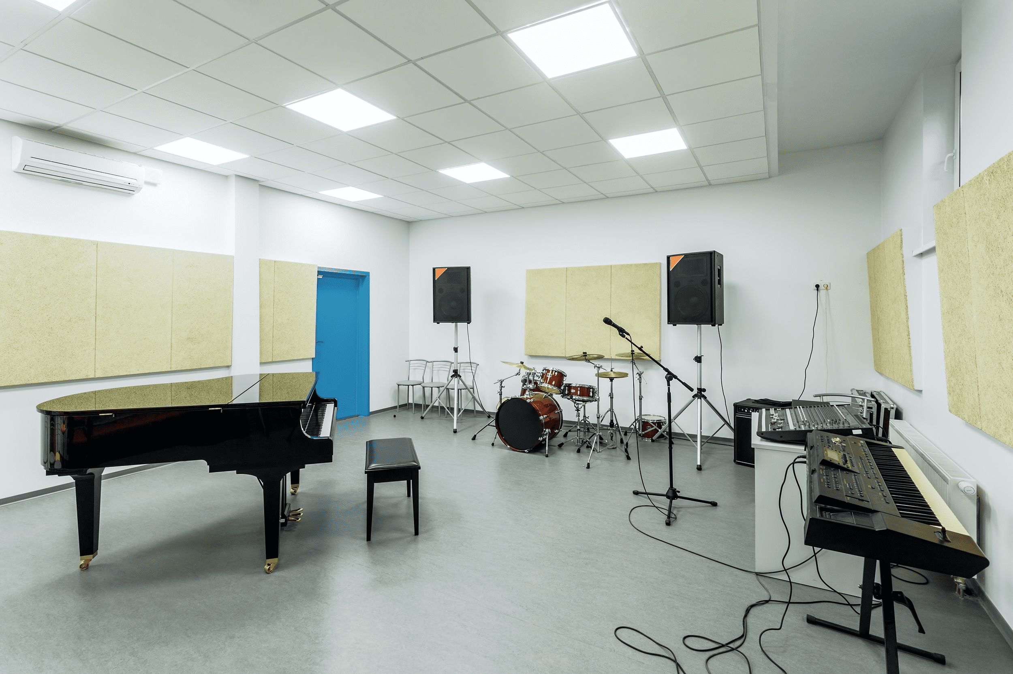
Read and say the correct answer.
We like singing songs.
Let’s go to the music room.

Slide 12
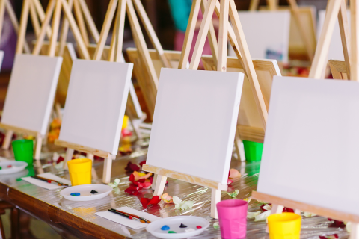
Read and say the correct answer.
I like drawing.
Let’s go to the art room.

Slide 13
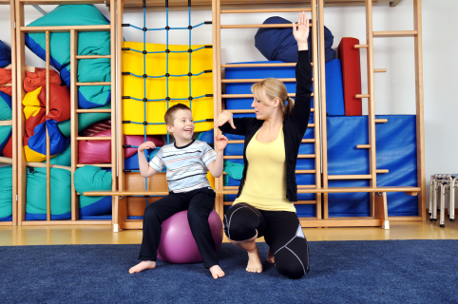
Read and say the correct answer.
We like playing sports.
Let’s go to the gym.

