Slide 1



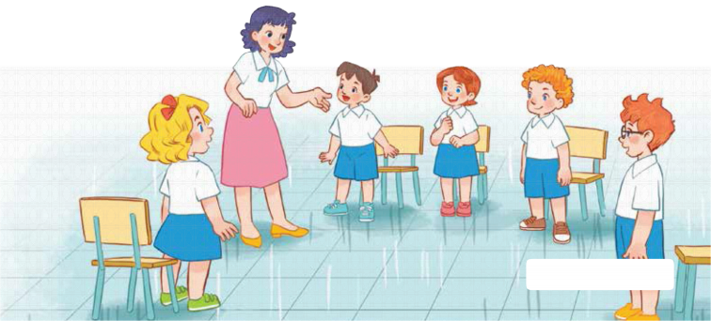
7
Classroom instructions
LESSON 1 – PERIOD 2
Teacher: Duong Thi Bich Ngoc
Quang Trung Primary School

Slide 2





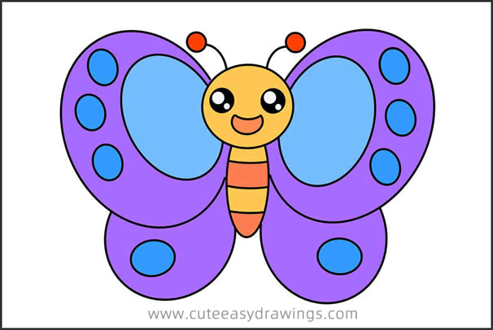
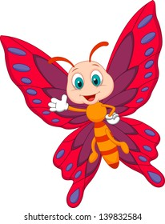


Warm-up and review
Notes:
- Divide the class into 2 teams.
- Each team chooses one butterfly to go to the question.
- Have pupils look, read and choose the right option.
- Back to the menu for another question.
- Pupils take turns to play until they catch all the butterflies.
- The team who gets the most butterflies is the winner.

Slide 3


A. Close your book, please!
B. Stand up, please!
C. Open your book, please!
Notes:
Click each answer to check.
Click the flower to go back to the game.

Slide 4

A. Close your book, please!
B. Sit down, please!
C. Open your book, please!
Notes:
Click on each answer to check.
Click on the flower to go back to the game.

Slide 5
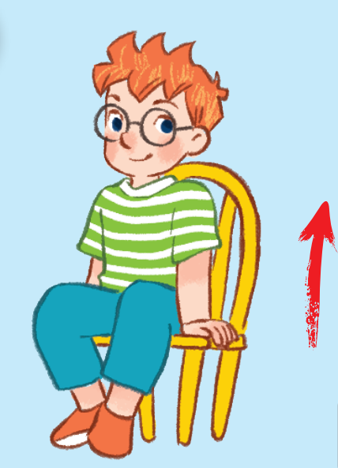
A. Sit down, please!
B. Stand up, please!
C. Close your book, please!
Notes:
Click on each answer to check.
Click on the flower to go back to the game.

Slide 6
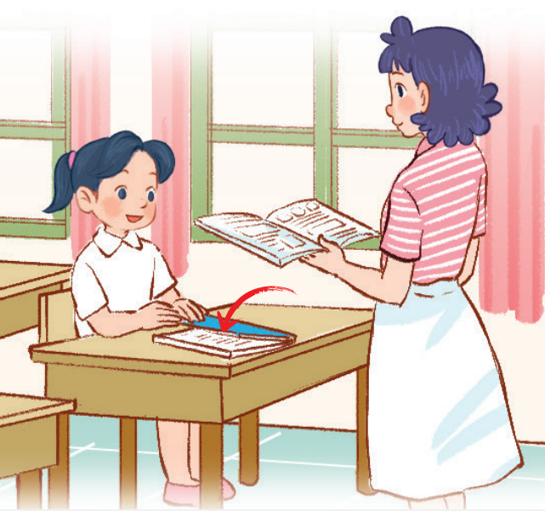
A. Close your books, please!
B. Sit down, please!
C. Open your books, please!
Notes:
Click on each answer to check.
Click on the flower to go back to the game.

Slide 7

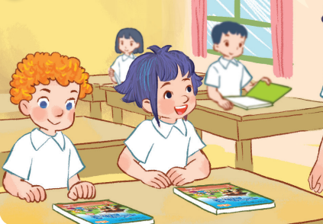
A. Close your books, please!
B. Open your books, please!
C. Stand up, please!
Notes:
Click on each answer to check.
Click on the flower to go back to the game.

Slide 8

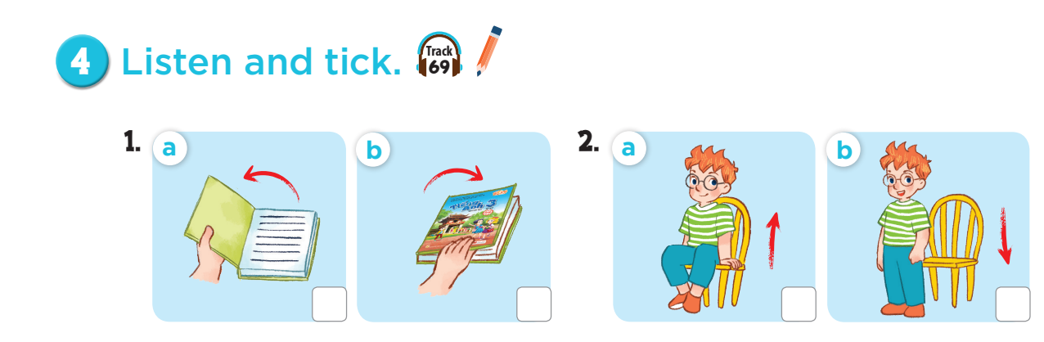



Slide 9
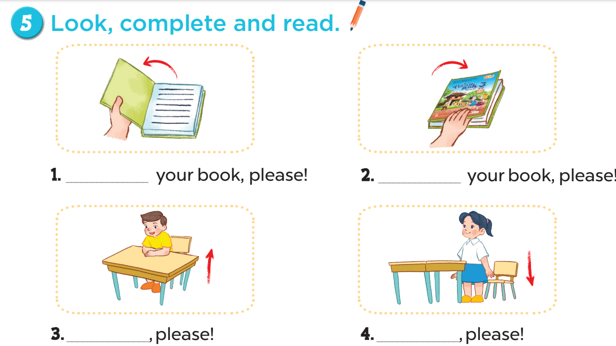
Open
Close
Stand up
Sit down

Slide 10
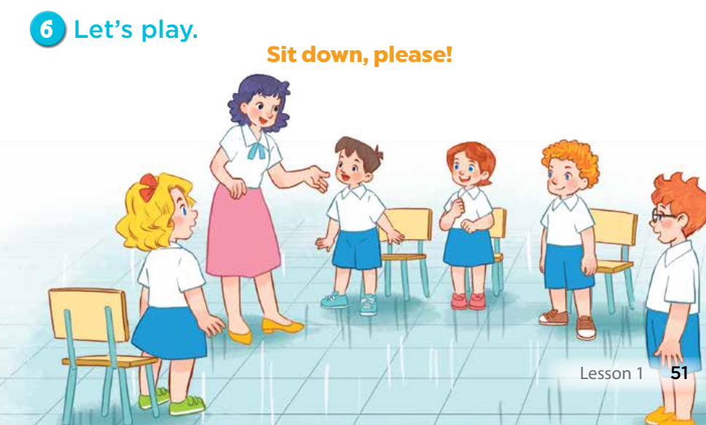

Slide 11
Fun corner and
wrap- up
10
20
Close your books, please!
Open your book, please!
70
Stand up, please!
30
Open your books, please!
Spin&
Stop
A
Sit down, please!
Close your book, please!
60
40
B
Hello, class.
Sit down, please!
Good morning, teacher!
50
80
Notes:
Divide the class into 2 teams.
Have pupils spin the wheel and read out loud the sentences and get points if they read correctly.
The team who gets the most points is the winner.
Teacher can write scores on box A and B

