Slide 1


Slide 2



My week
3
LESSON 2 - PERIOD 3
SUNDAY
SUNDAY
MONDAY
TUESDAY
WEDNESDAY
THURSDAY
FRIDAY
SATURDAY

Slide 3
Table of contents
01
Warm-up
04
02
03
Let’s talk.
Look, listen and repeat.
05
Fun corner & wrap-up
Listen, point and say.

Slide 4
01
Warm-up

Slide 5
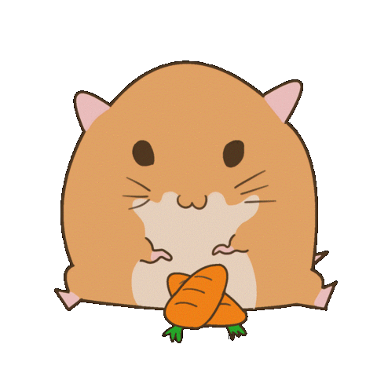
LISTEN AND GUESS WHAT DAY IT IS.
O
I
ED
TH
S
NOT SUNDAY
MONDAY
FRIDAY
WEDNESDAY
THURSDAY
SATURDAY
Notes:
TEACHER SPELLS THE FIRST LETTER OF ANY DAY/ OR SPELLS ANY LETTER IN A DAY, PUPILS GUESS.

Slide 6



Notes:
FLASH THE CARDS TO CONSOLIDATE PUPILS’ PRONUNCIATION AND SPEELING

Slide 7
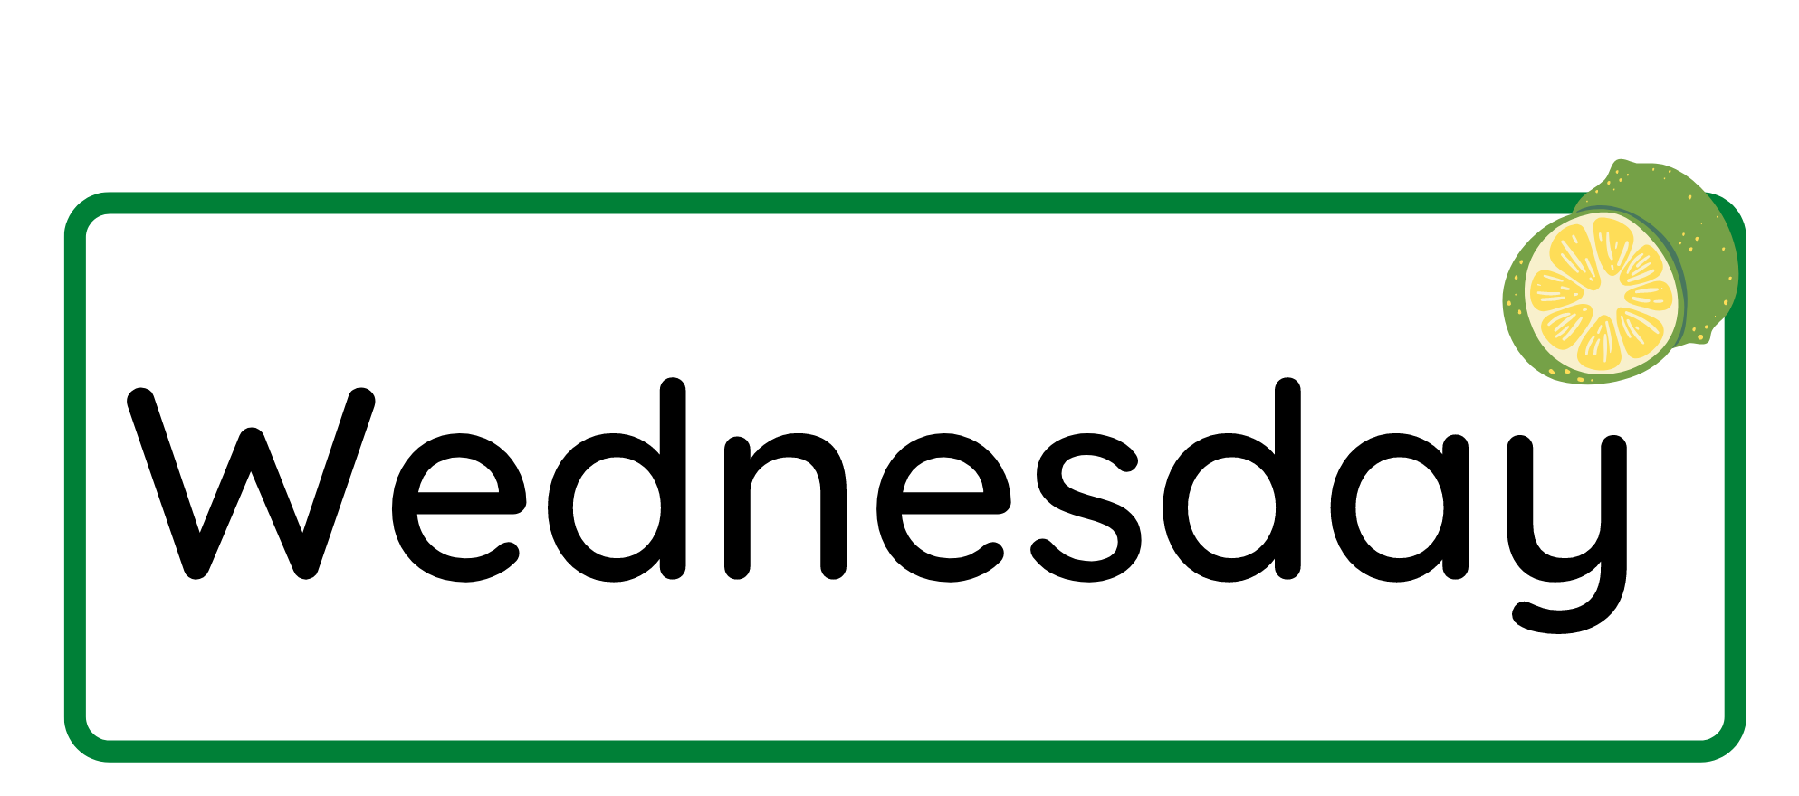


WHAT DAY IS IT?

Slide 8


Slide 9

WHAT DAY IS IT?

Slide 10
02
Activity 1
Look, listen and repeat.

Slide 11

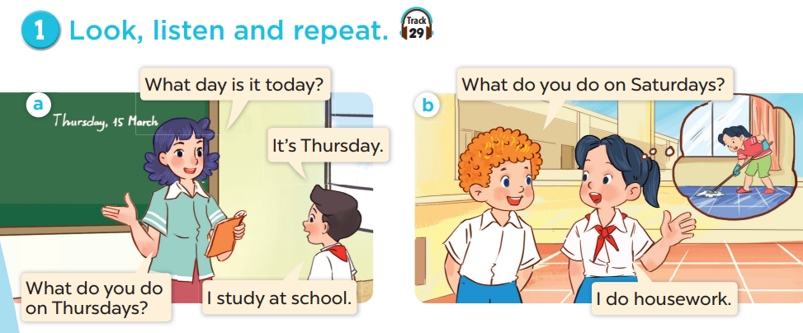

Slide 12
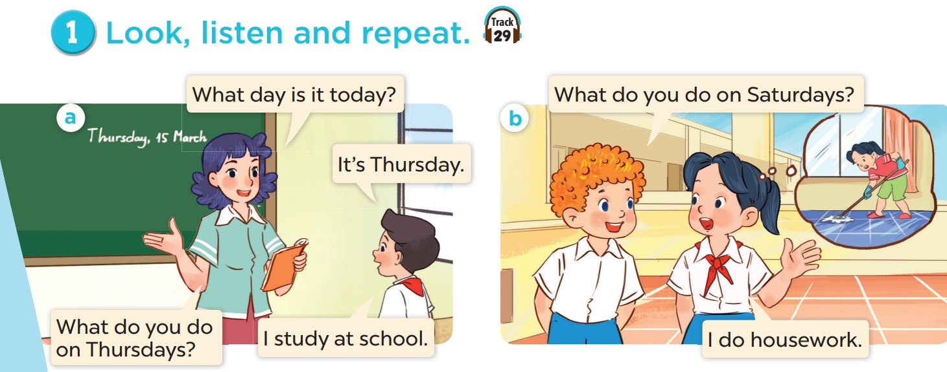
Explore the dialogues.
Notes:
EXPLORE THE QUESTIONS

Slide 13
03
Activity 2
Listen, point and say.

Slide 14
Practise in pairs.
What do you do on _______?
What do you do on Saturdays?
I study at school.
I _____.

Slide 15
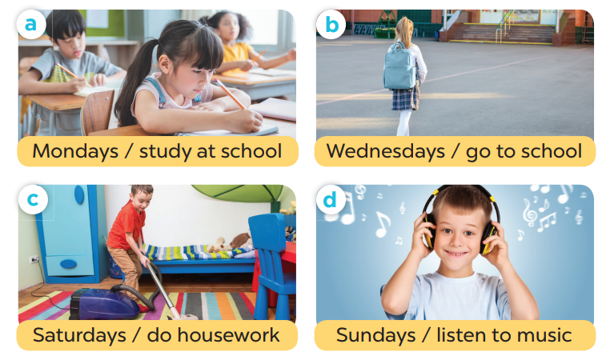
Point and say.
What do you do on _______?
- I _______.
Notes:
EXPLORE PICTURES

Slide 16
04
Activity 3
Let’s talk.

Slide 17
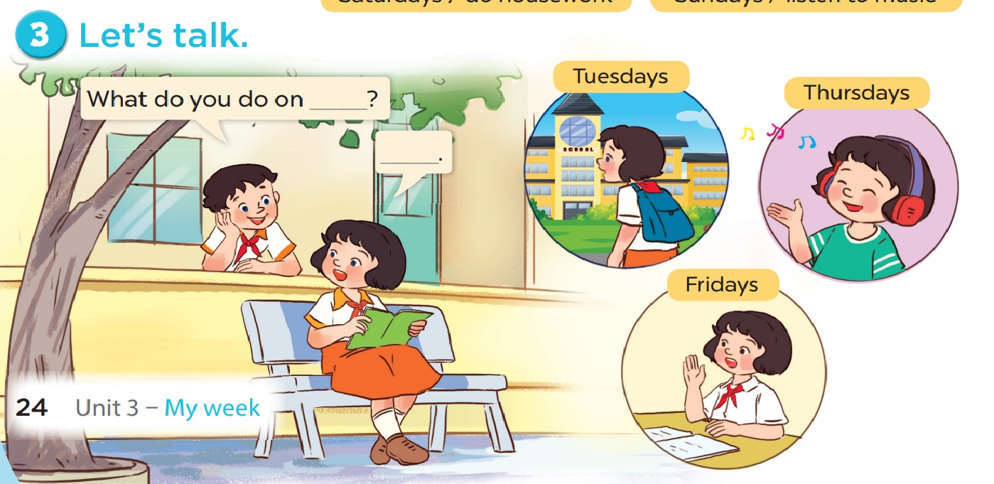

Slide 18
05
Fun corner & wrap-up

Slide 19
Spelling game
MONDAYS
CAN YOU SPELL
STUDY
CAN YOU SPELL
HOUSEWORK
CAN YOU SPELL
CAN YOU SPELL
LISTEN TO MUSIC

