Slide 1
WARMLY WElcome to my class
TEACHER: ĐÀO THỊ LIỄU
QUOC TUAN PRIMARY SCHOOL

Slide 3
Starter

Slide 4
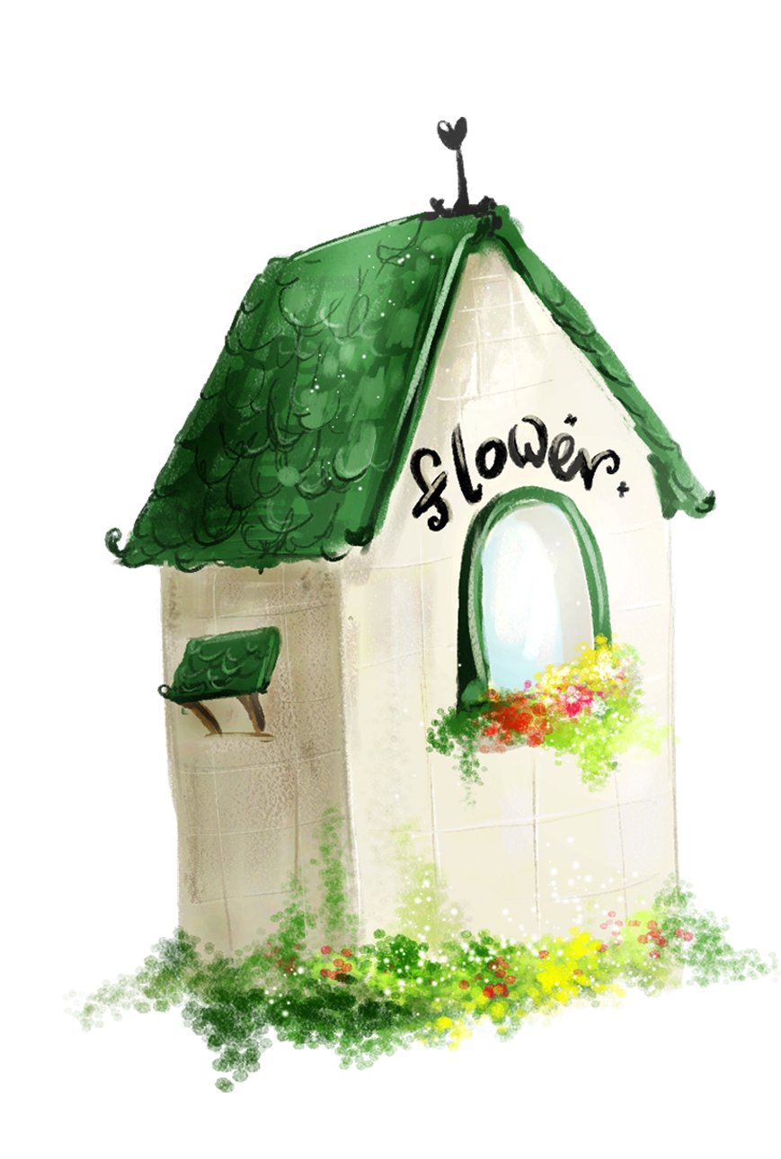
1. Warm-up
2. Listen, point and sing.
3. Read and complete.
4. Count the letters.
5. Fun corner and wrap-up
Contents

Slide 5
Warm-up
Game: Numbers showing
Notes:
Goal: Review the numbers.
Step 1: Teacher says “Numbers, numbers”, then moves hands round and round.
Step 2: Ask pupils to do like teacher.
Step 3: Teacher says a number randomly. Pupils show their fingers in correspondence with the numbers teacher says.
Step 4: Make it become more interesting by doing quicker and quicker.

Slide 6
three

Slide 7
six

Slide 8
five

Slide 9
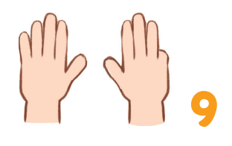
nine

Slide 10
2. Listen, point and sing.

Slide 12
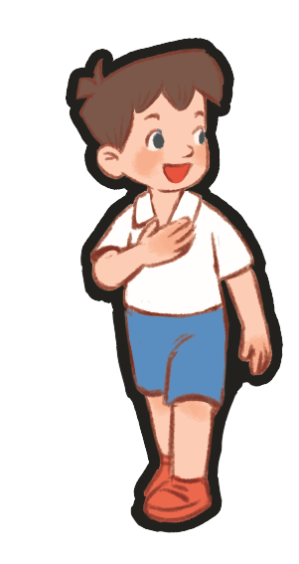
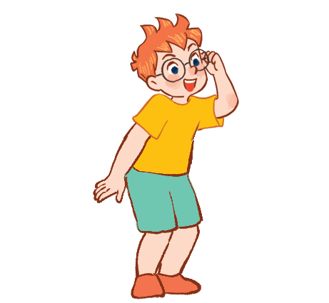
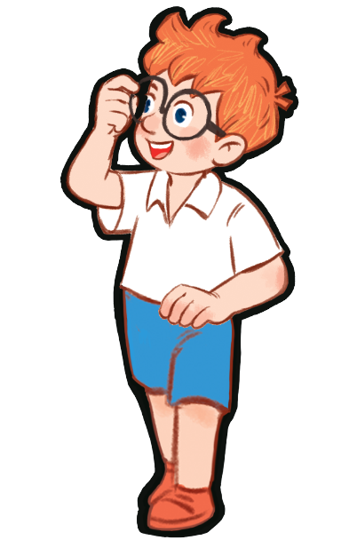
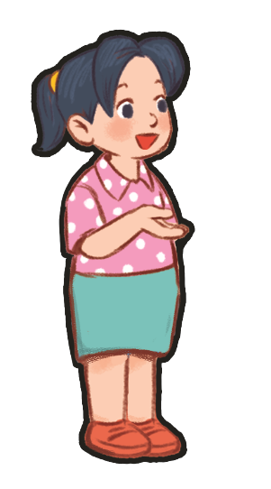
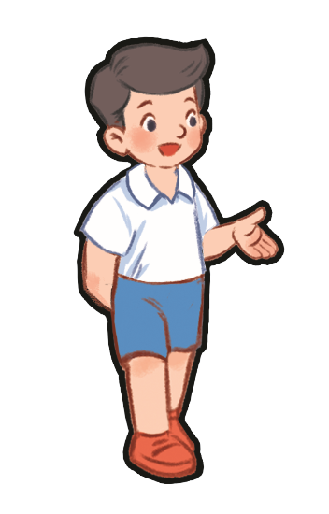
Group singing

Slide 13
3. Read and complete.

Slide 14
F
J
Z

Slide 15
4. Count the letters.

Slide 16
4
5

Slide 17
5. Fun corner and wrap-up
Game: What’s missing?

Slide 18
B E N
?
Notes:
Goal: Pupils can say the names of letters and recognize what’s missing.
Step 1: Let the pupils say the names of letters.
Step 2: One letter goes missing. Pupils have to say what’s missing. (This can be played between groups or individuals)
Step 3: Check the answer. If it’s correct, give points to the groups/ pupils.
Step 4: Ask pupils to say the name of the missing letter again.

Slide 19
?
MARY

Slide 20
LINDA
?

Slide 21
LUCY
?

Slide 22
Well done!

