Slide 1

WARMLY WElcome to my class
TEACHER: ĐÀO THỊ LIỄU
QUOC TUAN PRIMARY SCHOOL

Slide 3

Unit 1. All about me!
Lesson 1(4,5,6)

Slide 4
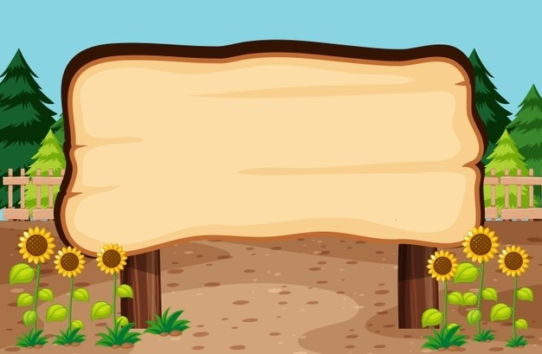

01
Listen and tick.

Slide 5

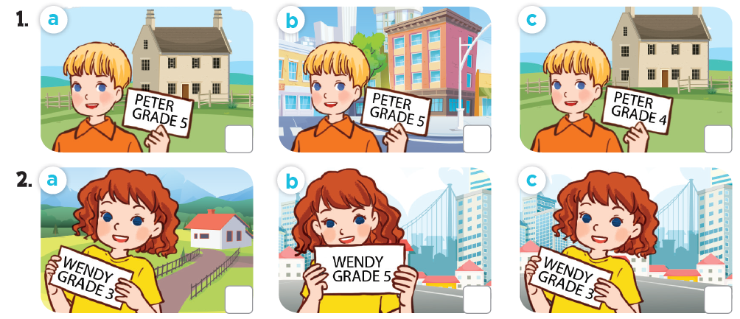
Listen and tick.

Slide 6
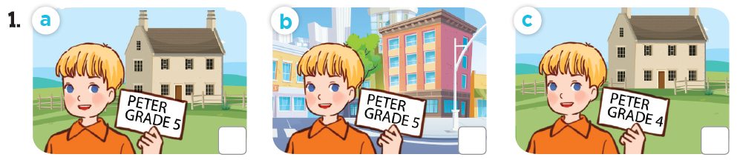
Listen and tick.
✓

Slide 7
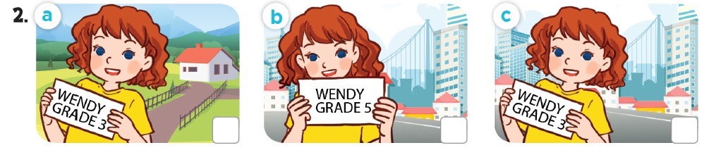
Listen and tick.
✓

Slide 8
Listen and tick.
✓
✓

Slide 9
02
Read and complete.

Slide 10
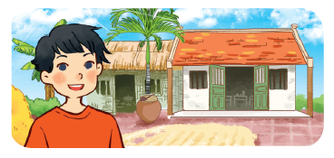
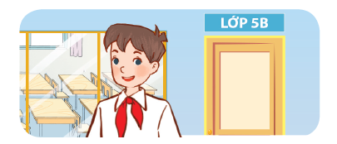


Read and complete.

Slide 11
Read and complete.
1. A: Can you tell me about yourself?
B: Sure. My name’s Ba. I live in the _____.
village

Slide 12
Read and complete.
2. A: Can you tell me about yourself?
B: Well, I’m Minh. I’m in _______.
Class 5B

Slide 13
Read and complete.
3. A: Can you ____ me about yourself?
B: Sure. I’m Phong. I live in the_________.
tell
city / town

Slide 14
Read and complete.
4. A: Can you tell me about _______?
B: Well, I’m Andy. I live in the ________________.
yourself
countryside / village

Slide 15
Read and complete.
1. A: Can you tell me about yourself?
B: Sure. My name’s Ba. I live the _____.
2. A: Can you tell me about yourself?
B: Well, I’m Minh. I’m in _______.
village
Class 5B
tell
yourself
3. A: Can you ____ me about yourself?
B: Sure. I’m Phong. I live in the _________.
4. A: Can you tell me about ________?
B: Well, I’m Andy. I live in the ________________.
city / town
countryside / village

Slide 16
03
Let’s sing.

Slide 17
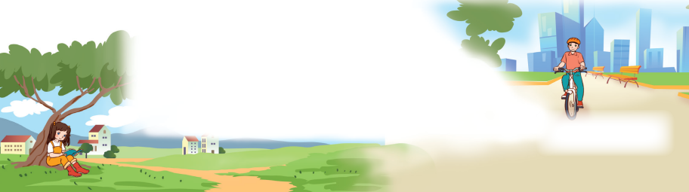
Let’s sing.
All about me!
I’m Lisa.
I’m in Grade 3.
I live in the countryside.
Where do you live?
I’m Alan.
I’m in Grade 5.
I live in the city.
Where do you live?

Slide 18
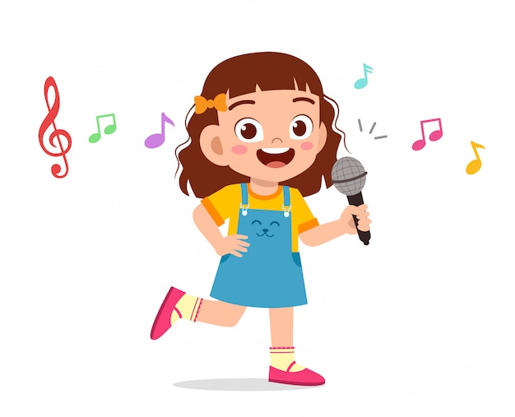

All about me!
I’m Lisa.
I’m in Grade 3.
I live in the countryside.
Where do you live?
I’m Alan.
I’m in Grade 5.
I live in the city.
Where do you live?

Slide 19

Video: https://www.youtube.com/watch?v=cvZ175neuss&list=PL8_ETpRL2xNZB9cLCxiQ99OV2IDn572U9&index=2

