Slide 1
My week
3
LESSON 1 - PERIOD 2
SUNDAY
SUNDAY
MONDAY
TUESDAY
WEDNESDAY
THURSDAY
FRIDAY
SATURDAY

Slide 3
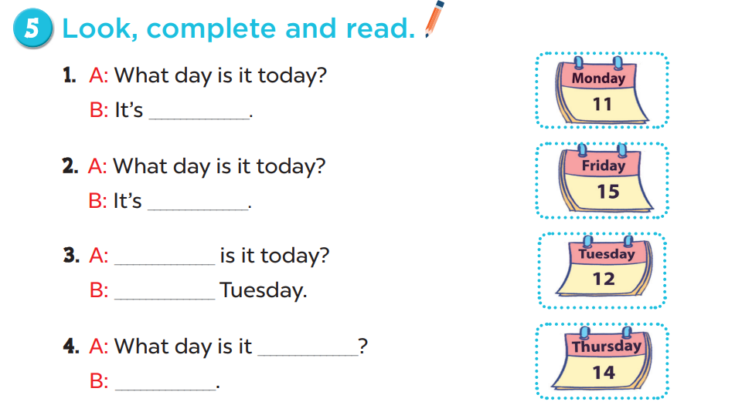
Monday
Friday
What day
It’s
today
It’s Thursday

