Slide 2
Unit 7 Our timetables
Lesson 3 - period 6

Slide 3
Table of Contents
01
02
03
04
Read and circle.
Warm-up
Let’s write.
Project
fun corner & wrap-up
05

Slide 4
01
Warm-up

Slide 6
02
Read and circle.

Slide 8
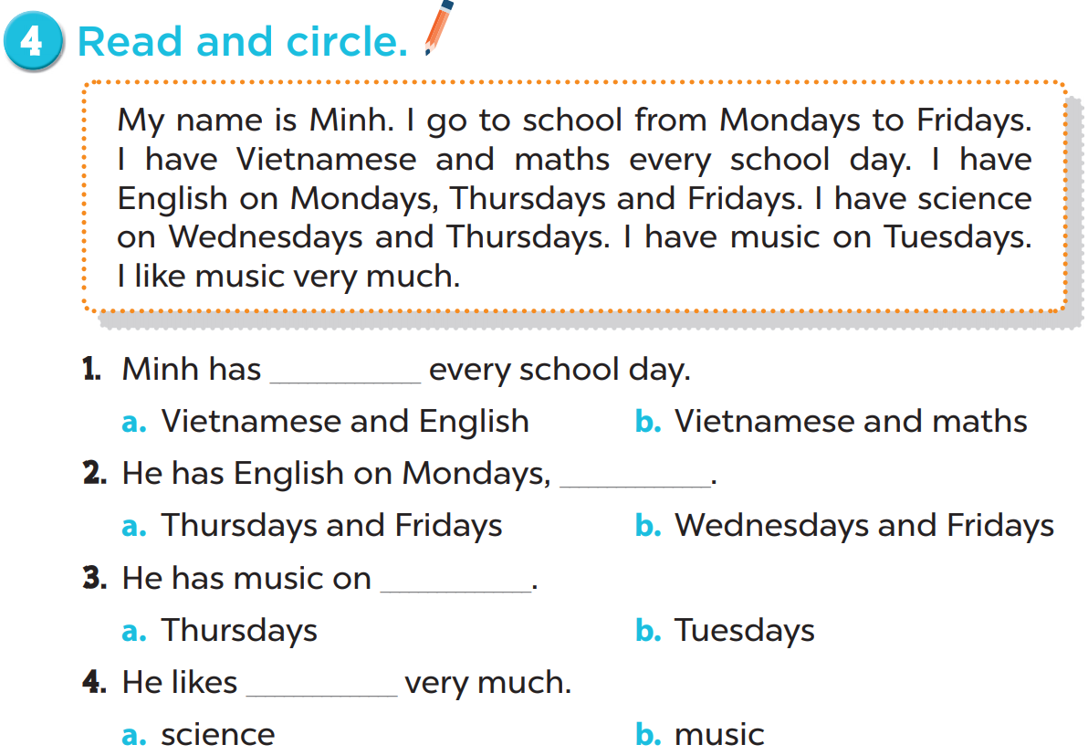

Slide 10
03
Let’s write.

Slide 11
Lucy
English
science
Tuesdays
music
Fridays
music

Slide 13
04
Project

Slide 15
05
Fun corner & wrap-up

Slide 16
Reorder the words.
Fridays./ Mondays/ I/ to/
school/ go/ from
5 points
I go to school from Mondays to Fridays.

Slide 17
Reorder the words.
every/ day./ I/ maths/ have
7 points
I have maths every day.

Slide 18
Reorder the words.
Fridays./ and/ have/ science
Mondays/ I/ on
15 points
I have science on Mondays and Fridays.

Slide 19
Reorder the words.
much./ like/ I/ science/ very
10 points
I like science very much.

