Slide 2
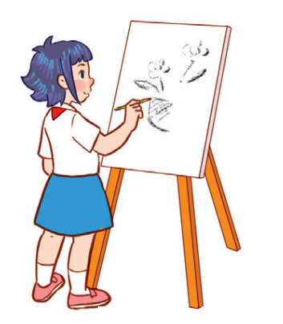
Unit 8
Period 1

Slide 3
Contents
Look, listen and repeat.
Listen, point and say.
Warm-up and review
Let’s talk.
Fun corner and wrap-up
2
1
2
1
3
3
5
4
5
4

Slide 4
Warm-up and review
1
1
Watch a video.

Slide 5
Notes:
Link: https://www.youtube.com/watch?v=2G85e-xBPX4&t=14s

Slide 6
2
Look, listen and repeat.
2
6

Slide 7
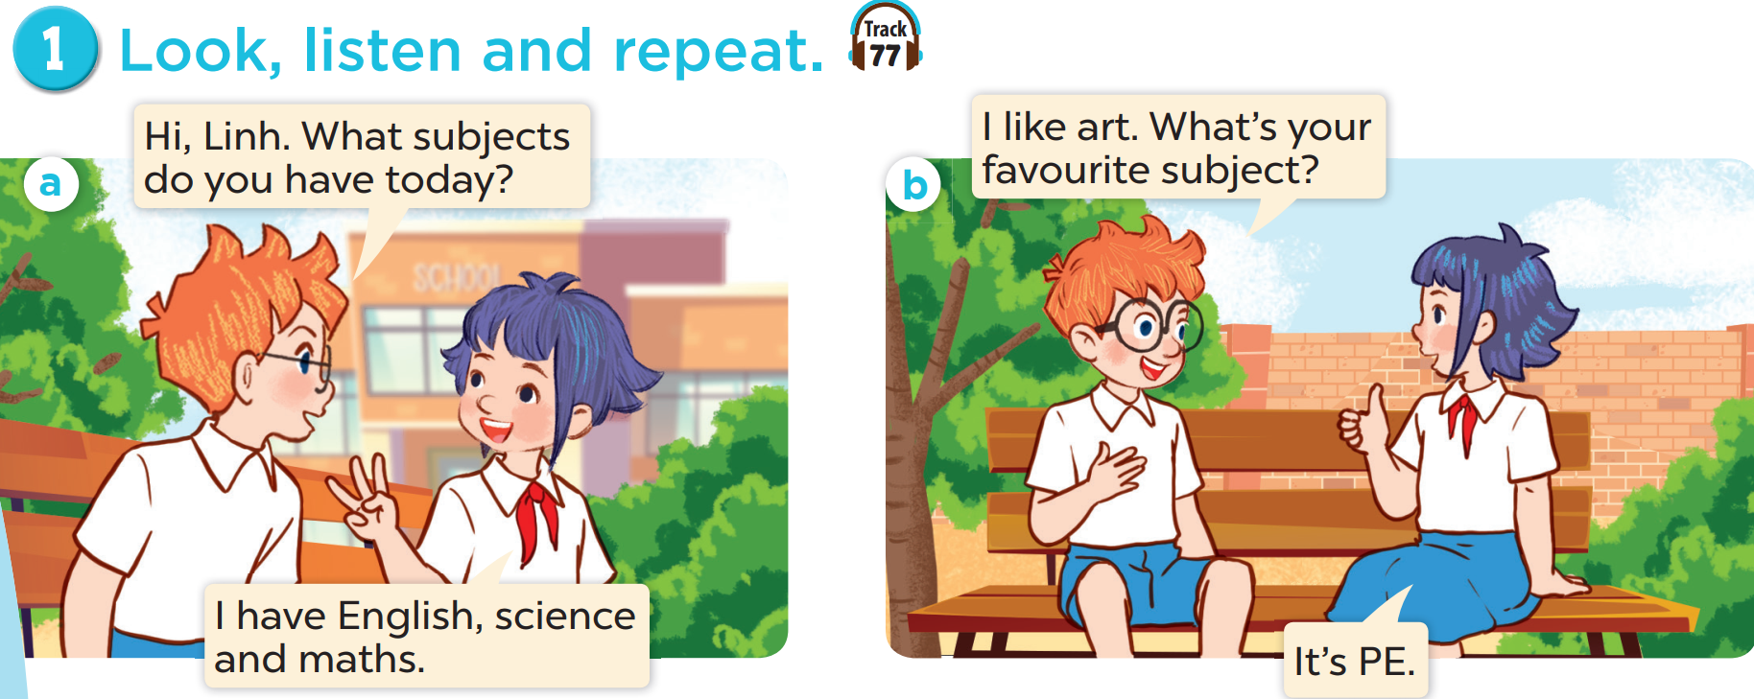

Slide 9
3
Listen, point and say.
3
9

Slide 11
4
Let’s talk.
4
11

Slide 13
5
Fun corner and wrap-up
5
Game: Matching game

Slide 14
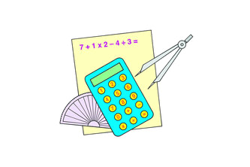
1
2
3
MATHS
4
5
6
PE
SCIENCE
7
8
9
ART
IT
MUSIC
10
11
12
Notes:
Click on the blue part to show pictures/words, if pupils get the correct pairs, leave the square open.
If pupils answer incorrectly, click on the red circle to cover the square again.
Repeat until pupils match all the words with the corresponding pictures.

