Slide 1
Our summer holidays
10
Lesson 1 – Period 2

Slide 2
Table of Contents
Listen and tick.
Look, complete and read.
01
02
03
Warm-up
04
Let’s sing.
05
Fun corner

Slide 3
01
Warm-up
Guessing Game

Slide 4
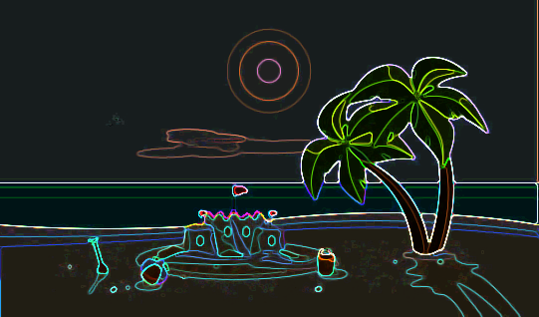
Where is it?

Slide 5
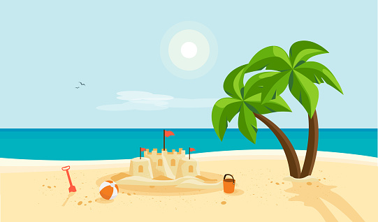
on the beach

Slide 6
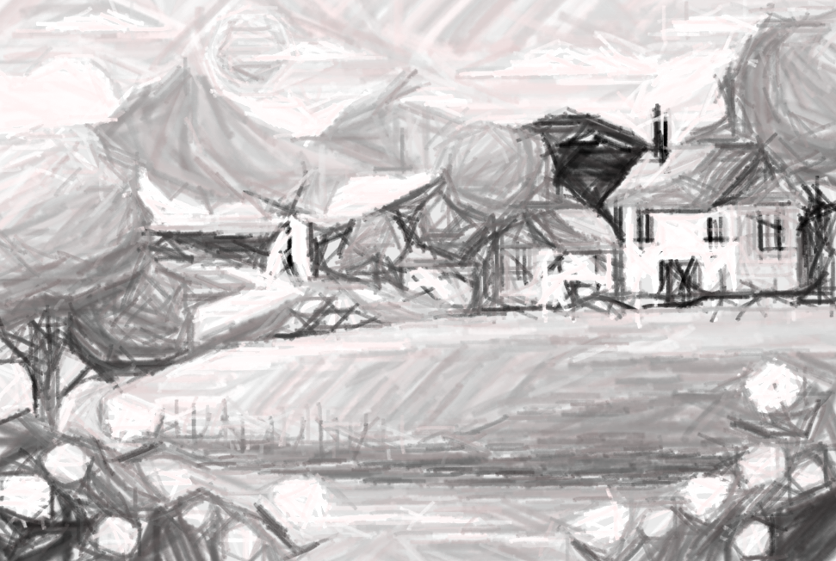
Where is it?

Slide 7
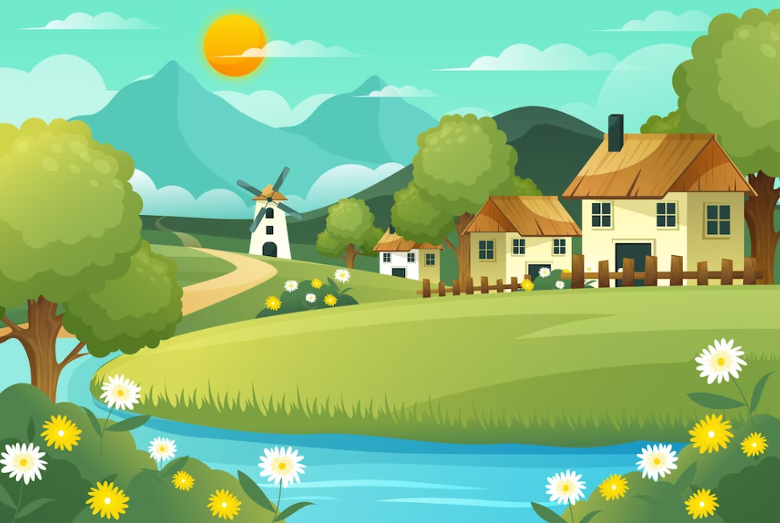
in the countryside

Slide 8
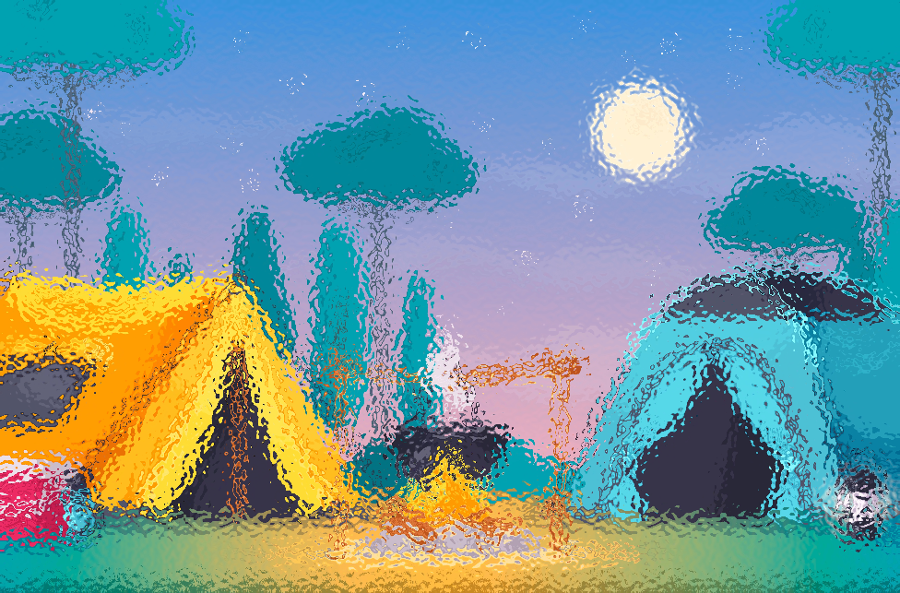
Where is it?

Slide 9
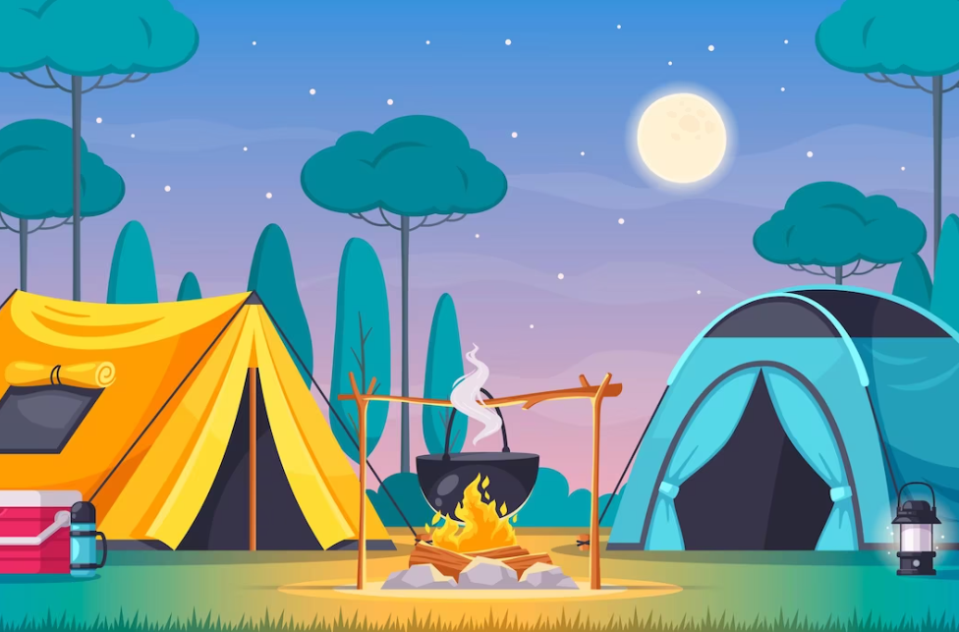
at the campsite

Slide 10
Where is it?

Slide 11
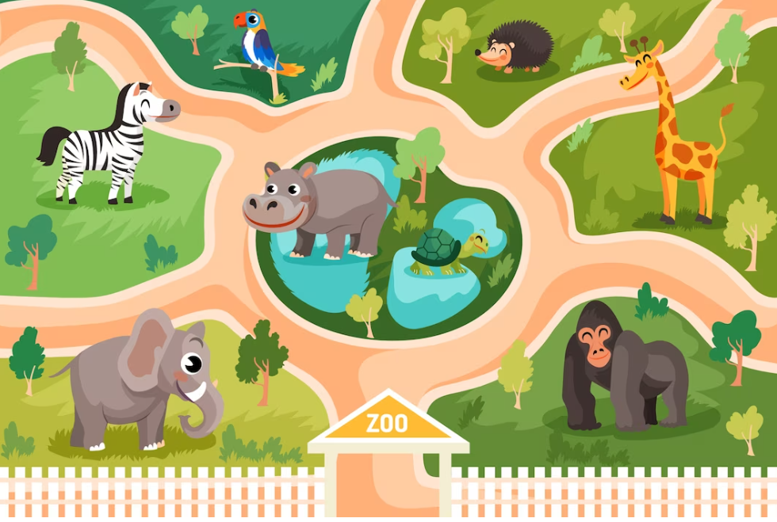
at the zoo

Slide 12
02
Activity 4
Listen and tick.

Slide 13
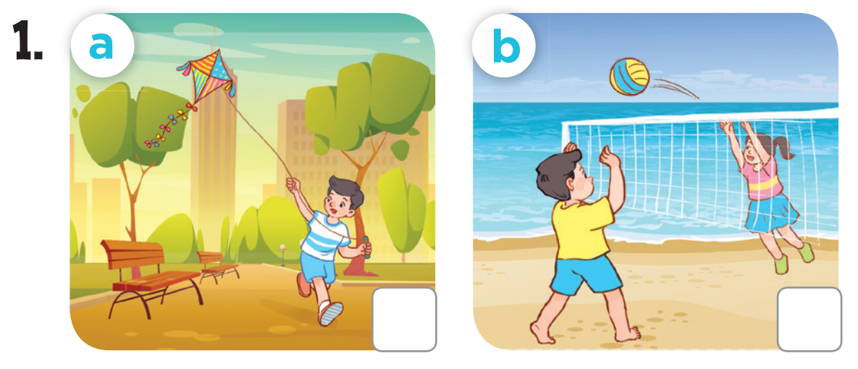

Slide 14
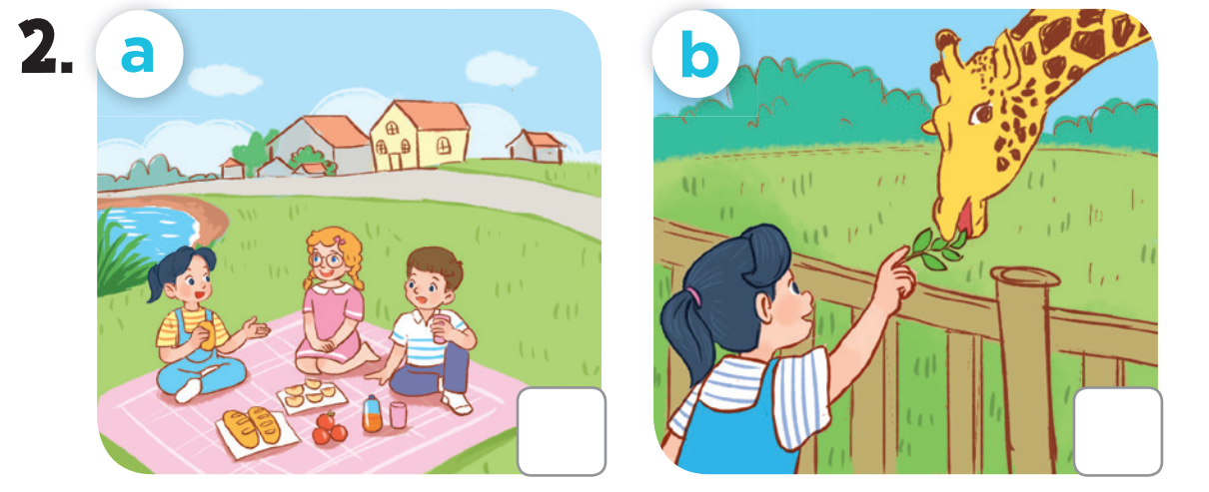

Slide 15
03
Activity 5
Look, complete and read.

Slide 16
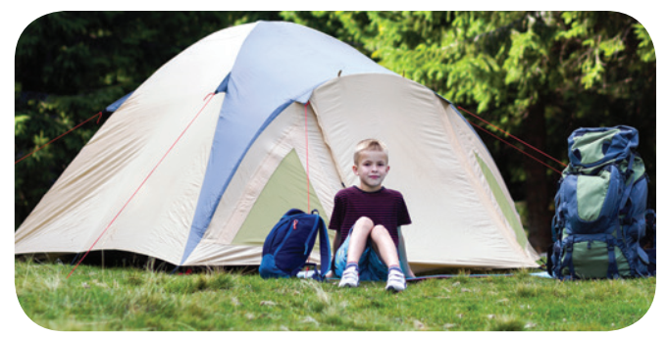
1. I was at __________ yesterday.
the campsite

Slide 17
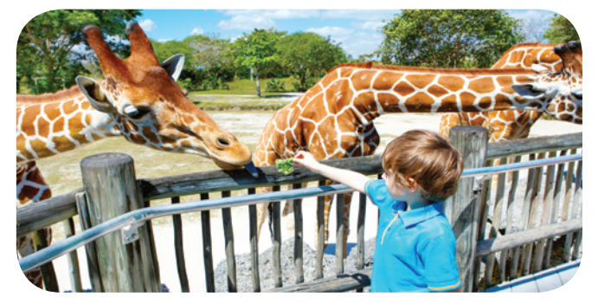
2. I was ________ last weekend.
at the zoo

Slide 18
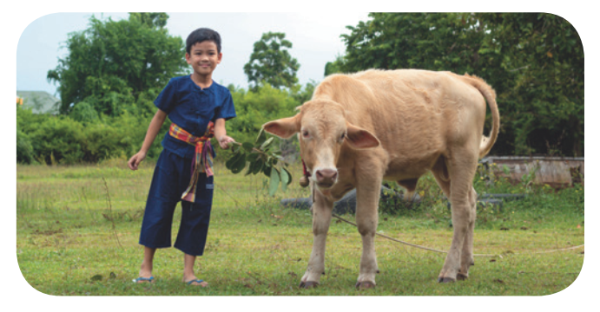
3. A: Were you in the mountains last weekend?
B: No, I wasn’t. I was in ____________.
the countryside

Slide 19
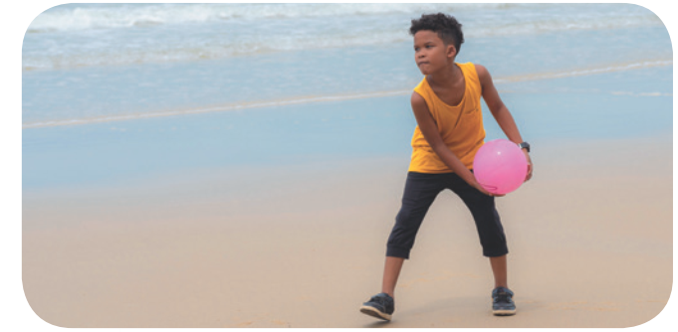
4. A: _____ you on the beach yesterday?
B: _____, I was.
Were
Yes

Slide 20
04
Activity 6
Let’s sing.

Slide 22
05
FUN CORNER
Fast food game

Slide 23
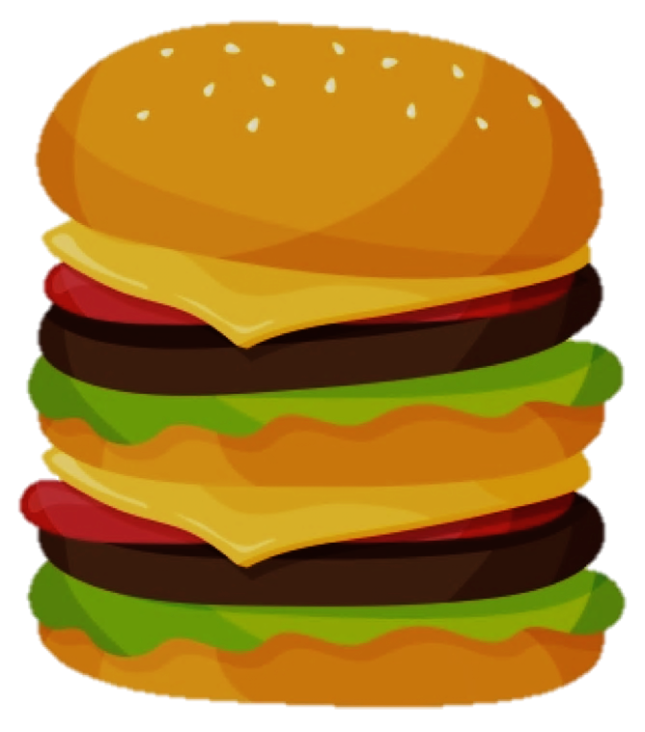
You got a double cheese burger!

Slide 24
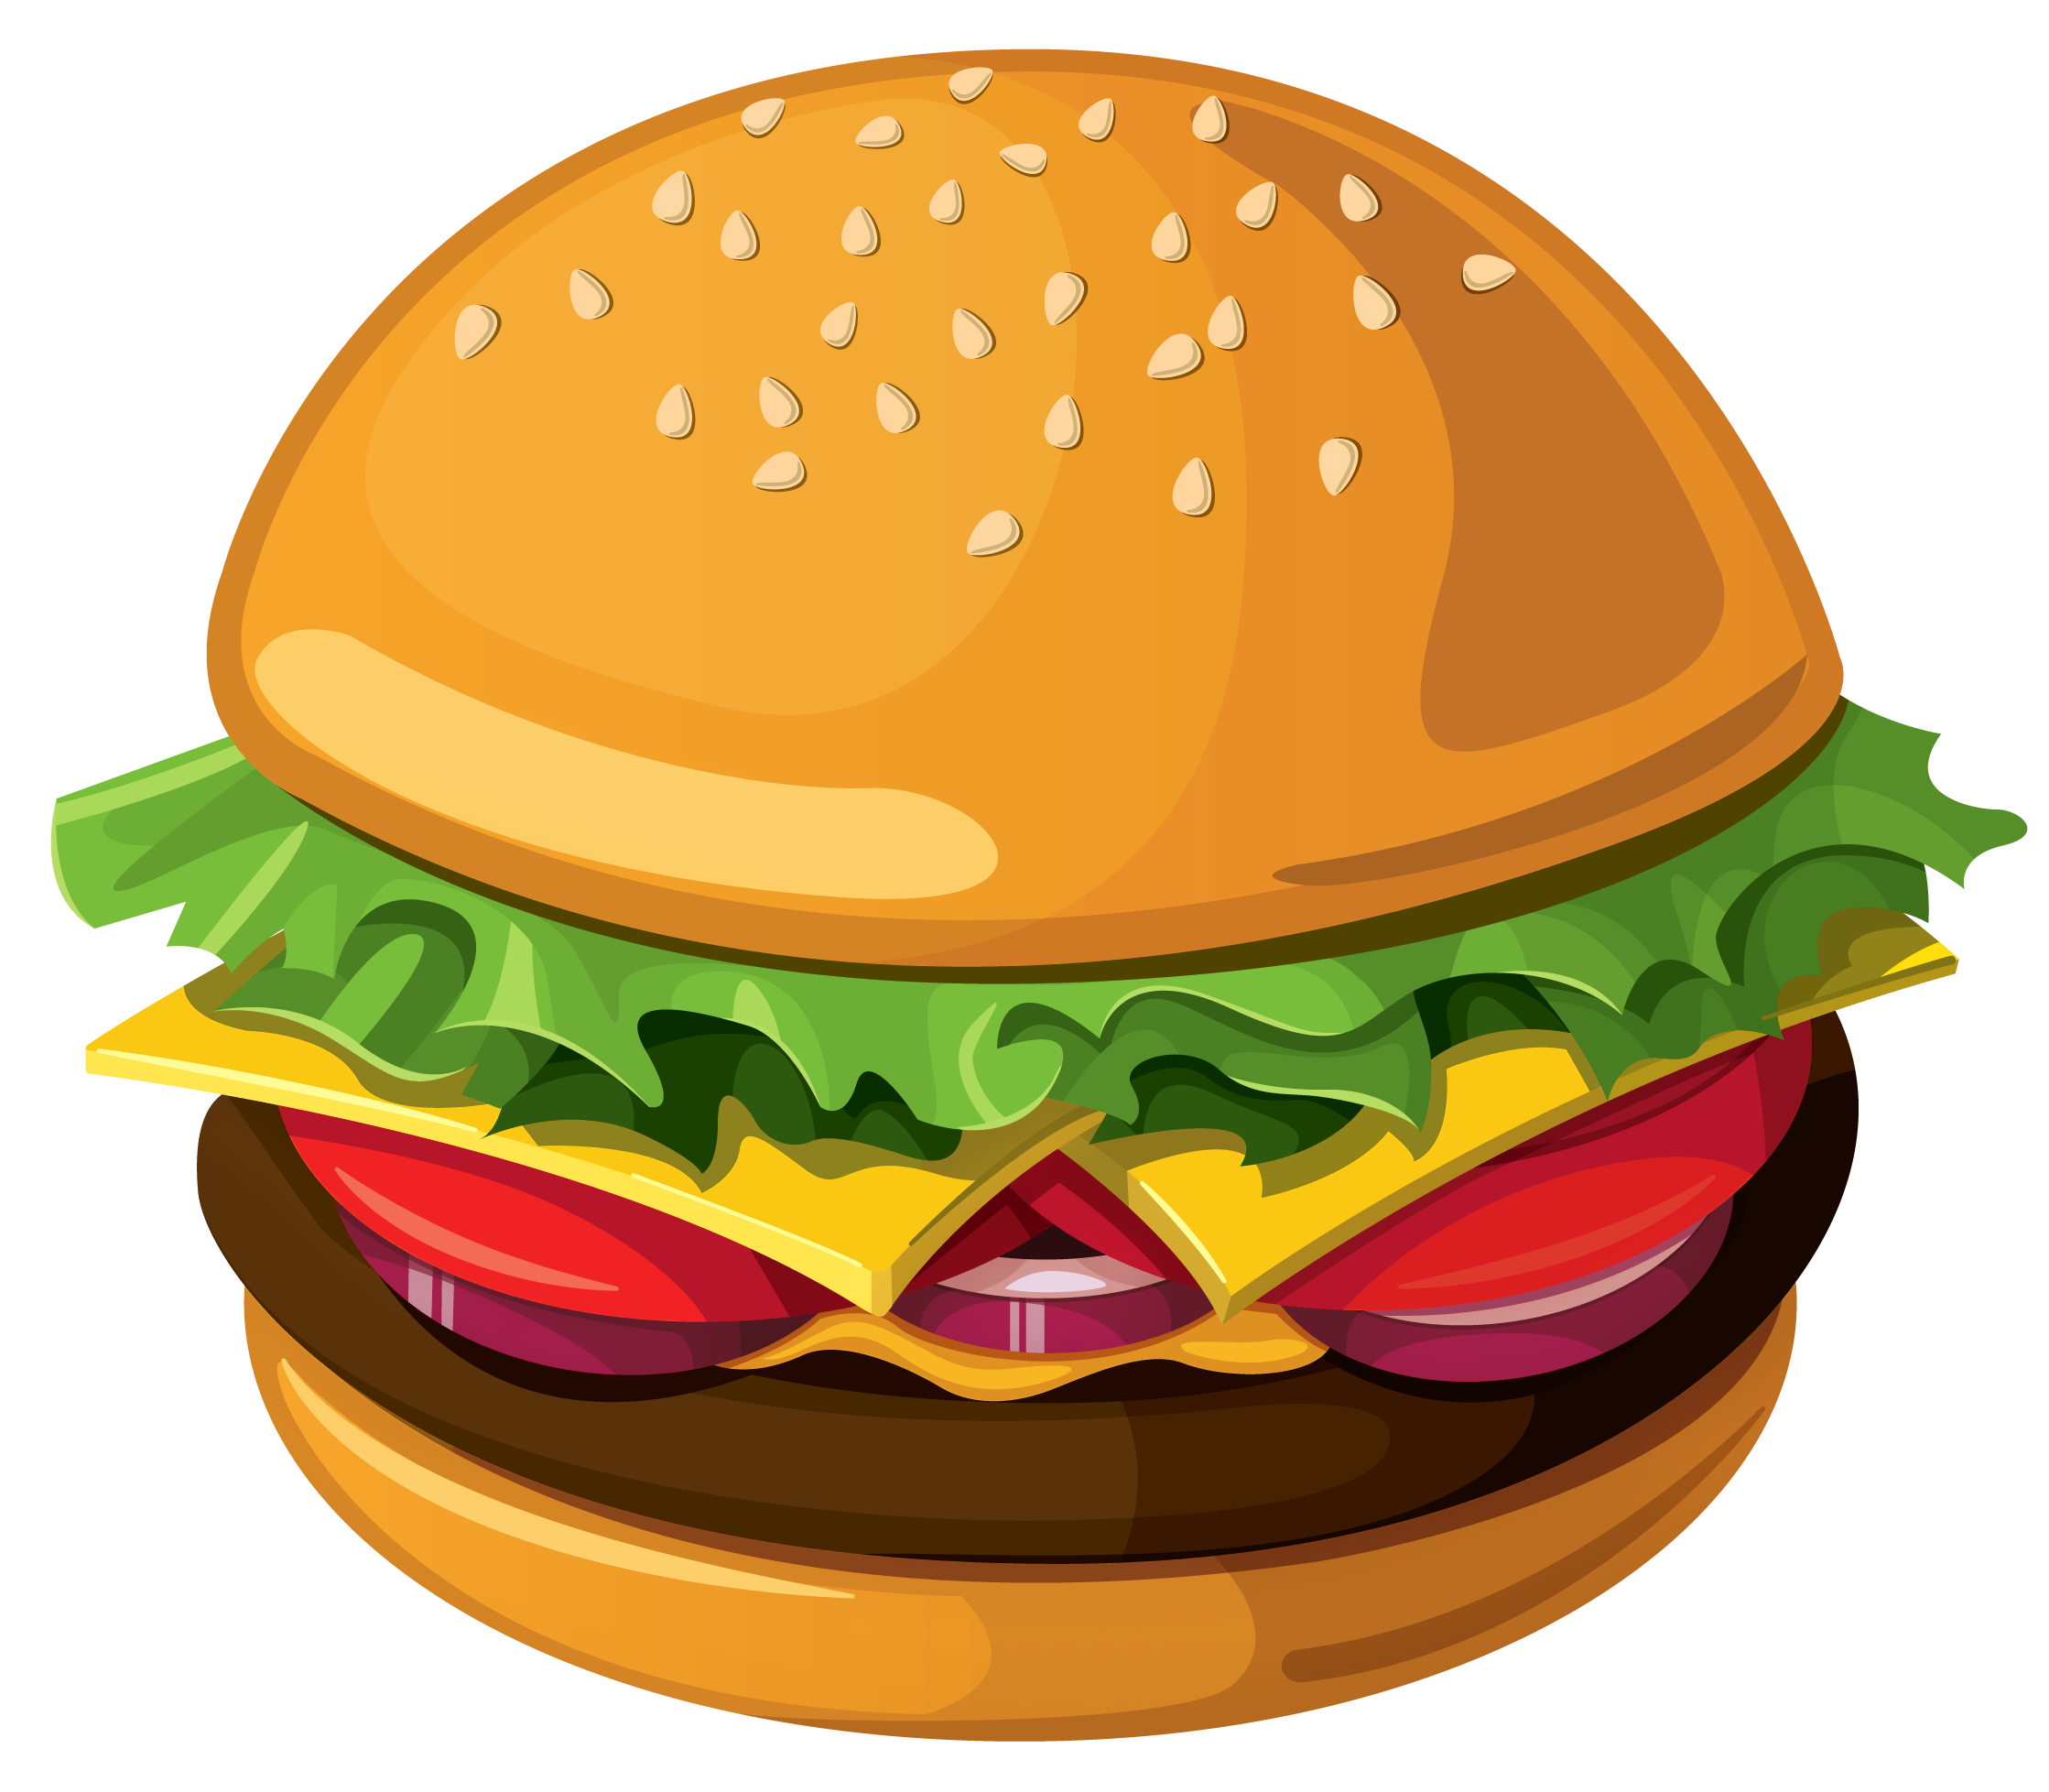
You got 4 hamburgers!

Slide 25
You got 3 hamburgers!

