Slide 1
Our summer holidays
10
Lesson 1 – Period 1

Slide 2
02
Activity 1
Look, listen and repeat.

Slide 3
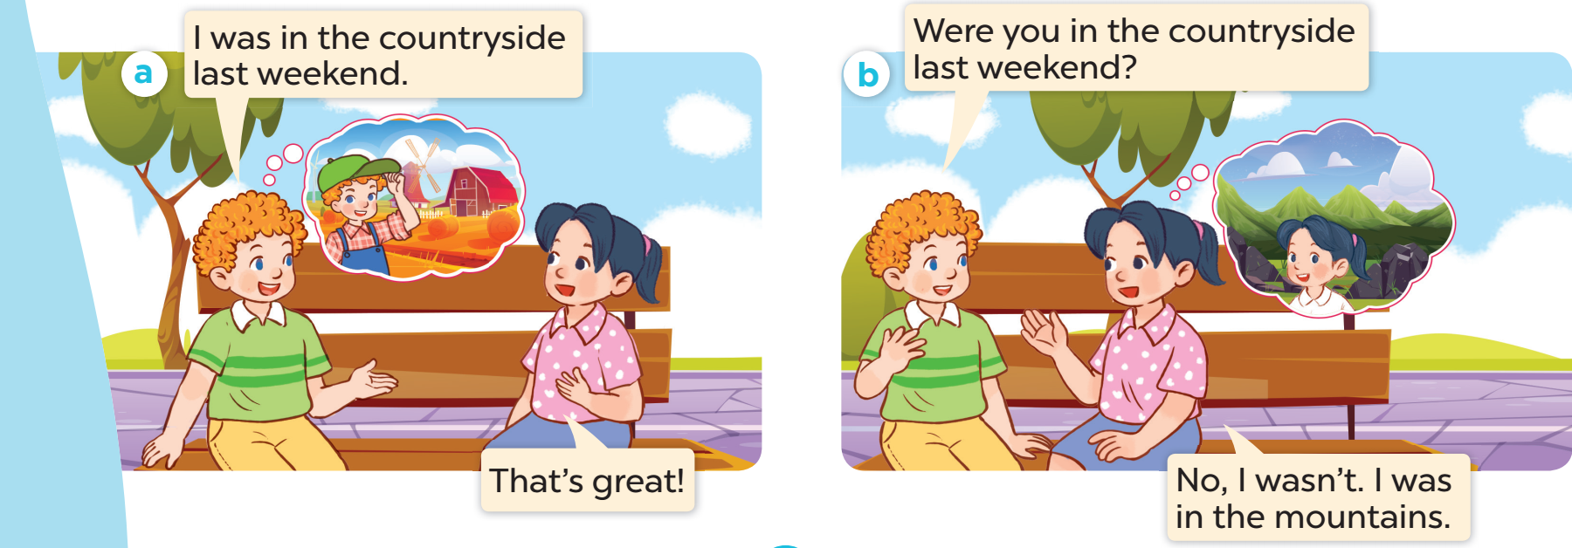
Look and listen.

Slide 5
03
New words
Places

Slide 6
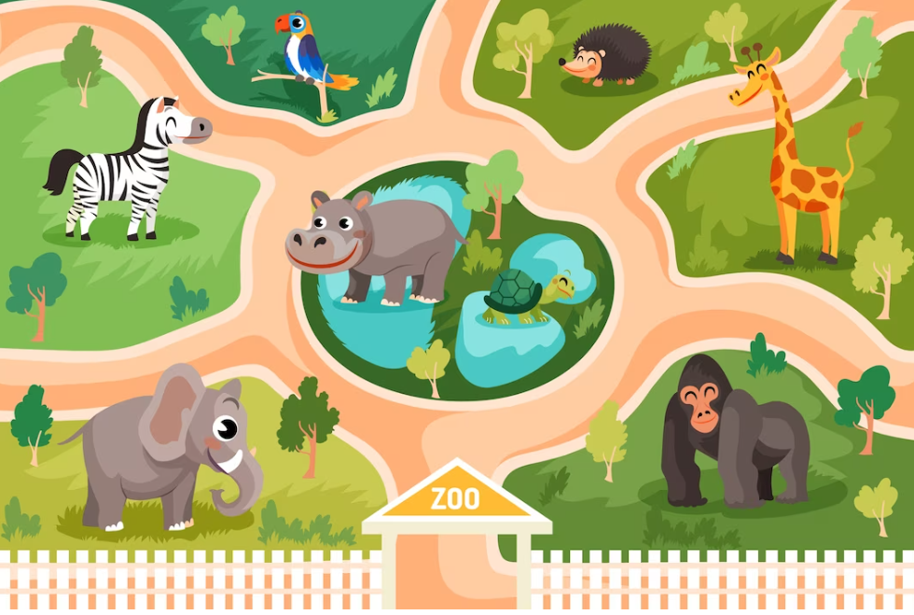
at the
zoo

Slide 7
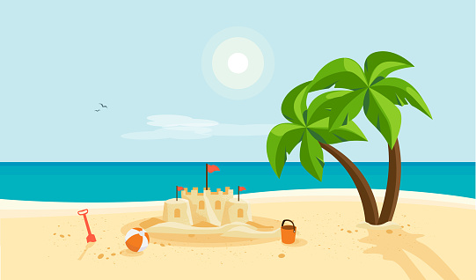
on the
beach

Slide 8
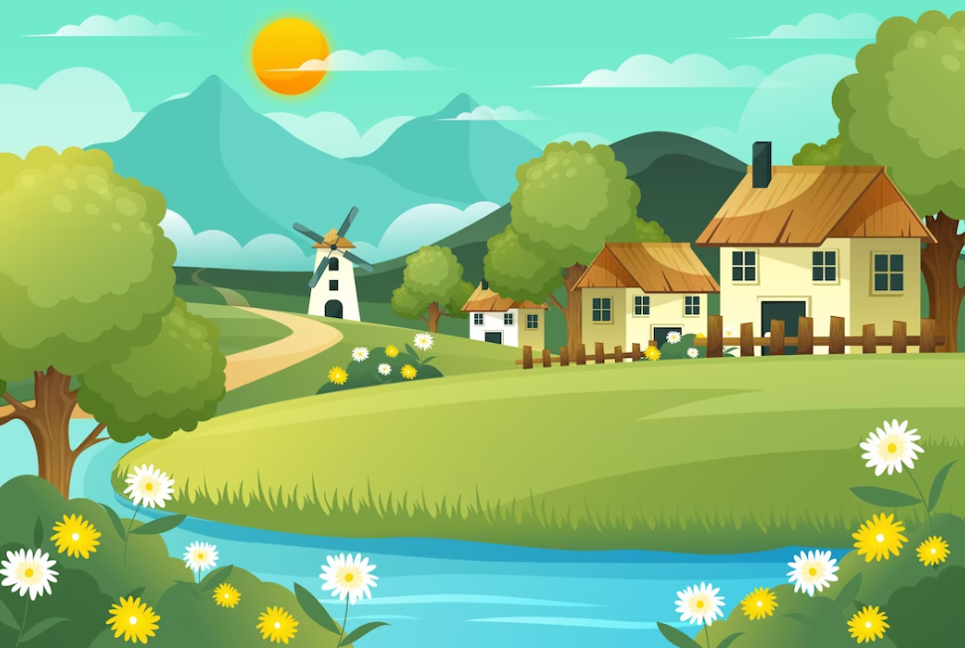
in the
countryside

Slide 9
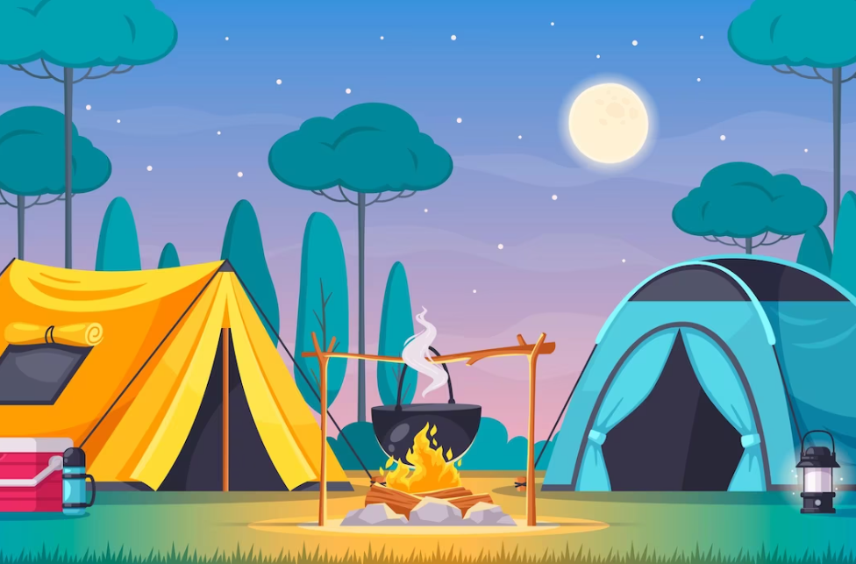
at the
campsite

Slide 10
beach
countryside
campsite
zoo

Slide 11
Where’s the minion?

Slide 12
on the beach

Slide 13
at the zoo

Slide 14
in the countryside

Slide 15
at the campsite

Slide 16
04
Activity 2
Listen, point and say.

Slide 17
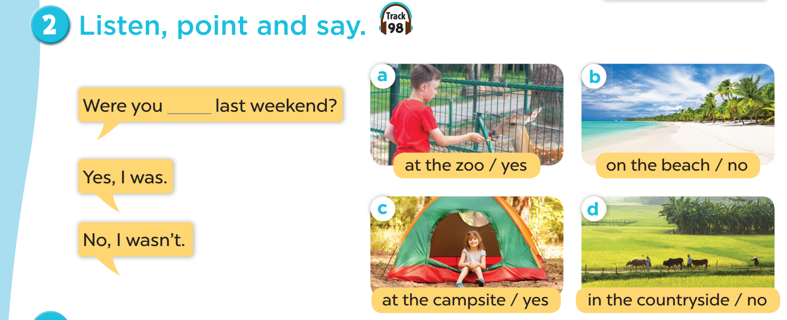

Slide 18
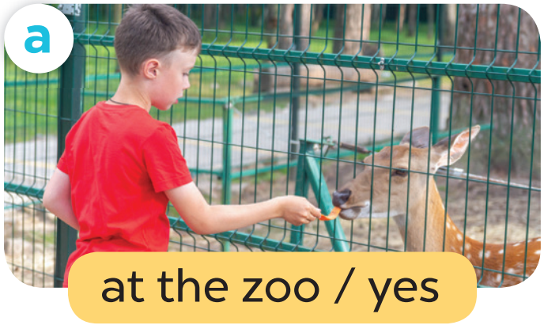
Work in pairs. Role play.
Were you at the zoo last weekend?
Yes, I was.

Slide 19
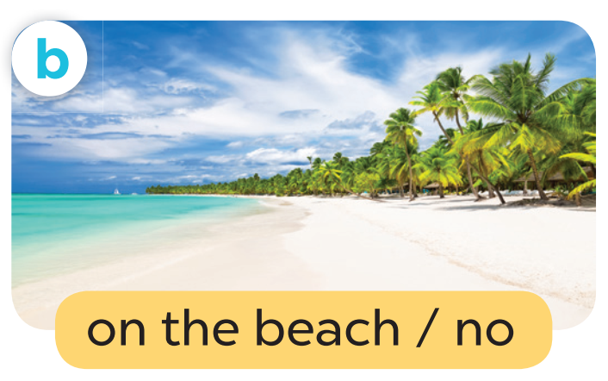
Work in pairs. Role play.
Were you on the beach last weekend?
No, I wasn’t.

Slide 20
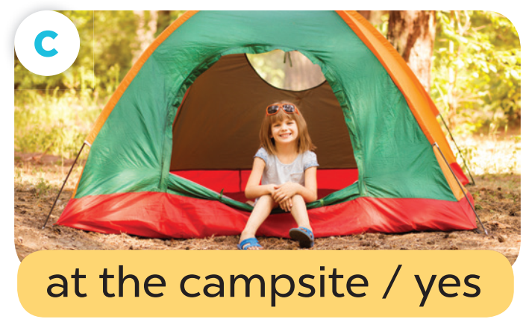
Work in pairs. Role play.
Were you at the campsite last weekend?
Yes, I was.

Slide 21
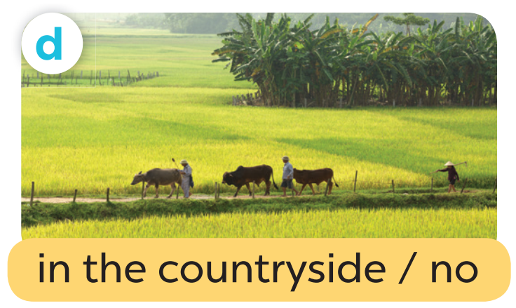
Work in pairs. Role play.
Were you in the countryside last weekend?
No, I wasn’t.

Slide 22
