Slide 2






















Unit 1: At my birthday party
Lesson 1 – Period 1

Slide 3
WELCOME
TO OUR CLASS!

Slide 4
Table of contents
1. Warm-up
2. Activity 1: Listen and repeat.
3. Activity 2: Point and say.
4. Fun corner and Wrap-up

Slide 5

  GREETING
Hello, I’m ….

Slide 6

  01
Warm-up
Notes:
https://www.youtube.com/watch?v=CrPVTFCF074

Slide 7





  Look and say

Slide 8
  02
Activity 1
Listen and repeat.
Notes:
https://www.youtube.com/watch?v=CrPVTFCF074

Slide 9
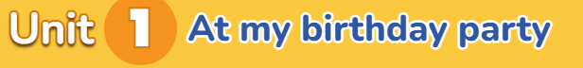
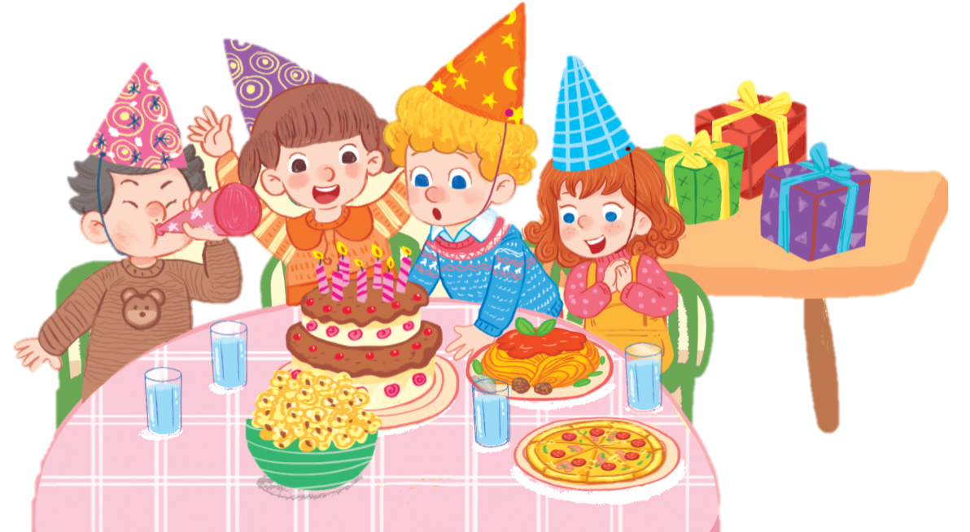

a party

Slide 10
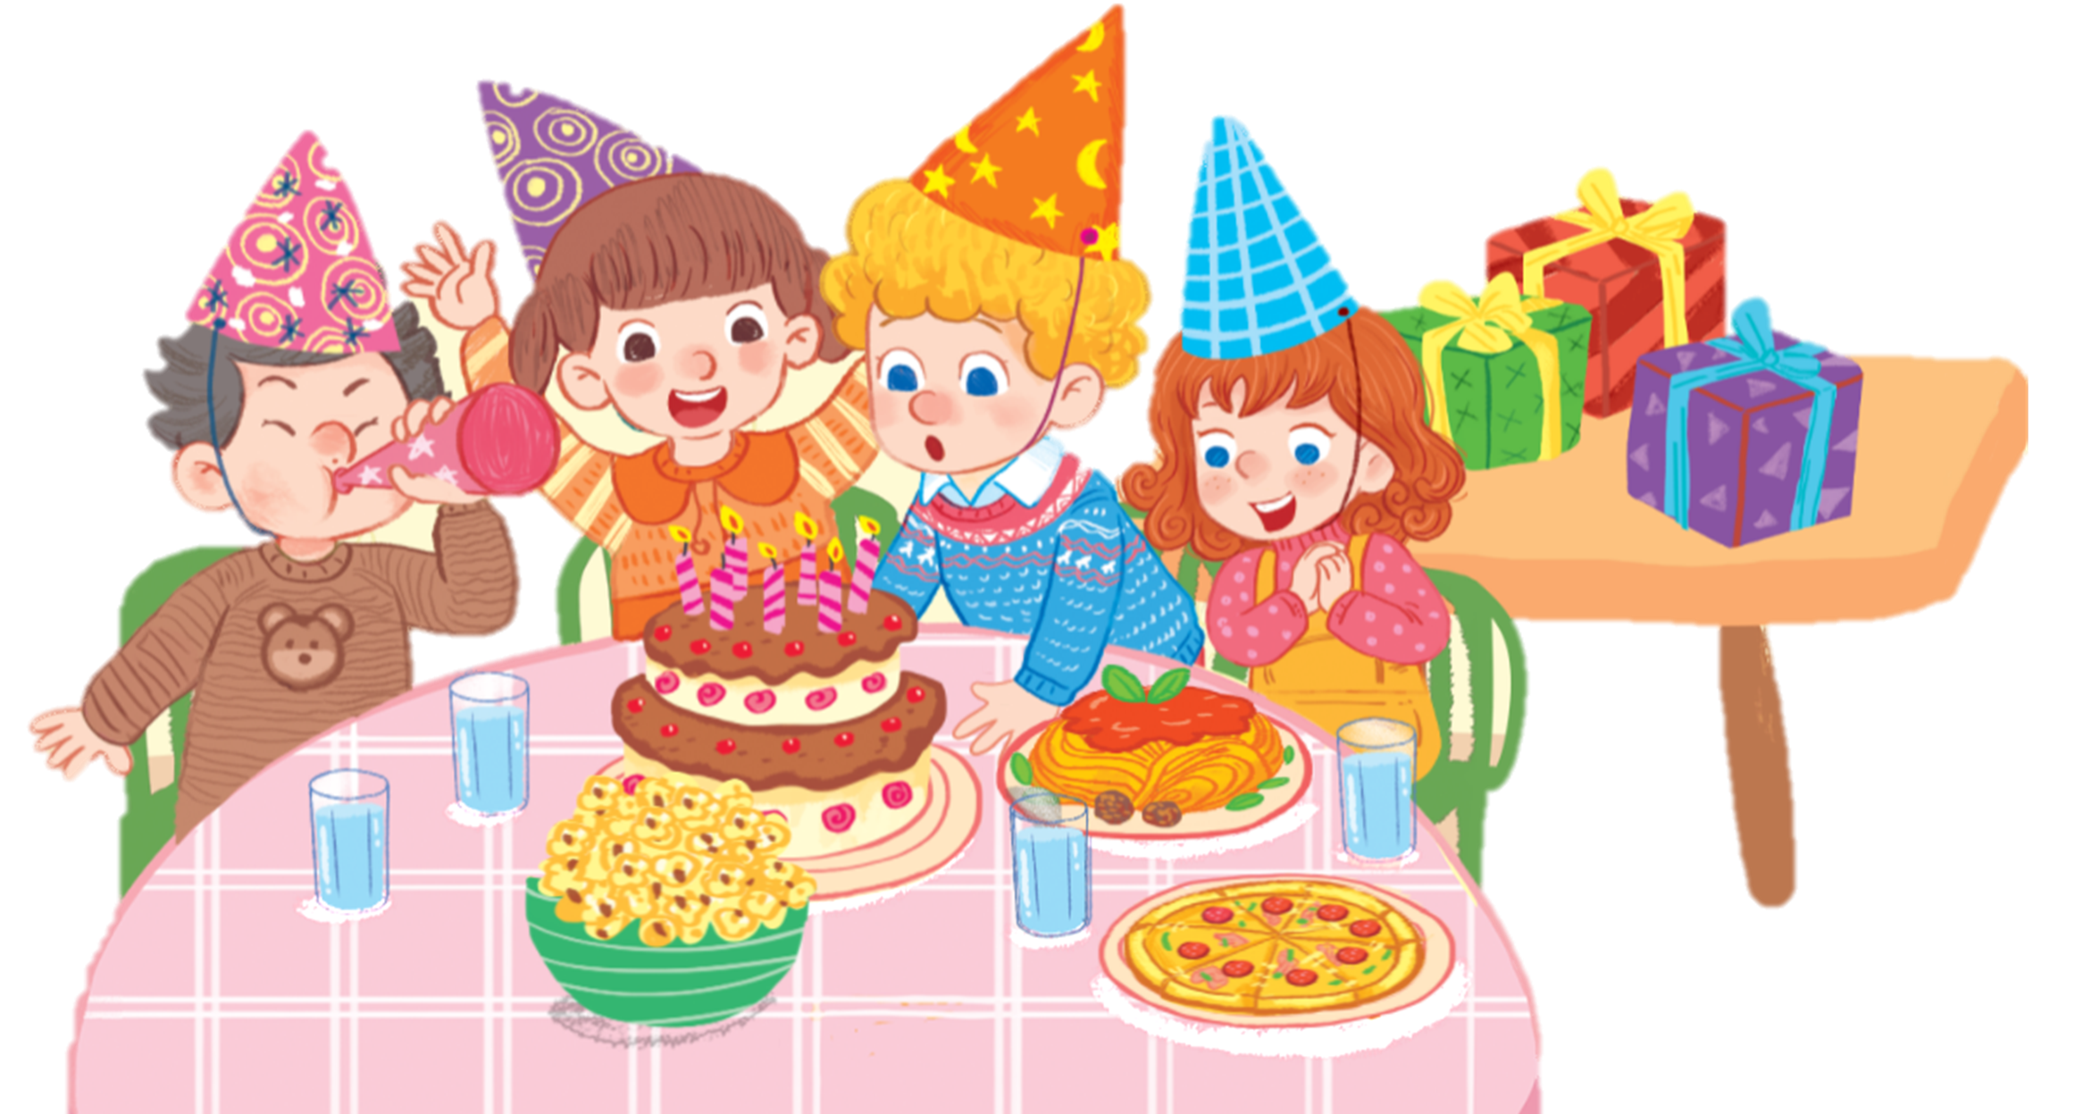
Pp

Slide 11
Pp
  pasta

Slide 12
Pp
  pasta
  pizza

Slide 13

  1. Listen and repeat.
Pp
  pasta
  popcorn
  pizza

Slide 14
  03
Activity 2
Point and say.
Notes:
https://www.youtube.com/watch?v=CrPVTFCF074

Slide 15
Pp
  pasta
  popcorn
  pizza

Slide 16





  Work in pairs.

Slide 17


  Look and say aloud.
popcorn

Slide 18
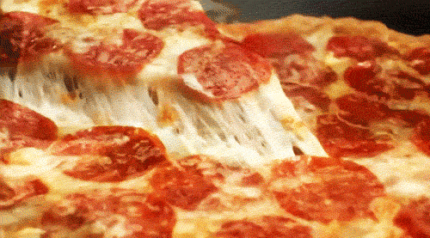
  Look and say aloud.
pizza

Slide 19
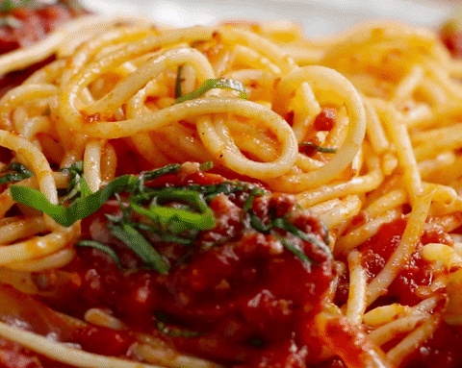
  Look and say aloud.
pasta

Slide 20

  Look and say aloud.
party

Slide 21
  04
Fun corner and Wrap-up
Notes:
https://www.youtube.com/watch?v=CrPVTFCF074

Slide 22
KIM’S GAME

Slide 23


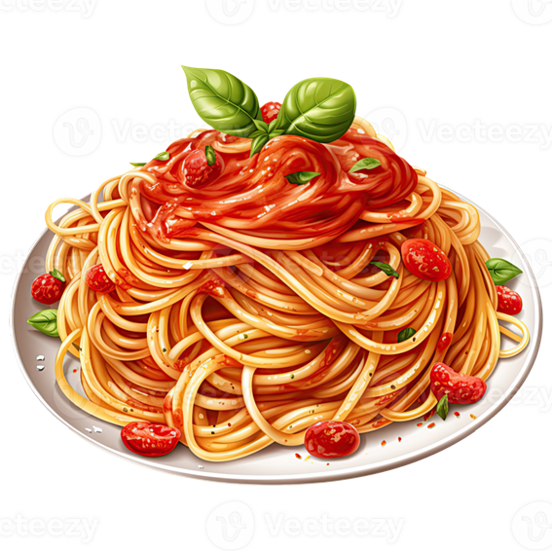

KIM’S GAME
(Turn 1)
Time’s up!

Slide 24



KIM’S GAME
(Turn 1)
pizza
popcorn
pasta

Slide 25

KIM’S GAME
(Turn 2)
Time’s up!

Slide 26



KIM’S GAME
(Turn 2)
popcorn
pasta
pizza

Slide 27

KIM’S GAME
(Turn 3)
popcorn
pizza
pasta
Time’s up!

Slide 28



KIM’S GAME
(Turn 3)
pizza
pasta
popcorn

Slide 29


Slide 30
Goodbye
Notes:
https://www.youtube.com/watch?v=E7BRrNU25lE

Slide 31
Website: hoclieu.vn
Fanpage: https://www.facebook.com/tienganhglobalsuccess.vn/

