Slide 2
WELCOME
To Our Class

Slide 3
Unit 3: At the seaside
Lesson 3 – Period 3

Slide 4
TABLE OF CONTENTS
1. Warm-up & Review
2. Activity 6. Listen and repeat.
3. Activity 7. Let’s talk.
4. Activity 8. Let’s sing.
5. Fun corner & Wrap-up

Slide 5
01
WARM-UP & REVIEW
Game: A magic apple

Slide 6
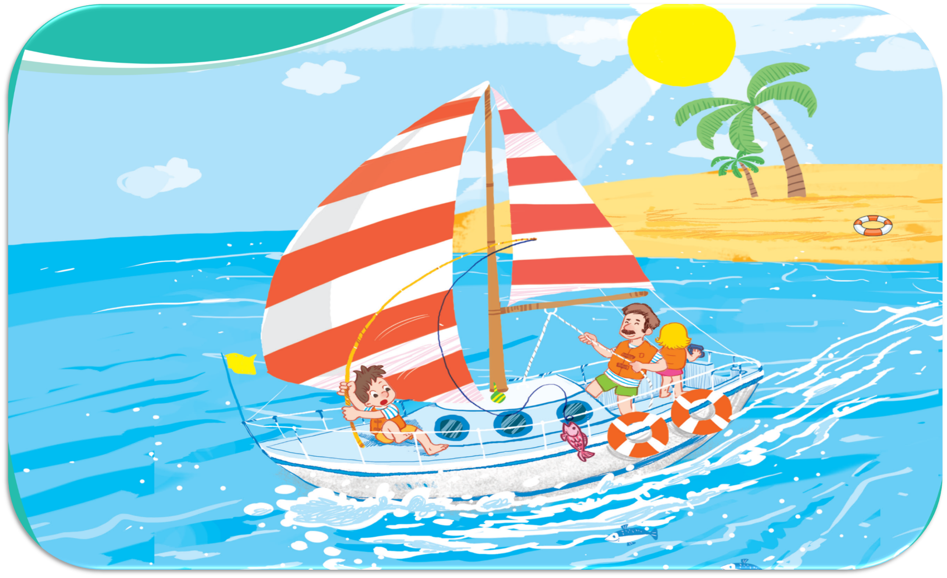
Oops, Try again!
3
2
5
4
6
1
Let’s look at the sail!
Let’s look at the seaside!
Let’s look at the sun!
7
Let’s look at the sand!
Let’s look at the sea!
TEAM 1
TEAM 2
Notes:
Click the apple to see the picture then say the sentences
Click the pictures to see the right sentences
Click the pictures again to clear them
Click the Team 1/ 2 to get points/ presents

Slide 7
Team 1
3
2
5
4
6
1
7
Back

Slide 8
Team 2
3
2
5
4
6
1
7
Back

Slide 9
Team …

Slide 10
02
Activity 6
Listen and repeat.

Slide 11
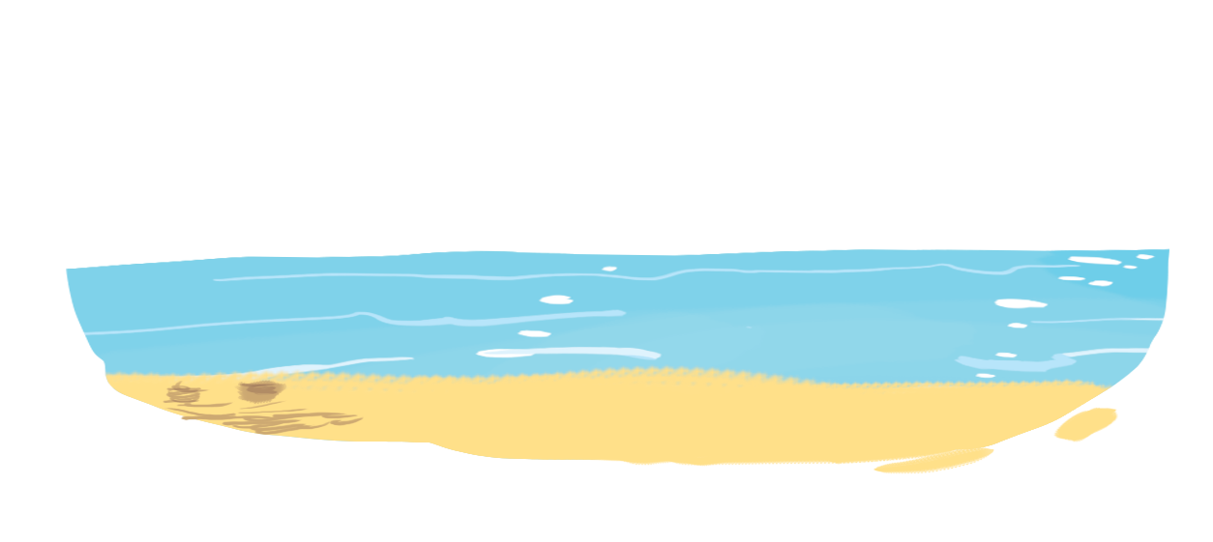
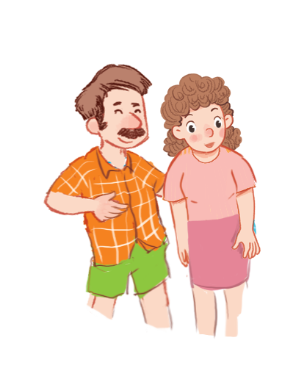
Unit
6. Listen and repeat.
Let’s look at the sea!

Slide 12
03
Activity 7
Let’s talk.

Slide 13
Unit
7. Let’s talk.
Let’s ____ !
a
b
c

Slide 14
Unit
7. Let’s talk.
Let’s ____ !
a

Slide 15
Unit
7. Let’s talk.
Let’s ____ !
b

Slide 16
Unit
7. Let’s talk.
Let’s ____ !
c

Slide 17
04
Activity 8
Let’s sing.

Slide 18
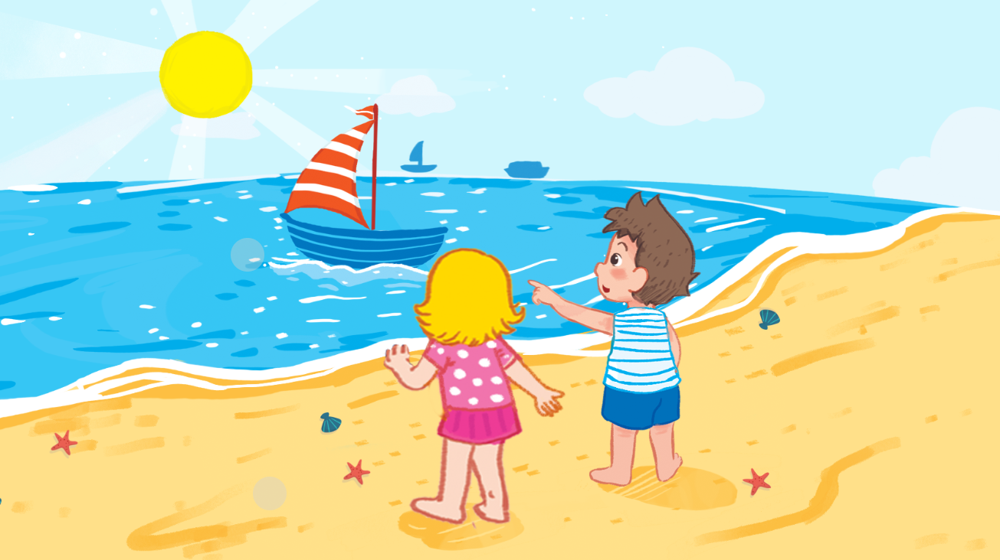
Unit
Let’s sing!

Slide 19
Unit
Let’s sing!
Saturday

Slide 20
Unit
Let’s sing!
sunny

Slide 21
Unit
Let’s sing!
It’s Saturday.
It’s a sunny day.
We’re at the seaside.
Let’s look at the sail!
It’s Sunday.
It’s a sunny day.
We’re at the seaside.
Let’s look at the sand!

Slide 23
Watch and sing along

Slide 24
05
Fun corner & Wrap-up
Game: Lucky numbers

Slide 25
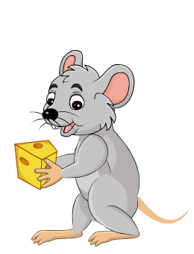
Game: Lucky numbers
1
2
3
4
You get points
5
6
7
8

Slide 26
Let’s ____________!
look at the sea

Slide 27
see the sail
I can __________.

Slide 28
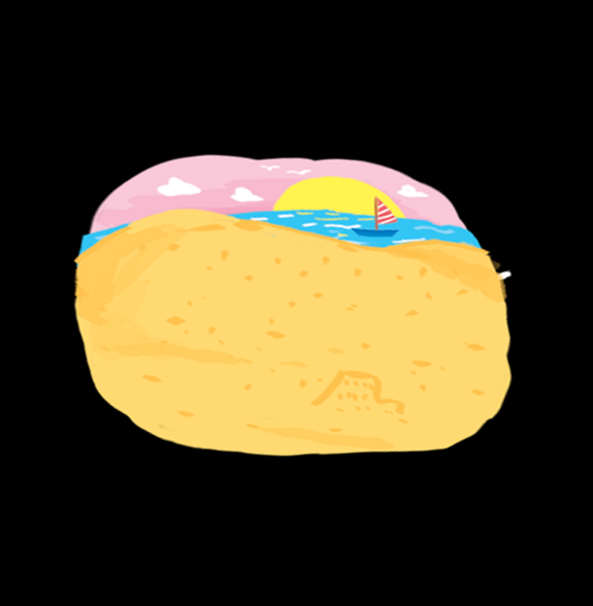
I can __________.
see the sand

Slide 29
sunny
It’s a ____ day.

Slide 32
Website: hoclieu.vn
Fanpage: https://www.facebook.com/tienganhglobalsuccess.vn/

