Slide 2
WELCOME
TO OUR CLASS

Slide 3
FUN TIME 1
Period 1

Slide 4
Table of contents
1. Warm-up & Review
2. Activity 1: Find and circle the words. Then say.
3. Activity 2: Let’s play.
4. Fun corner and Wrap-up

Slide 5
01 WARM-UP & REVIEW Game: Disappearing cards

Slide 6
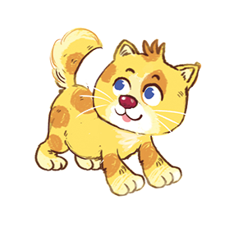
Game: Disappearing cards
Notes:
Click the circle to see the pictures
Click the pictures to cover it

Slide 7
02
Activity 1
Find and circle the words. Then say.

Slide 8
Find and circle the words.Then say.
obspizzanm
vokittenbh
abpopcornd
mkbikebdal
a
b
c
d

Slide 9
Find and circle the words. Then say.
obspizzanm
a

Slide 10
Find and circle the words. Then say.
vokittenbh
b

Slide 11
Find and circle the words. Then say.
abpopcornd
c

Slide 12
Find and circle the words. Then say.
mkbikebdal
d

Slide 13
Find and circle the words. Then say.
pizza
kitten
popcorn
bike
a
b
c
d

Slide 14
03
Activity 2
Let’s play.

Slide 15
Game: Stand up! Sit down!
pizza
kitten
bike
Notes:
Click the words first to stand up or sit down
Click the picture to see the answer
Click the picture inside to hear the sound

Slide 16
pizza
popcorn
kitten
Notes:
Click the words first to stand up or sit down
Click the picture to see the answer
Click the picture inside to hear the sound

Slide 17
kite
pasta
pizza
Notes:
Click the words first to stand up or sit down
Click the picture to see the answer
Click the picture inside to hear the sound

Slide 18
popcorn
kitten
bike
Notes:
Click the words first to stand up or sit down
Click the picture to see the answer
Click the picture inside to hear the sound

Slide 19
pizza
bike
pasta
Notes:
Click the words first to stand up or sit down
Click the picture to see the answer
Click the picture inside to hear the sound

Slide 20
04
Fun corner & Wrap-up
Option 1
Game: Word game

Slide 21
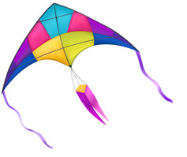
p
* Click to move pictures having the sound ‘’p’’ into the square.

Slide 22
p
* Click to move pictures having the sound ‘’p’’ into the square.

Slide 23
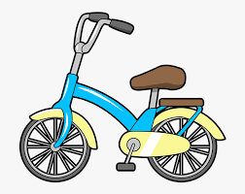
k
* Click to move pictures having the sound ‘’k’’ into the square.

Slide 24
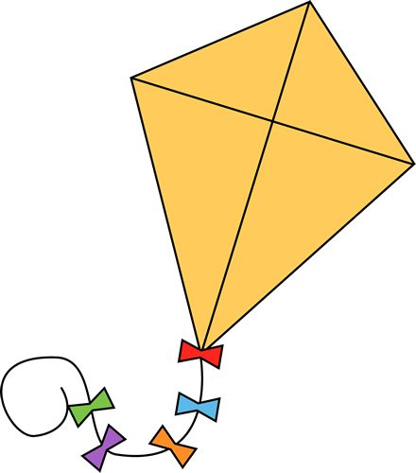
k
* Click to move pictures having the sound ‘’k’’ into the square.

Slide 25
Option 2
Game: Guess the word

Slide 26
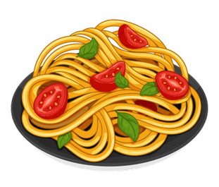
pasta
_ _ _ _ _

Slide 27
pizza
_ _ _ _ _

Slide 28
popcorn
p_ _c_ _n

Slide 29
kite

Slide 30
kitten
_ _t_ _ _

Slide 31
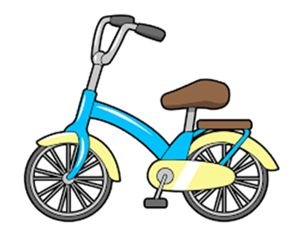
bike
_ _ _ _

Slide 33
Website: hoclieu.vn
Fanpage: https://www.facebook.com/tienganhglobalsuccess.vn/

