Slide 2
Unit 7 – Lesson 1 In the garden
Notes:
By the end of the unit, pupils will be able to:
- pronounce the sound of the letter G/g in isolation and in the words garden, girl, goat and gate correctly.
- say the sound of the letter G/g and the words garden, girl, goat and gate in a chant.
- recognize the words in different situations when listening.
- use There’s a ______. to introduce something.
- trace the letter G/g.
- sing a song with the structure There’s a ______ in the garden.
Lesson 1
By the end of the lesson 1, pupils will be able to:
pronounce the sound of the letter G/g in isolation and in the words garden, gate, girl and goat correctly.
point to the letter G/g and the girl/things/animal (garden, gate, girl, goat) in the picture and say the sound of the letter G/g and the words garden, gate, girl and goat.

Slide 3
Warm-up
Notes:
Game: Slap the board
Goals:
- Help pupils feel happy at the beginning of the lesson.
- Review vocabulary of the previous lesson.
Time limit: 5 mins
- Teacher sticks flashcards and word cards on the board.
- Teacher draws a circle under each picture.
- Teacher says a word, pupils slap the corresponding circle.
- Teacher may have pupils say the words.

Slide 4
Notes:
Goal:
- Pupils will be able to pronounce the sound of the letter G/g in isolation and in the words garden, gate, girl and goat correctly.
Step 1: Lead-in
Time limit: 3 mins
Objective: pupils are able to identify and pronounce sound /g/.
- Teacher shows letter “g” on slide and asks pupils What letter is this? and What sound does this make?
- Teacher pronounces sound /g/. Pupils listen and repeat. (as a class/ teams)
- Teacher says Today we are going to learn 4 words that have the sound /g/.
Step 2: Listen and repeat vocabulary
Time limit: 5 mins
Objectives: Pupils are able to identify and pronounce 4 words: garden, goat, girl, gate
- Teacher shows pictures on slide and says the words. (Teacher may pronounce each sound of the word separately, for example g – g – garden).
- Pupils listen to teacher and repeat.
Step 3: Quick check
Time limit: 4 mins
- Teacher checks pronunciation (as teams).
- Teacher sticks flashcards and word cards on the board randomly. Teacher has pupils go to the board and put word cards under the matching flashcards.
- Teacher checks pronunciation individually. Teacher points to a picture and has a pupil say the word.

Slide 5
g

Slide 6
garden

Slide 7
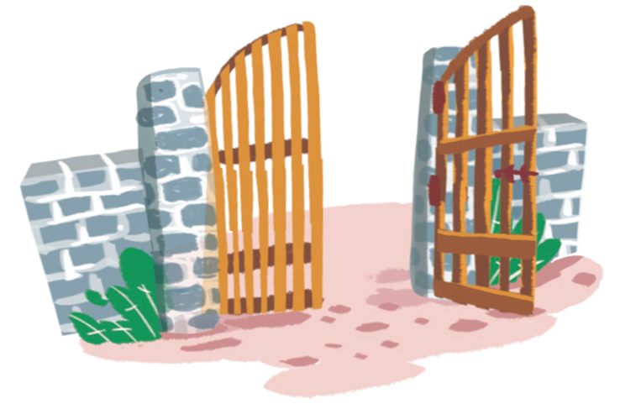
gate

Slide 8
girl

Slide 9
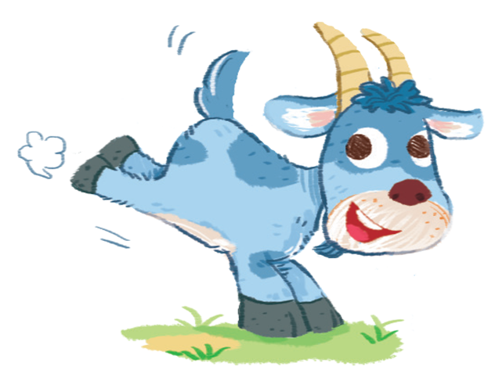
goat

Slide 10
Notes:
Goal:
- Pupils will be able to point to the letter G/g and the girl/things/animal (garden, gate, girl, goat) in the picture and say the sound of the letter G/g and the words garden, gate, girl and goat.
Step 1: Listen, point and say
Objective: Pupils are able to point to the correct picture and pronounce the words.
Time limit: 3 mins
- Teacher plays the audio, pupils listen and point only.
- Then pupils point and say the words.
Pupils repeat the words as a class and teams.
Step 2: Point and say (in pairs)
Time limit: 3 mins
Pupils work in pairs: 1 pupil points, 1 pupils says the words.
Teacher goes around the class and gives feedback on pupils’ pronunciation.
Step 3: Quick check
Game: What’s missing?
- Teacher sticks 4 flashcards: girl, gate, goat and garden on the board.
- Teacher says Go to sleep, whole class close their eyes.
- Teacher takes one flashcard away, then says Wake up, pupils open their eyes and says the missing picture.

Slide 11
GAME
Notes:
Game: Hungry Bobby
Time limit: 5 mins
- Teacher shows a picture covered partly by a wheel turning 360* clockwise.
Teacher has 1 pupil from each team in a turn. Pupils look and say the word. Faster team gets 2 stars, the others get 1 star.
Teacher has whole class read the word out loud at the end of a turn.

Slide 12
garden

Slide 13
gate

Slide 14
girl

Slide 15
goat

Slide 16
Goodbye
Notes:
- Teacher shows the vocabulary of the lesson on slide.
- Pupils say goodbye.

Slide 17
Goodbye

Slide 18
Goodbye

Slide 19
Goodbye

Slide 20
Website: hoclieu.vn
Fanpage: facebook.com/www.tienganhglobalsuccess.vn

