Slide 2
Unit 1. All about me!
Lesson 2 - Period 4

Slide 3
Table of contents
01
Warm-up and review
02
Listen and match.
03
Read and complete.
04
Let’s play.
05
Fun corner and wrap-up

Slide 4
01
Warm-up and review

Slide 5
02
Listen and match.

Slide 6
Lucky Windows
Game

Slide 7
What’s your favourite ____?
It’s ____.

Slide 8
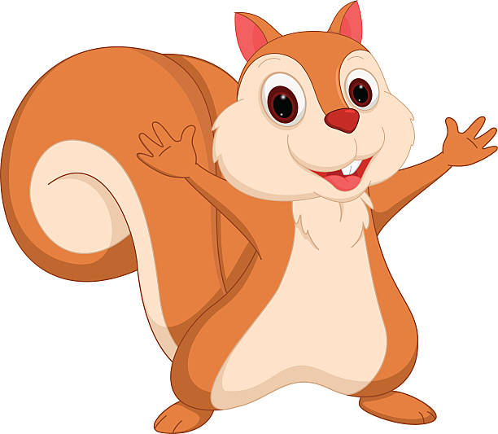
Team: Rabbit
Team: Squirrel

Slide 9
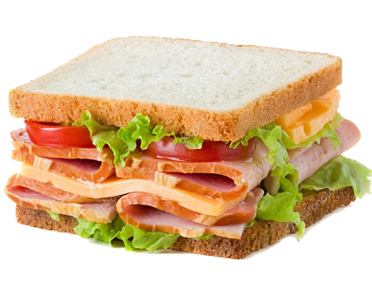
Notes:
Nháy vào cửa sổ để mở, nháy vào hình để đi tới Slide tương ứng.

Slide 10
What’s your favourite sport?
It’s table tennis.
Notes:
Click vào hình ảnh để xuất hiện mẫu câu

Slide 11
What’s your favourite colour?
It’s pink.
Notes:
Click vào hình ảnh để xuất hiện mẫu câu

Slide 12
What’s your favourite animal?
It’s a dolphin.
Notes:
Click vào hình ảnh để xuất hiện mẫu câu

Slide 13
What’s your favourite food?
It’s a sandwich.
Notes:
Click vào hình ảnh để xuất hiện mẫu câu

Slide 14
Summary
Team: Rabbit
Team: Squirrel
Notes:
GV nháy vào biểu tượng của đội chơi để tính điểm cho các đội. Mỗi lần nháy 1 ngôi sao xuất hiện.

Slide 15
Listen and match.

Slide 16
03
Read and complete

Slide 17
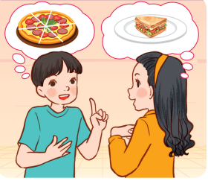
Read and complete.

Slide 18
Read and complete.
1.
A: Where were you yesterday?
B: I was at the zoo.
A: What’s your favourite animal?
B: It’s _________.
A: _____ do you like it?
B: Because it jumps and dances beautifully.
a dolphin
Why

Slide 19
Read and complete.
2.
pizza
A: My favourite food is ______.
Do you like pizza, too?
B: No, I _____.
A: What’s your favourite food?
B: It’s ___________.
A: A sandwich?
B: Yes. I love sandwiches.
don’t
a sandwich

Slide 20
Read and complete.
1.
A: Where were you yesterday?
B: I was at the zoo.
A: What’s your favourite animal?
B: It’s ________.
A: _____ do you like it?
B: Because it jumps and dances beautifully.
a dolphin
Why
2.
pizza
A: My favourite food is ______.
Do you like pizza, too?
B: No, I ______.
A: What’s your favourite food?
B: It’s ___________.
A: A sandwich?
B: Yes. I love sandwiches.
don’t
a sandwich

Slide 21
04
Let’s play.

Slide 22
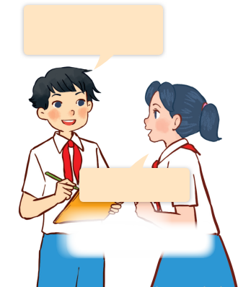
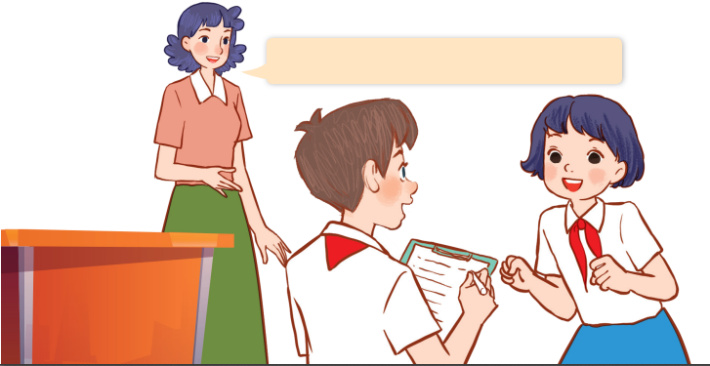
Let’s play.
Find someone who …
What’s your favourite animal?
Find someone who likes dolphins.
It’s a dolphin.

Slide 23
05
Fun corner and wrap-up

Slide 24
Guessing Game

Slide 25
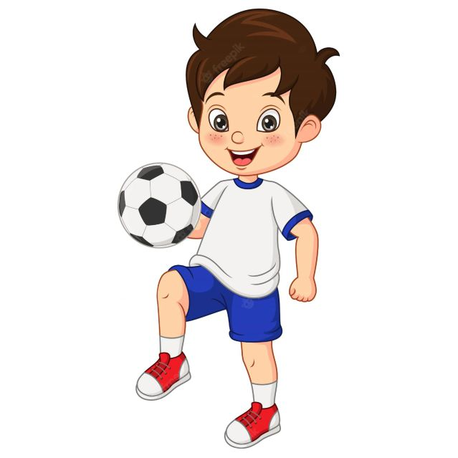
What’s your favourite _____?
sport
football
It’s ________.

Slide 26
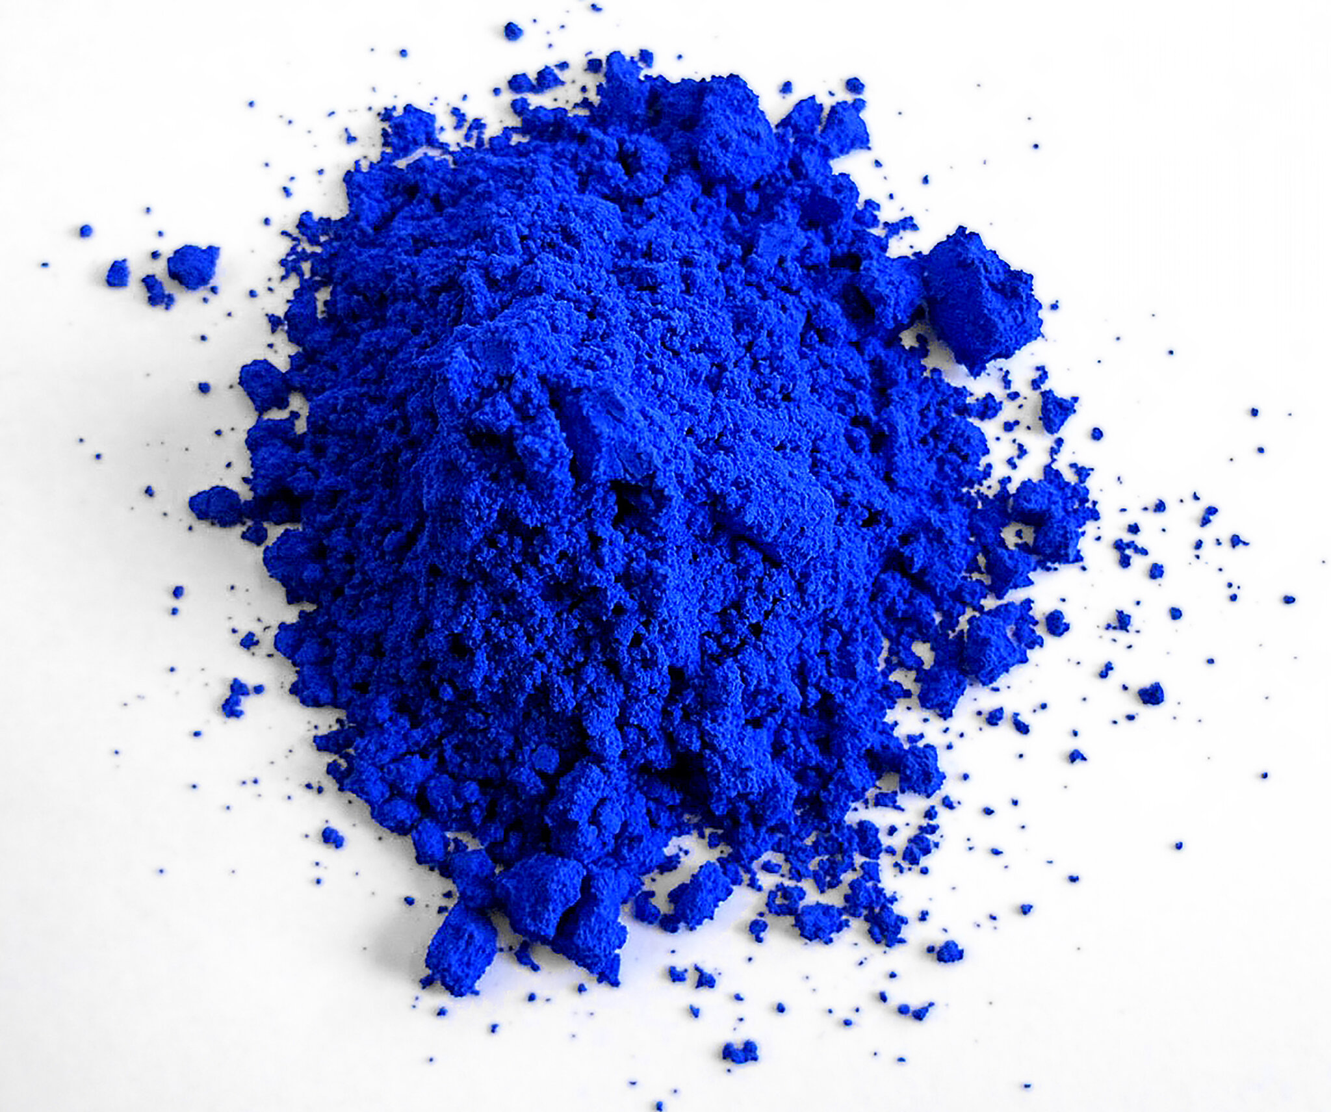
What’s your favourite ______?
blue
It’s ____.
colour

Slide 27
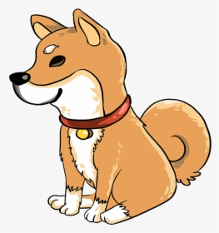
What’s your favourite ______?
a dog
It’s _____.
animal

Slide 28
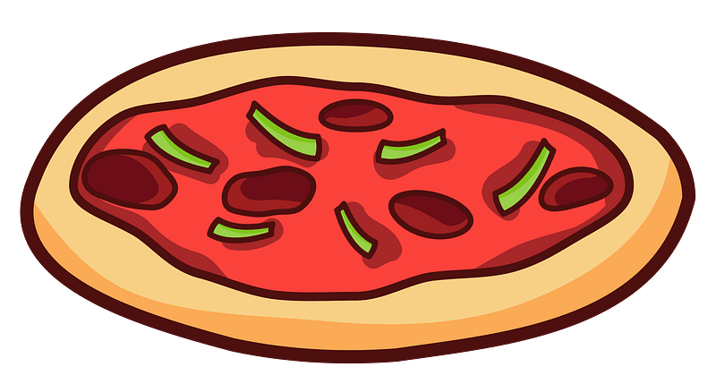
What’s your favourite ____?
a pizza
It’s ______.
food

Slide 29
Website: hoclieu.vn
Fanpage: https://www.facebook.com/tienganhglobalsuccess.vn/

