Slide 2
Unit 1. All about me!
Lesson 3 - Period 6

Slide 3
Table of contents
01
Warm-up and review
02
Read and circle.
03
Let’s write.
04
Project
05
Fun corner and wrap-up

Slide 4
01
Warm-up and review

Slide 5
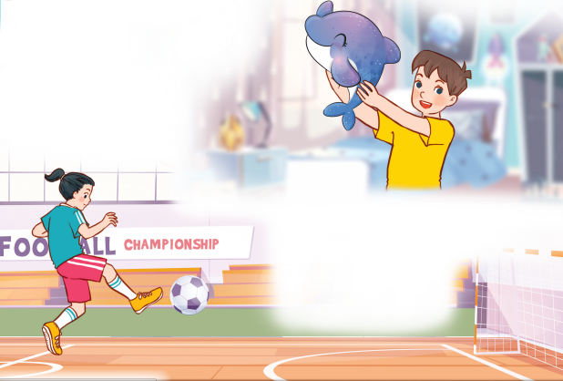
Let’s chant.
What’s your favourite animal?
Do you like pandas?
No, I don’t.
I don’t like pandas.
I like dolphins.
What’s your favourite sport?
Do you like tennis?
No, I don’t.
I don’t like tennis.
I like football.

Slide 6
Let’s chant.
What’s your favourite animal?
Do you like pandas?
No, I don’t.
I don’t like pandas.
I like dolphins.
What’s your favourite sport?
Do you like tennis?
No, I don’t.
I don’t like tennis.
I like football.

Slide 7
02
Read and circle.

Slide 8
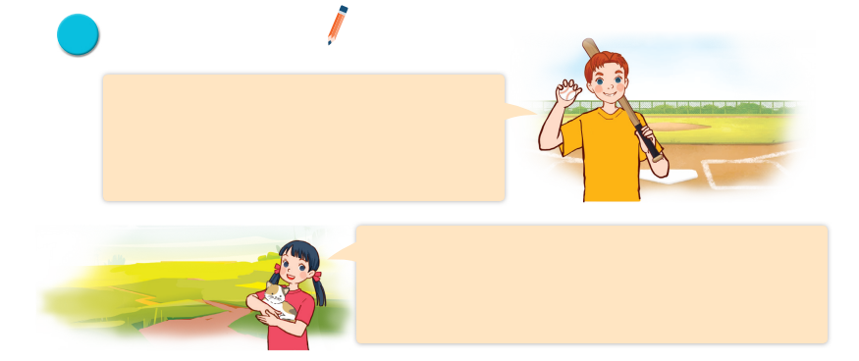
Read and circle.
Hi, all. Let me tell you a little bit about myself. My name’s Tom. I’m in Grade 5. I live in a big city. My favourite subject is maths. My favourite food is fish and chips. I’m a big fan of baseball.
It’s really fun.
Hello, everyone. Let me introduce myself. My full name’s Le Mai Lan. You can call me Lan. I’m in Class 5C. I live in the countryside. I love pets. I have two kittens and a rabbit. My favourite colour is pink. My favourite food is chicken pho. Yum!

Slide 9
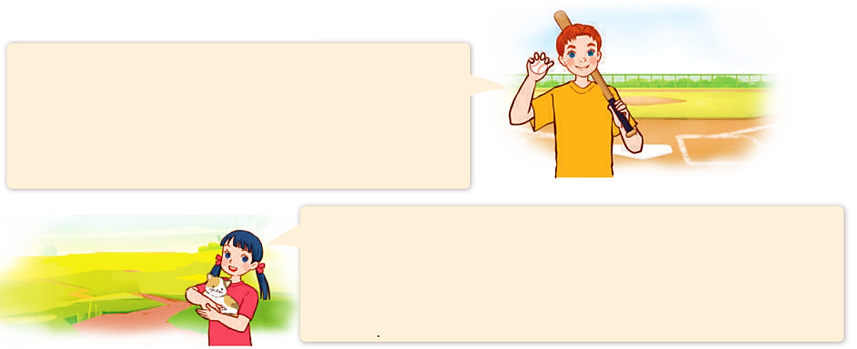
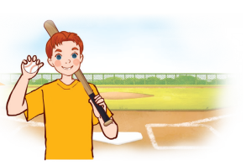
Read and circle.
Hi, all. Let me tell you a little bit about myself. My name’s Tom. I’m in Grade 5. I live in a big city. My favourite subject is maths. My favourite food is fish and chips. I’m a big fan of baseball.
It’s really fun.
Hello, everyone. Let me introduce myself. My full name’s Le Mai Lan. You can call me Lan. I’m in Class 5C. I live in the countryside. I love pets. I have two kittens and a rabbit. My favourite colour is pink. My favourite food is chicken pho. Yum!
1. Tom lives in _______.
a. a big village b. a big city c. a big town

Slide 10
Read and circle.
Hi, all. Let me tell you a little bit about myself. My name’s Tom. I’m in Grade 5. I live in a big city. My favourite subject is maths. My favourite food is fish and chips. I’m a big fan of baseball.
It’s really fun.
Hello, everyone. Let me introduce myself. My full name’s Le Mai Lan. You can call me Lan. I’m in Class 5C. I live in the countryside. I love pets. I have two kittens and a rabbit. My favourite colour is pink. My favourite food is chicken pho. Yum!
2. He likes _______.
a. fish and rice b. chicken and chips c. fish and chip

Slide 11
Read and circle.
Hi, all. Let me tell you a little bit about myself. My name’s Tom. I’m in Grade 5. I live in a big city. My favourite subject is maths. My favourite food is fish and chips. I’m a big fan of baseball.
It’s really fun.
Hello, everyone. Let me introduce myself. My full name’s Le Mai Lan. You can call me Lan. I’m in Class 5C. I live in the countryside. I love pets. I have two kittens and a rabbit. My favourite colour is pink. My favourite food is chicken pho. Yum!
3. Lan is in _______.
a. Class 4C b. Class 5C c. Class 3C

Slide 12
Read and circle.
Hi, all. Let me tell you a little bit about myself. My name’s Tom. I’m in Grade 5. I live in a big city. My favourite subject is maths. My favourite food is fish and chips. I’m a big fan of baseball.
It’s really fun.
Hello, everyone. Let me introduce myself. My full name’s Le Mai Lan. You can call me Lan. I’m in Class 5C. I live in the countryside. I love pets. I have two kittens and a rabbit. My favourite colour is pink. My favourite food is chicken pho. Yum!
4. Her favourite colour is _______.
a. pink b. green c. blue

Slide 13
Read and circle.
Hi, all. Let me tell you a little bit about myself. My name’s Tom. I’m in Grade 5. I live in a big city. My favourite subject is maths. My favourite food is fish and chips. I’m a big fan of baseball.
It’s really fun.
Hello, everyone. Let me introduce myself. My full name’s Le Mai Lan. You can call me Lan. I’m in Class 5C. I live in the countryside. I love pets. I have two kittens and a rabbit. My favourite colour is pink. My favourite food is chicken pho. Yum!
4. Her favourite colour is _______.
a. pink b. green c. blue

Slide 14
Read and circle.
Hi, all. Let me tell you a little bit about myself. My name’s Tom. I’m in Grade 5. I live in a big city. My favourite subject is maths. My favourite food is fish and chips. I’m a big fan of baseball.
It’s really fun.
Hello, everyone. Let me introduce myself. My full name’s Le Mai Lan. You can call me Lan. I’m in Class 5C. I live in the countryside. I love pets. I have two kittens and a rabbit. My favourite colour is pink. My favourite food is chicken pho. Yum!
1. Tom lives in _______.
a. a big village b. a big city c. a big town
2. He likes _______.
a. fish and rice b. chicken and chips c. fish and chips
3. Lan is in _______.
a. Class 4C b. Class 5C c. Class 3C
4. Her favourite colour is _______.
a. pink b. green c. blue

Slide 15
03
Let’s write.

Slide 16
Let’s write.
My name is _________. I live in the __________________. I am in Class _______. My favourite sport is ____________. My favourite food is ___________________. My favourite colour is ___________________. My favourite animal is ___________________.
What about you? What are your favourite things?

Slide 17
Let’s write.
Nam
My name is _____.

Slide 18
04
Project

Slide 19
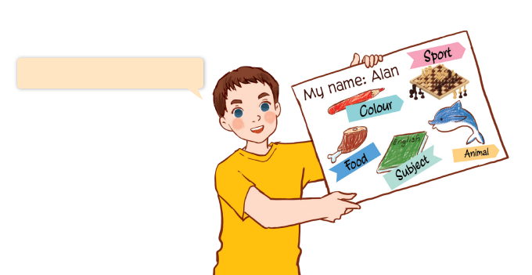
Project
My favourite things
My favourite colour is red.

Slide 20
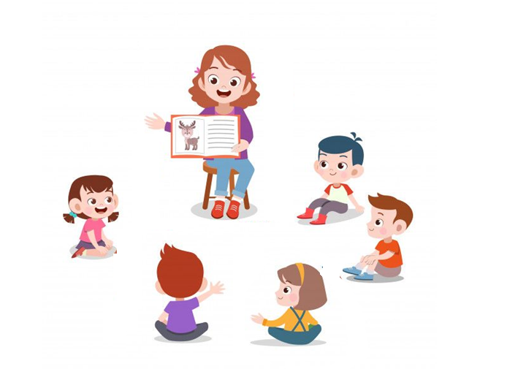
My favourite food is chicken.
My favourite sport is chess.

Slide 21
05
Fun corner and wrap-up

Slide 23
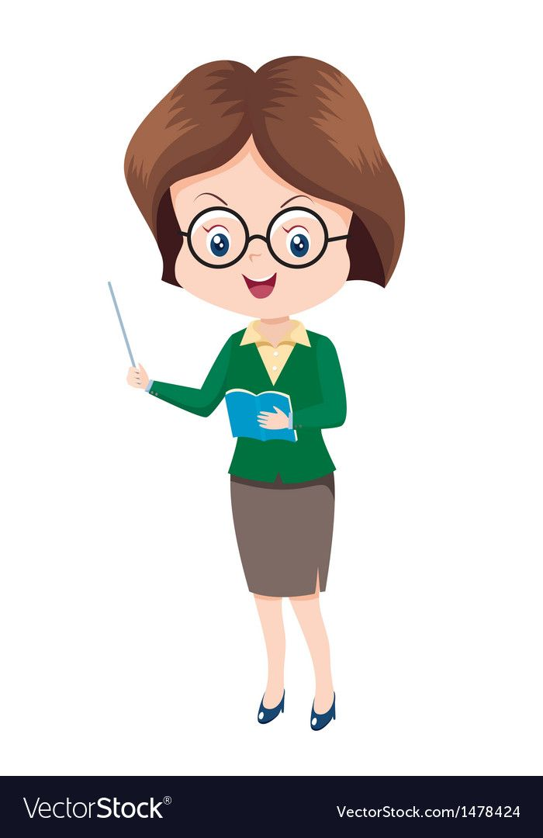
What’s your favourite animal?

Slide 24
What’s your favourite sport?

Slide 25
What’s your favourite food?

Slide 26
What’s your favourite colour?

Slide 27
Website: hoclieu.vn
Fanpage: https://www.facebook.com/tienganhglobalsuccess.vn/

