Slide 2
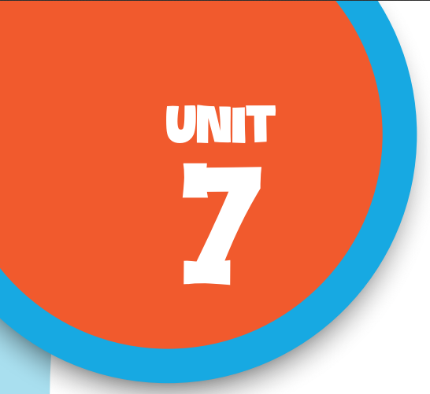
Our favourite
school activities
Lesson 2 - Period 3

Slide 3
Table of contents
01
Warm-up & Review
02
Look, listen and repeat.
Listen, point and say.
03
04
Let’s talk.
05
Fun corner & Wrap-up

Slide 4
01
Warm-up
& Review

Slide 5
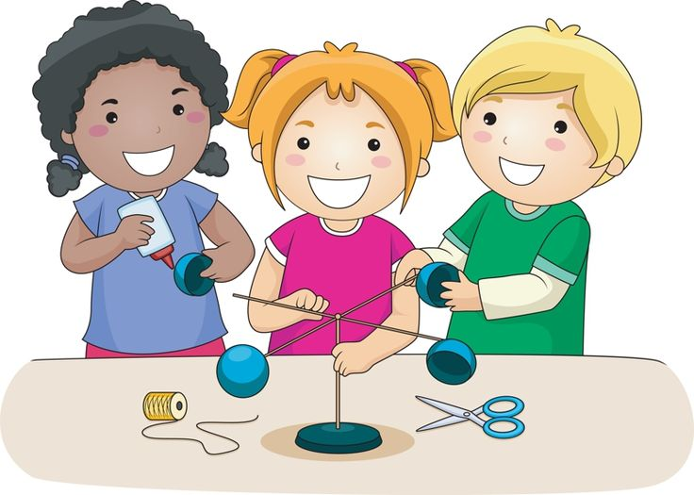
do projects

Slide 6
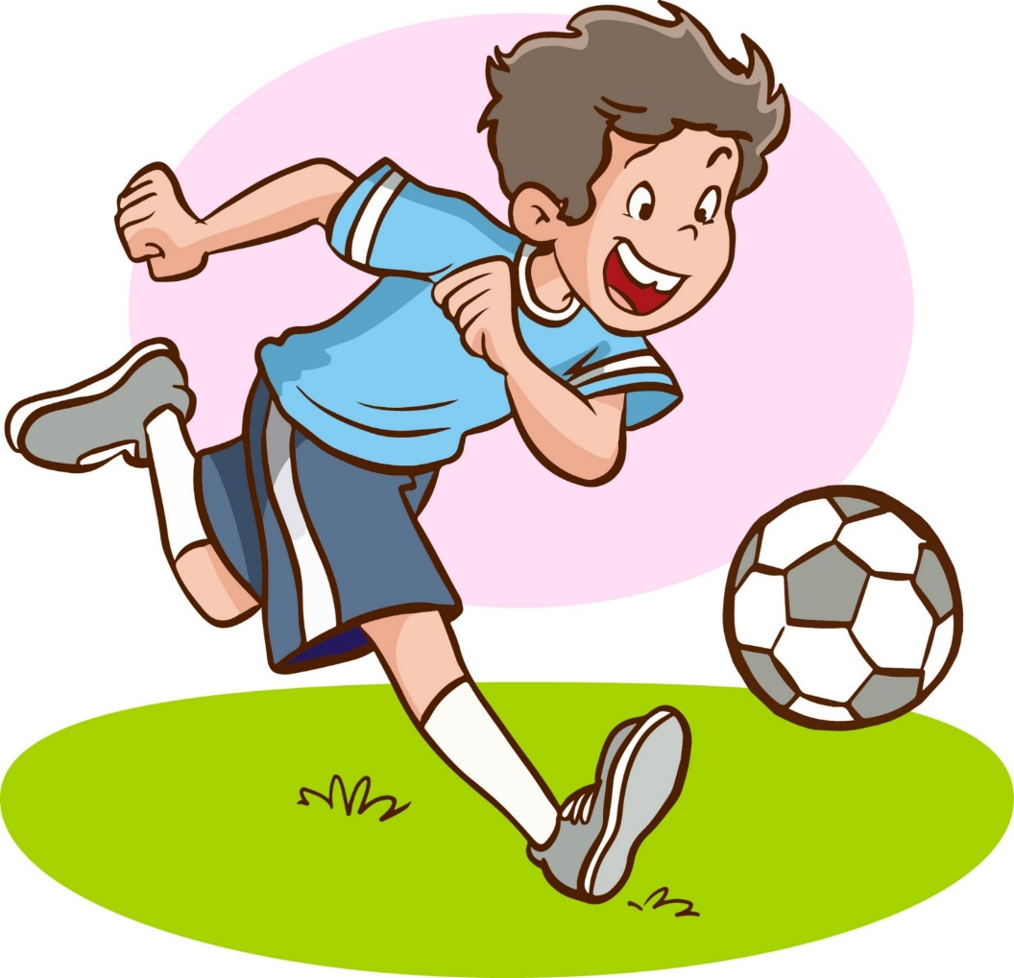
play football

Slide 7
read books

Slide 8
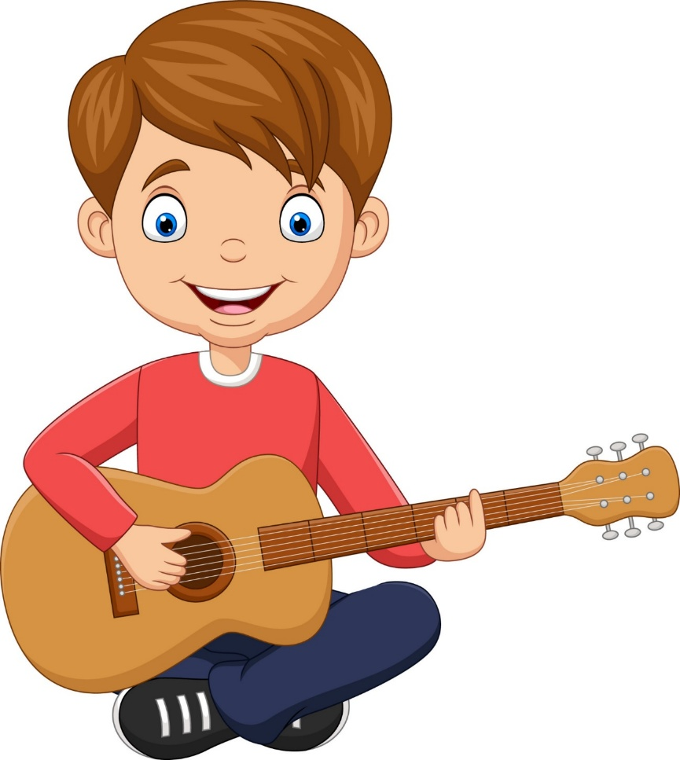
play the guitar

Slide 9
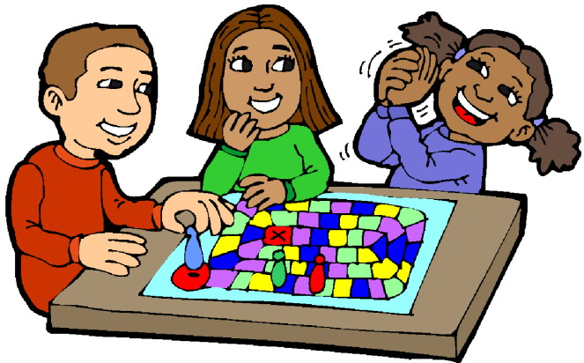
play games

Slide 10
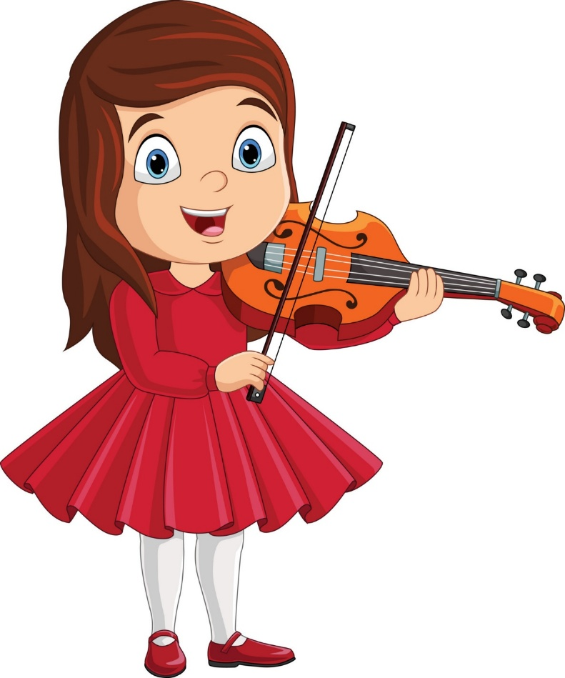
play the violin

Slide 11
02
Look, listen
and repeat.

Slide 12
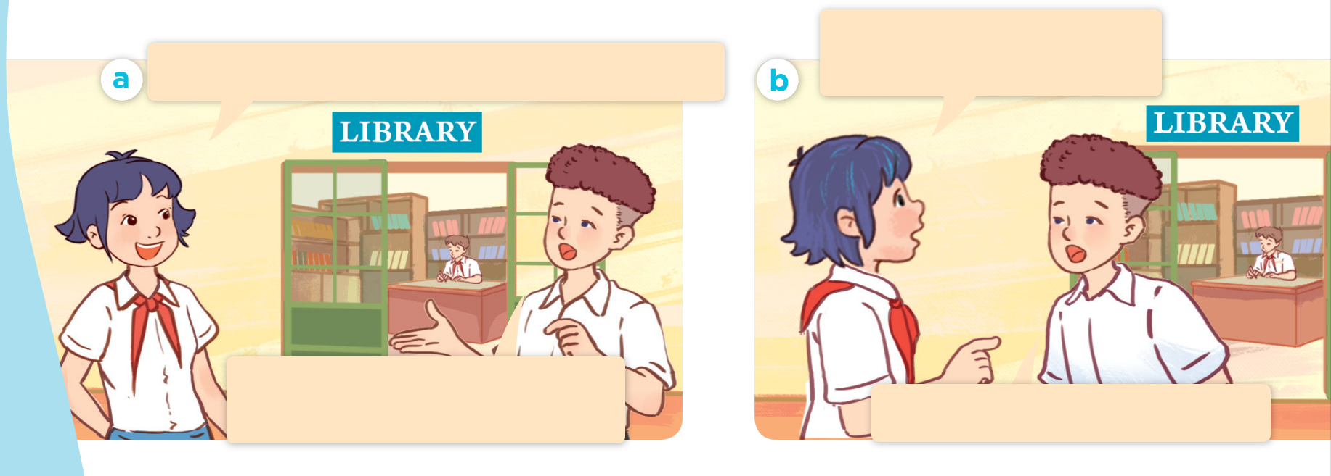
What are they talking about?
Why does he like solving maths problems?
Hi, Tom. I can’t see Minh. What’s he doing?
He’s solving maths problems in the library. He likes maths.
Because he thinks it’s useful.

Slide 13
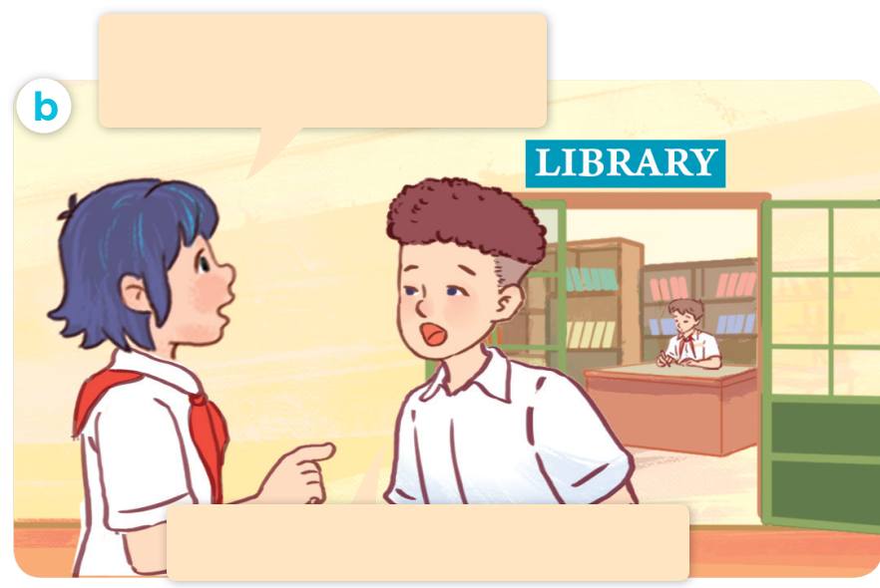
We use “Why” to ask about reasons.
Why does he like solving maths problems?
Because he thinks it’s useful.
Reason why he likes maths.

Slide 14
Listen and repeat.
Why does he like solving maths problems?
Hi, Tom. I can’t see Minh. What’s he doing?
He’s solving maths problems in the library. He likes maths.
Because he thinks it’s useful.

Slide 15
Why does he like
solving maths problems?
Because he thinks it’s useful.

Slide 16
03
Listen, point
and say.

Slide 17
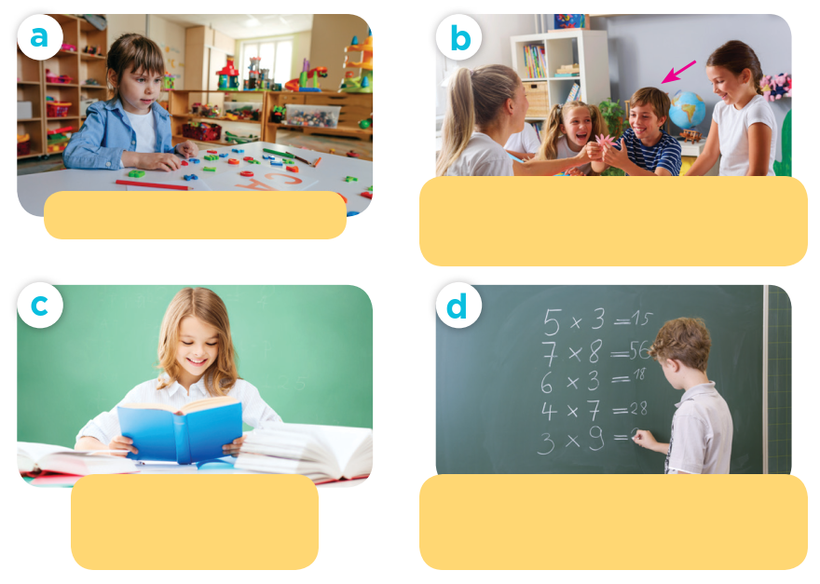
Look and guess.

Slide 18
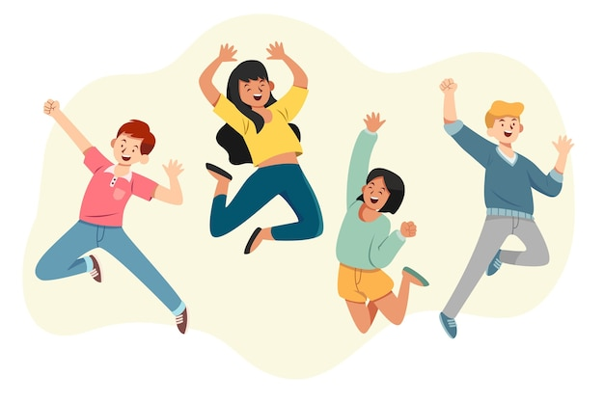
fun
We had a lot of fun.

Slide 19
useful
This tools are useful.

Slide 20
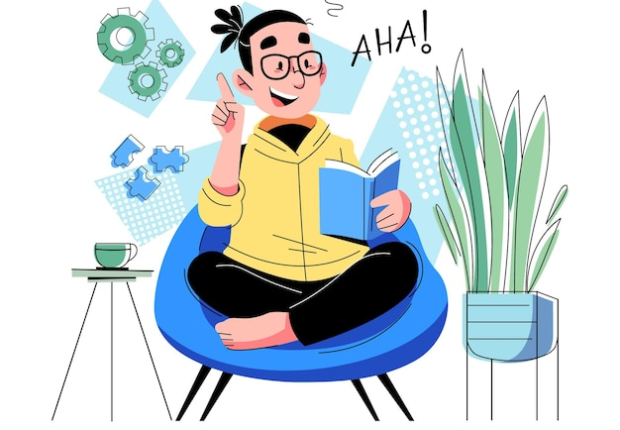
interesting
This book is interesting.

Slide 21
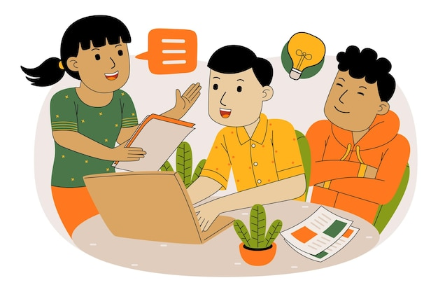
good for group work
Doing projects is good for group work.

Slide 22
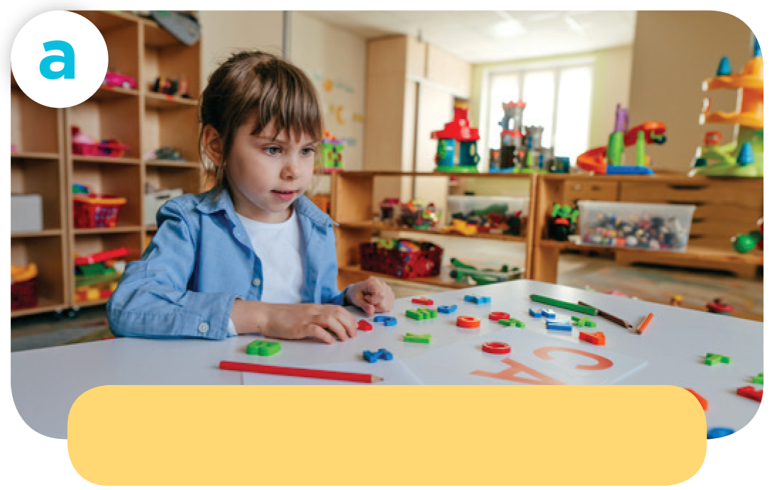
Why does she like playing games?
play games / fun
Because she thinks it’s fun.

Slide 23
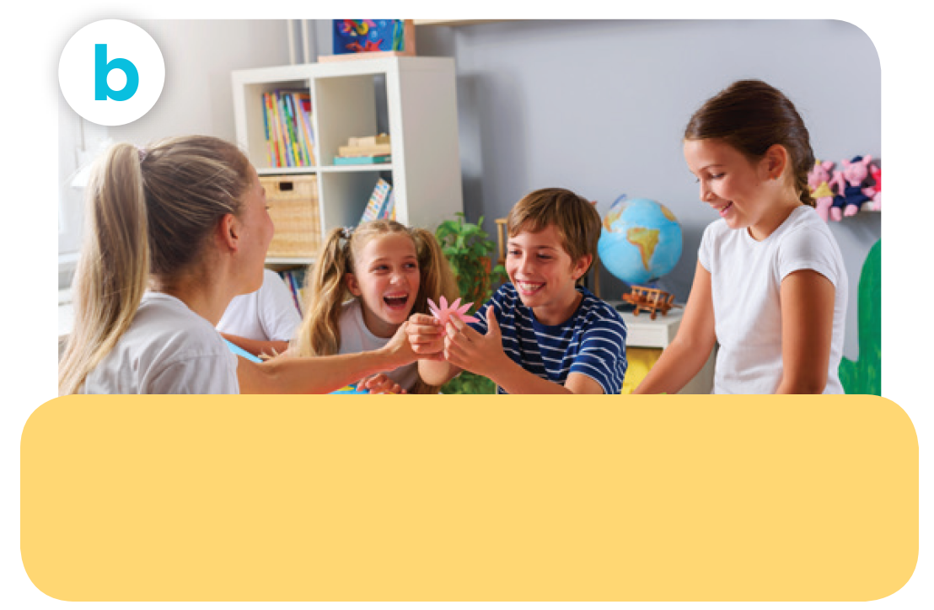
Why does he like doing projects?
do projects / good for group work
Because he thinks
it’s good for group work.

Slide 24
Why does she like reading books?
read books / interesting
Because she thinks it’s interesting.

Slide 25
Why does he like
solving maths problems?
solve maths problems / useful
Because he thinks it’s useful.

Slide 26
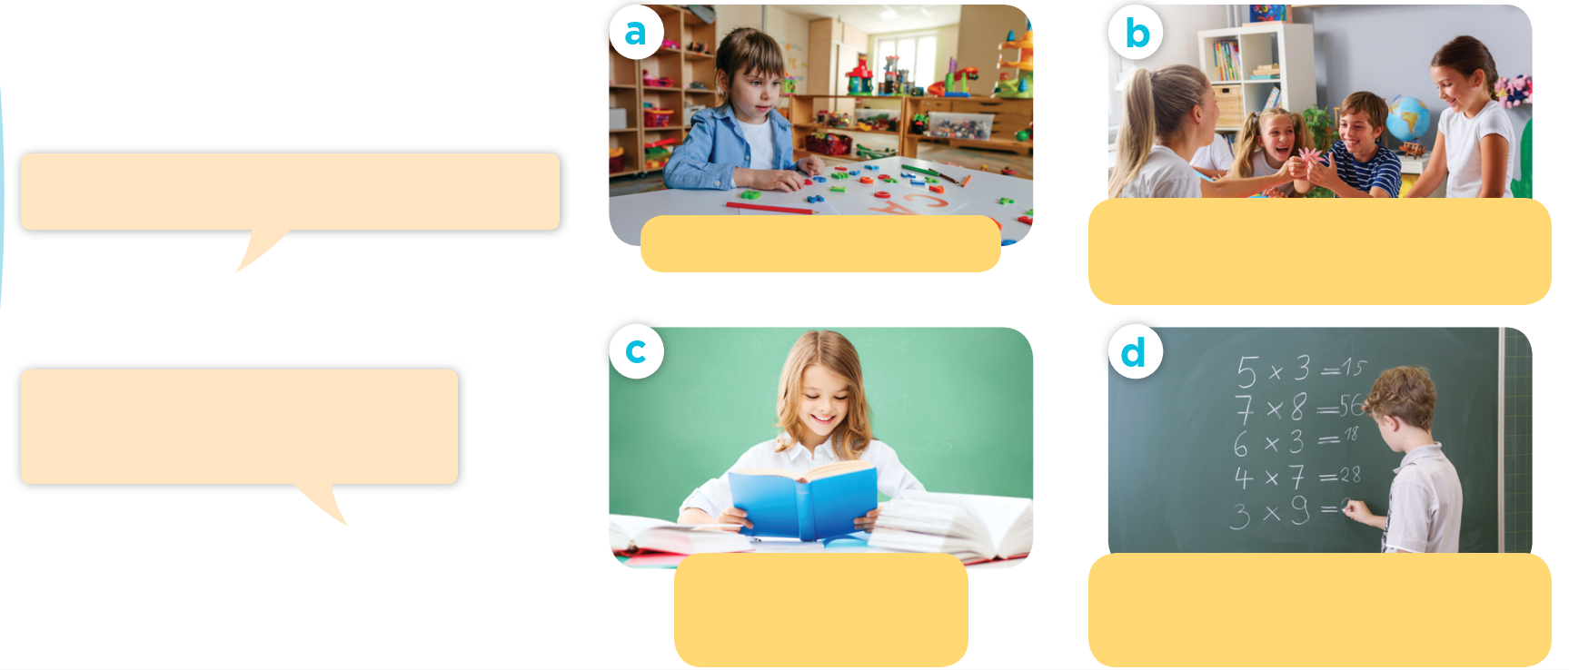
Listen and repeat.
Work in pairs. Ask and answer.
Why does he / she like __?
play games / fun
do projects / good for group work
Because he / she thinks it’s _______.
read books / interesting
solve maths problems/ useful

Slide 27
04
Let’s talk.

Slide 28
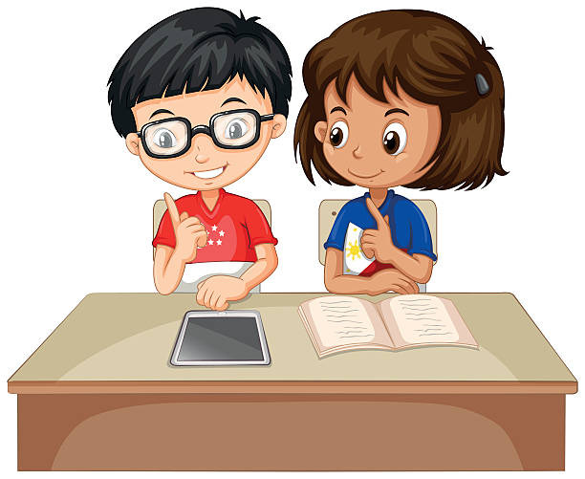
Why does he / she like _______?
Because he / she thinks ______.

Slide 29
05
Fun corner & Wrap-up

Slide 30
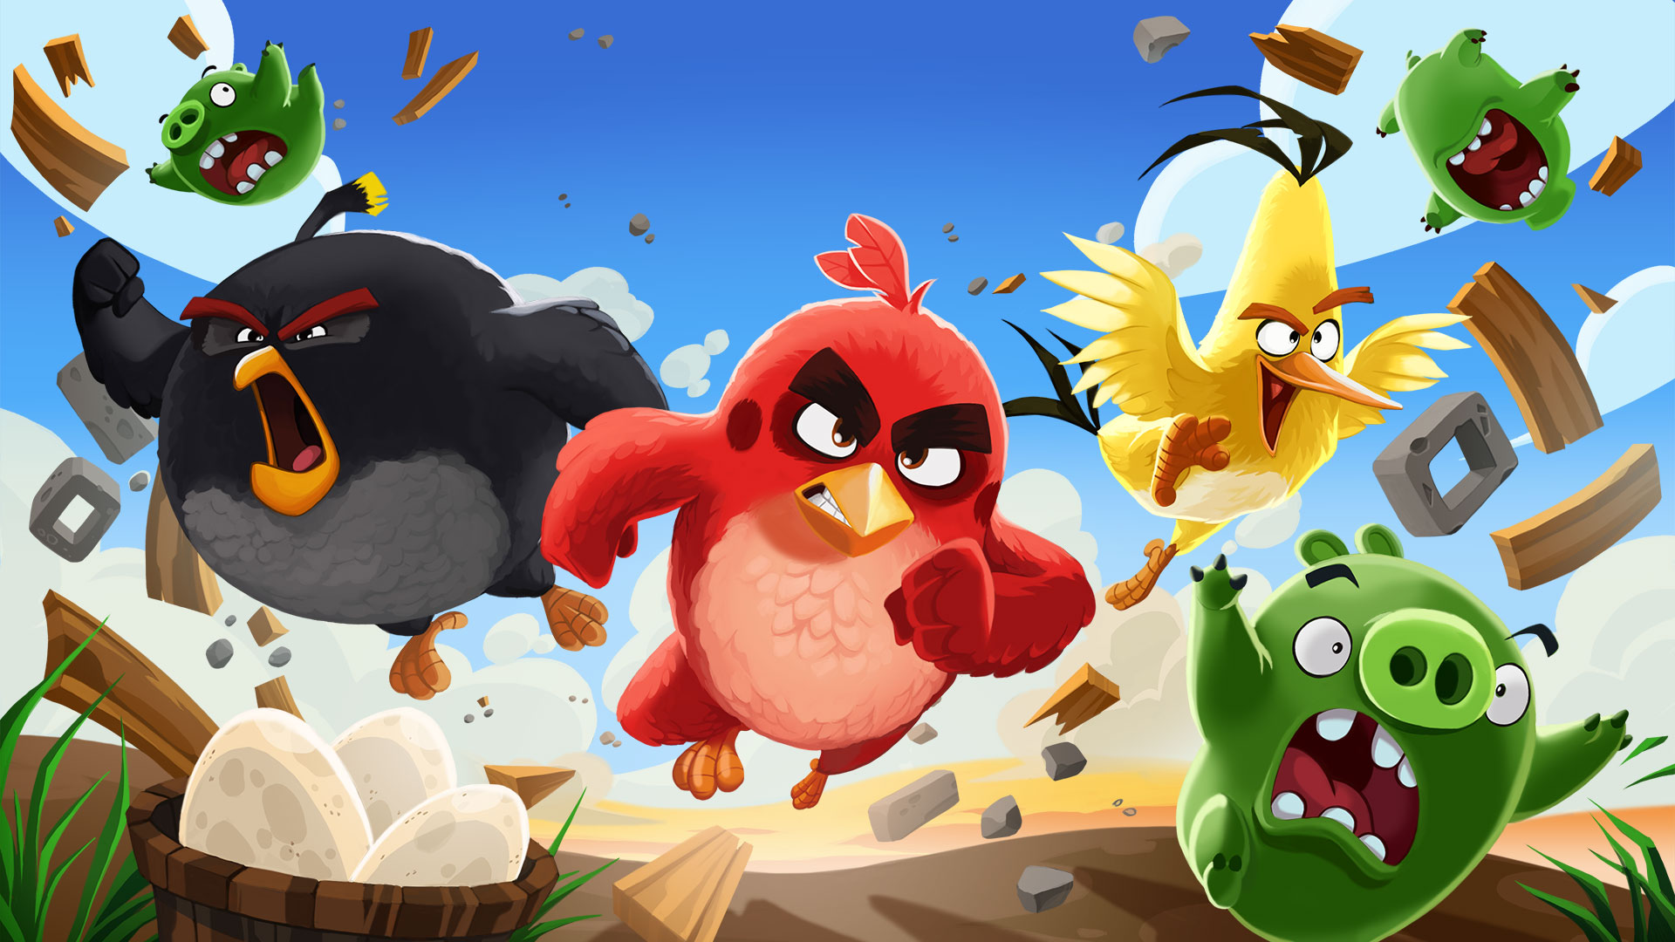

Slide 31
1
2
3
4
5
6
7
8
1
2
3
4
5
6
7
8
1 point
3 points
Take 5 points
2 points
4 points
Notes:
31

Slide 32
she / Because / it’s / thinks / fun /.
Because she thinks it’s fun.

Slide 33
reading / Why / books / like / does / she / ?
Why does she like reading books?

Slide 34
Why does he like …?
solving math problems
reading books
play games
solving maths problems

Slide 35
Why does he like doing project?
fun
Because he thinks it’s good for … .
group work
interesting
group work

Slide 36
Why does she like …?
reading book
doing project
playing games
playing games

Slide 37
Why
… does he like playing game?
What
How
Because he thinks it’s fun.
Why

Slide 38
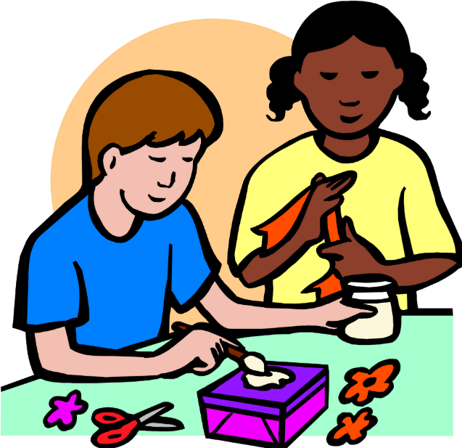
Why does she like … ?
playing football
doing project
reading books
doing project

Slide 39
Why does she like playing games?
Because she … it’s fun.
think
does
thinks
thinks

Slide 40
Why does she like solving maths problems?
… he thinks it’s useful.
Because

Slide 41
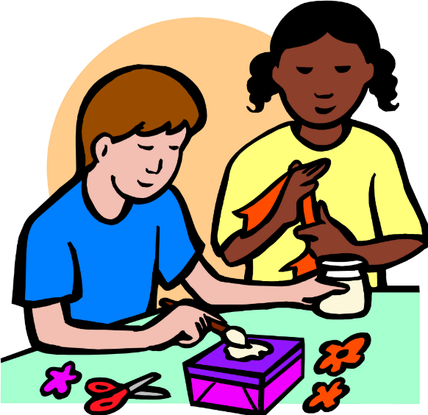
they / do / Why / projects / like / doing / ?
Why do they like doing projects?

Slide 42
Website: hoclieu.vn
Fanpage: https://www.facebook.com/tienganhglobalsuccess.vn/

