Slide 2

Unit 10
Our school trip
Lesson 2 - Period 4

Slide 3
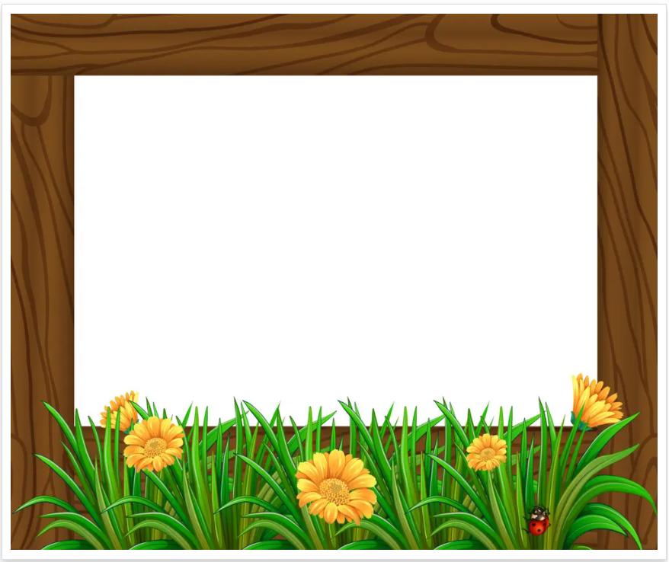
Table of contents
01
Warm-up and Review
02
Activity 1. Listen and tick.
03
Activity 2. Read and complete.
04
Activity 3. Let’s play.
05
Fun corner and Wrap-up

Slide 4
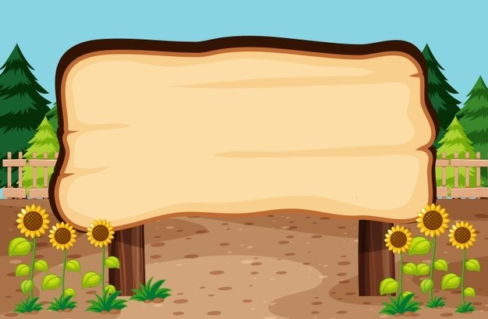

01
Warm-up and Review

Slide 5



What did they do there?
They ____.

Slide 6


Run and write
Game
?

Slide 7
02
Activity 1. Listen and tick.

Slide 8

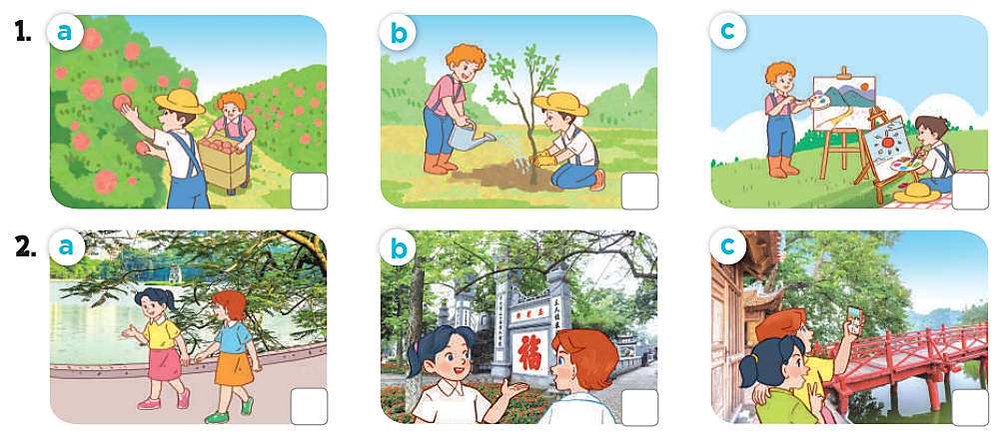
Listen and tick

Slide 9
Listen and tick
✓

Slide 10
Listen and tick
✓

Slide 11
Listen and tick
✓
✓

Slide 12
03
Activity 2.
Read and complete.

Slide 13
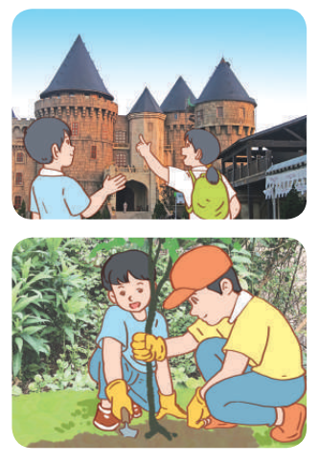
Read and complete.

Slide 14
Read and complete.
1. A: Did they ______ to Ba Na Hills last September?
B: Yes_______.
A: What did they do there?
B: They ______ the old _______ .
go
they did
visited
buidings

Slide 15
Read and complete.
2. A: ___ go to a pagoda last November?
B: No, we didn’t. We _____ to a farm.
A: What _____ you do there?
B: We___________ .
Did
went
did
planted trees

Slide 16
Read and complete.
go
1. A: Did they ______ to Ba Na Hills last September?
B: Yes_______.
A: What did they do there?
B: They ______ the old _______ .
2. A: ___ go to a pagoda last November?
B: No, we didn’t. We _____ to a farm.
A: What _____ you do there?
B: We___________ .
they did
visited
buidings
Did
went
did
planted trees

Slide 17
04
Activity 3. Let’s play.

Slide 18
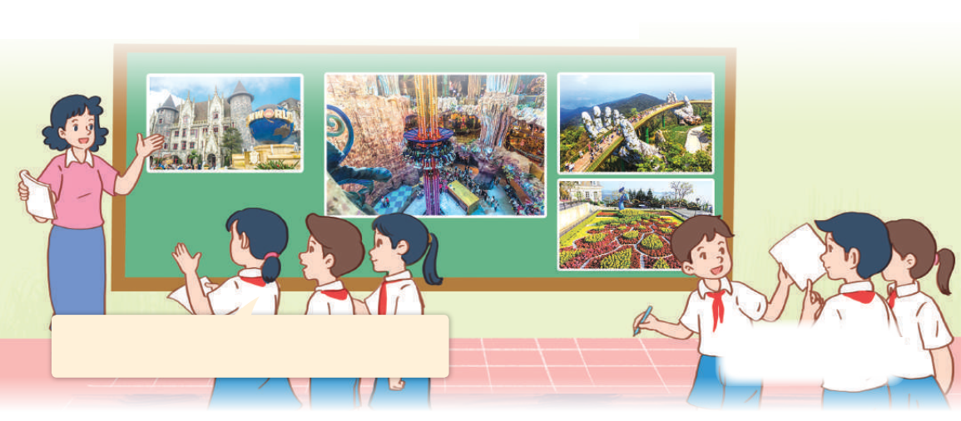
Let’s play
What did they do there?
Last weekend, they went to Ba Na Hills. They visited the famous buildings there.

Slide 19


GUESSING
GAME

Slide 20
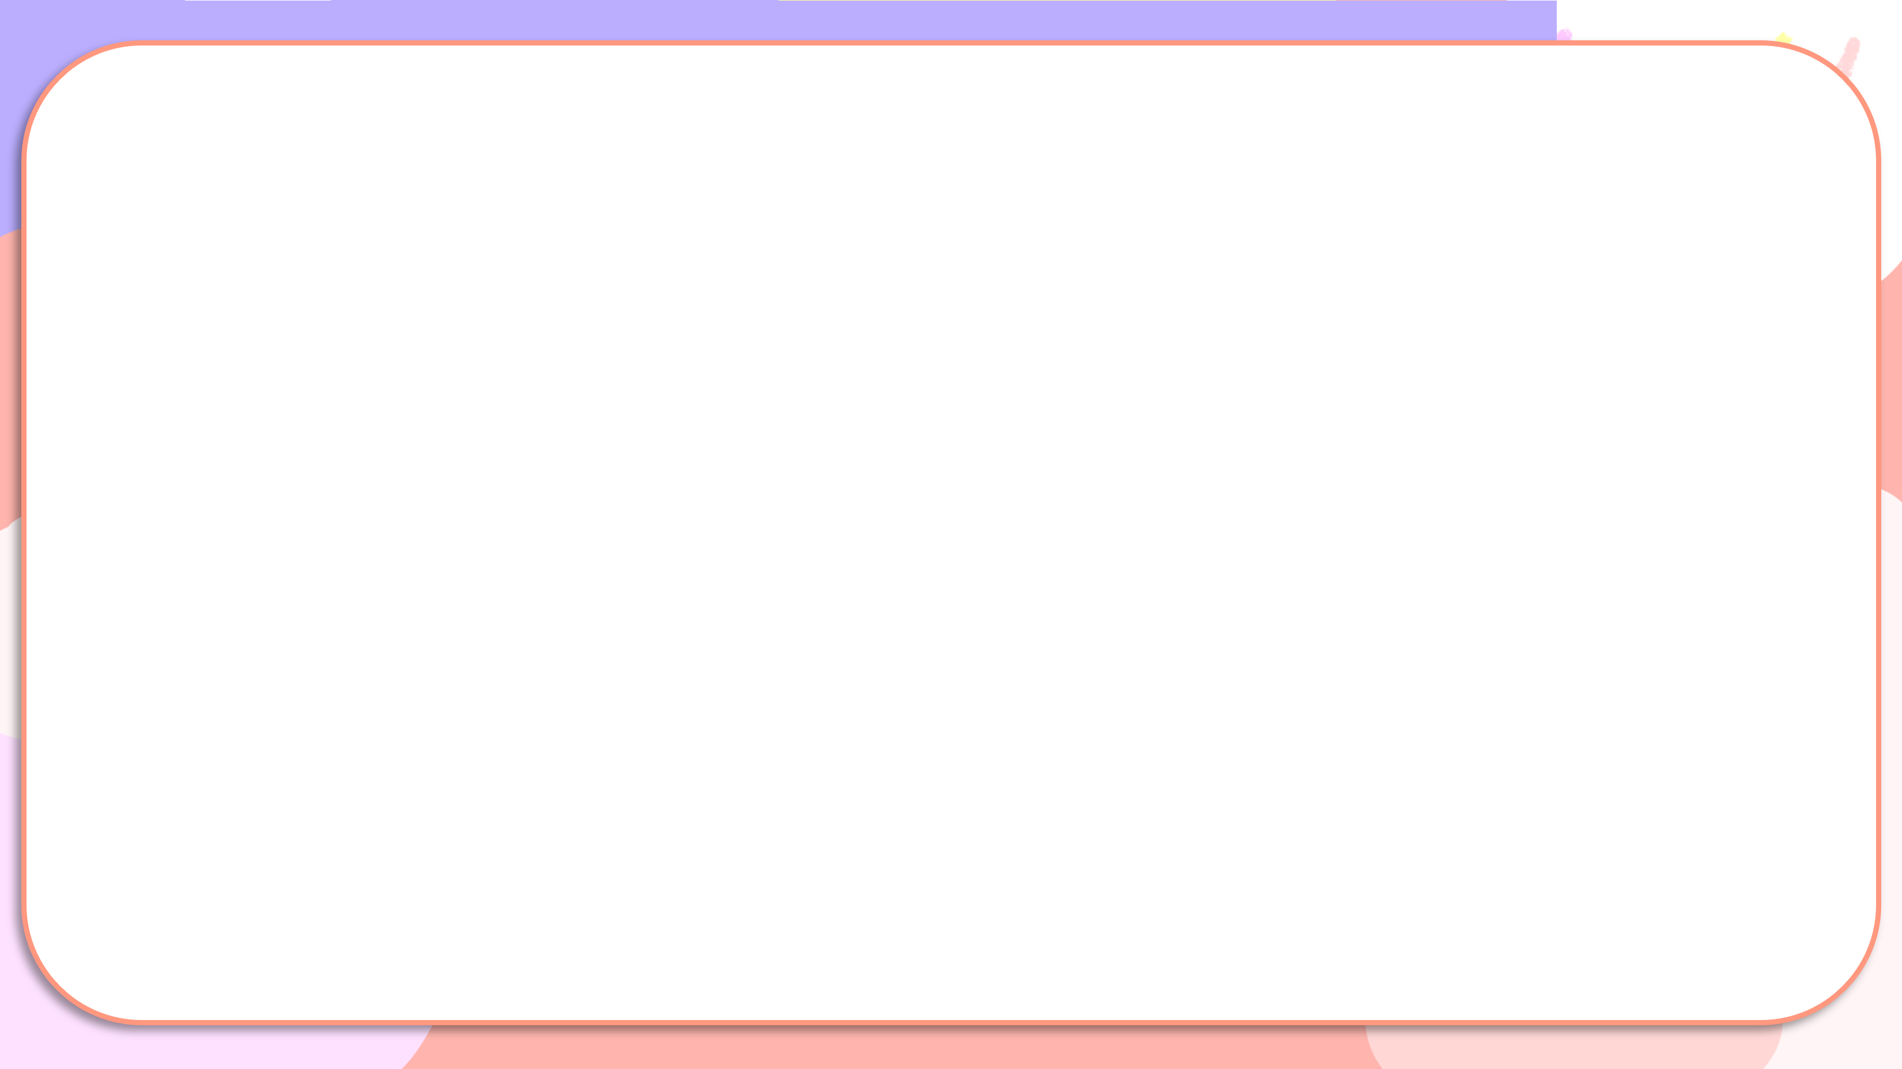

Last weekend, they went to Ba Na Hills.
They visited the famous buildings there.

Slide 21





Slide 22
05
Fun corner and Wrap-up

Slide 23


Throw the dice
Game

Slide 24

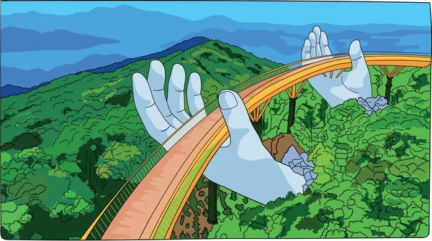
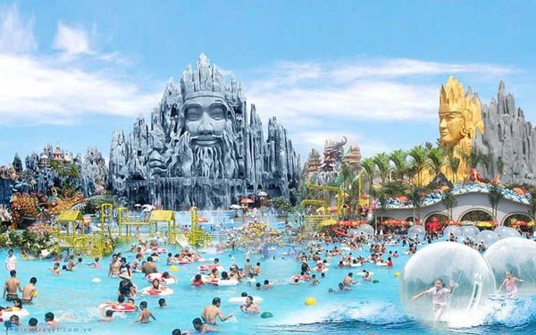
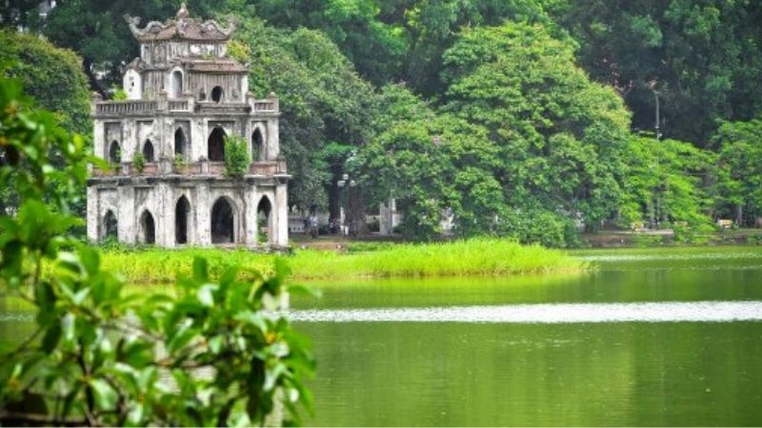
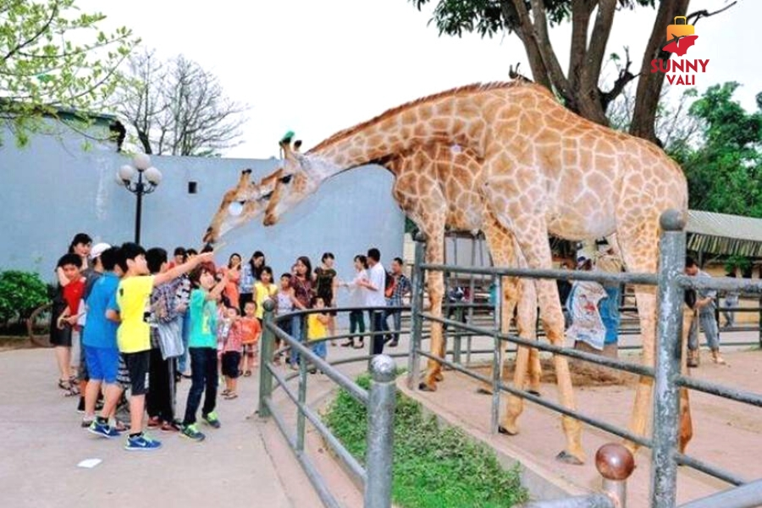
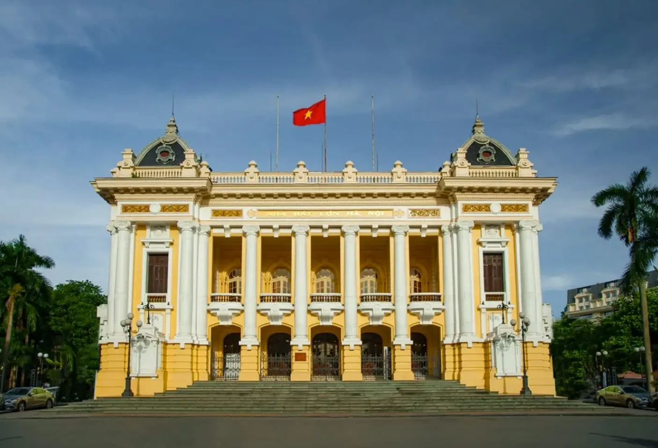
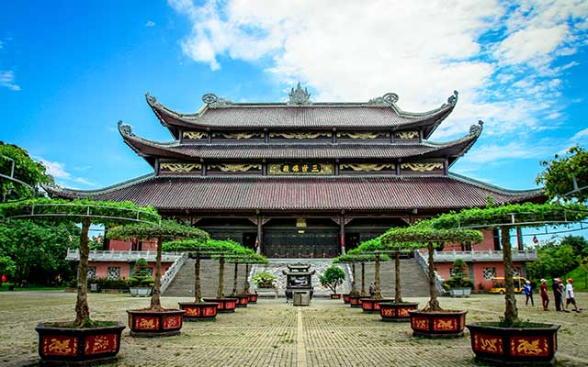

Throw the dice
Game
1
2
3
4
5
6
Notes:
Click vào tranh để làm tranh biến mất

Slide 25


Very Good!

Slide 26
Website: hoclieu.vn
Fanpage: https://www.facebook.com/tienganhglobalsuccess.vn/

