Slide 1
Unit 6: I like chicken
Lesson 3/period 2
Teacher: Nguyen Thi Thanh Nhan
School: Tien Thanh Primary school

Slide 2
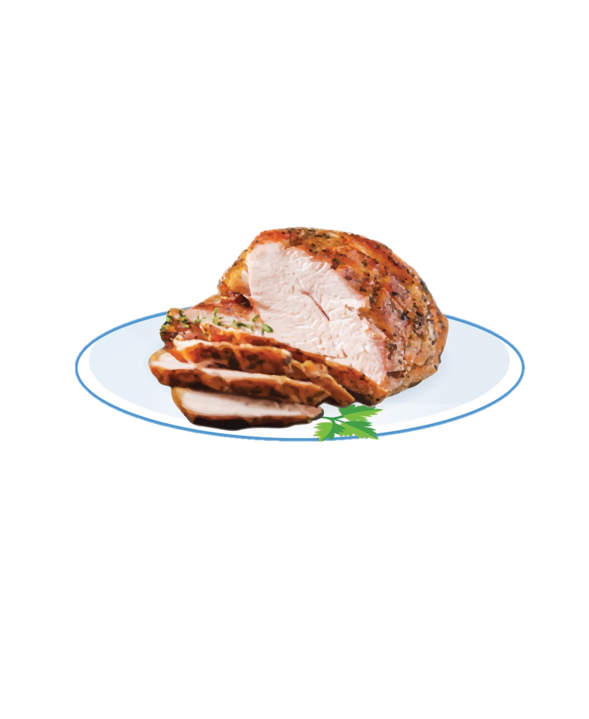

Slide 3
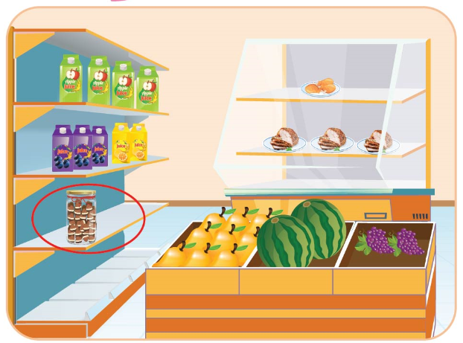
Lesson 3
Period 6

Slide 4
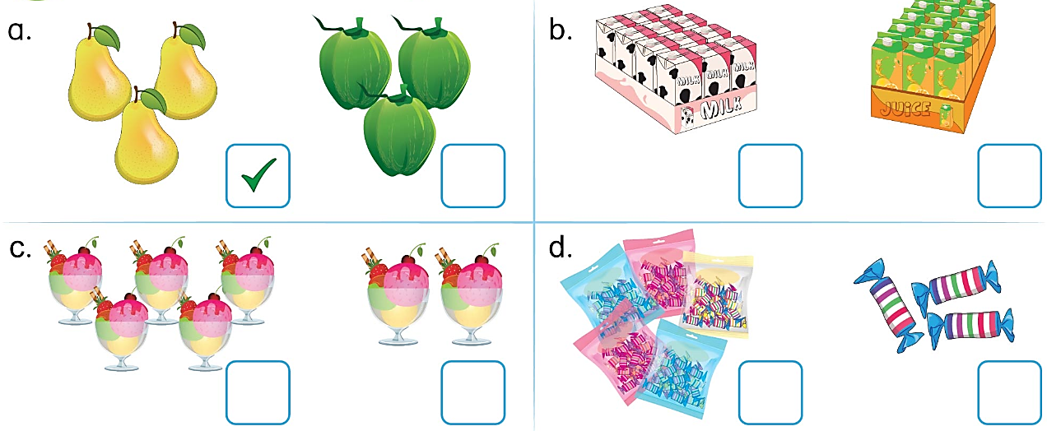

Slide 5
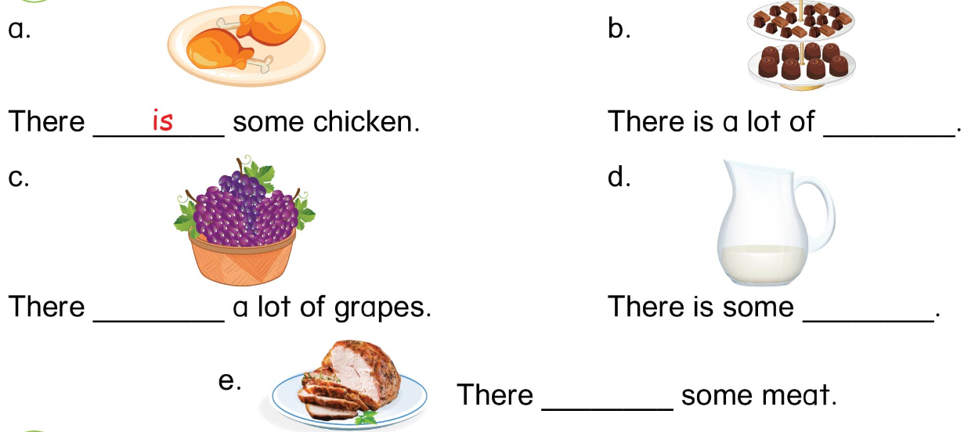
chocolate
are
milk
is

Slide 6
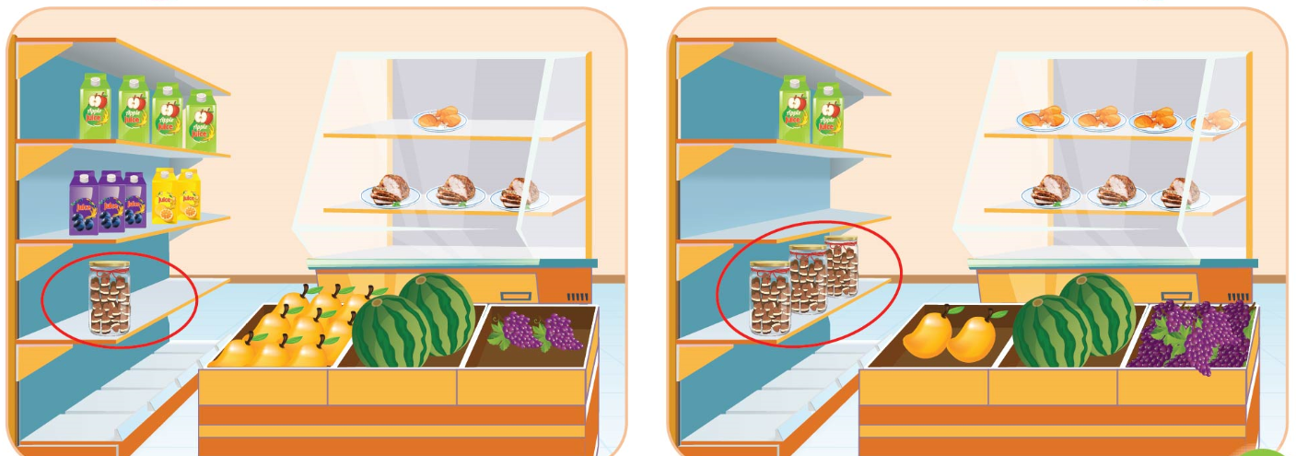

Slide 7
Sentence structure
There is some milk.
There are a lot of grapes.
There is a lot of / some
There are a lot of / some
+ uncountable nouns
+ countable nouns

Slide 8
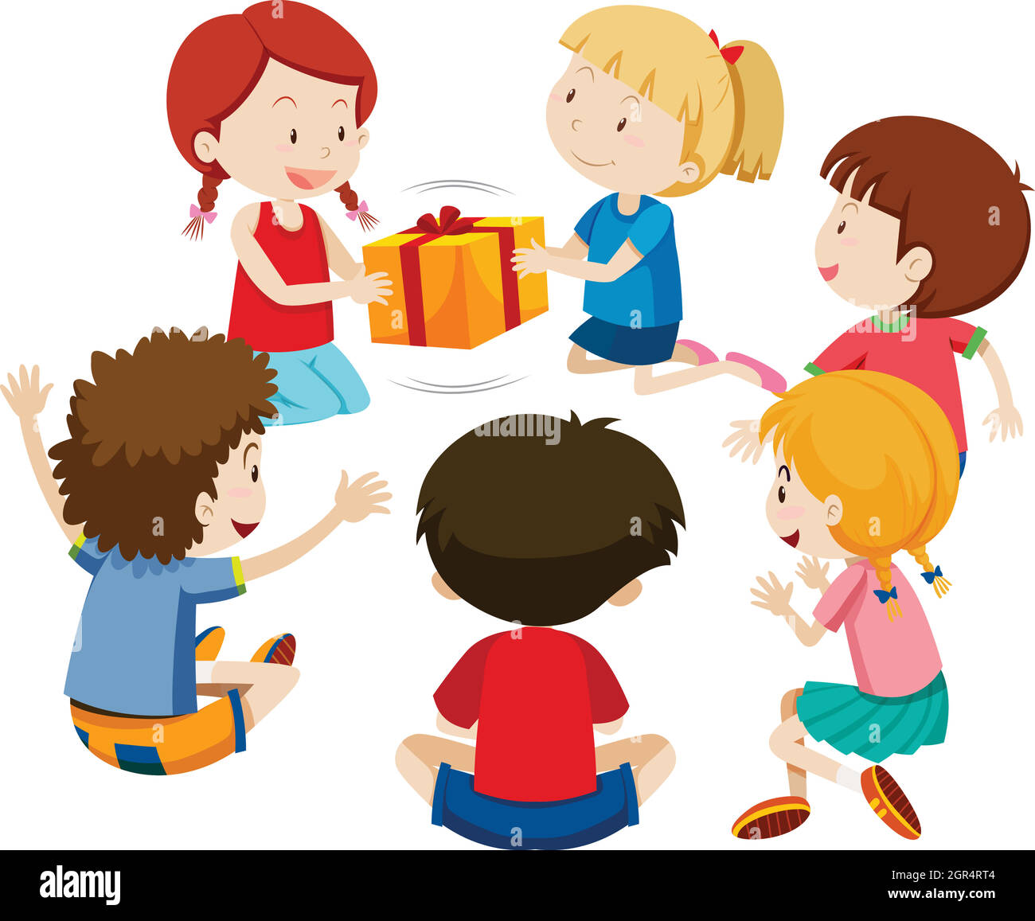
PASSING BOX

