Slide 1
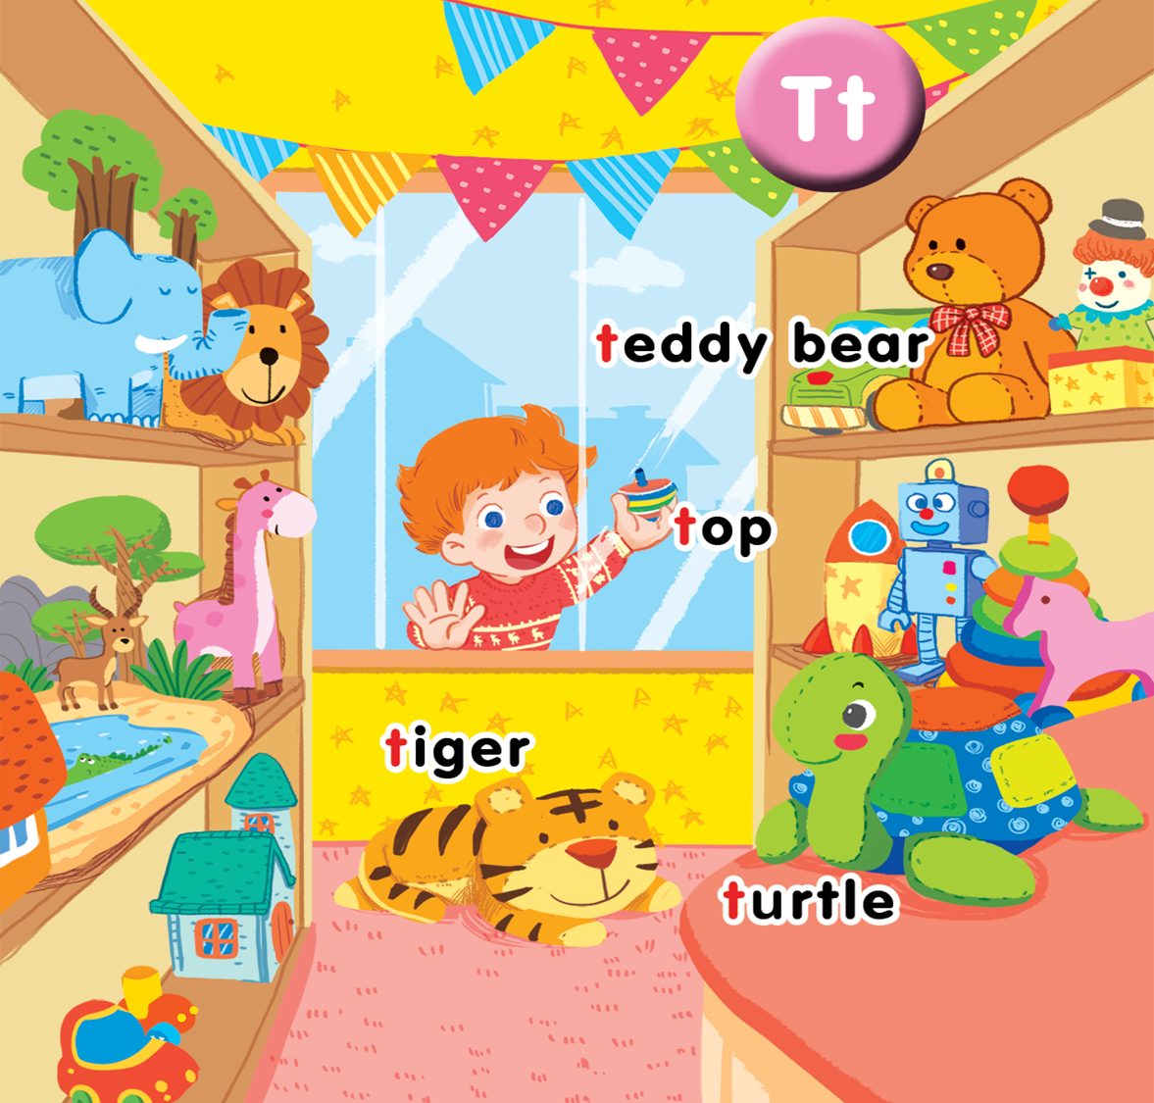
Unit 14
In the toy shop
Lesson 1
Notes:
By the end of the unit, pupils will be able to:
pronounce the sound of the letter T/t in isolation and in the words teddy bear, tiger, turtle and top correctly.
say the sound of the letter T/t and the words teddy bear, tiger, turtle and top.
recognize the words in different situations when listening.
know the structure “He has _____.” to talk about possessive.
use the structure “I can see_____.” to talk about the toy.
trace the letter T/t.
sing a song with the structure “He has _____.” and “I can see_____.”
Lesson 1
By the end of the lesson, pupils will be able to:
pronounce the sound of the letter T/t in isolation and in the words teddy bear, tiger, turtle and top correctly.
listen, repeat and understand the words teddy bear, tiger, turtle and top.

Slide 2

Warm-up
Notes:
Goal: Warm up the class and get pupils ready for the new lesson.
Time: 5 minutes
Sing a song: https://www.youtube.com/watch?v=BoJBeGUHGv8
Have pupils listen to the song twice.
Ask: What can you see in the song? What is the song about? (Vietnamese is accepted).
Teacher points out the topic of the song: TOY.
Write the word TOY on the board and have pupils repeat the word 3 times.

Slide 3



Notes:
Listen and repeat is divided into 3 steps.

Slide 4

Notes:
Step 1
Goals: Set up the context; Predict what pupils will learn; introduce the main character.
Time: 5 minutes
Have pupils look at the picture on the screen and ask: What can you see?
Introduce: This is Tony, Tony.
Have pupils say hello to Tony.
Set the scene: Today Tony’s at the toy shop. We will meet many interesting toys here. (Vietnamese is accepted)
Teacher writes the word TOY SHOP in the middle of the board.
Step 2
Goal: Pupils will be able to understand, listen and repeat the unit keywords: teddy bear, turtle, tiger, top
Time: 5 minutes
Open digital book and have pupils look at the picture.
Point to the picture of teddy bear and click to play the recording 2 times.
Hold the teddy bear flashcard, say the word and have pupils repeat the word in chorus, groups, individuals. Do the TPR action when saying the word.
Do the same with top, tiger and turtle.
Introduce the sound /t/, point to the letter of each word and say. Have pupils listen and repeat.
Step 3
Goal: Check
Time: 4 minutes
Place the flashcards on the board and turn over.
Have pupils guess and say the word.
Swap the cards and have pupils guess.

Slide 5


teddy bear

Slide 6

tiger
Notes:
Giáo viên giơ thẻ tiger
Cho HS đọc lại, có thể lên giọng, xuống giọng. (kèm hành động 2 bàn tay giả làm móng vuốt, miệng có thể gầm gừ)
Cho Hs đọc và làm hành động theo nhóm, và cá nhân.

Slide 7

top
Notes:
Giáo viên giơ thẻ top
Cho HS đọc lại, có thể đọc to dần đều. (kèm hành động chỉ ngón trỏ xuống dưới xoay tròn như cù)
Cho Hs đọc và làm hành động theo nhóm, và cá nhân.

Slide 8

turtle
Notes:
Giáo viên giơ thẻ turtle
Cho HS đọc lại, có thể đọc nhanh chậm kiểu rùa. (kèm hành động tay bơi chải như rùa)
Cho Hs đọc và làm hành động theo nhóm, và cá nhân

Slide 9



Notes:
Point and say is divided into 2 main steps.
Step 1
Goal: Pupils will be able to point to the pictures and say the words.
Time: 5 minutes
Have pupils listen and point to the pictures in the book.
Hold up your index finger, demonstrate the action for Point.
Say Point and say with the TRP actions.
Point to the teddy bear and say teddy bear. Have pupil point and say.
Repeat the procedure.
Vary the speed to make the activity fun.
Do the same with other words
Have pupils do point and say in pairs
Step 2
Goal: Check
Time: 4 minutes
Call 1 pupil from each team to come up to the front, face their friends.
Ask 1 pupil to be “the teacher”, when “ the teacher” points to any pictures on the board, pupils who are sitting have to act the word, the ones who are standing on the front need to say the word quickly. The slow or wrong answer will be eliminated from the game.
The game continues until the winner is found

Slide 10
Game
Notes:
Step 3
Miming
Goal: Review the unit words through pictures, sounds, meaning.
Time: 5 minutes
Have pupils look at the screen and guess the word by saying.
The winner is the one giving out the word in a shortest time.
Have pupils repeat the word.

Slide 11

SHOW
www.Games4esl.com

Slide 12

SHOW
www.Games4esl.com

Slide 13
SHOW
www.Games4esl.com

Slide 14

SHOW
www.Games4esl.com

Slide 15

It’s time to say goodbye
Notes:
Goodbye
Time: 3 minutes
Teacher and pupils say goodbye to the words.

Slide 16
Goodbye

Slide 17
Goodbye

Slide 18
Goodbye

Slide 19
Goodbye

Slide 20
Website: hoclieu.vn
Fanpage: facebook.com/www.tienganhglobalsuccess.vn

